Slide 1
Missione 4 Istruzione e Ricerca
Development of SC cavities for qubits and quantum memories
Eduard Chyhyrynets @ INFN LNL chyhyryn@infn.it
Second National Congress NQSTI, Rome
5 – 7 February 2025

Slide 2
Goal
Production
Post treatments
Superconducting (SC) resonant cavities for 3D qubit

Slide 3
Why SC cavities?
High Quality Factor (Q-Factor) – reducing energy dissipation and enabling long coherence times for quantum states.
Easy Coupling to Qubits – fast and reliable quantum state transfer and storage.
Efficient Quantum Memories – The long coherence times, low decoherence rates make SC cavities suitable for storing quantum information and interfacing with qubits in quantum computing architectures.
Protection Against Environmental Noise – quantum states are shielded from electromagnetic interference.

Slide 4
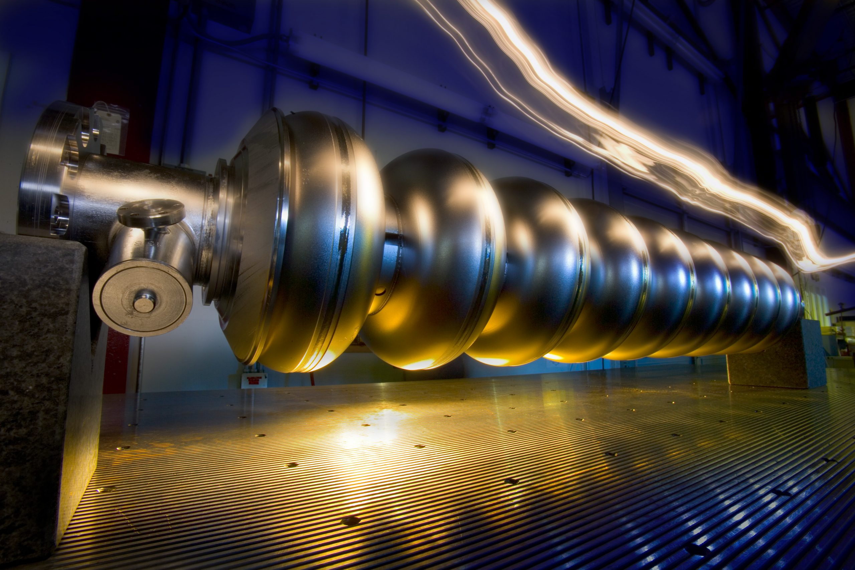
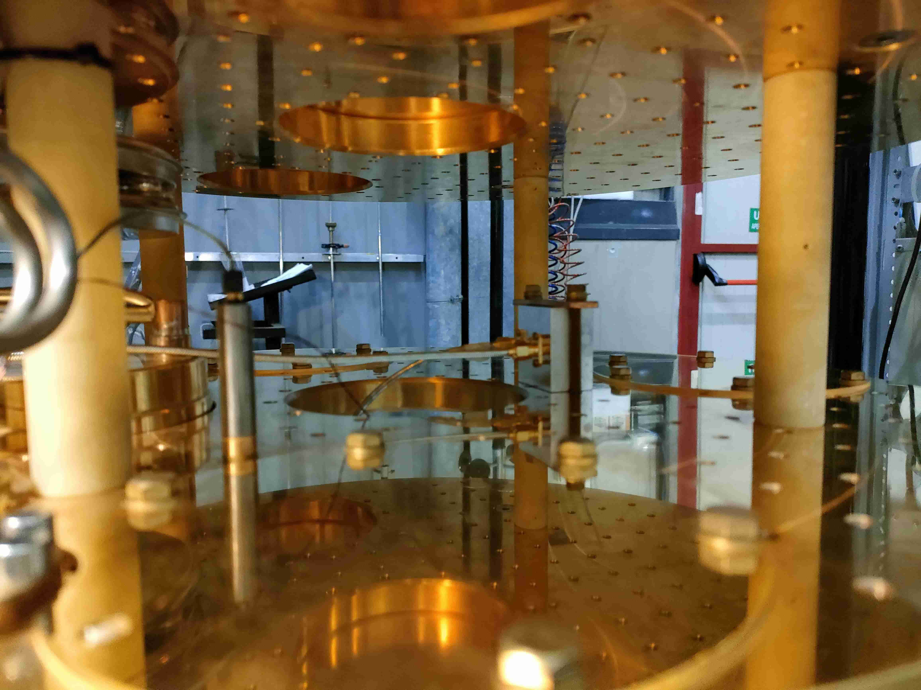
Particle accelerators
Quantum computing and sensing
Shape and frequency
$$Q_{0}= \frac{G}{R_{s}}$$
Important parameters:
Cavity Quality factor (Q₀ )
Accelerating field
Meissner regime
2 K or 4.2 K operation temperature
material/surface treatments
Important parameters:
Both Meissner and Shubnikov regime
mK operation regime
Cavity Quality factor (Q₀ )
London penetration Depth
Tens to Hundreds nm
$$R_{s}=R_{BCS}+R_{res}$$
Notes:
In SC cavity-based qubit applications, the uppermost nanometres dictate the performance, rather than a classical frequency-dependent skin depth. This makes surface treatment, material purity, and interface engineering critical to minimising losses and maximising the Q-factor.

Slide 5
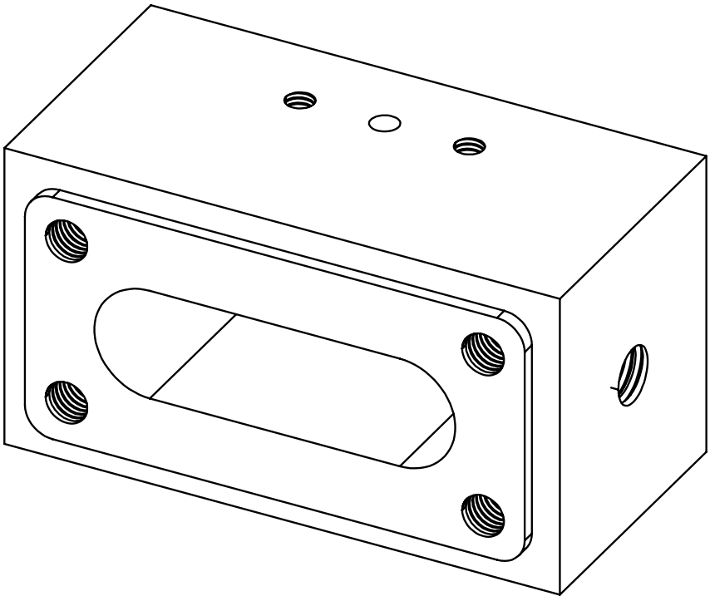
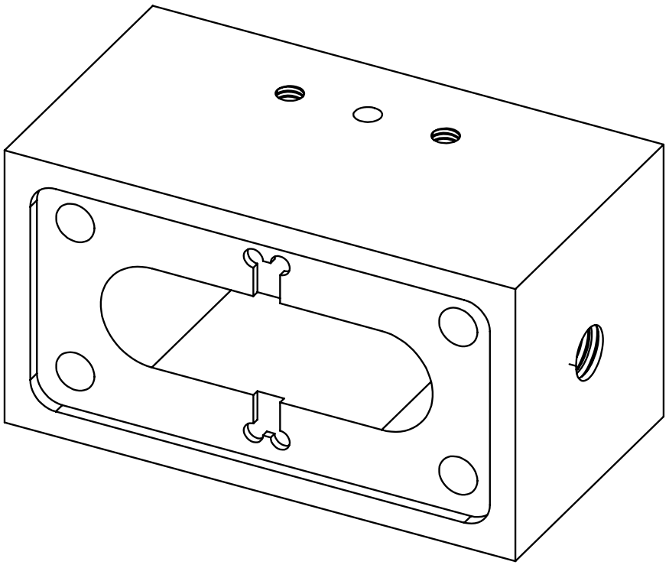
Key Design Considerations for SC cavities
Geometry: Optimised cavity and film designs can reduce local magnetic field concentrations, preventing unintended transitions to the Shubnikov regime.
Material Choice: Materials with higher H_{c1} (e.g., Nb, Ti, NbTi, Al, Ta) are preferred to ensure operation in the Meissner regime. Other applications, like photon sensor requires high H_{c2} materials.
Surface Engineering: Minimising impurities and defects in the penetration depth region helps suppress vortex nucleation and motion.
$$Q_{0}= \frac{G}{R_{s}}$$

Slide 6
Current state of the art
Al SC cavity production
Pure Al 5 N Determines baseline purity and performance potential.
Etching
100 μm in acids (H₃PO₄:HNO₃=3:2) 50 C°
Annealing
3h/500 C°
Electropolishing
H₃PO₄:H₂SO₄ (3:2)
1 h at 30 C°
0,5 h at 60 C°
Relieves stresses, increases grain size
Achieves a mirror-like surface, minimising losses and improving uniformity.
Removes surface damage and roughness, critical for low surface resistance.
N₂ atmosphere
Purity, or absence of defects, limits the quality factor
EP of Al alloys 6081, 6061 will not overpass the limitation
Etching of more than 100 um are useless
Annealing can sligthly imrpove the Q
M. Kudra et al., ‘High Quality 3-Dimensional Aluminum Microwave Cavities’, Applied Physics Letters, vol. 117, no. 7, p. 070601, Aug. 2020, doi: 10.1063/5.0016463.
M. Reagor et al., ‘Reaching 10 ms single photon lifetimes for superconducting aluminum cavities’, Applied Physics Letters, vol. 102, no. 19, p. 192604, May 2013, doi: 10.1063/1.4807015.

Slide 7
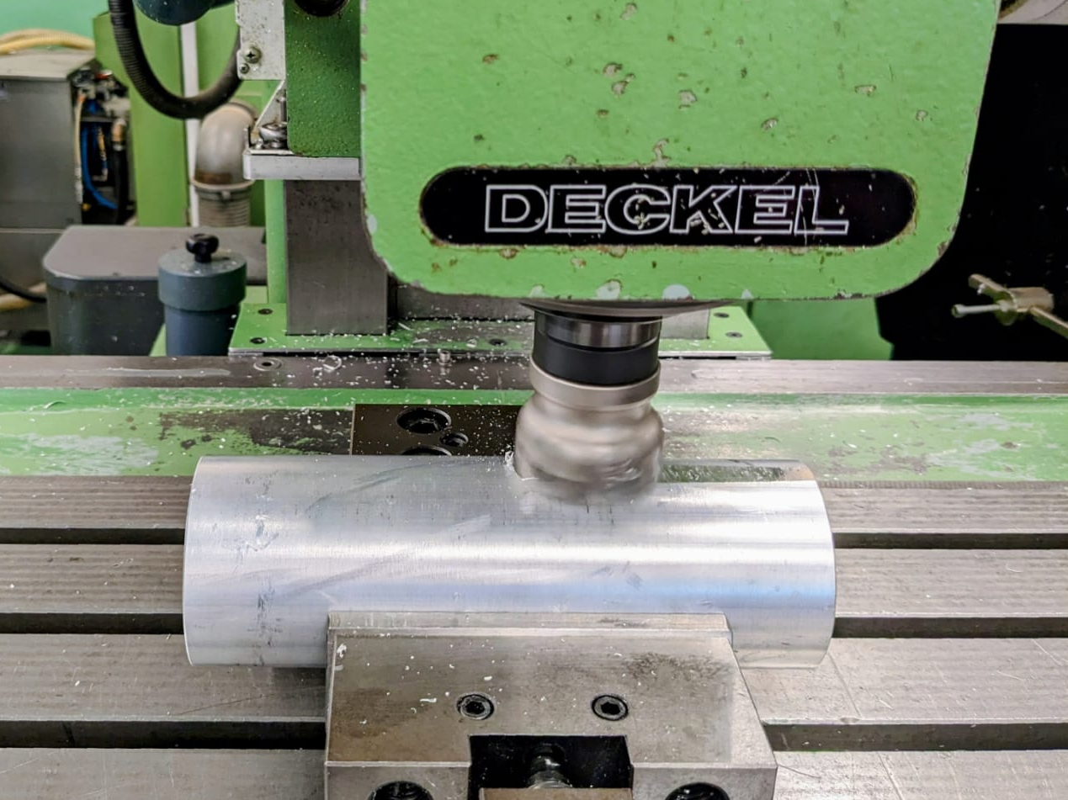
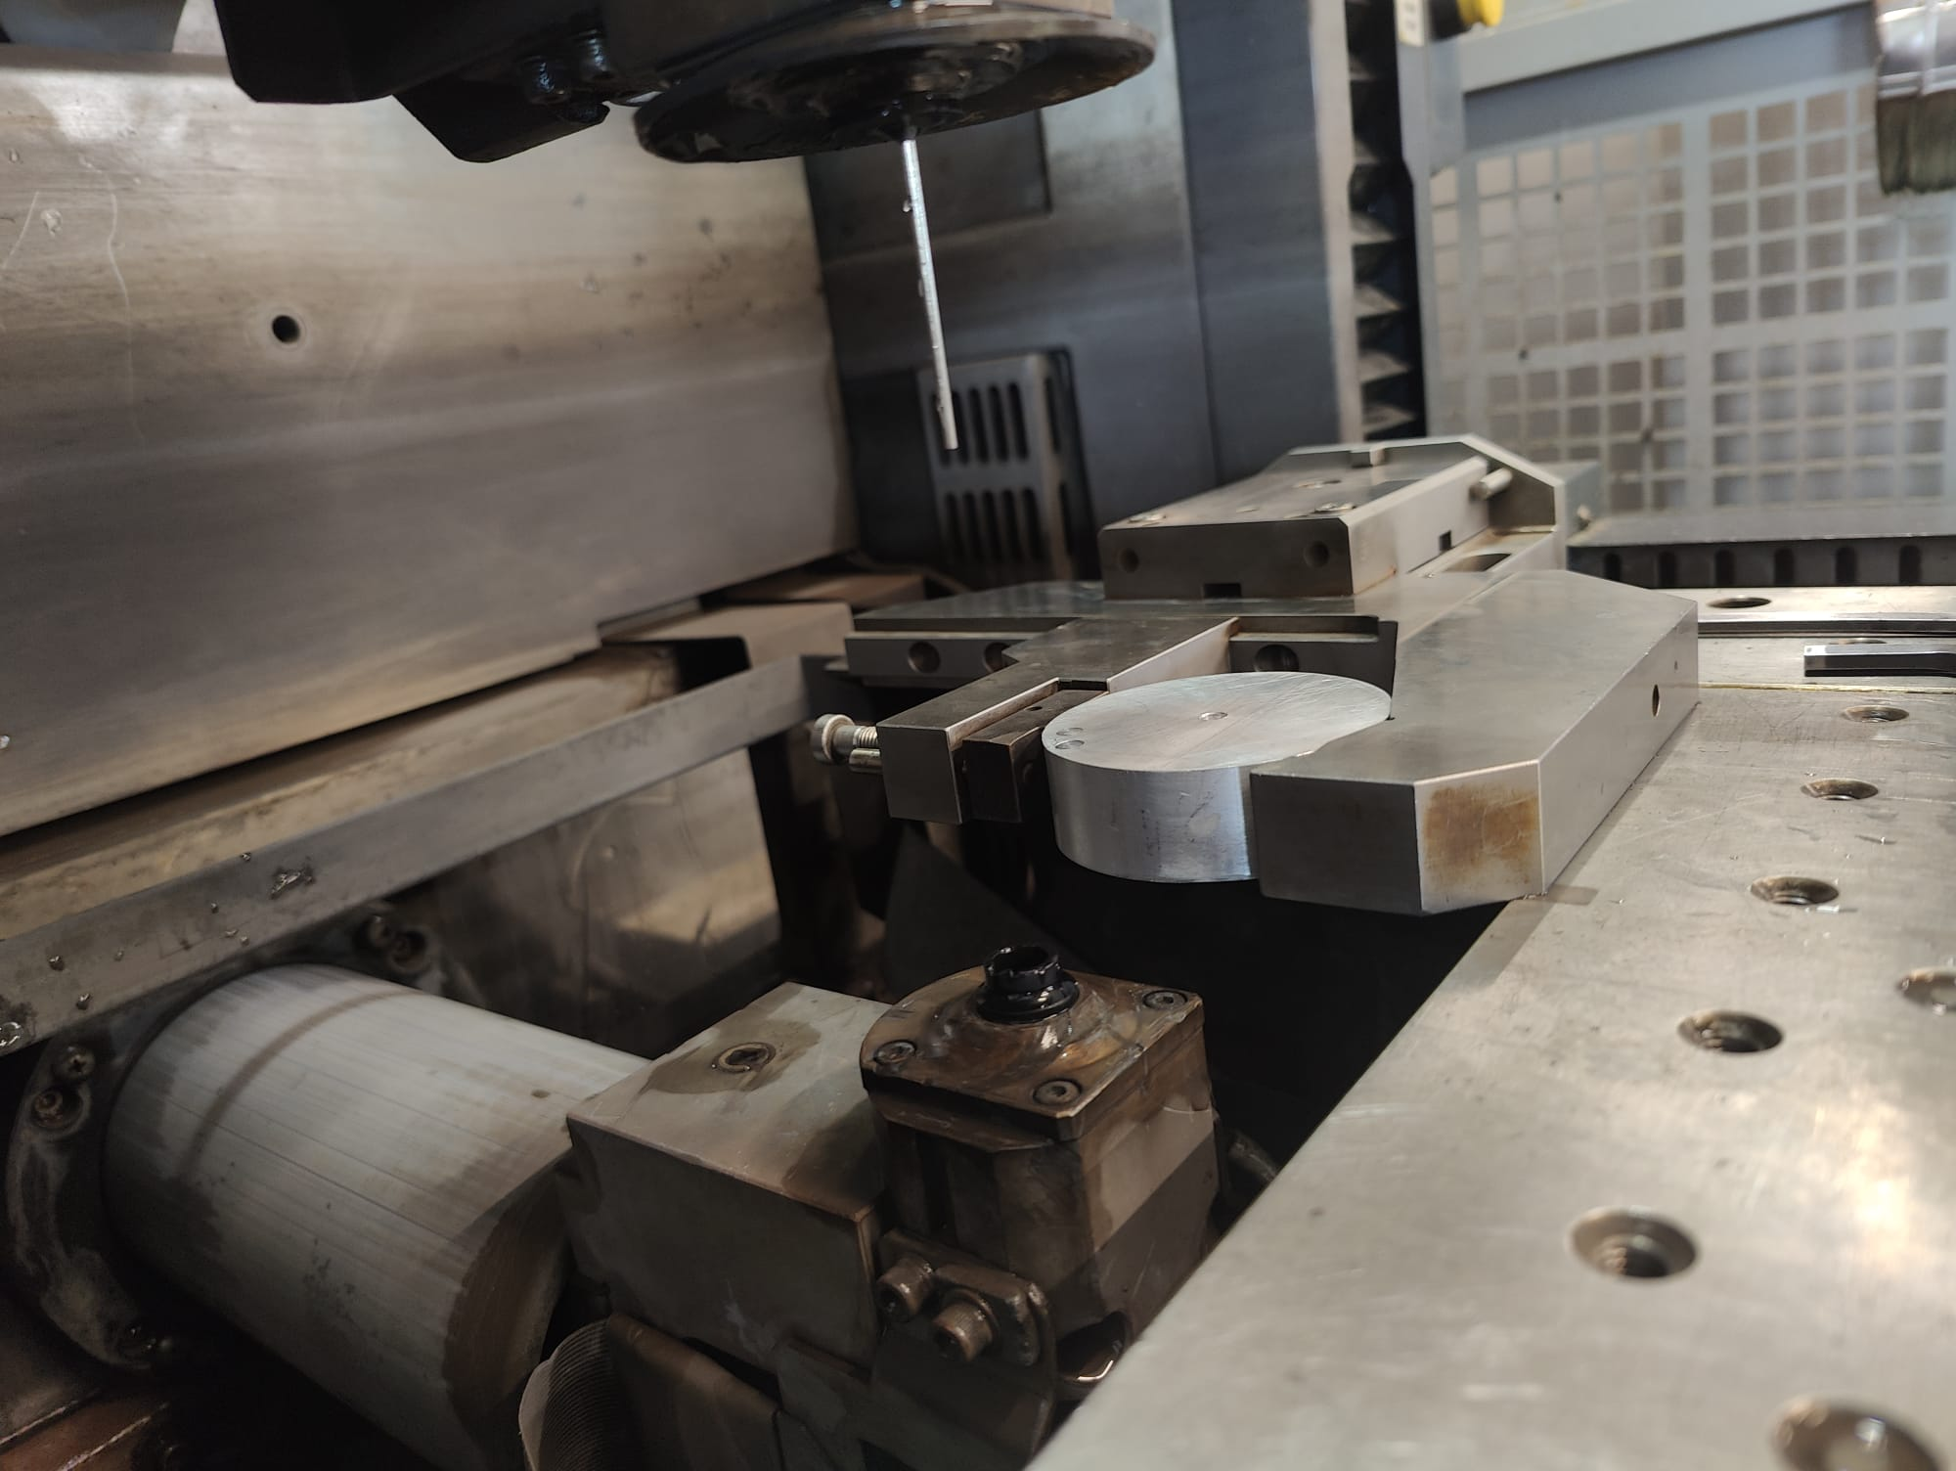
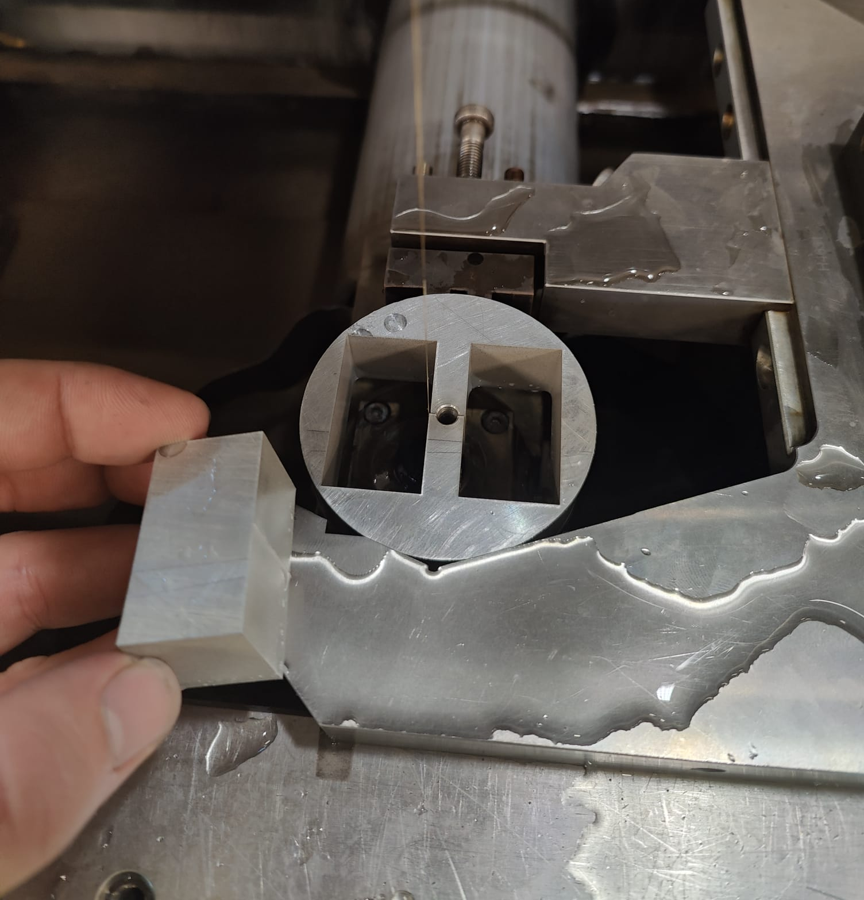
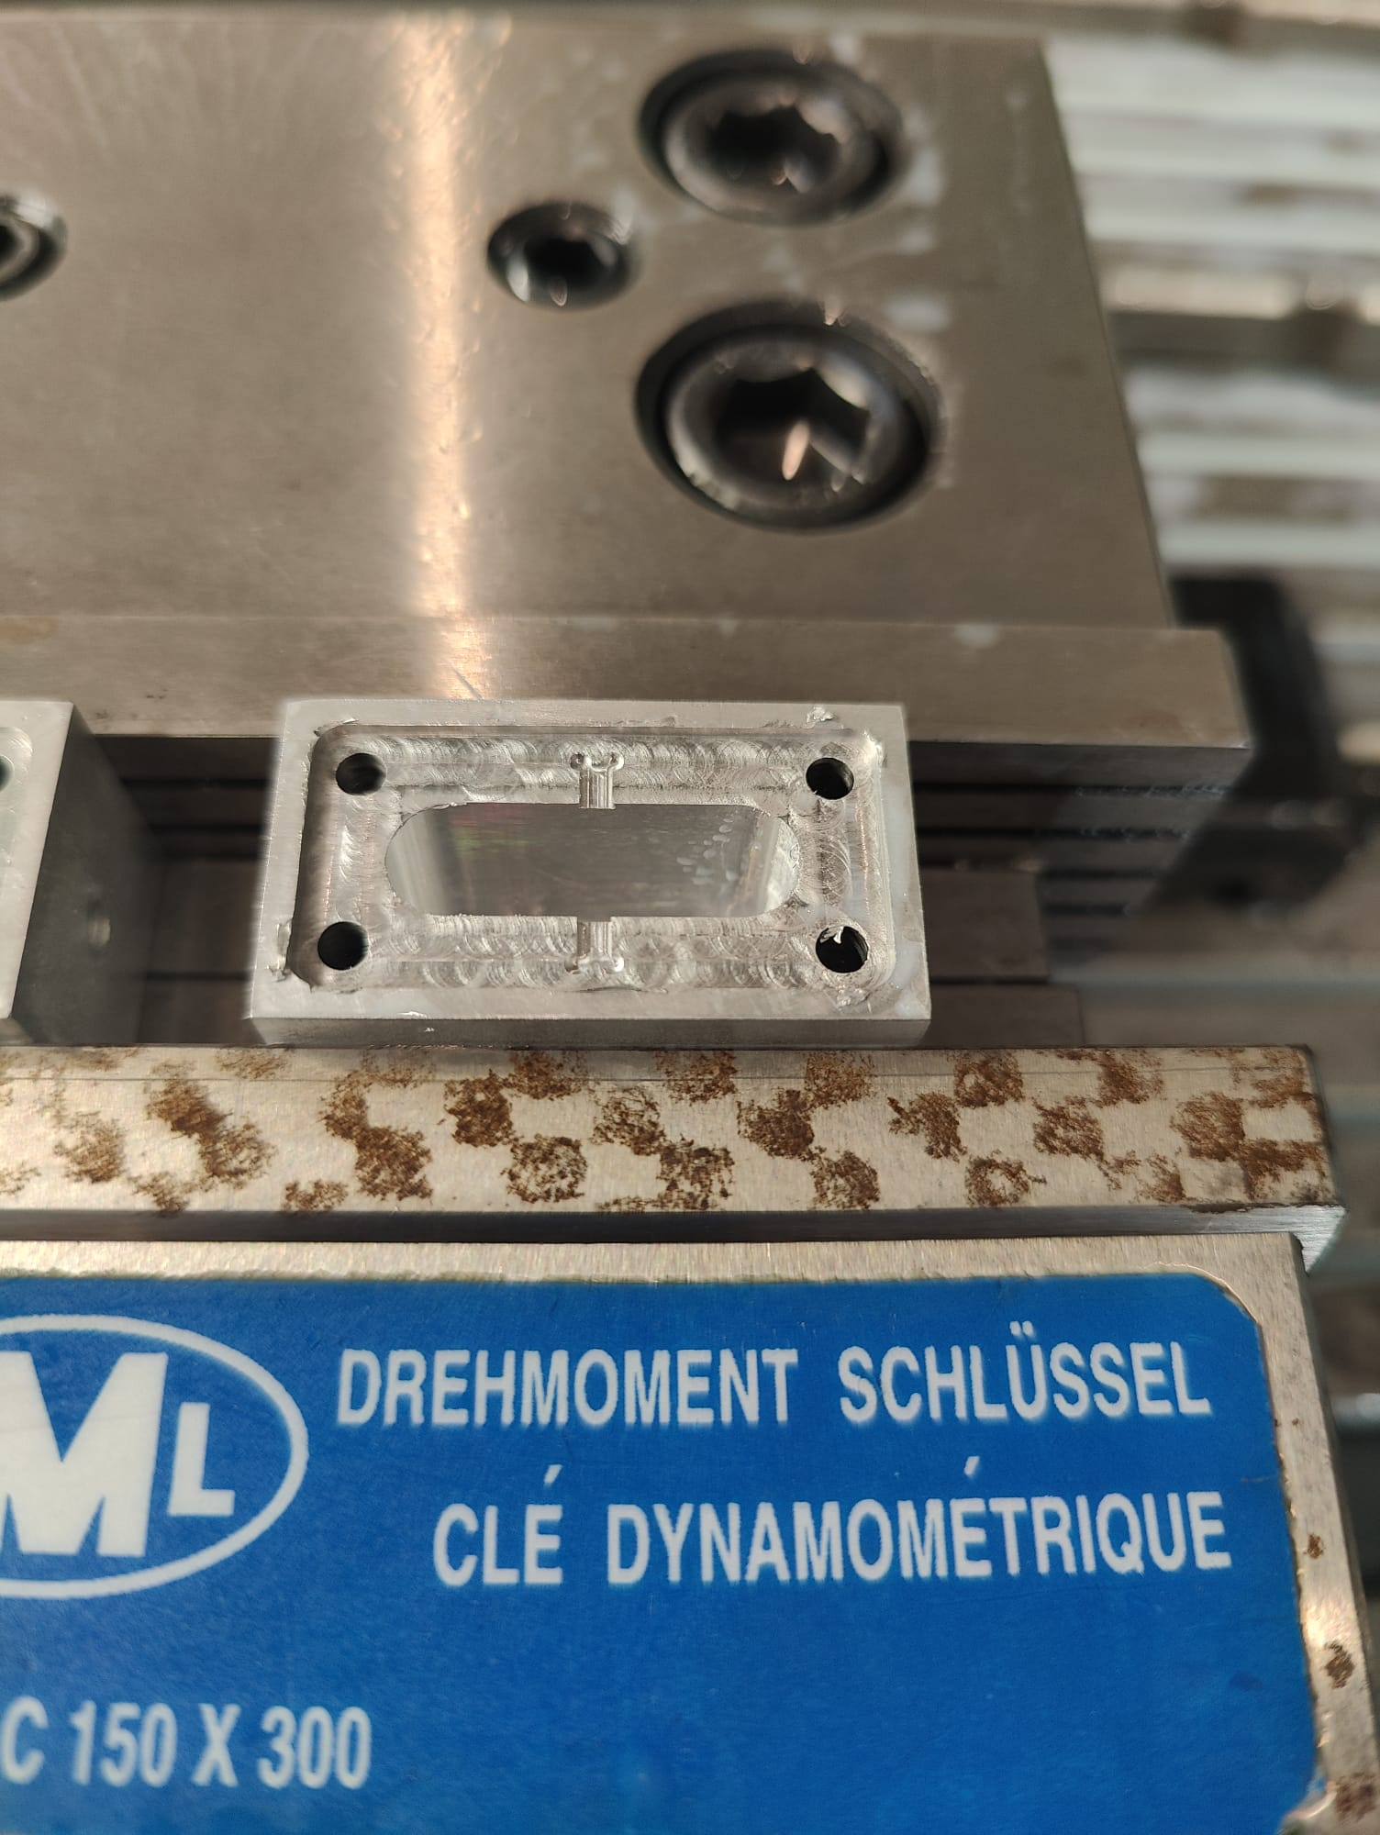
Mechanical production
Working with 5N Aluminium
Softness: The material is very soft, making it prone to deformation during machining
Tool Clogging: Tends to stick to and clog tools during processing, reducing efficiency and precision.
Unreliable Threading: Difficult to produce reliable threads due to the material's low hardness and strength.
CNC
Final protocol
Bandsaw: Cut cylinder.
Lathe: Machine hole and dimensions.
EDM: Cut contour.
Drill/Thread: Add side holes.
CNC Milling: Used 11 tools for precision.
Deburring/Polishing: Smooth and refine.
Drill/Thread
Quality Check: Verify accuracy and finish.
EDM

Slide 8
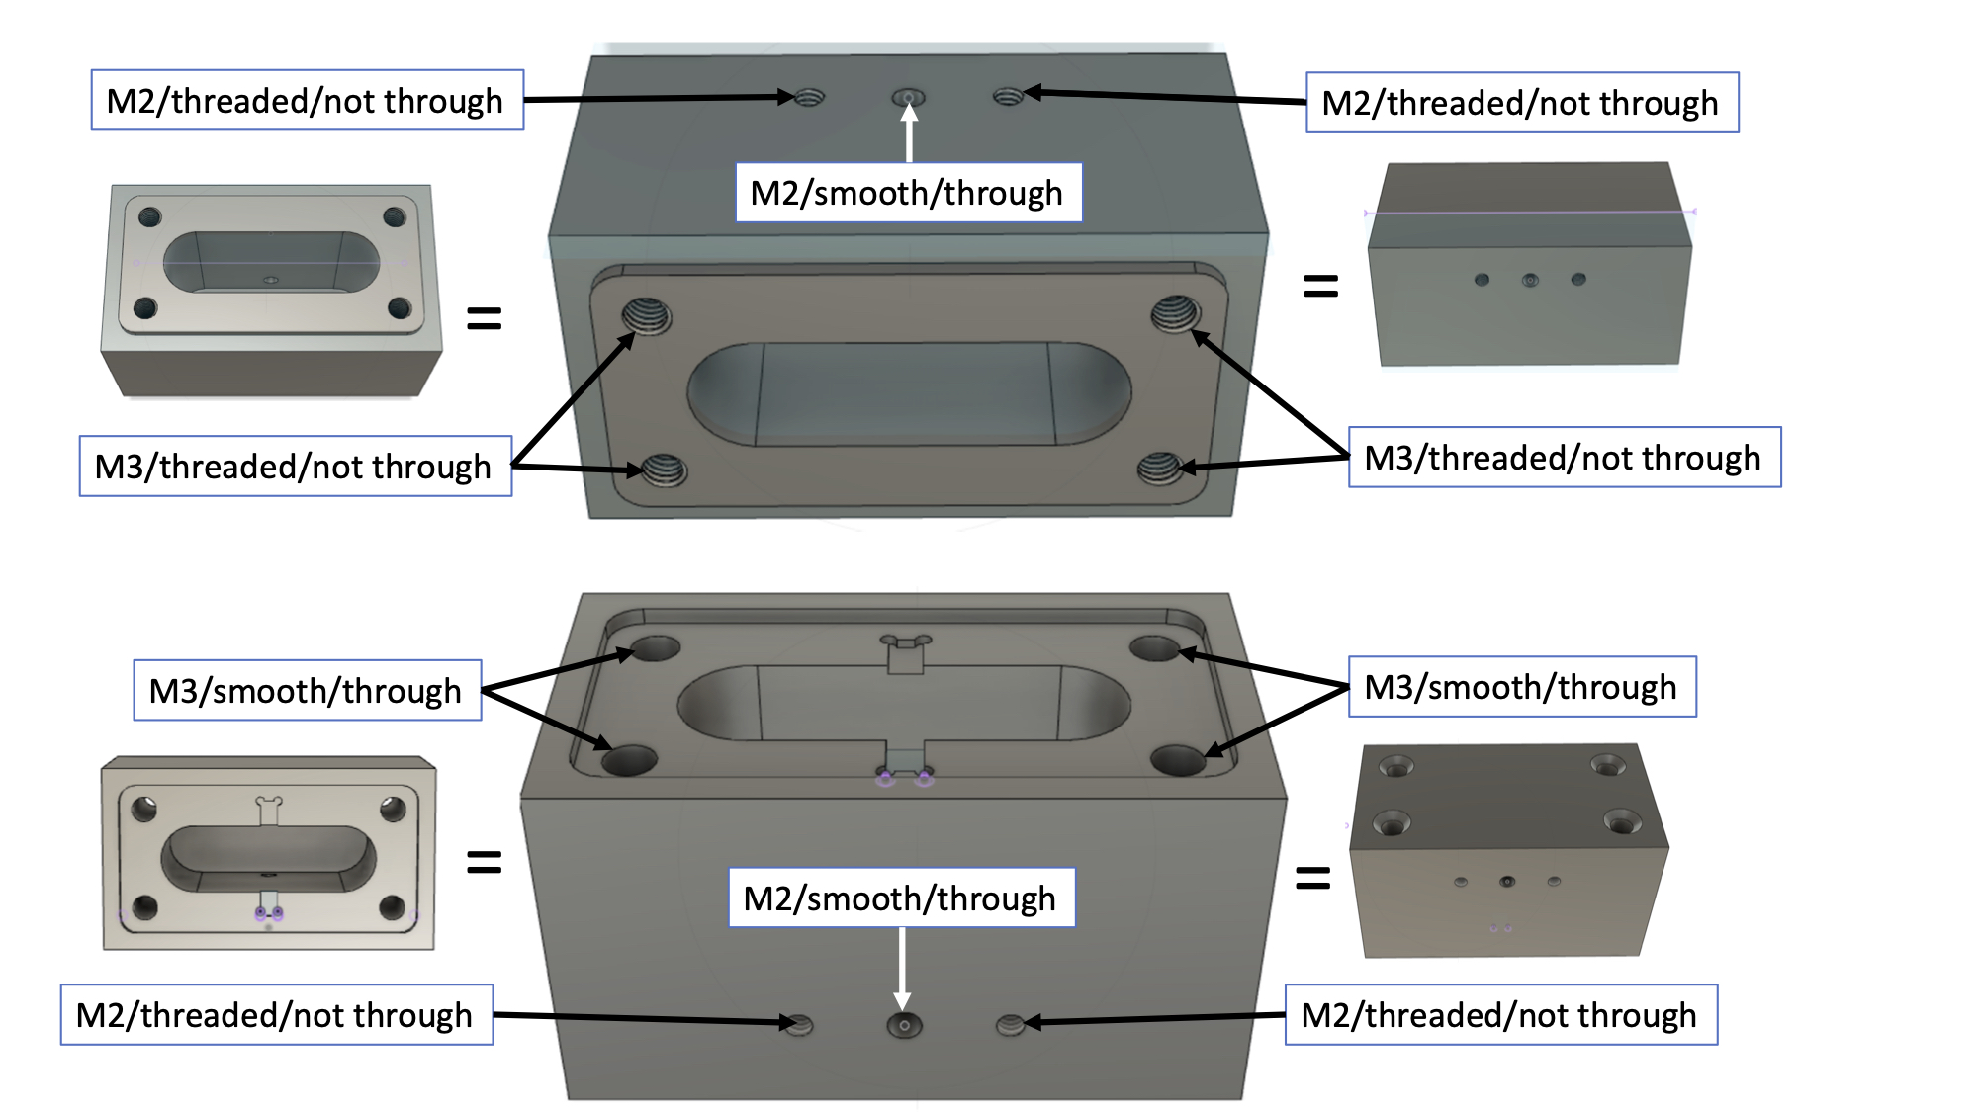
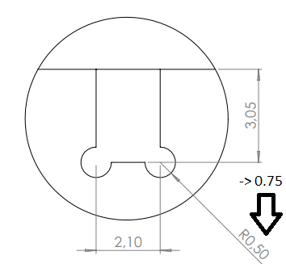
Production
High purity ensures fewer defects, impurities, and grain boundaries that could lead to energy dissipation or decoherence.
Quality of mechanical production, will limit the maximum achievable performance of a SC cavity.
8 mm
24 mm

Slide 9
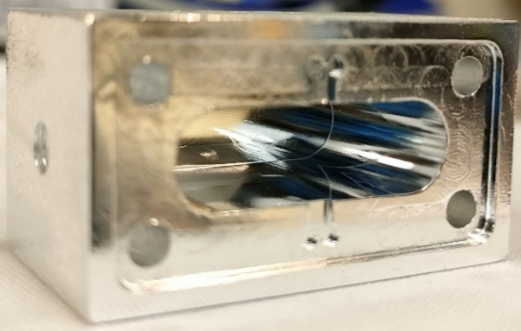
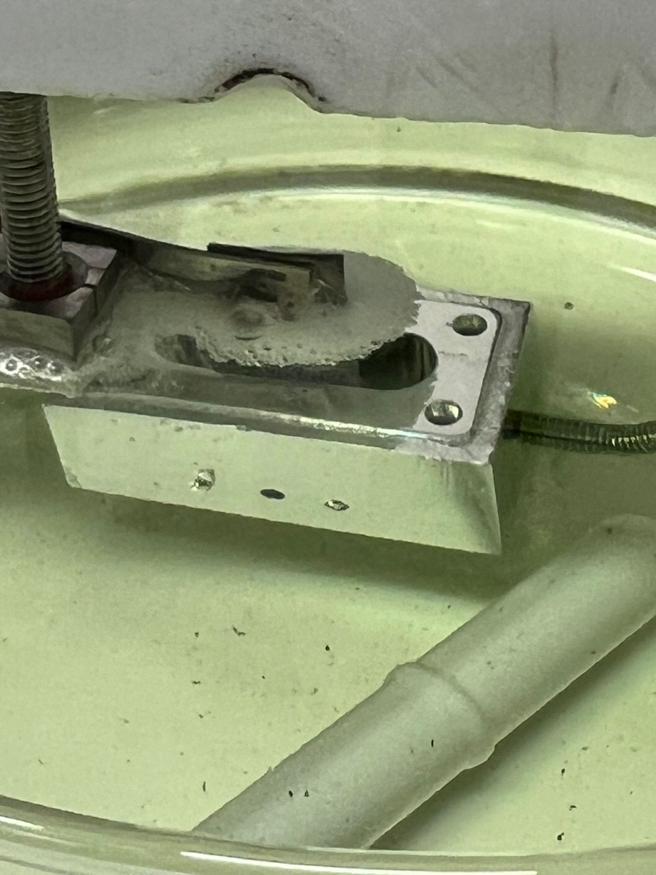
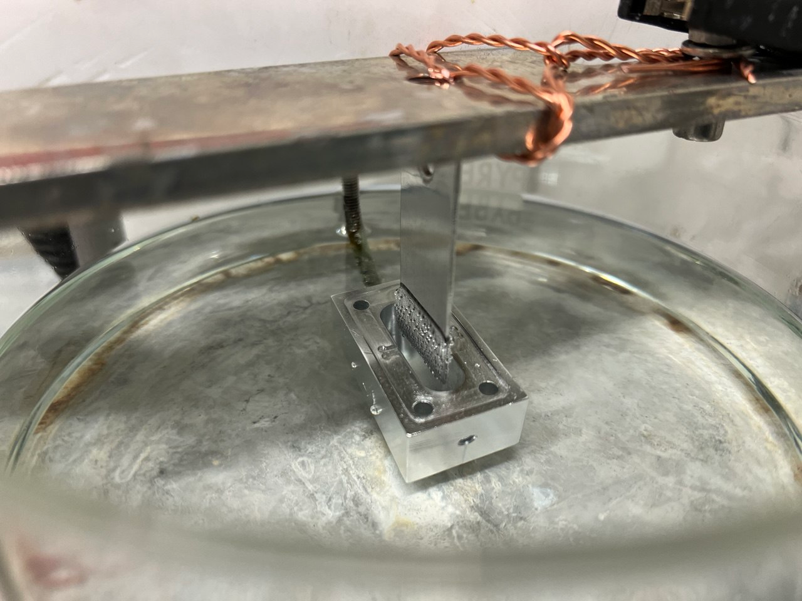
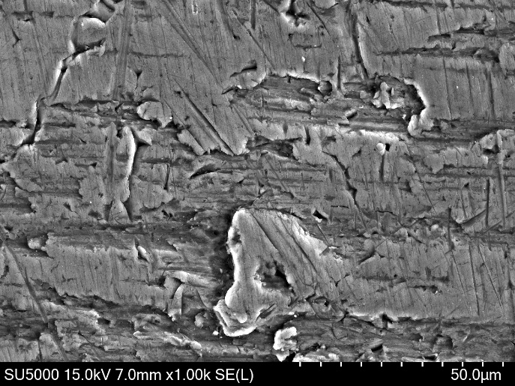
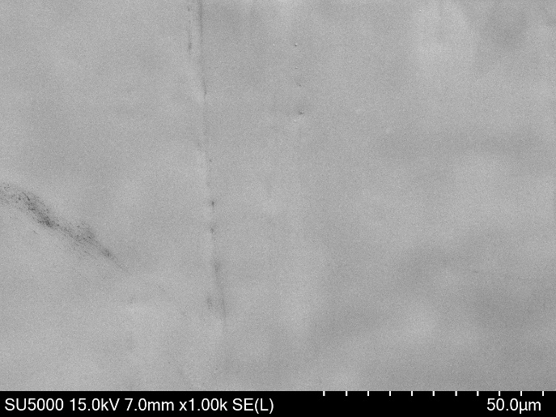
Electropolishing
Smooth surfaces, critical for minimising surface resistance (𝑅𝑠).
Eliminate microscopic defects and oxides that could trap vortices or cause energy dissipation.
Significantly reduces surface roughness, leading to higher Q-factors.
Ensures uniform superconducting properties across the cavity surface.
H₃PO₄:BuOAc=65:35 60 C° 30-60 min
FESEM picture of on face of the cavity after mechanical machining
FESEM picture of one face of the aluminum cavity after Electrochemical Polishing (EP)

Slide 10
Electropolishing challanges
High purity Al 5N, is extremely reactive (possible pitting and oxidation), different EP behaviour.
Narrow and deep cave Positioning of the cathode.
EP can not eliminate macro-defects (made during machining).

Slide 11
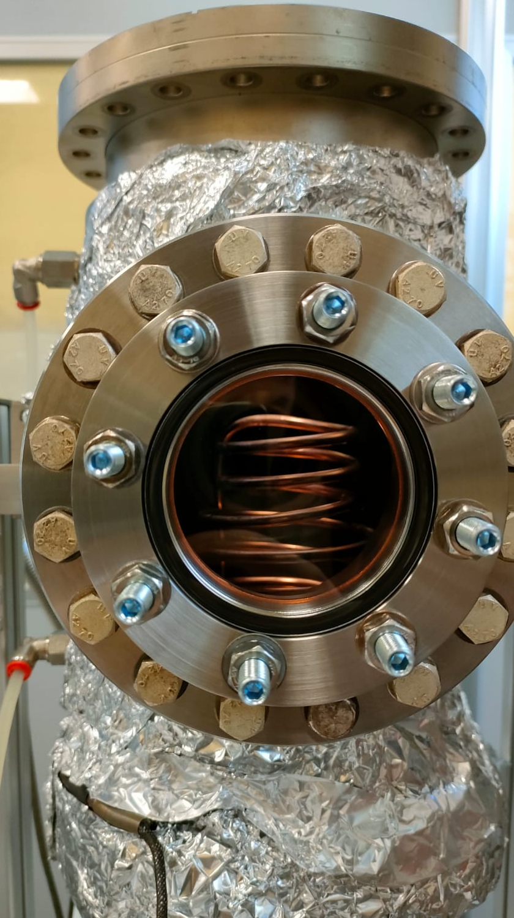
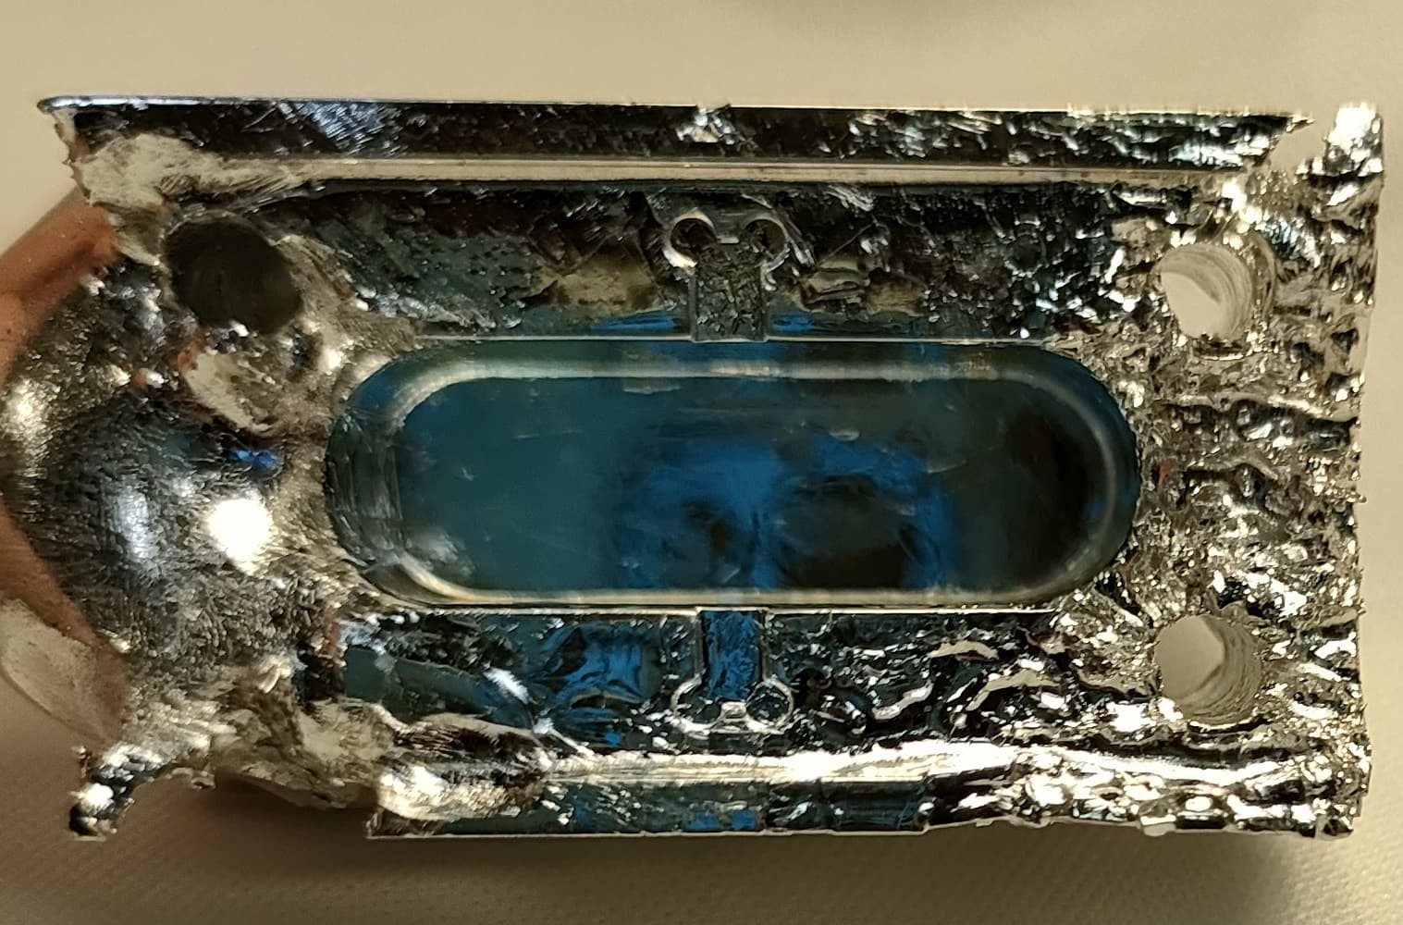
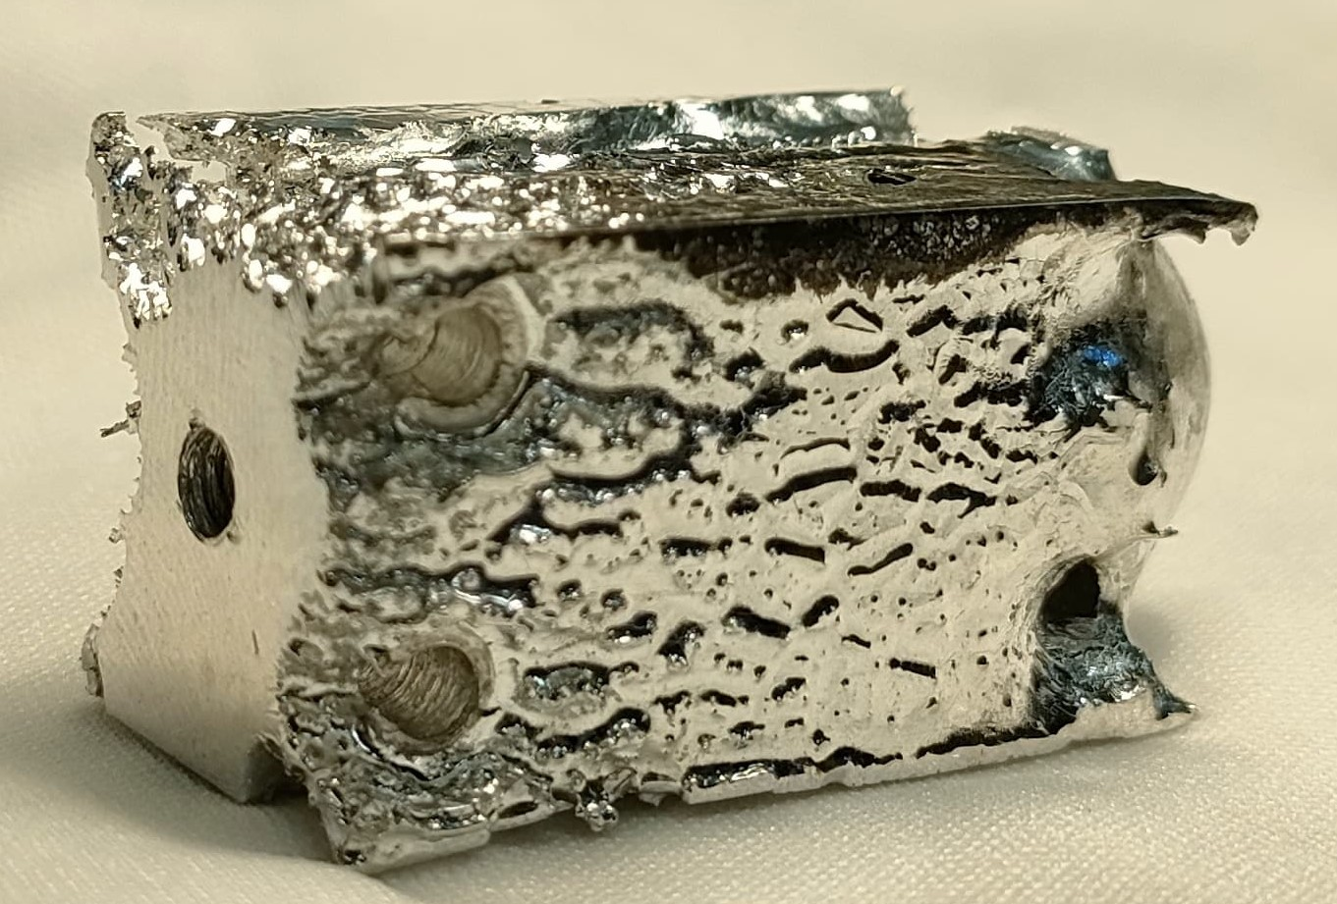
Annealing UHV
First attempt with Induction Heating failed due to difficult control of the process.
Relieve residual mechanical stresses induced during machining or forming
Increase grain size and reduce grain boundary density, which improves superconducting performance.
Larger grain sizes and reduced dislocations lower microwave losses.
Improves coherence by reducing two-level system (TLS) defects associated with grain boundaries.

Slide 12
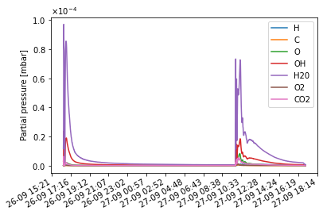
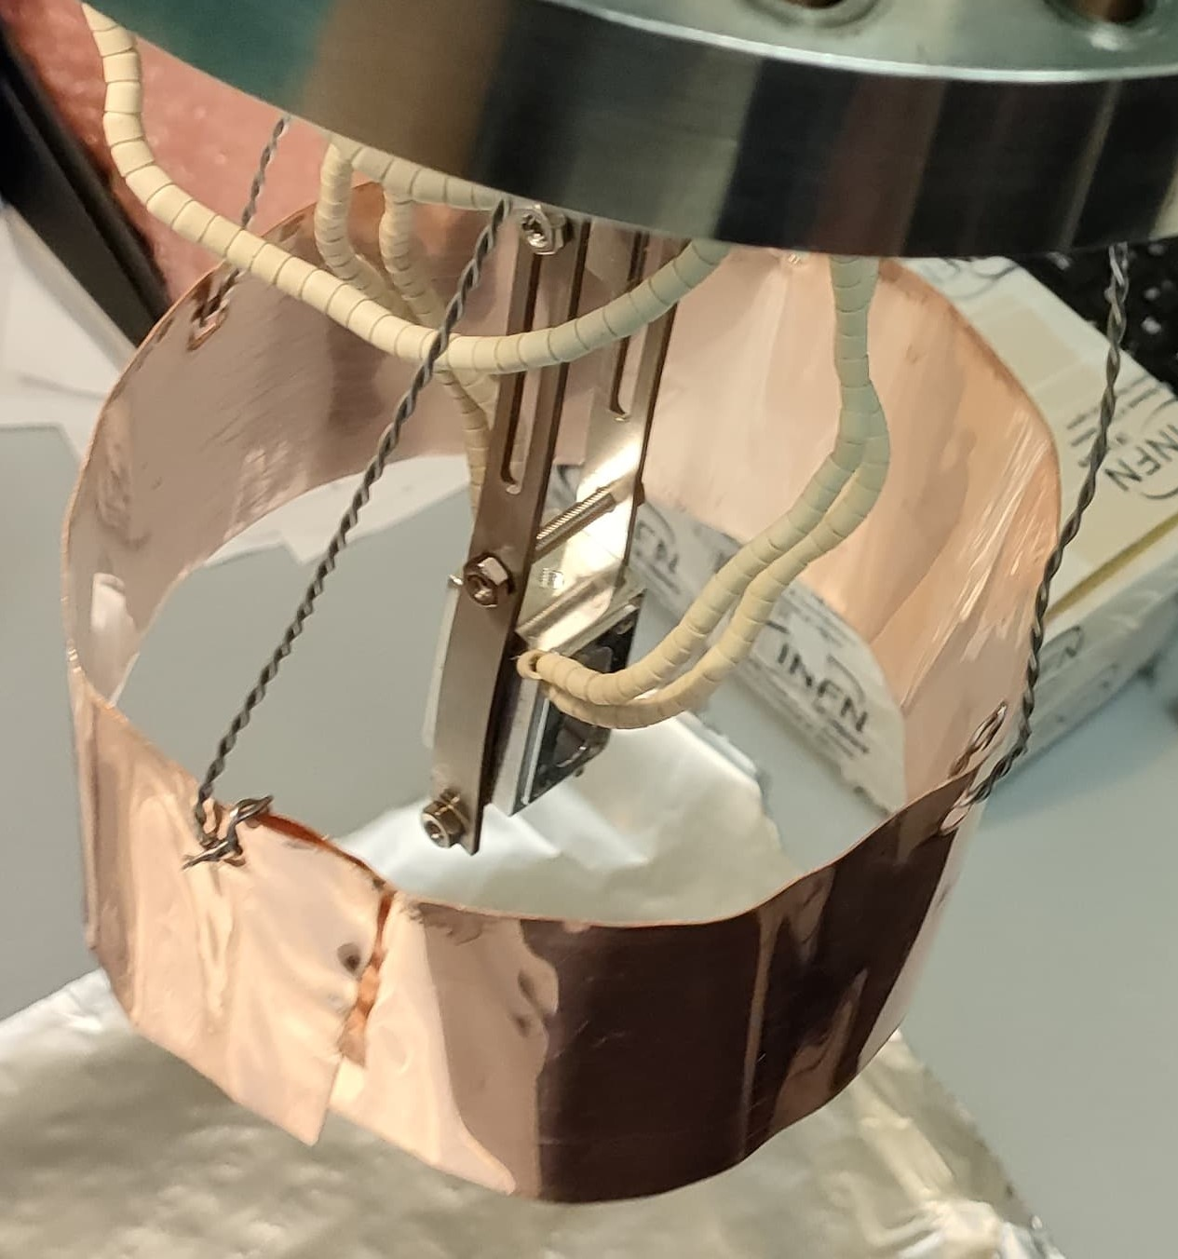
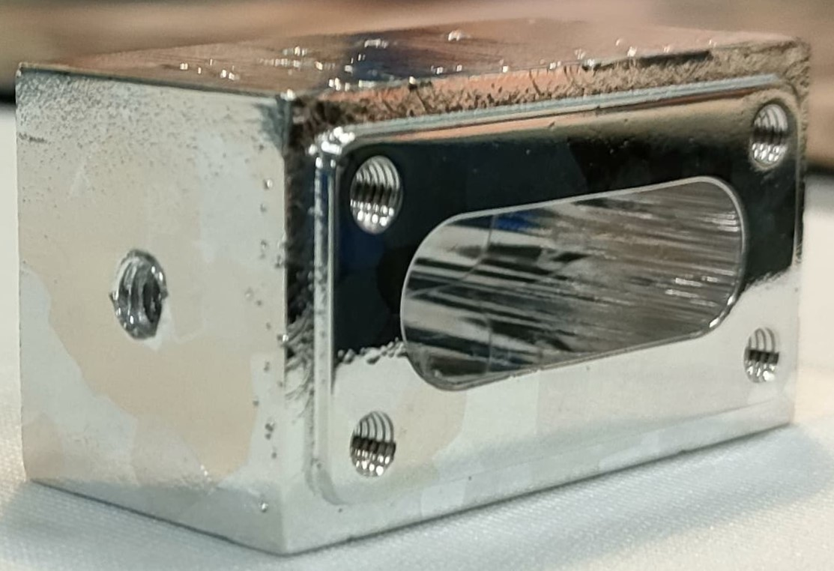
Annealing UHV
Final protocol with InfraRed lamps
Oxidation mitigated with:
Longer ultrasound cleaning
Initial pre-baking.
Oxidation: Most likely due to the residuals of EP/water on the Al cavity, during vaccum heating.
Baking
120°C
Annealing
450°C
24h 8h
Oxide formation!

Slide 13
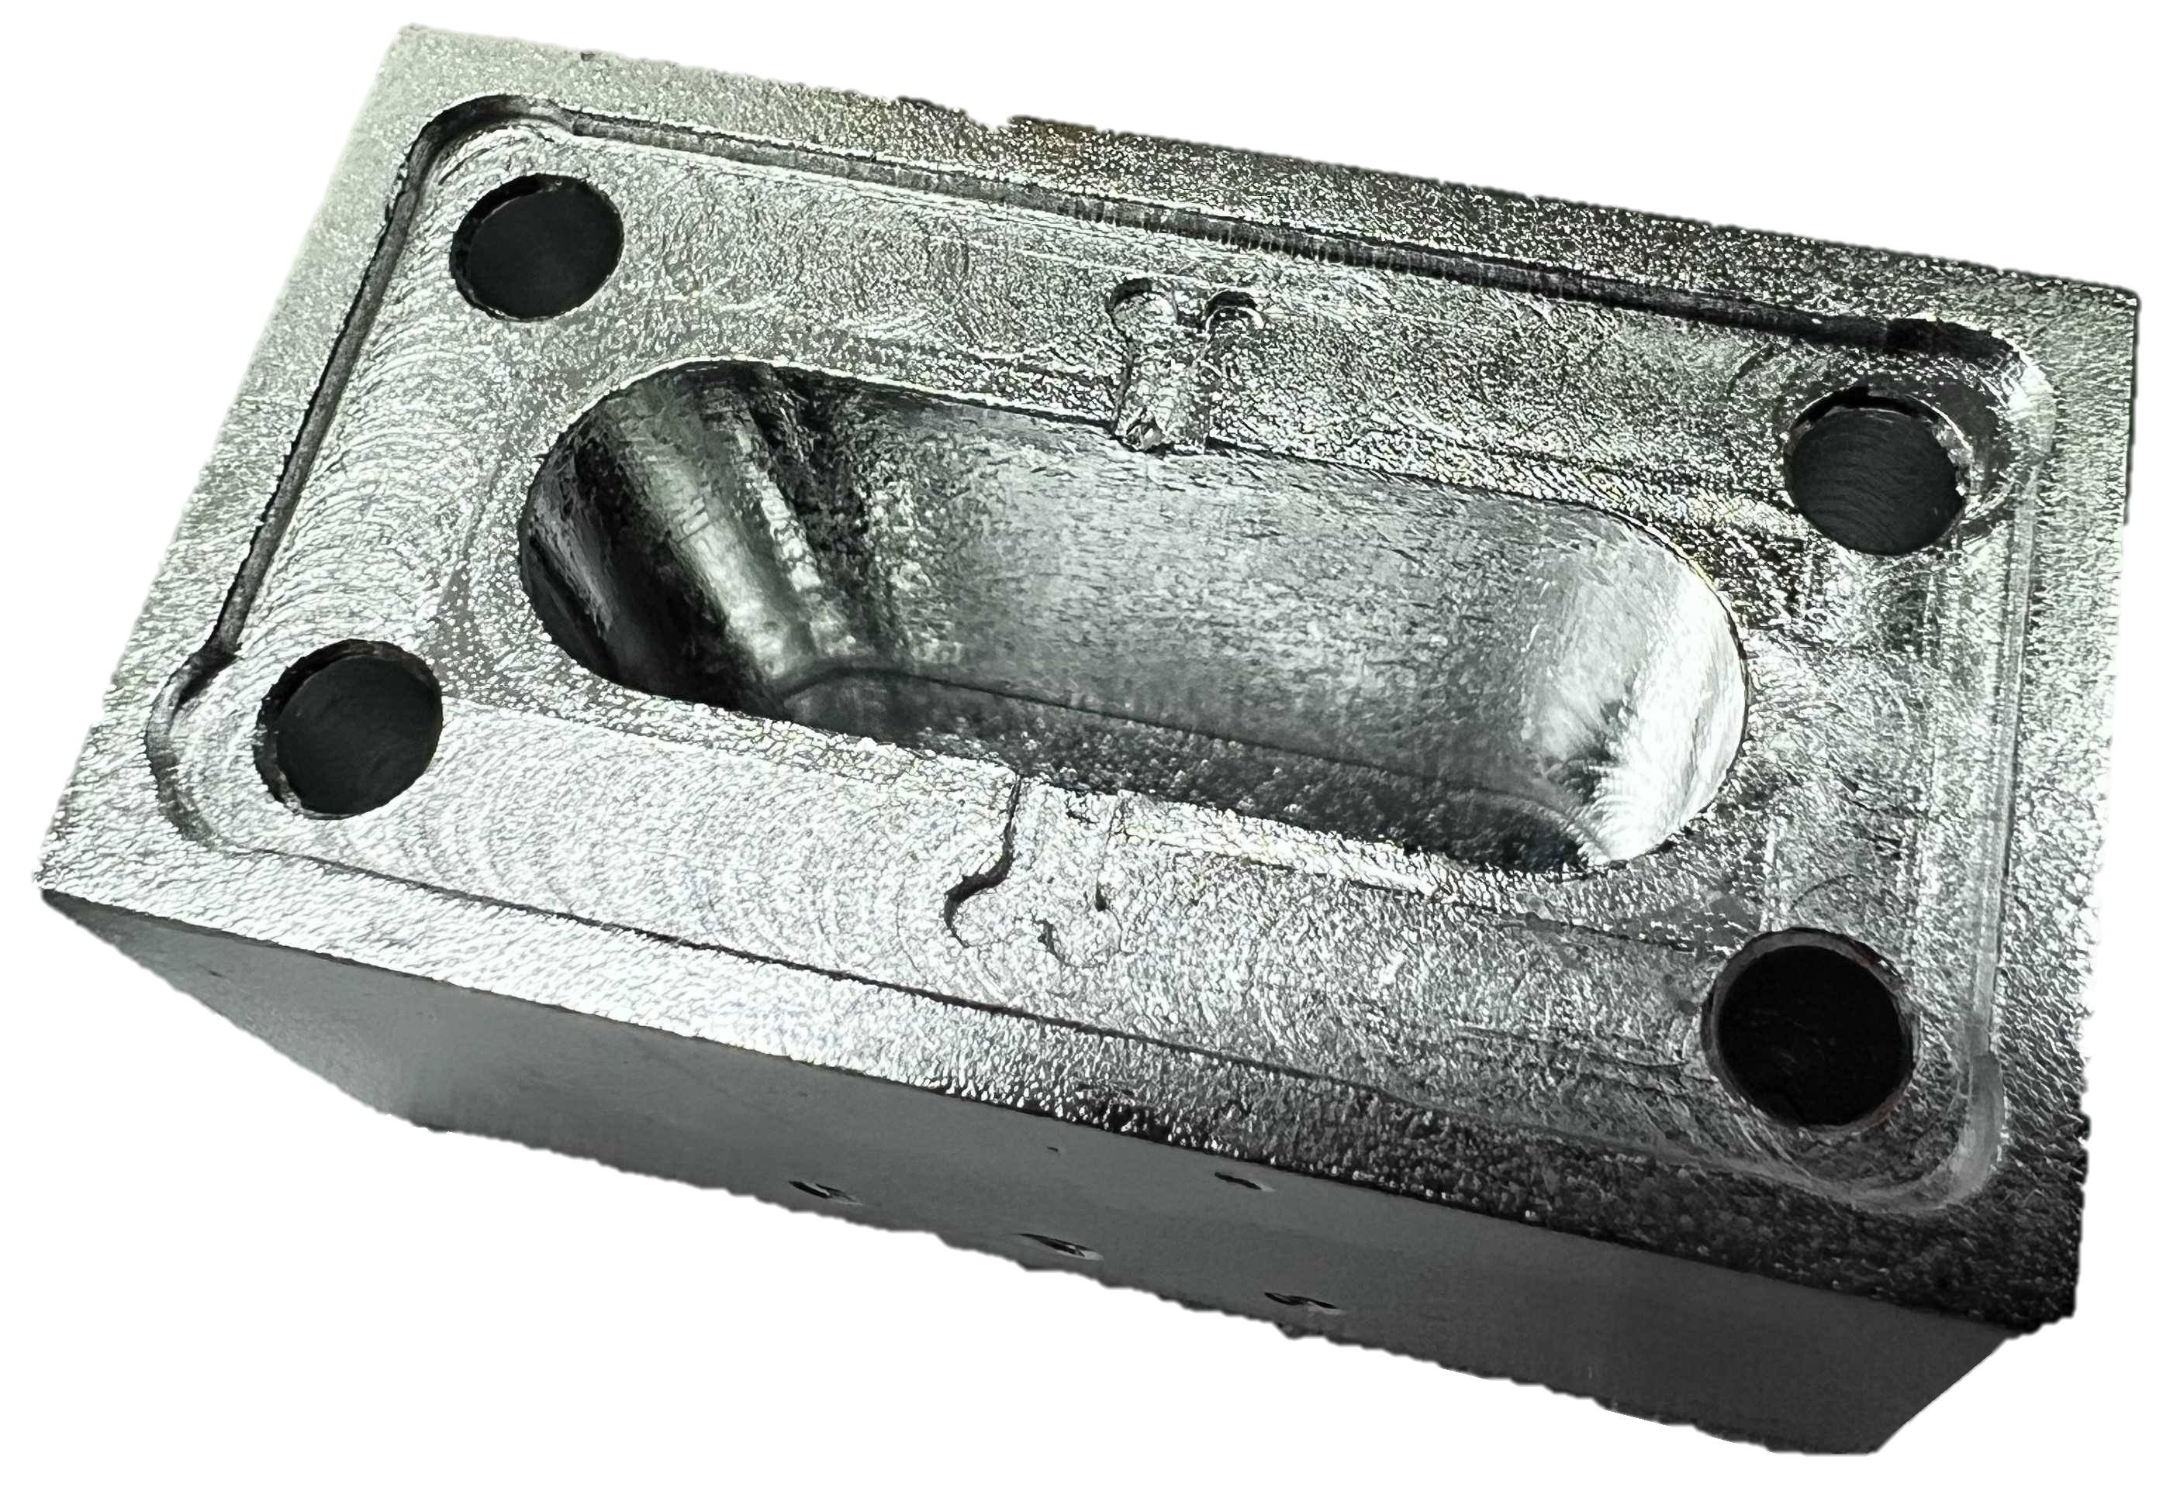
Our Protocol
Al SC cavity production
Pure Al 5 N
Electropolishing
H₃PO₄:BuOAc (65:35)
Annealing
6h/375 C°
Fast EP
H₃PO₄:BuOAc (65:35)
30 min 60 C° 15 μm
1 h at 60 C° 20-30 μm
SRF cleanliness standard
Al alloy
Al 5N #1
Al 5N #2
Cavity | Q_{L} | Q₀ | Treatments
Al alloy |  | 1,17·10⁵ | No treatments
Al 5N #1 | 2,2·10⁵ |  | Light EP
Al 5N #2 |  | 3,7·10⁶ | New machining protocol, EP
Al 5N #3 | n/a | To be measured | New protocol: EP + Annealing + Post EP
Al 5N #3
See S. Tocci talk A. Rettaroli PM2024, Pisa Meeting on Advanced Detectors

Slide 14
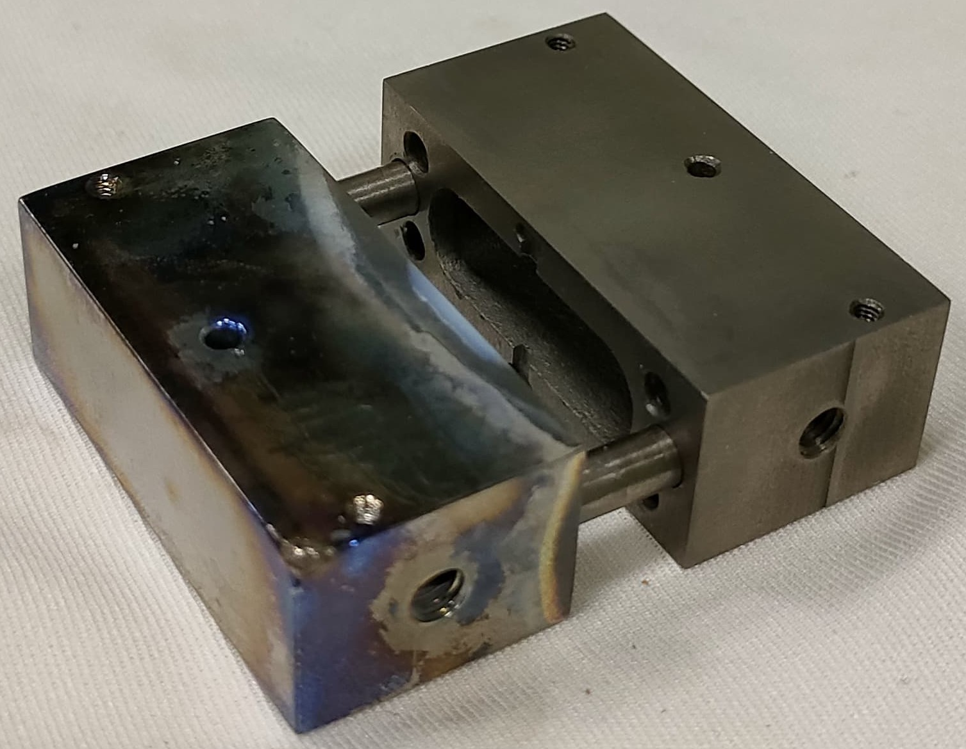
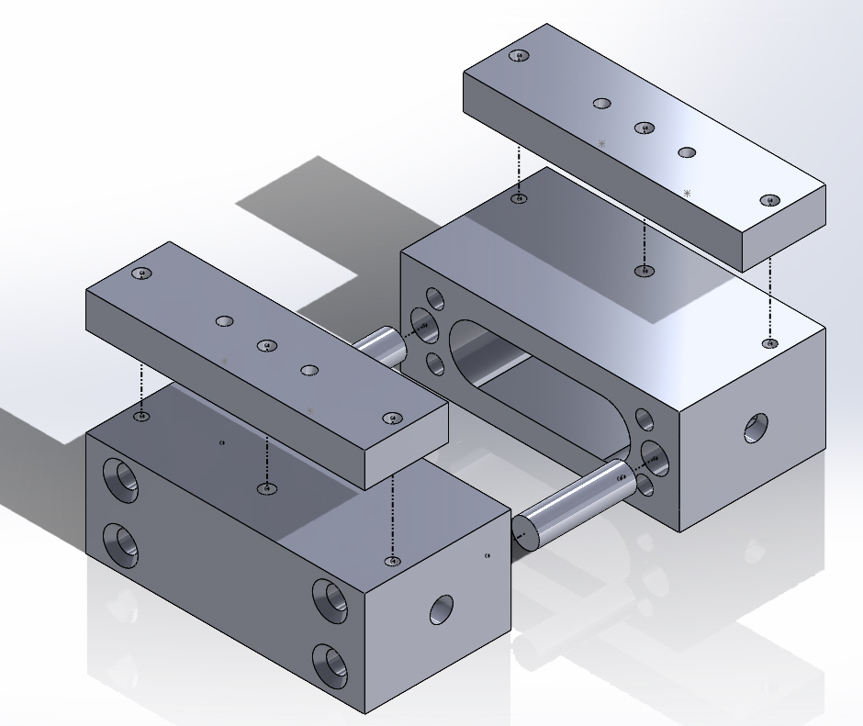
Niobium SC cavity for 3D qubit?
Mature fabrication techniques and High-Q
BCP (chemically polished)
As fabricated
Surface initial quality is critical, new mechanical procedure for Al should improve also Nb cavity quality
https://doi.org/10.1103/PhysRevLett.119.264801
Other studies on Nb application for quantum and at low RF power

Slide 15
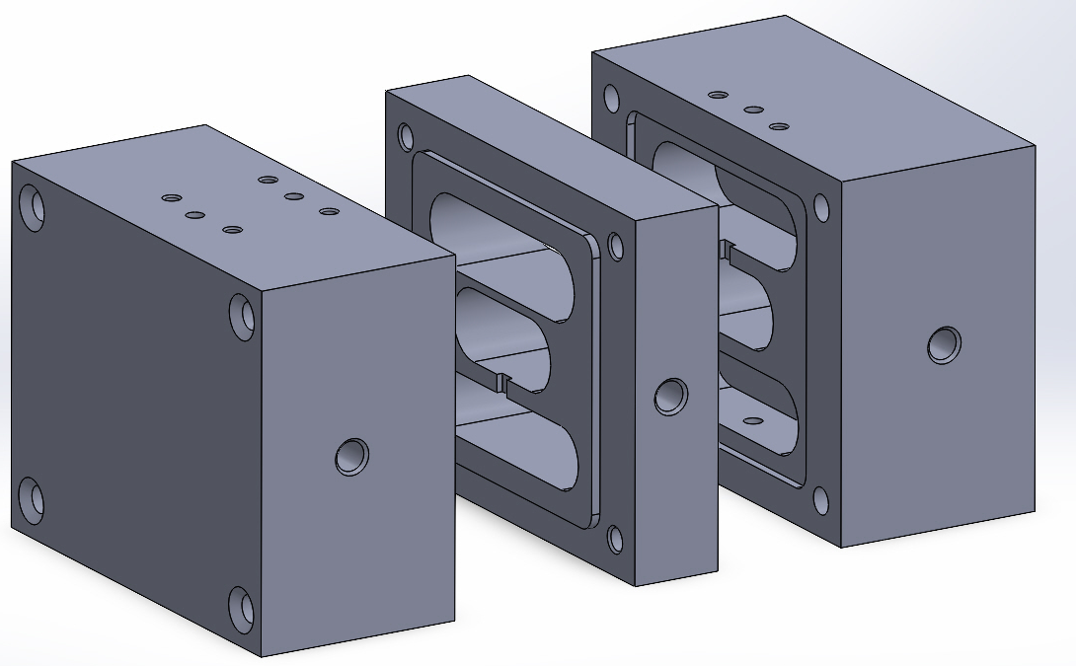
3-cell cavity design
2 mm distance check - passed
A. Rettaroli https://doi.org/10.1016/j.nima.2024.170010; A. D’Elia Appl. Sci. 2024, 14(4), 1478.

Slide 16
Conclusions
Quality factor has been increased from 10⁵ to 10⁶
Nb SC cavity for quantum is considered
3-cell cavity design
Al 5N is highly reactive material. Easy to oxides in vacuum and after EP. Additionally difficulties with mechanical processing.
Switching to Nb is advantageous due to well-known properties from accelerator cavity development.

