Slide 1

Missione 4
Istruzione e Ricerca
Development of 3D superconducting Qubit
Simone Tocci
5-7 February 2025 - Secondo Congresso Nazionale NQSTI

Slide 2
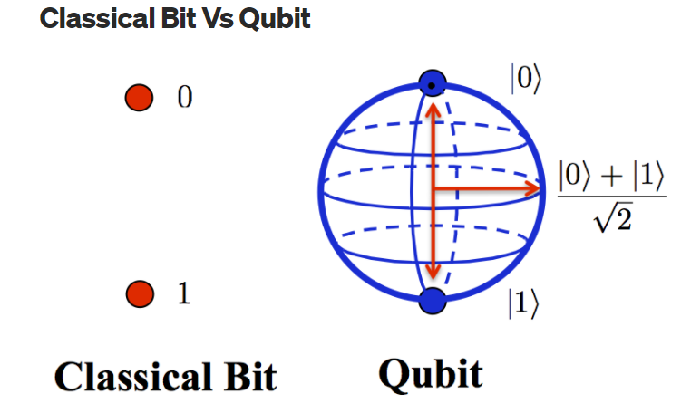
Qubit
Qubits exploits the states superposition to increase calculation power
A two-level quantum system is required
By Abhishek Dubey
JJ provide a solid-state system that can mimic the features of an artificial atom with discrete energy levels
Missione 4 • Istruzione e Ricerca
Missione 4 • Istruzione e Ricerca
Notes:
I think we can start with this question, What is the qubit? The qubit is the quantum mechanical equivalent of the Boolean bit. To realise a qubit, it is necessary to fabricate a two-level system. This requirement is met by the Josephson junction.

Slide 3
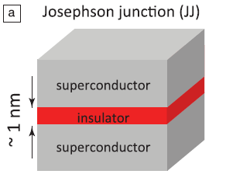
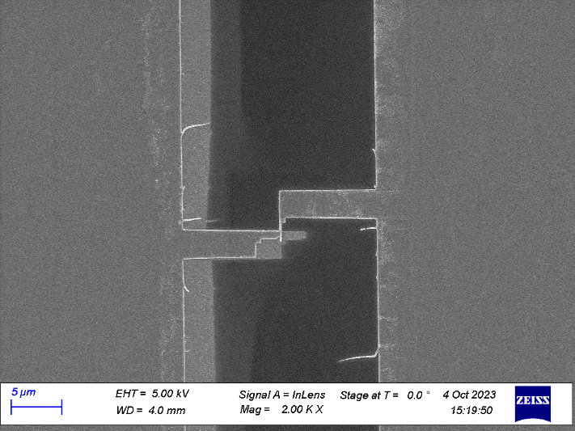

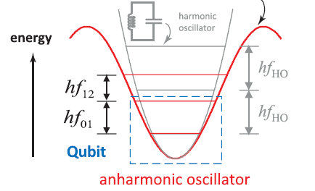



Josephson Junction
The most widespread qubit type is the transmon.
$$ψ_{1}=\left|ψ\right|e^{iφ_{1}}$$
$φ_{1}$-$φ_{2}=φ$
$$ψ_{2}=\left|ψ\right|e^{iφ_{2}}$$
Transmon consists of a small JJ shunted by two large capacitors to reduce the charge noise. Its simple design and high quality performance make the transmon one of the best candidates for large-scale production.
W. D. Oliver, P.B. Welander, MRS Bulletin, 2013
Notes:
A JJ is a device consisting of two superconductors separated by an insulating layer of the order of 1 nm. The phase difference between two SC layers is governed by the Josephson equations. Solving these equations shows that the energy landscape of the junction is that of an anharmonic oscillator where the first two levels can be used as a two-level system for the qubit. There are many types of qubits based on JJ. We have studied the transmon, which consists of a small JJ shunted by two large capacitors to reduce the charge noise. Its simple design and high-quality performance make the transmon one of the best candidates for large-scale production.

Slide 4
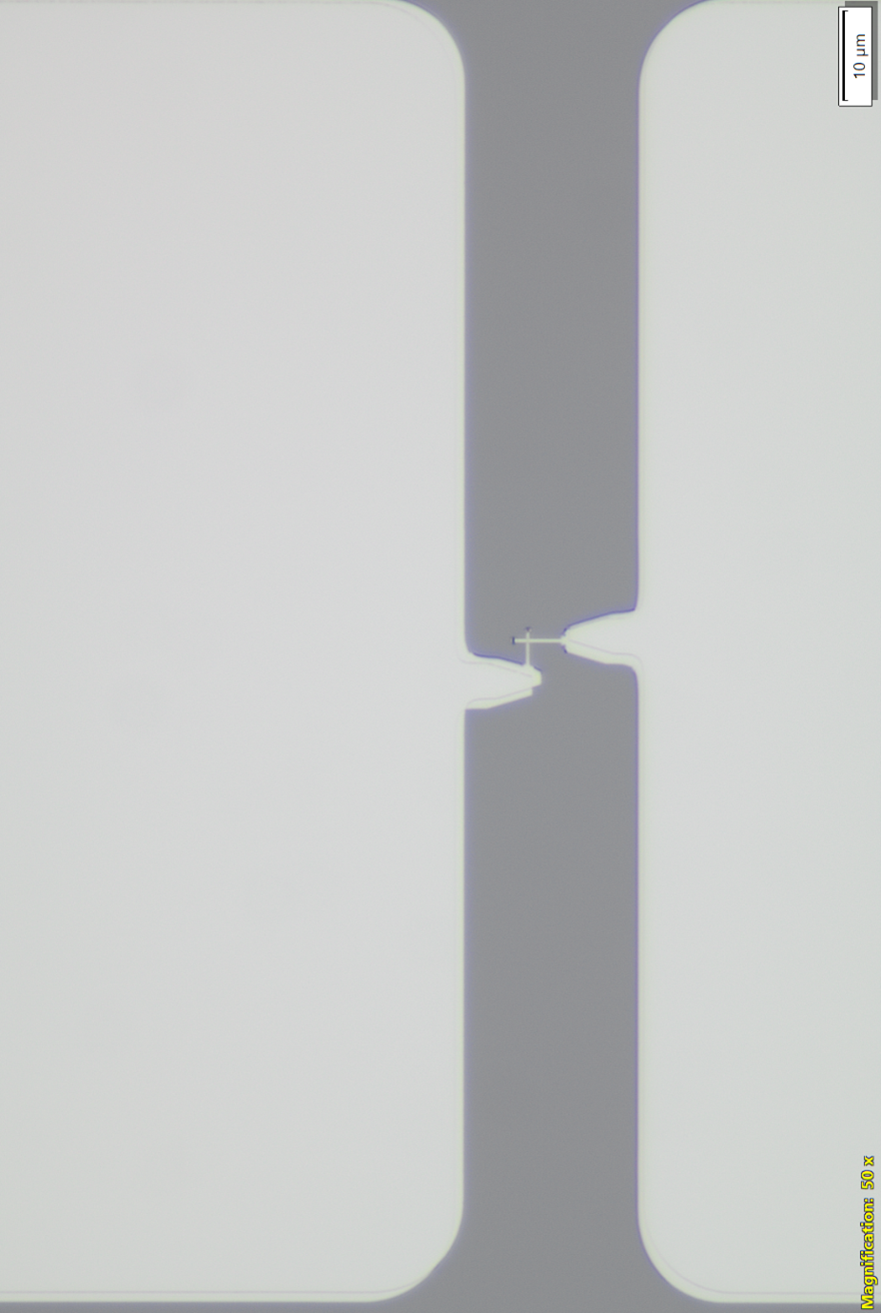
Transmon
Josephson Junction
Two metal pads (two capacitors of about 50 fF)
JJ Area:
216 x 148 nm²
Ic=20 nA
Al Qubit fabricated at IFN CNR;
Notes:
The transmon characterized has been fabricated at Institute of Photonics and Nanotechnology of Rome . It consists of a JJ shunted by two rectangular metal pads that act as two capacitors. It has an Area of about 0.032 square um and a critical current of about 20 nA.

Slide 5
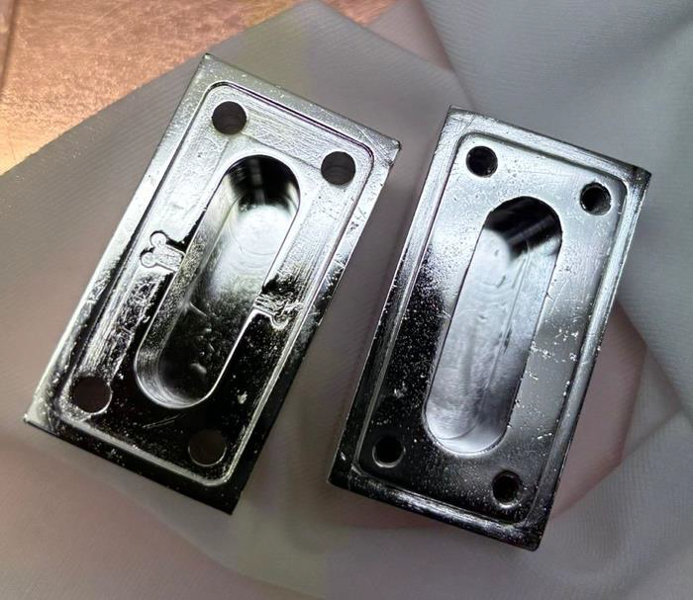

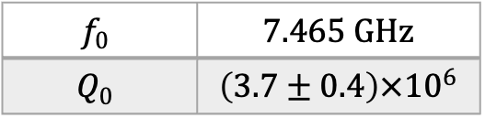
Ultra–pure Al cavity
$$f_{0}$$ | $$7.465 GHz$$
$$Q_{0}$$ | $$\left(3.7±0.4\right)×{10}^{6}$$
Pure Al cavity fabricated at LNL – INFN;
more details in the talk by Eduard Chyhyrynets
Notes:
So, in order to improve the performance of the transmon and can read its state, we placed it inside a pure Al cavity. We use a 3D cavity since it has smaller losses respect to planar resonators. On slide we can see the pure Al cavity that we used to characterize our qubit. It has been fabricated at the National Institute of Nuclear Physics of Legnaro. This cavity was able to reach a quality factor of 3.7 millions. This is result is an improvement of one order of magnitude respect to previous fabrication.

Slide 6
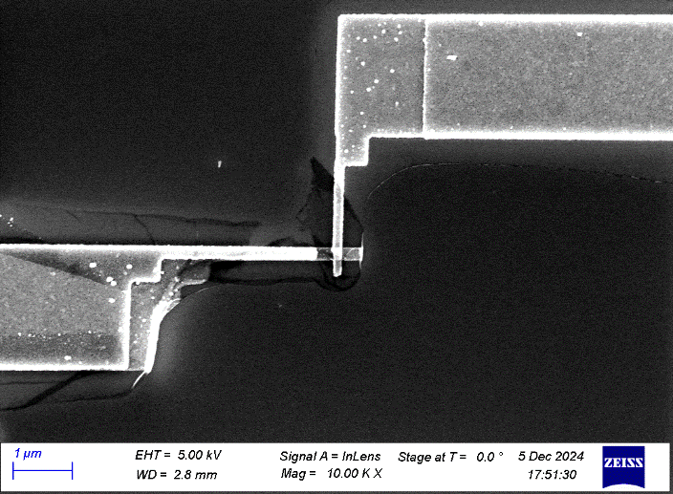
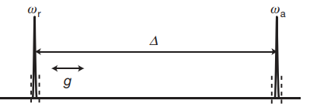

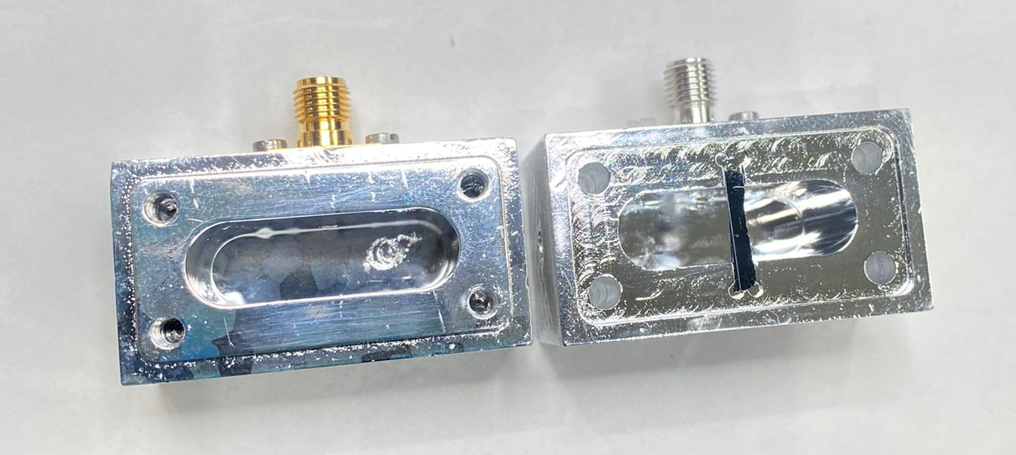
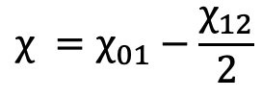
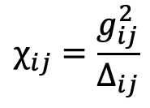
Qubit in 3D Ultra–pure Al cavity
Dispersive regime
ω_{q}
ω_{r}
Δ₀₁
$$χ_{ }=χ_{01}−\frac{χ_{12}}{2}$$
$$χ_{ij}=\frac{g_{ij}^{2}}{Δ_{ij}}$$
Δ₀₁=ω_{q}-ω_{r}
ω_{q}=ω₀₁
We read the Qubit state through a cavity measurement
Al Qubit fabricated at IFN CNR;
Notes:
Here we can see our transmon inside a pure Al cavity. The cavity and the Qubit have been designed to be coupled in the dispersive regime. In this regime the Jaynes Cumming Hamiltonian is the following « indicare». Wr is the resonance frequency of the bare cavity, chi is the effective dispersive shift, defined as following « indicare equazione sotto», wq is the qubit frequency. Chi01 and chi12 are the dispersive shift relative to the levels 01 and 12 of the transmon. For an arbitrary couple of levels, the dispersive shift can be written as a function of the coupling strength and the detuning from the resonator (indicare equazione). Since the qubit and the cavity are coupled, we can read the Qubit state through a cavity measurement and to characterize the system to extract the Hamiltonian parameters.

Slide 7

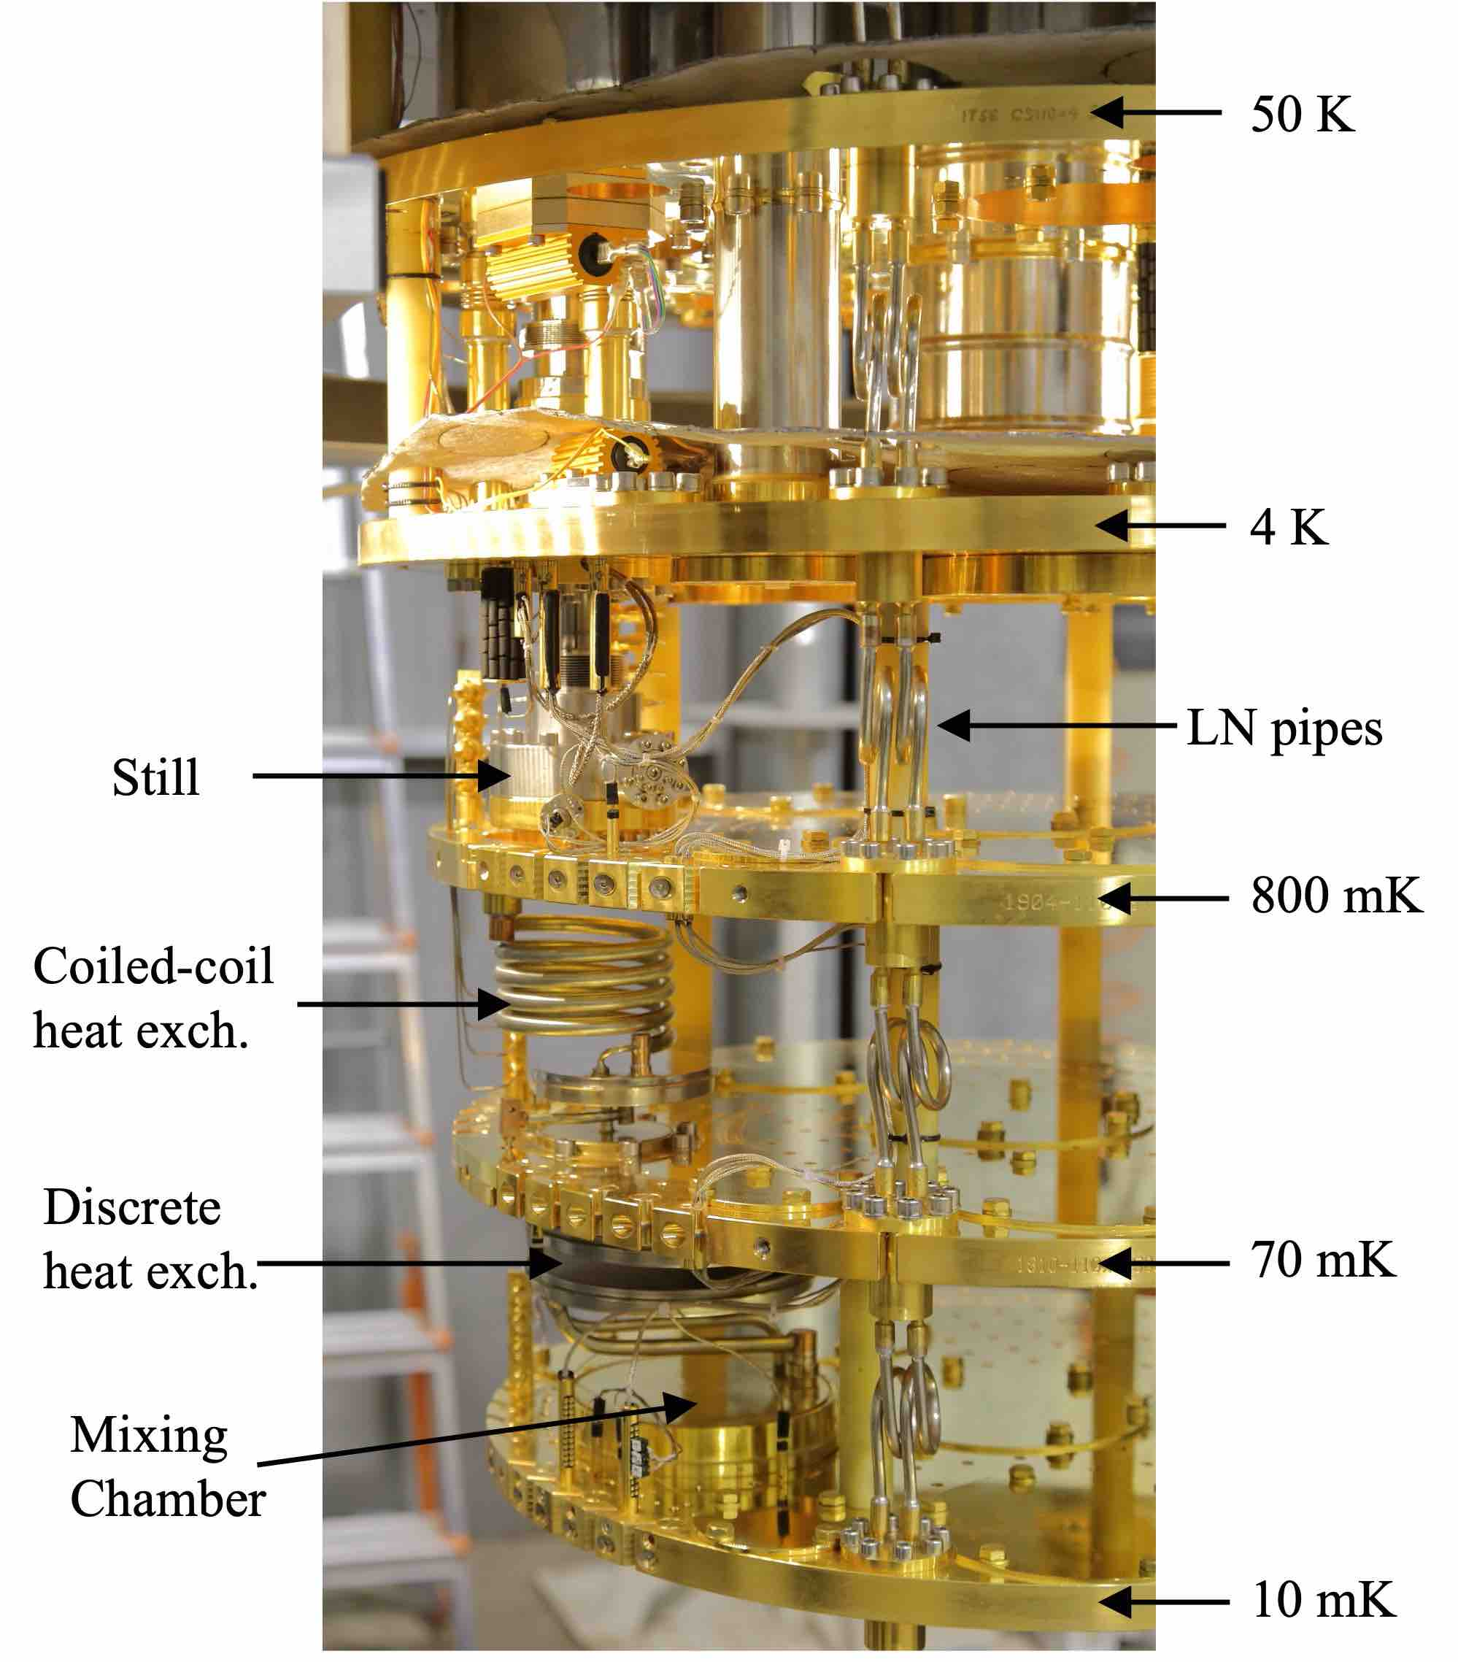
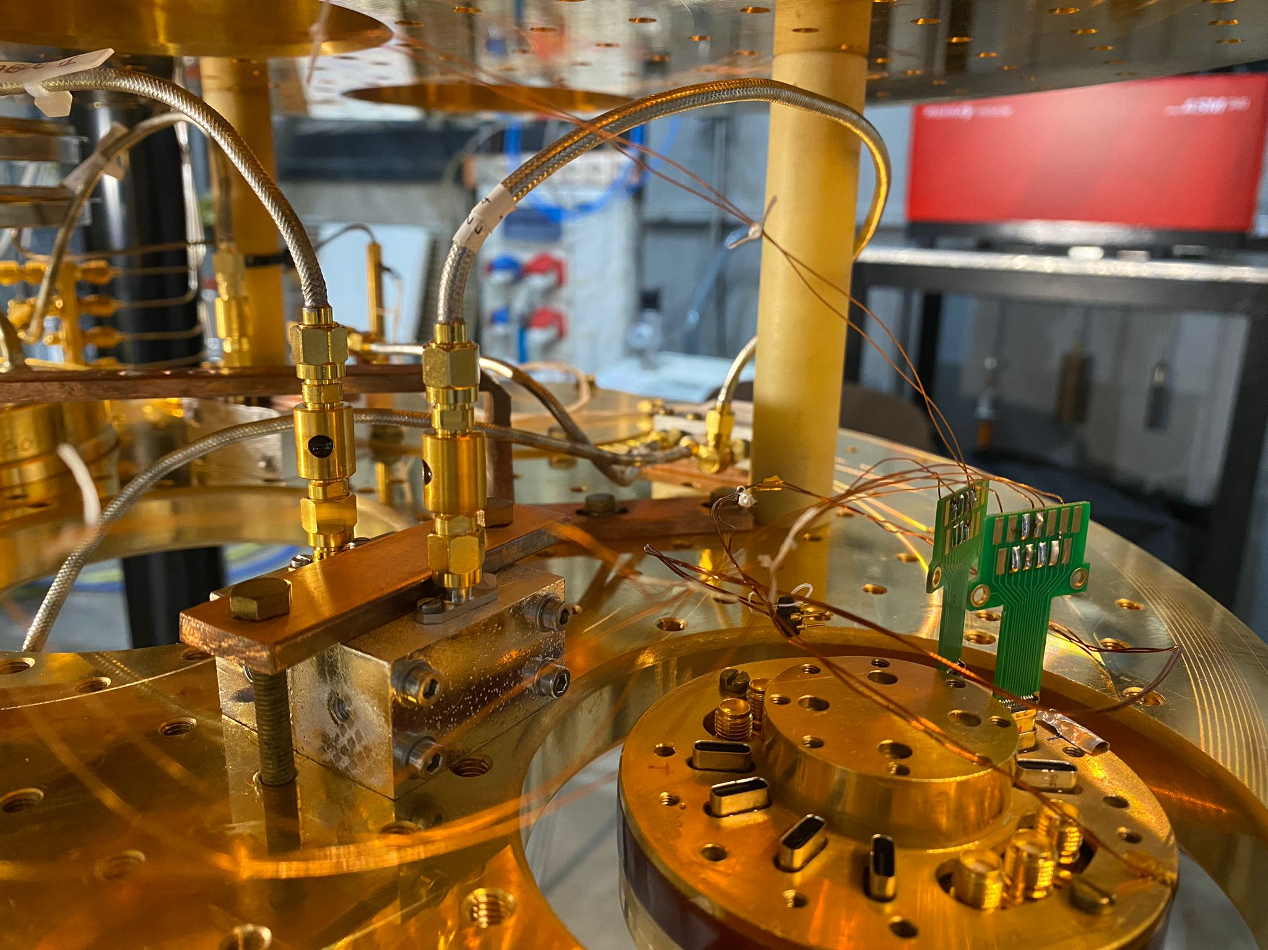
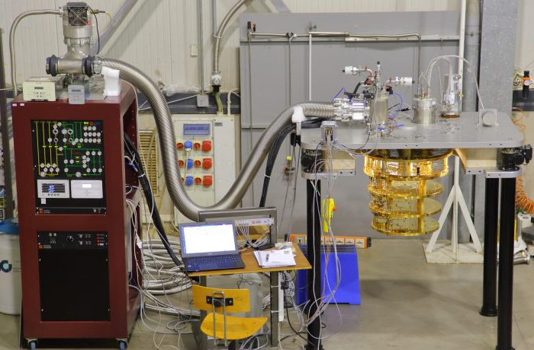
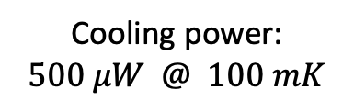

LNF-cryostat
$$T_{base}=8 mK$$
Cooling power:
$$500 μW @ 100 mK$$
3D Transmon
Courtesy of A. Rettaroli
Notes:
We tested the transmon in our dilution cryostat located in LNF. It is a Leiden cryostat that can reach 8 mK with a cooling power of $500 μW @ 100 mK$. Here is a picture (indicare immagine destra) of the different plates of the cryostat where the device hosted on the 10 mK plate

Slide 8
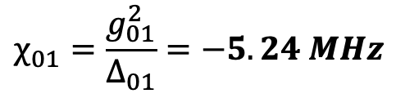

Qubit in 3D cavity: Cavity spectroscopy
Bare cavity frequency
ν_{r}= 7.252 GHz
$$χ_{01}=\frac{g_{01}^{2}}{Δ_{01}}=−5.24 MHz$$
$$χ_{01}=\frac{g_{01}^{2}}{Δ_{01}}$$
Qubit in ground state
Notes:
So, to characterise the system we start by performing a cavity spectroscopy measurement. We used the VNA to acquire different spectra with different probing powers. We can see that increasing the VNA power a second feature at low freq. appears. It can be attributed to the bare cavity since at high power the qubit transit to the normal state. With this information, we can extract chi01 value that is equal to 5.24 MHz

Slide 9
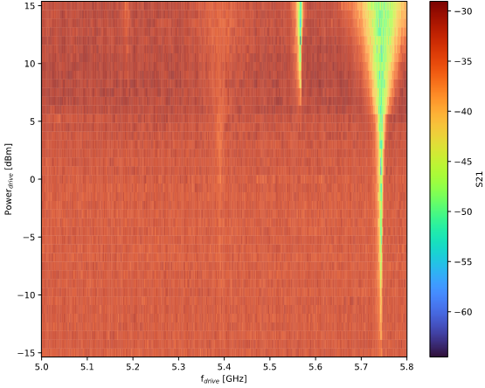


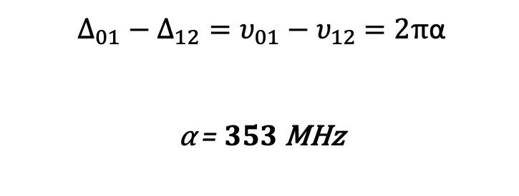

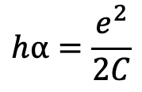

Qubit spectroscopy: Anharmonicity and capacity
$Δ_{01}−Δ_{12}=υ_{01}−υ_{12}$ $=2π$α
α = $353$ MHz
$$\frac{υ_{02}}{2}$$
$$υ_{12}$$
$$hα=\frac{e^{2}}{2C}$$
$$C=54.87 fF$$
$$υ_{01}$$
Notes:
After we made cavity spectroscopy, we then proceeded with two-tone qubit spectroscopy. In this measurement, we recorded the transmission at the cavity frequency as a function of drive frequency and power. We were able to observe v01 at about 5.75 GHz and we also observed transitions at higher levels such as v12 and v02\2. From these measurements we can estimate the anharmonicity to be 353 MHz and the qubit capacitance to be about 55 fF. Both these values are in good agreement with the device design.

Slide 10
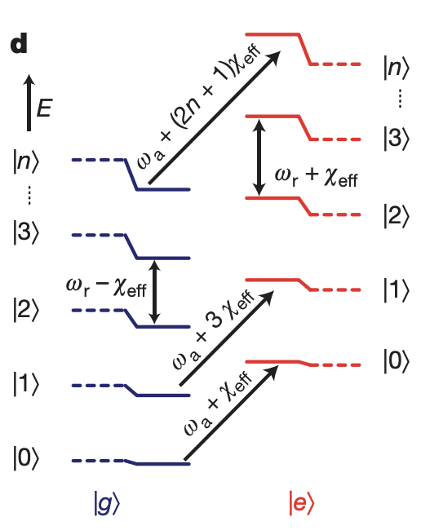

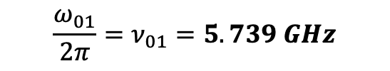
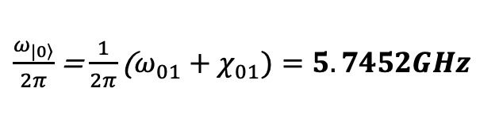
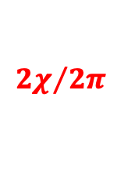
Qubit in 3D cavity: Resolving Photon Number
The qubit frequency depends on the number of photons in the cavity
Number of photons in cavity
4 3 2 1 0
$\frac{χ_{ }}{2π}$ = $−1.2$ MHz
$${2χ}/{2π}$$
$\frac{ω_{\left.|0\right\rangle }}{2π}$ = $\frac{1}{2π}\text{(}ω_{01}+χ_{01})=5.7452GHz$
$$\frac{ω_{01}}{2π}=ν_{01}=5.739 GHz$$
f_{VNA} = 7.257 GHz
P_{VNA}= -55 dBm
Schuster, D. Houck, A. Schreier, J. et al. Resolving photon number states in a superconducting circuit. Nature 445, 515–518 (2007).
Notes:
Once the frequency of the qubit was known, we were able to resolve the photon number states within the cavity. This is possible because the frequency of qubit depends on number of photons in the cavity since adaga sigmaZ term appears in the Hamiltonian. So, using a probing power of -55 dBm, we injected an average of 3-4 photons into the cavity. We can distinguish up to 7 Fock states. From these measurements we extracted the chi and from zero Fock state frequency and by using the equations that you can see on slide we estimated the exact value of the qubit frequency. Indeed, since we measured a chi01 of -5.24 MHz we obtain a qubit frequency of 5.739 GHz.

Slide 11
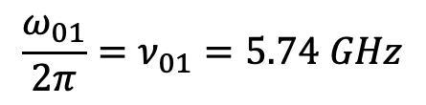
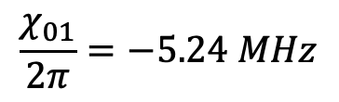

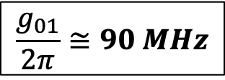
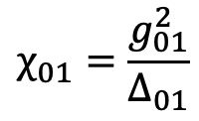

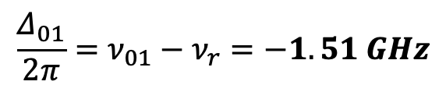
Qubit-cavity coupling
$\frac{χ_{ }}{2π}$ = $−1.2$ MHz
$$\frac{Δ_{01}}{2π}=ν_{01}−ν_{r}=−1.51 GHz$$
ν_{r} = 7.252 GHz
$$\frac{χ_{01}}{2π}=−5.24 MHz$$
$$C=55 fF$$
$$χ_{01}=\frac{g_{01}^{2}}{Δ_{01}}$$
$$\frac{g_{01}}{2π}≅90 MHz$$
$$\frac{ω_{01}}{2π}=ν_{01}=5.74 GHz$$
Notes:
With this parameters and using this equation (indicare) we compute the detuning and then inverting this equation (indicare) we can estimate the coupling strength between the qubit and the cavity to be 90MHz. This value is in good agreement with the design value of about 92 MHz.
For the moment I have finished with the qubit characterisations, but I would like to tell you about some future developments that we are carrying out in our laboratory.

Slide 12
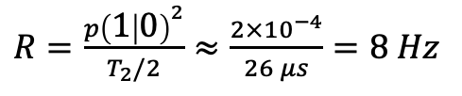
Next step: 2 Qubit Photon Counter
Dark count rate
Derived from the time evolution of the density matrix.
$R=\frac{p{\left(1 | 0\right)}^{2}}{T_{2}/2}≈\frac{2×{10}^{−4}}{26 μs}=8 Hz$
Kono, S. Koshino, K. Tabuchi, Y. et al. Quantum non-demolition detection of an itinerant microwave photon. Nature Phys 14, 546–549 (2018).
more details in the talk by Marco Gobbo
Notes:
Indeed soon, we plan to implement a two qubits single photon detector. The idea of this detector, as you can see the sketch on slide, is the following: We place two uncoupled qubits in the same storage cavity and then we prepare the qubits in the ground+excited state with a pi\2 pulse. If there is a photon in the storage cavity, the qubits will precede on the Block sphere with 2chi speed. After a time of pi\2chi the qubits will be on the opposite side of the Block sphere equator. Now closing the Ramsey cycle with a –pi\2 pulse will bring the qubits in excited state 11. On the other hand, without photon in the cavity, closing the cycle will bring the qubits in ground state. We plan to use two qubit to measure in coincidence the double excited state and thus reducing the noise of up to two orders of magnitude respect to the 1 qubit case. On the right side of the slide, we can see the result of a simulation run with Qutip. It’s clear that the probability to find the qubits in the excited state is different from zero only with a photon in the cavity.

Slide 13
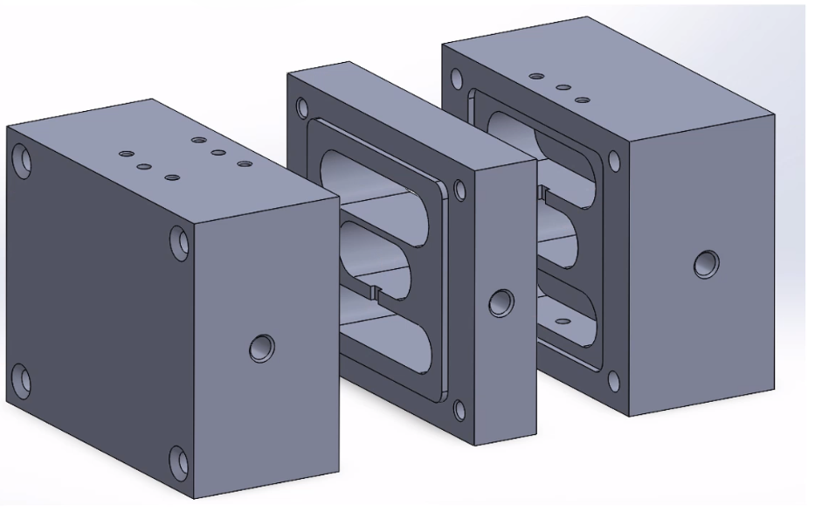
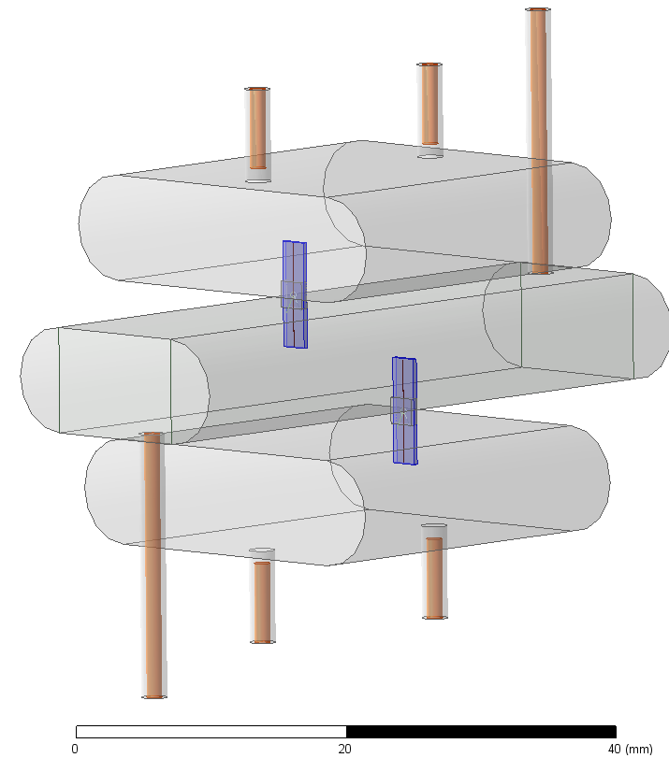
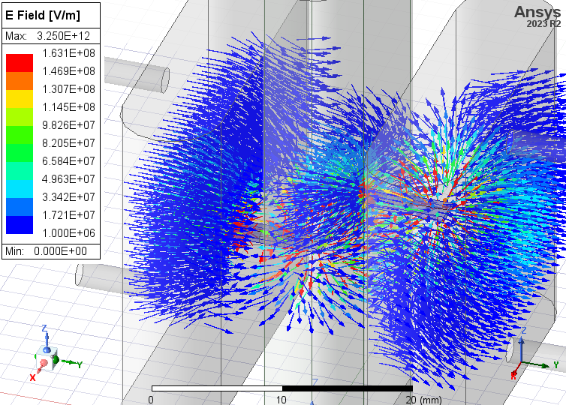
Next step: 2 Qubit Photon Counter
Readout Cavity 2
Storage Cavity
Qubits
E field: Cavities + Qubits
Readout Cavity 1
D. Milillo, Roma Tre University
A. Rettaroli https://doi.org/10.1016/j.nima.2024.170010; A D’Elia Appl. Sci. 2024, 14(4), 1478.
Notes:
We also performed mechanical and electromagnetic design and simulations that we plan to use to fabricate and assembly the 2-qubit photon detector in the near future.

Slide 14
Conclusion:
We designed and fabricated a 3D transmon qubit
We characterized the transmon using spectroscopic techniques and measured all the main parameters of Hamiltonian; qubit frequency, dispersive shift, qubit capacitance, anharmonicity etc.
I showed you some of the future development we plan to implement in the near future, like the two qubits photon detector.
In conclusion, we showed that our collaboration can fabricate an Al transmon qubit with parameters closely matching the design requirements and that we are able to control all the steps, from design to production.

Slide 15






People involved in this work
Notes:
Finally, I would like to thank all the people involved in this work.

Slide 16
Thank you for your attention

