Slide 1
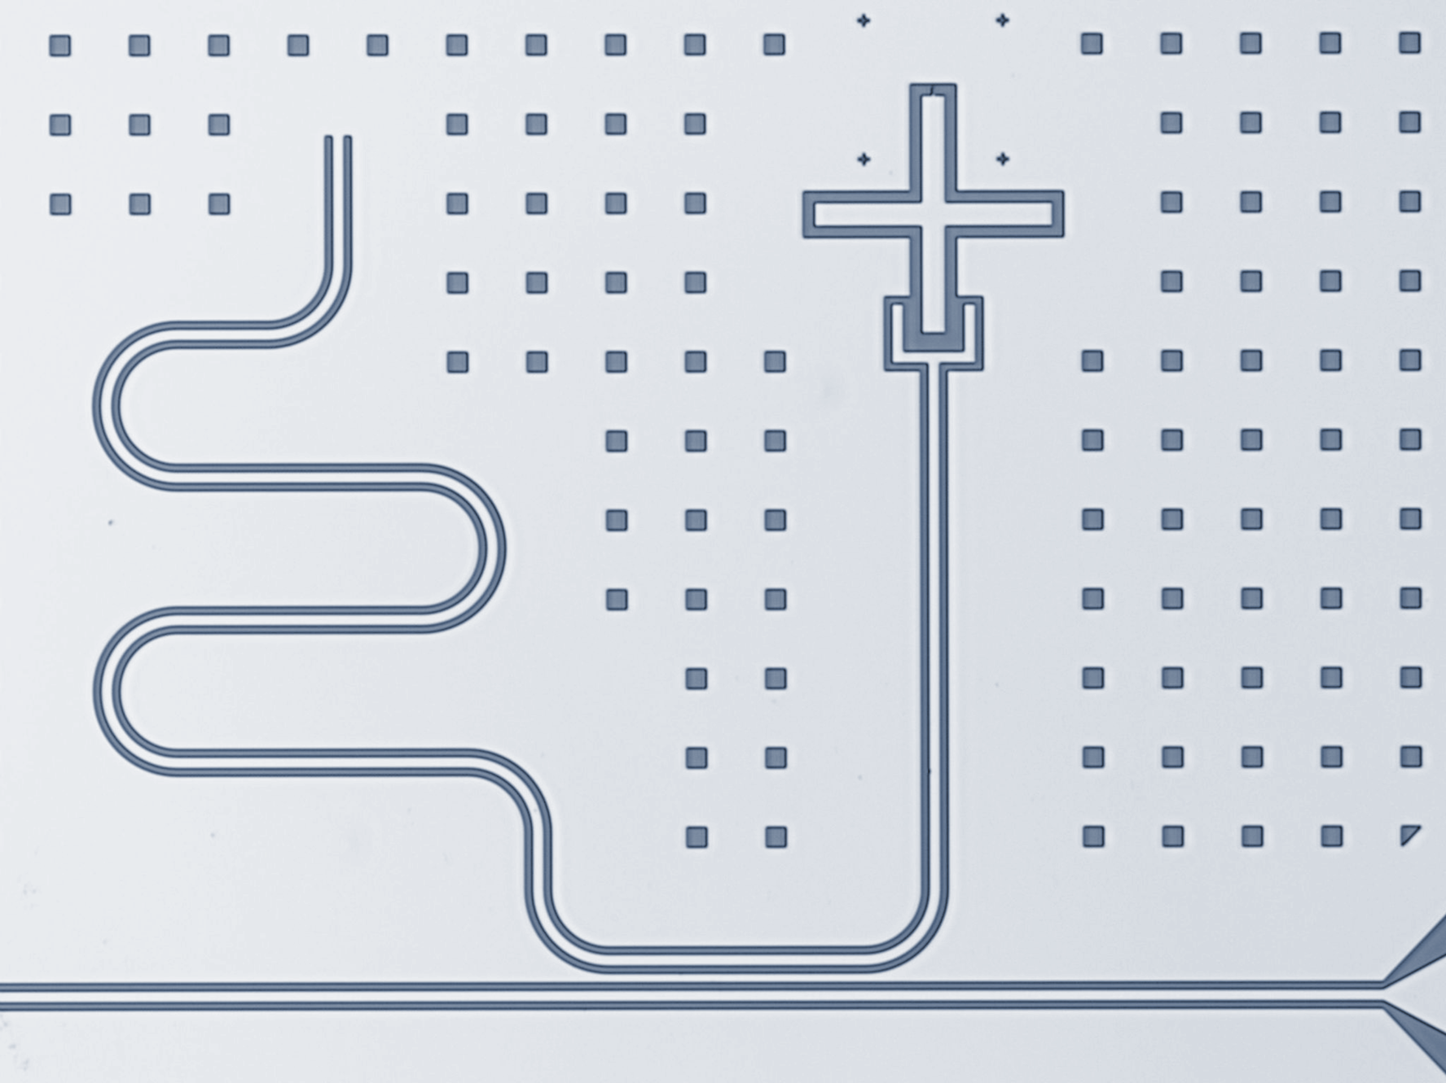
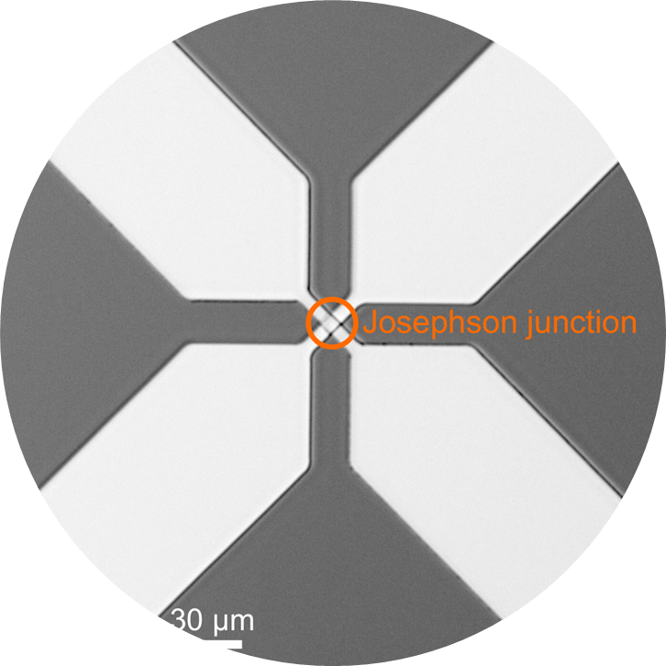
Integration of overlap Al/Al-Ox/Al Josephson junctions in superconducting quantum circuits: from transmon qubits to novel devices
Alessandro Irace
(Milano-Bicocca / Fondazione Bruno Kessler)
Secondo Congresso Nazionale NQSTI, Roma 5-7 Febbraio 2025

Slide 2
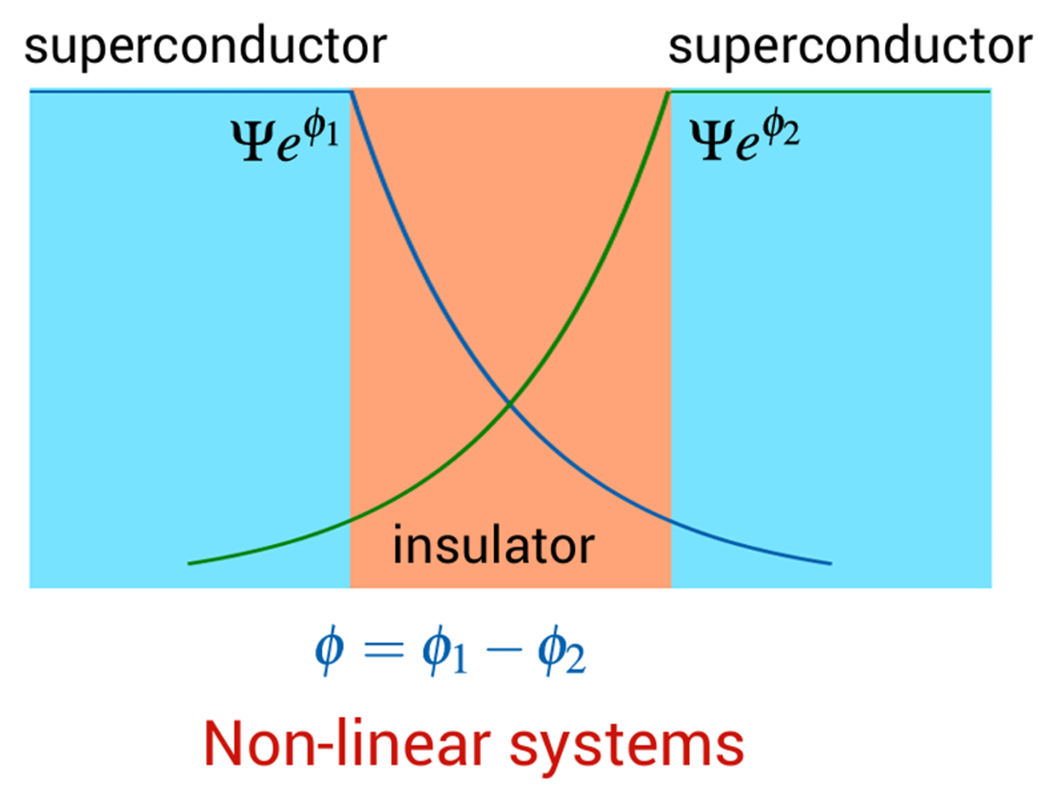
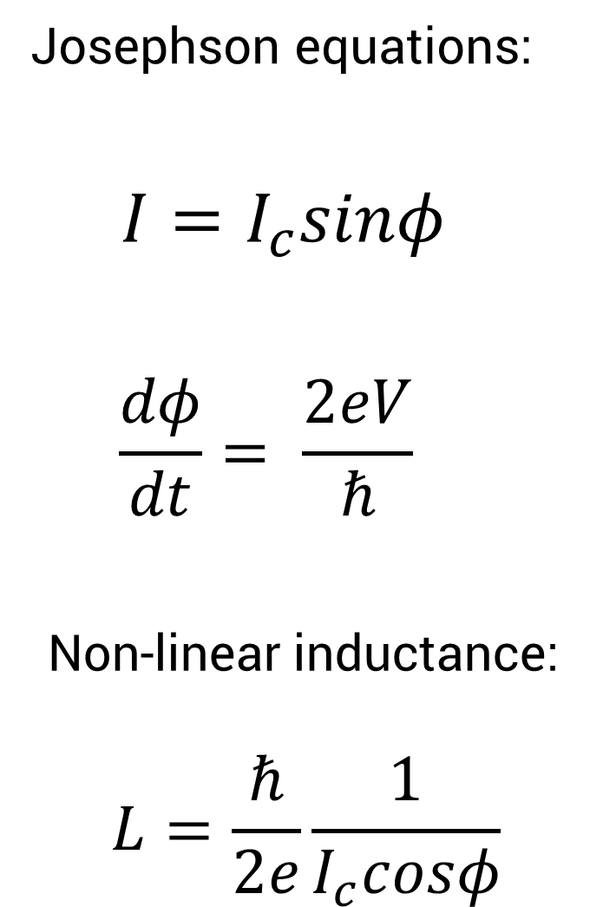

Slide 3
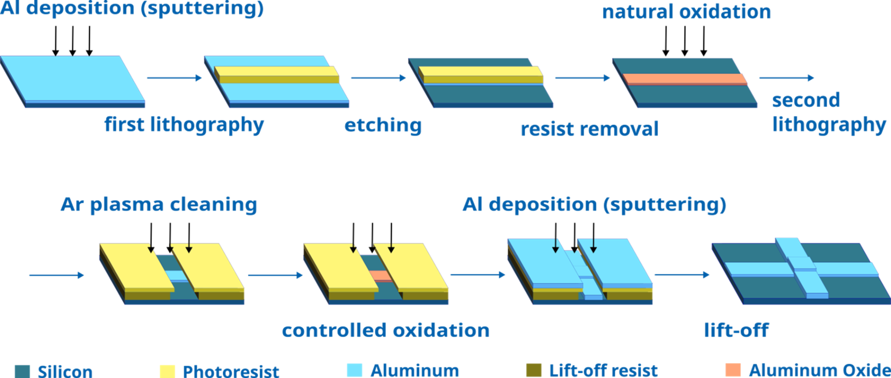

Slide 4
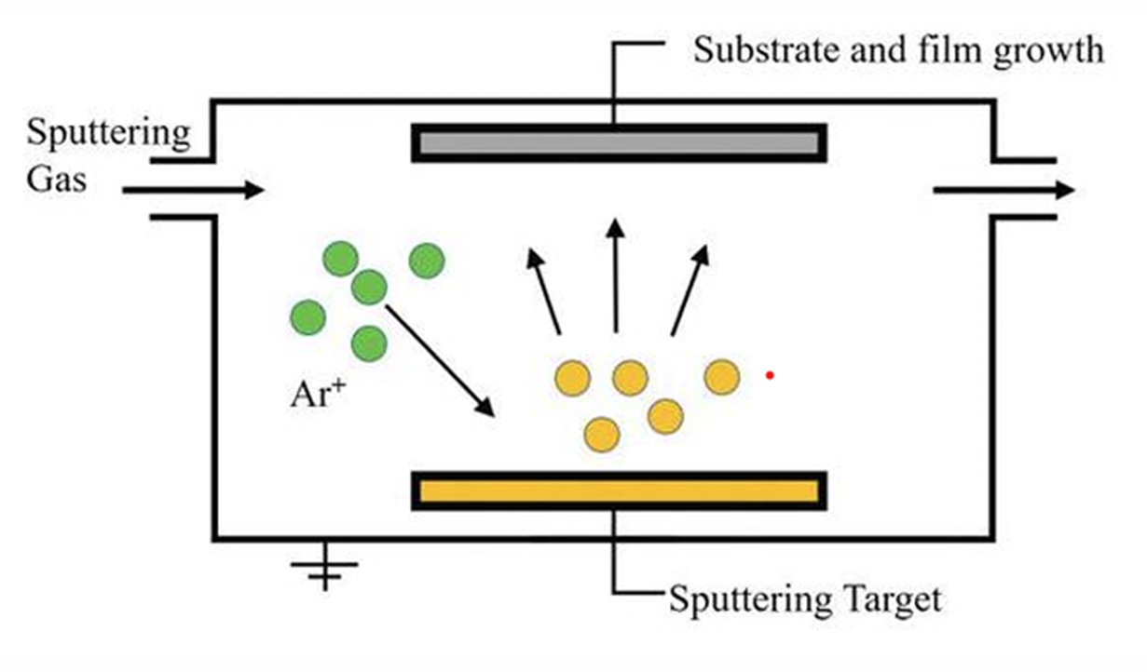
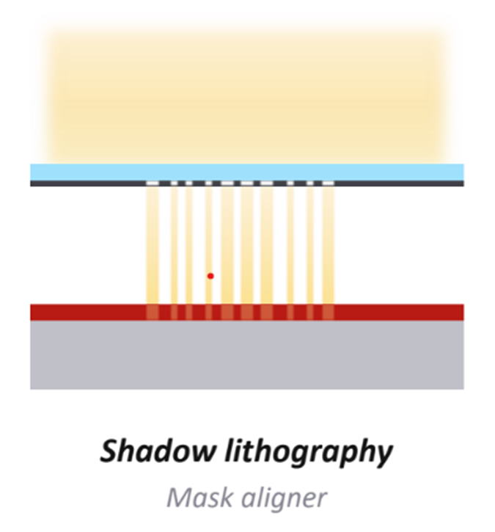
Currently working on optimizing better lithography processes

Slide 5
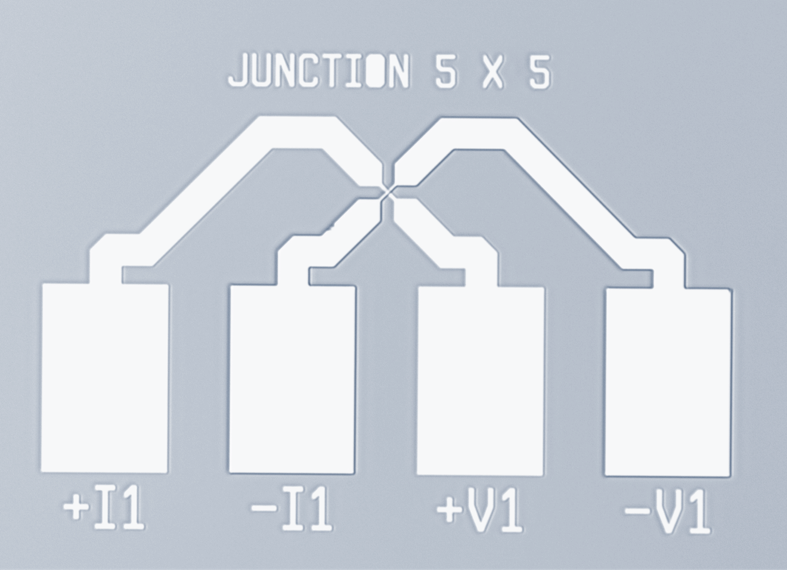

Slide 6
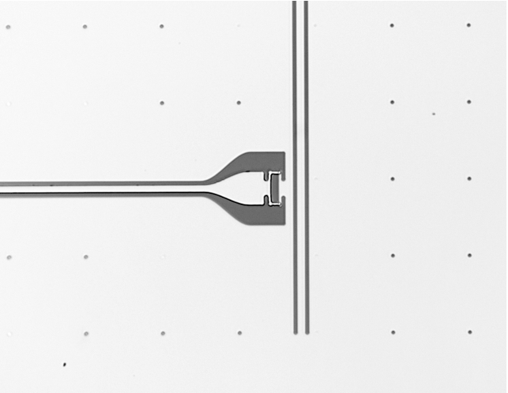
What can we do with JJs?
2 examples
Superconducting qubits
Microwave photon energy lifter

Slide 8
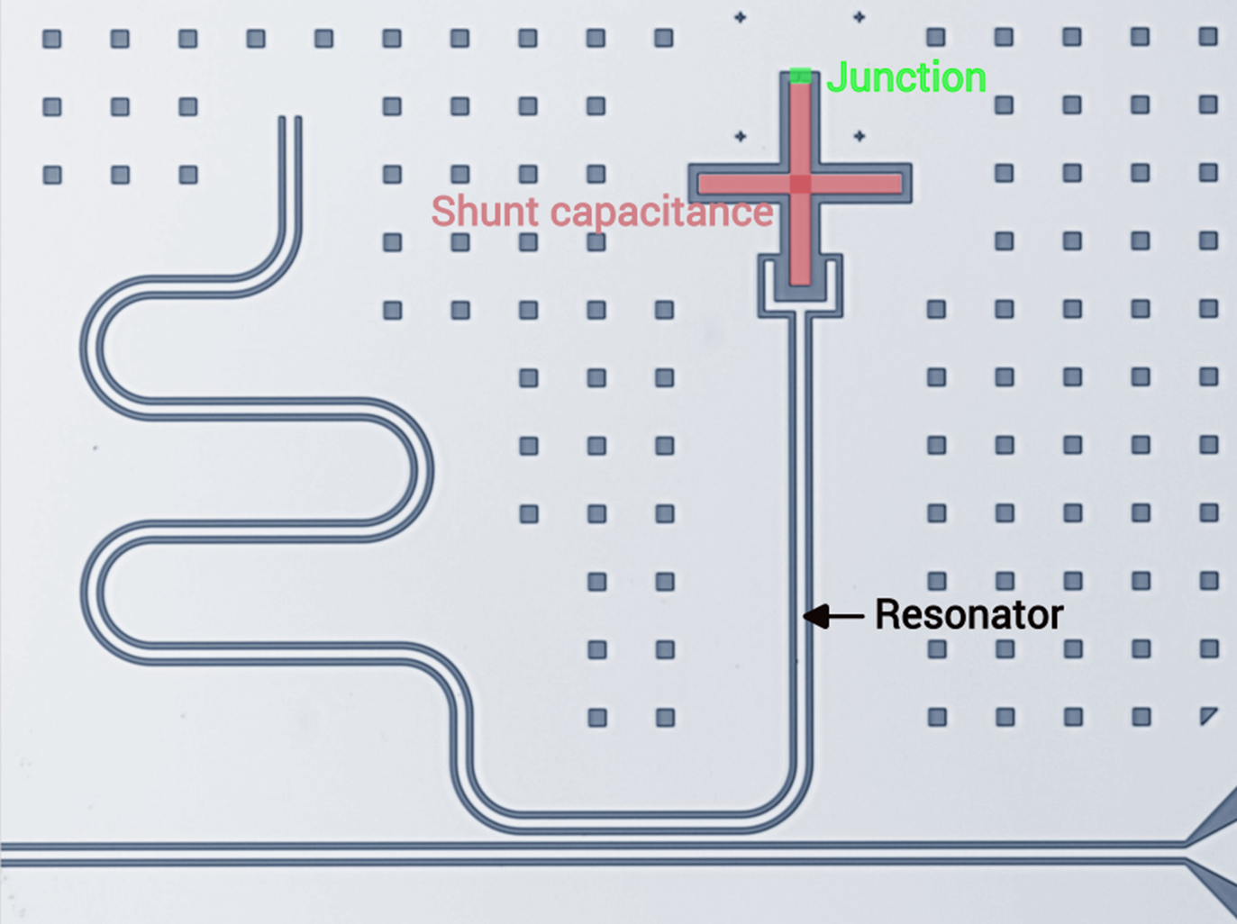
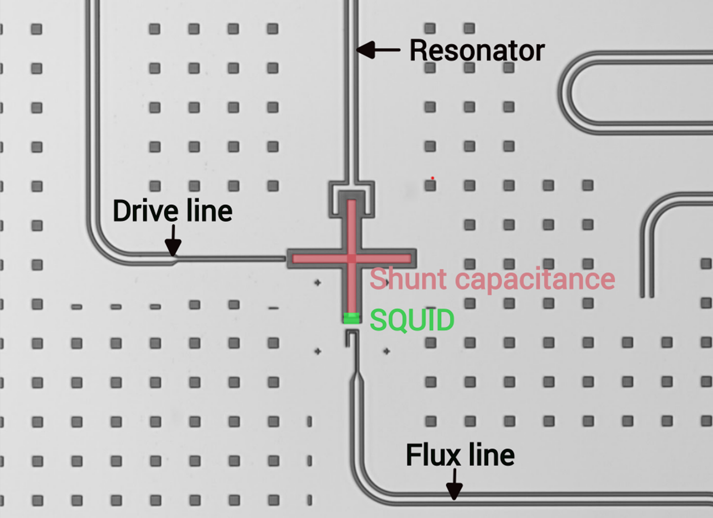
Designed @ Bicocca

Slide 9
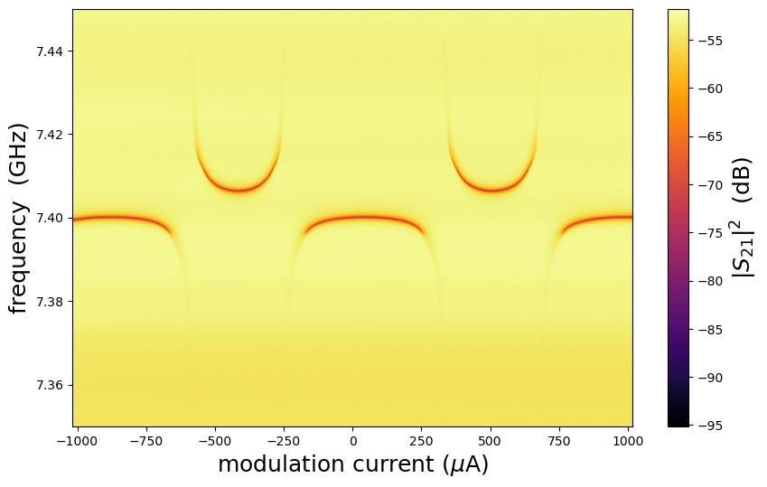

Slide 10
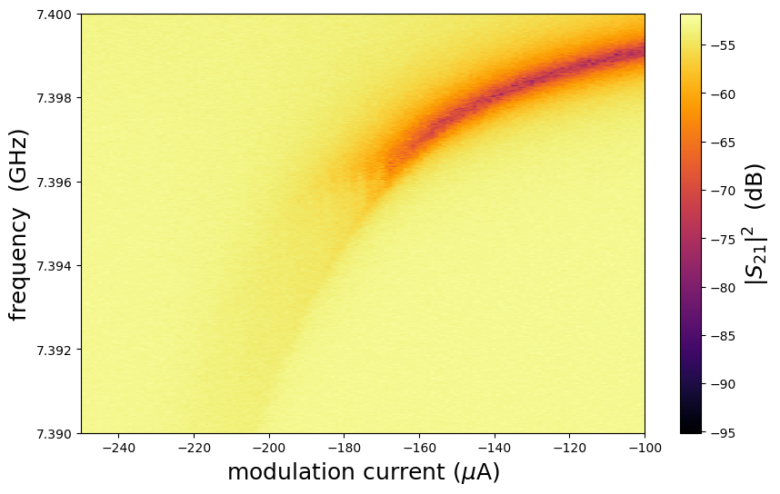

Slide 11
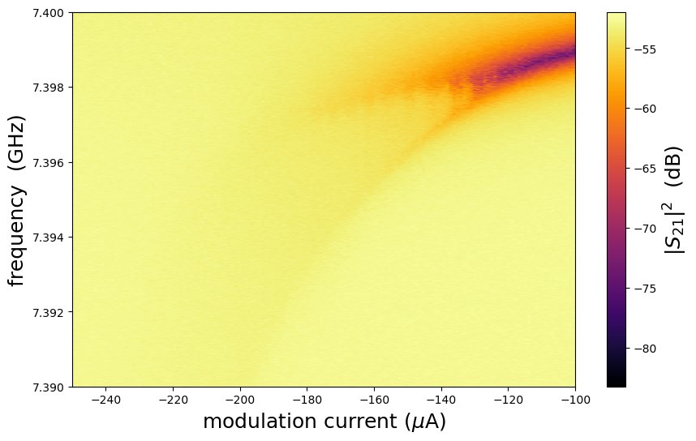
Increasing readout power

Slide 12
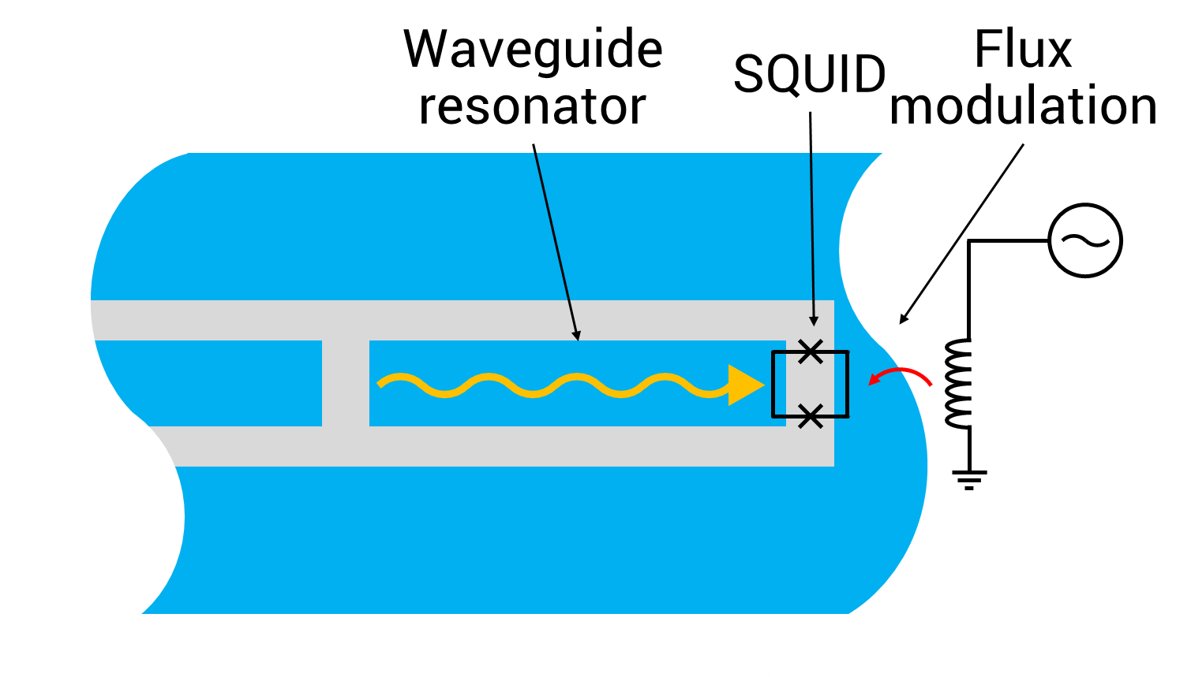
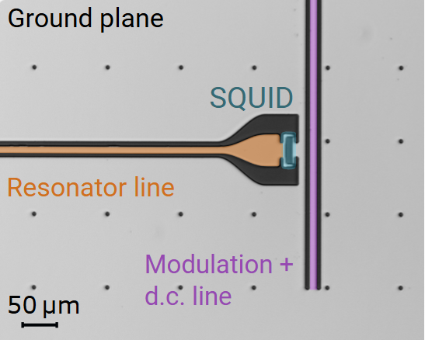
Microwave photon energy lifter

Slide 13
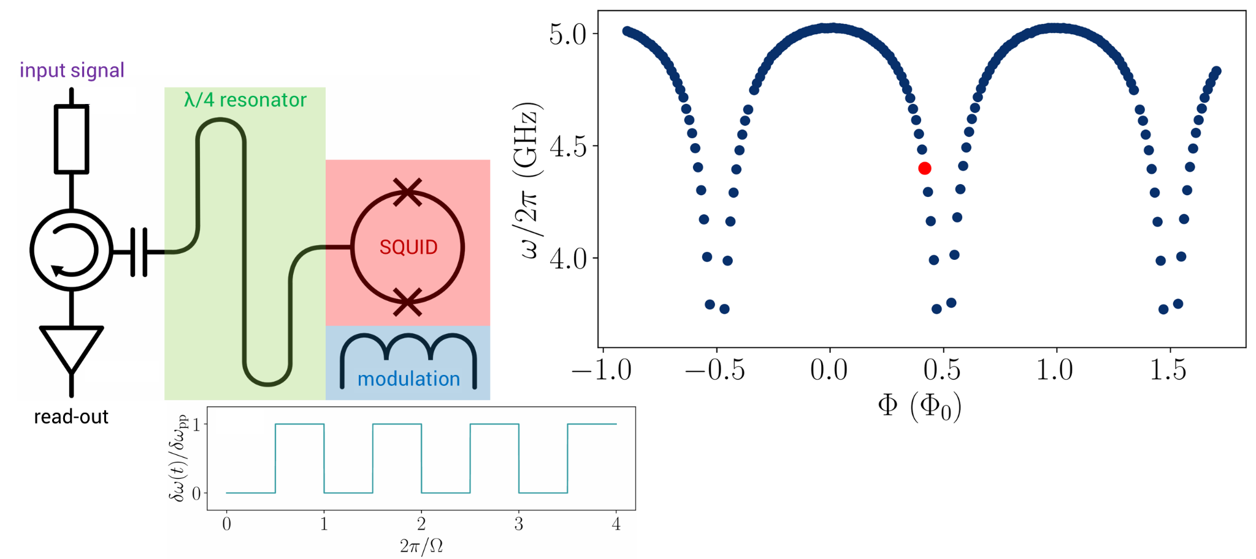
Microwave photon energy lifter

Slide 14
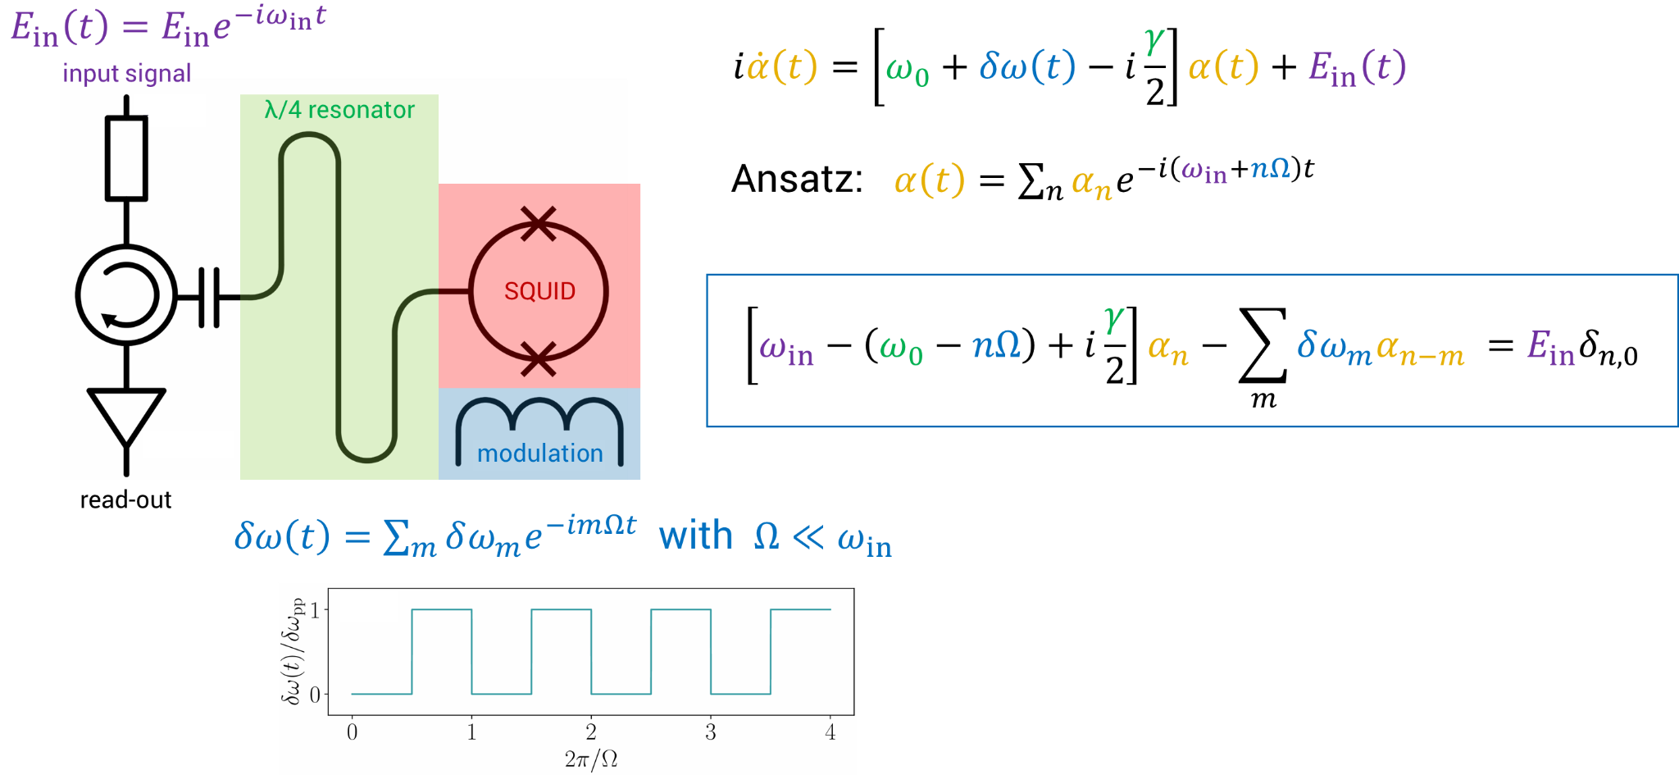
Microwave photon energy lifter
Theoretical work done by I. Carusotto and G. Rastelli

Slide 15
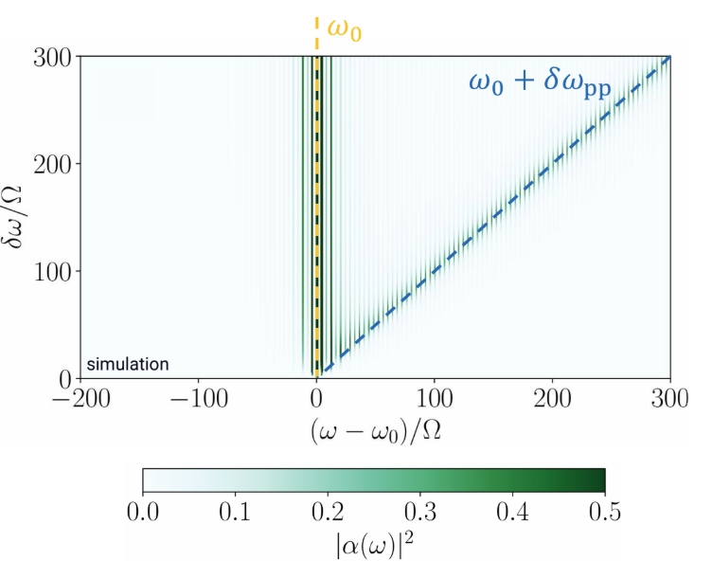
Microwave photon energy lifter
Numerical solution for a square wave modulation

Slide 16
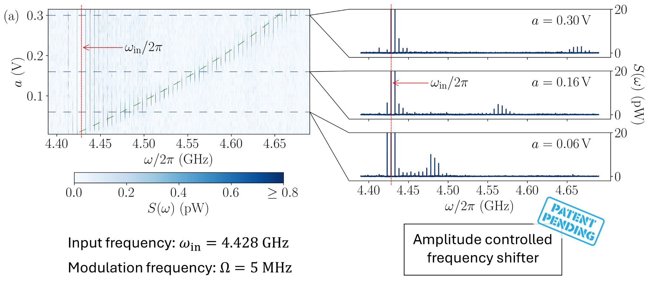
Microwave photon energy lifter
Another shape-preserving architecture in development, talk by Felix Ahrens tomorrow!!

Slide 17
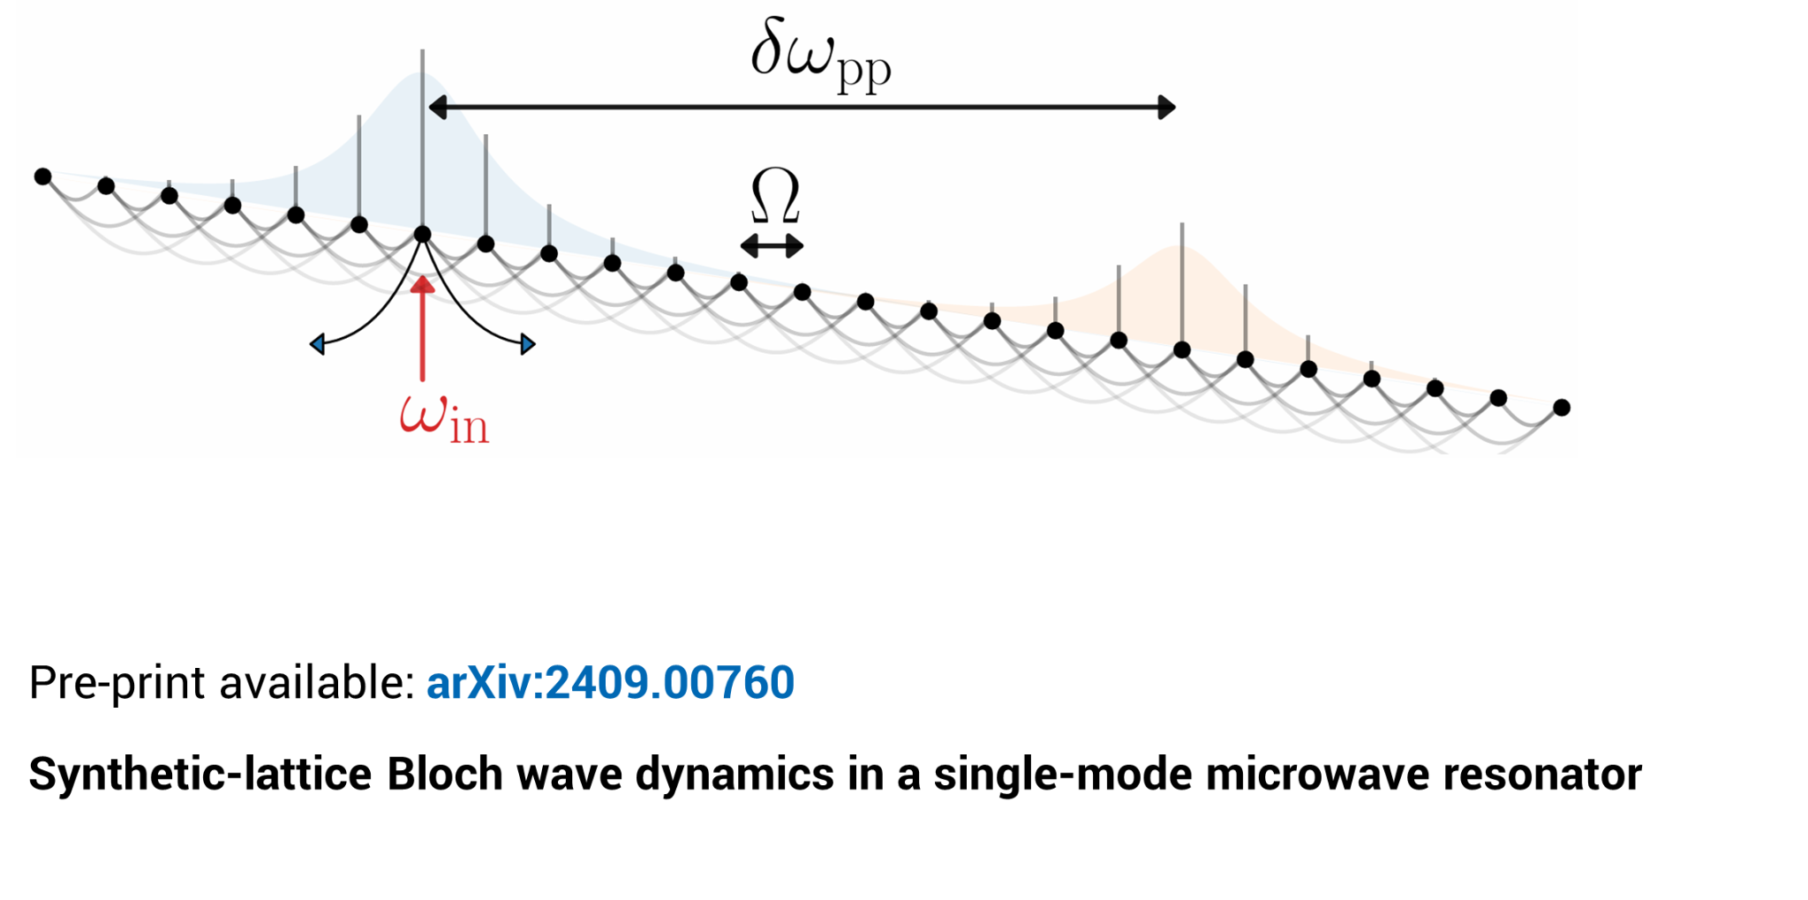
Microwave photon energy lifter
F. Ahrens, N. Crescini, A. Irace, G. Rastelli, P. Falferi, A. Giachero, B. Margesin, R. Mezzena, A. Vinante, I. Carusotto and F. Mantegazzini

Slide 19
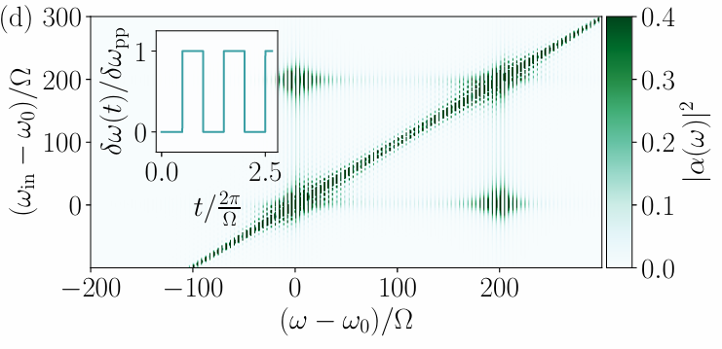
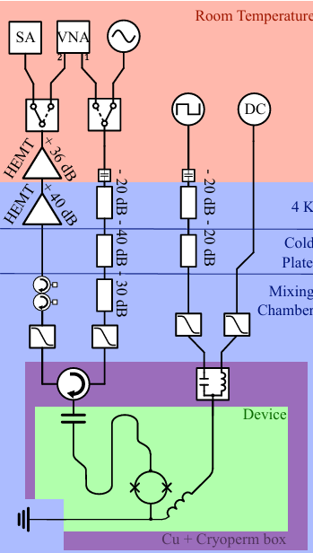
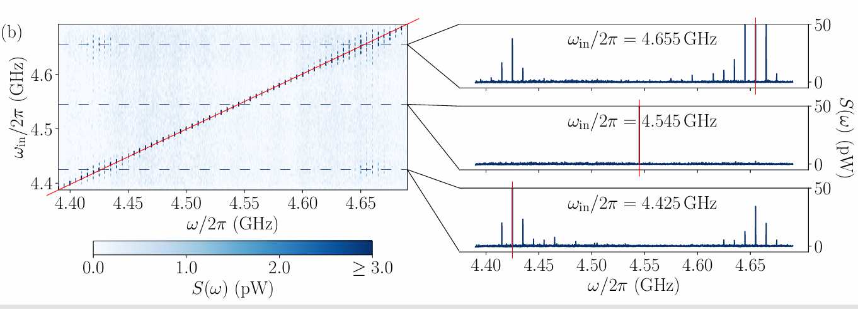
backup

