Slide 1
Missione 4 Istruzione e Ricerca
Development and Analysis of Transmon Qubits: Design, Simulation, and Characterization
Danilo Labranca
danilo.labranca@mib.infn.it

Slide 2
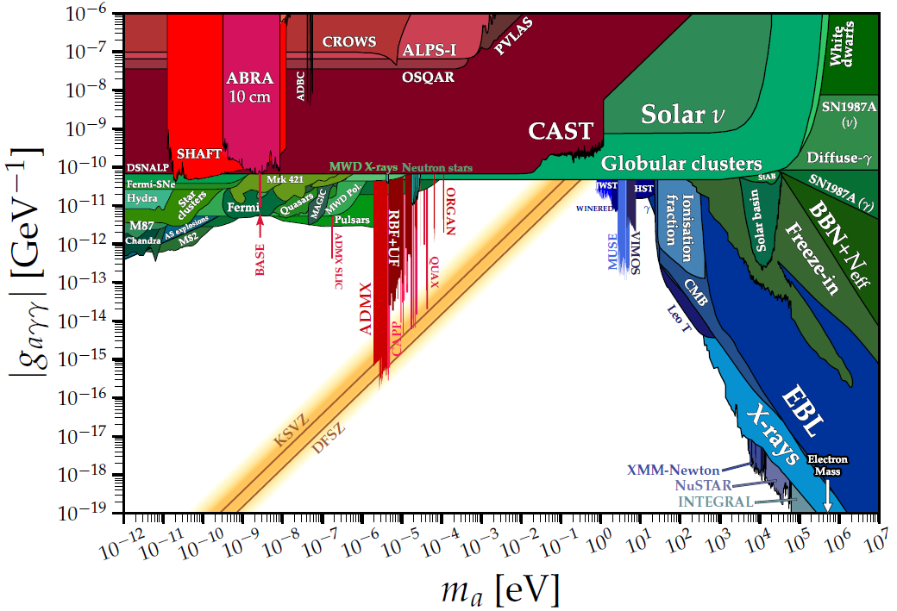
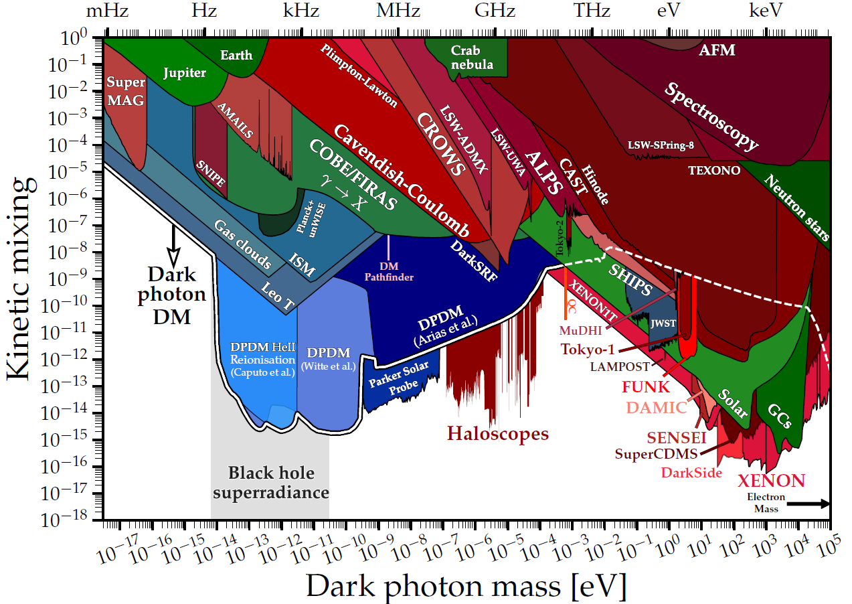
Interest in light Dark Matter
DM particles with $m<1 GeV/c^{2}$
Candidates
Axion: Peccei-Quinn symmetry breaking → would solve the strong CP symmetry problem
Dark photon: from extensions of Standard Model → a massive particle that mixes with the photon
Both candidates can convert into photons at frequencies that depend on the DM particle mass
Transmon qubits are sensitive to weak EM fields at GHz frequencies

Slide 3
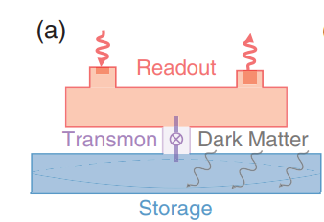
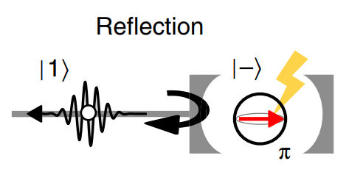
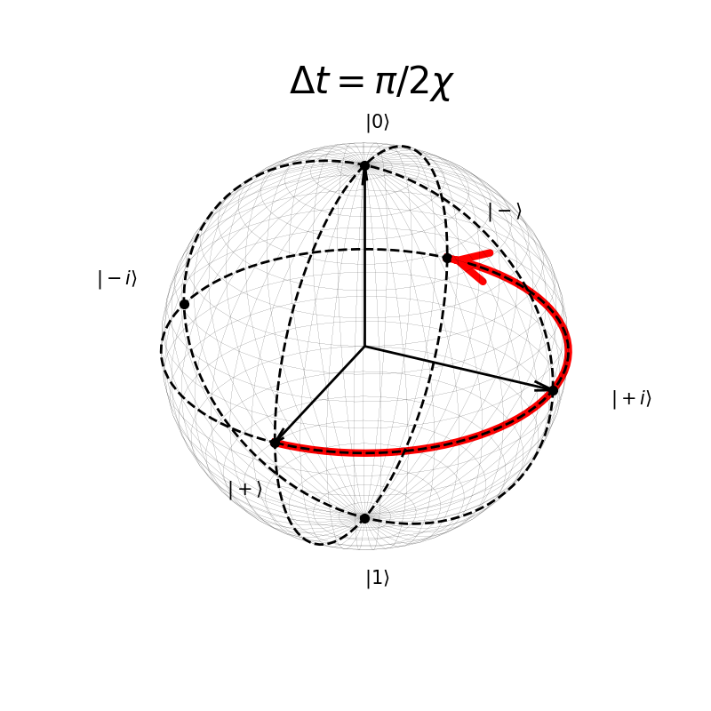
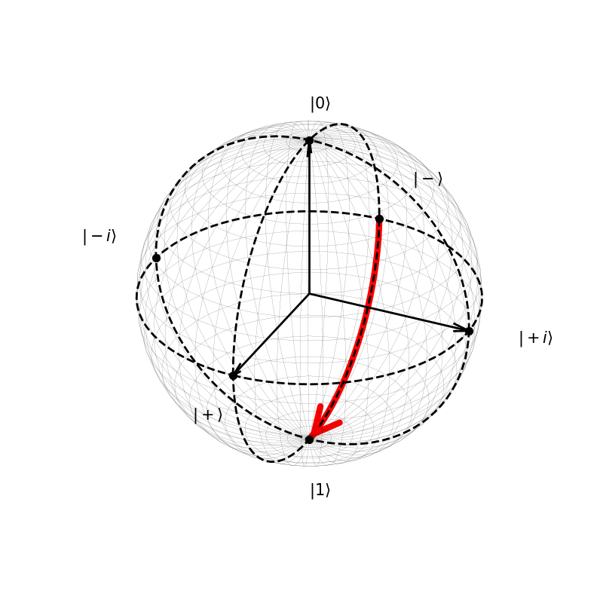
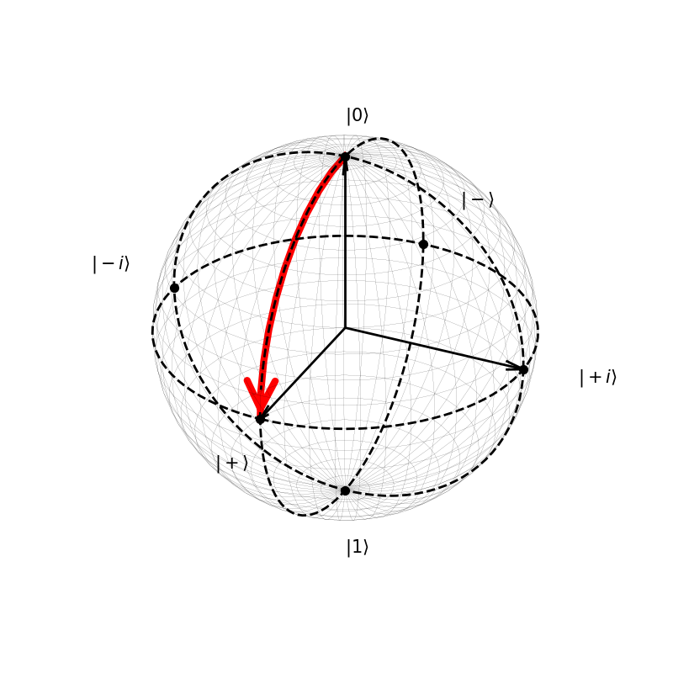
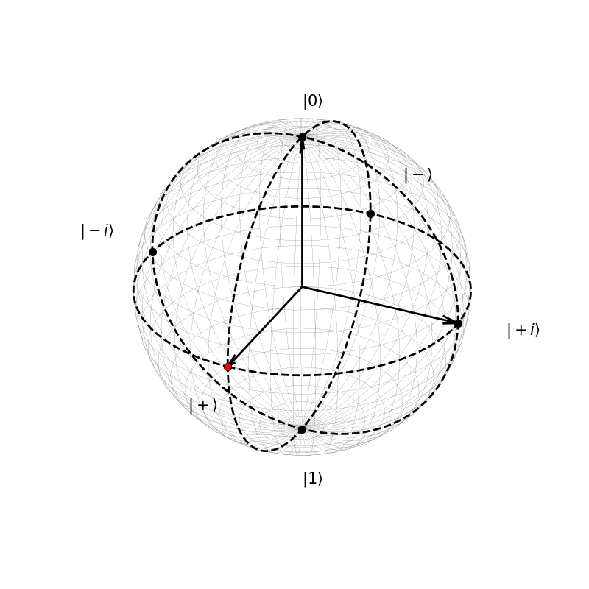
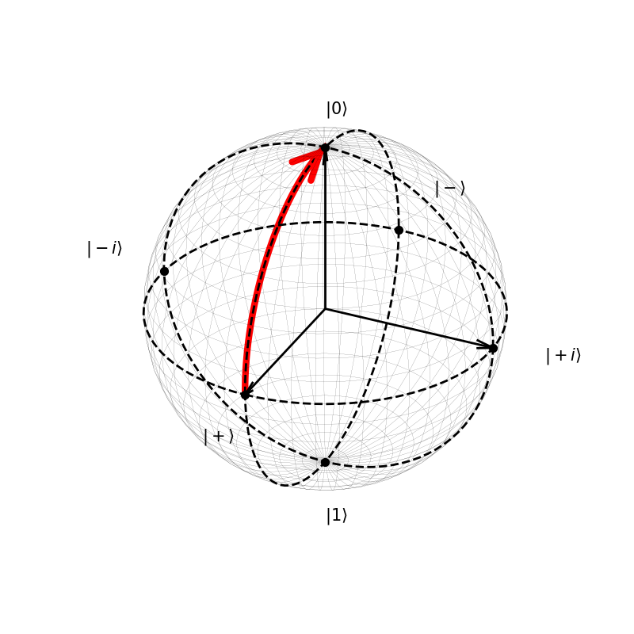
Transmon as single photon detector
Phys. Rev. Lett. 126, 141302 (2021)
Nature Phys 14, 546–549 (2018)
Detection through Ramsey sequence
QND detection → reduction in dark counts
$${\hat{H}}_{q−int}≈\frac{ℏ}{2}\left(ω_{q}+2χ{\hat{a}}^{†}\hat{a}\right){\hat{σ}}_{z}$$
$$\left|−\right\rangle =\frac{\left|0\right\rangle −\left|1\right\rangle }{\sqrt{2}}$$
$$\left|1\right\rangle$$
Single Photon
No Photon
$$\left|+\right\rangle =\frac{\left|0\right\rangle +\left|1\right\rangle }{\sqrt{2}}$$
$$\left|0\right\rangle$$
$$\left|+\right\rangle =\frac{\left|0\right\rangle +\left|1\right\rangle }{\sqrt{2}}$$

Slide 4
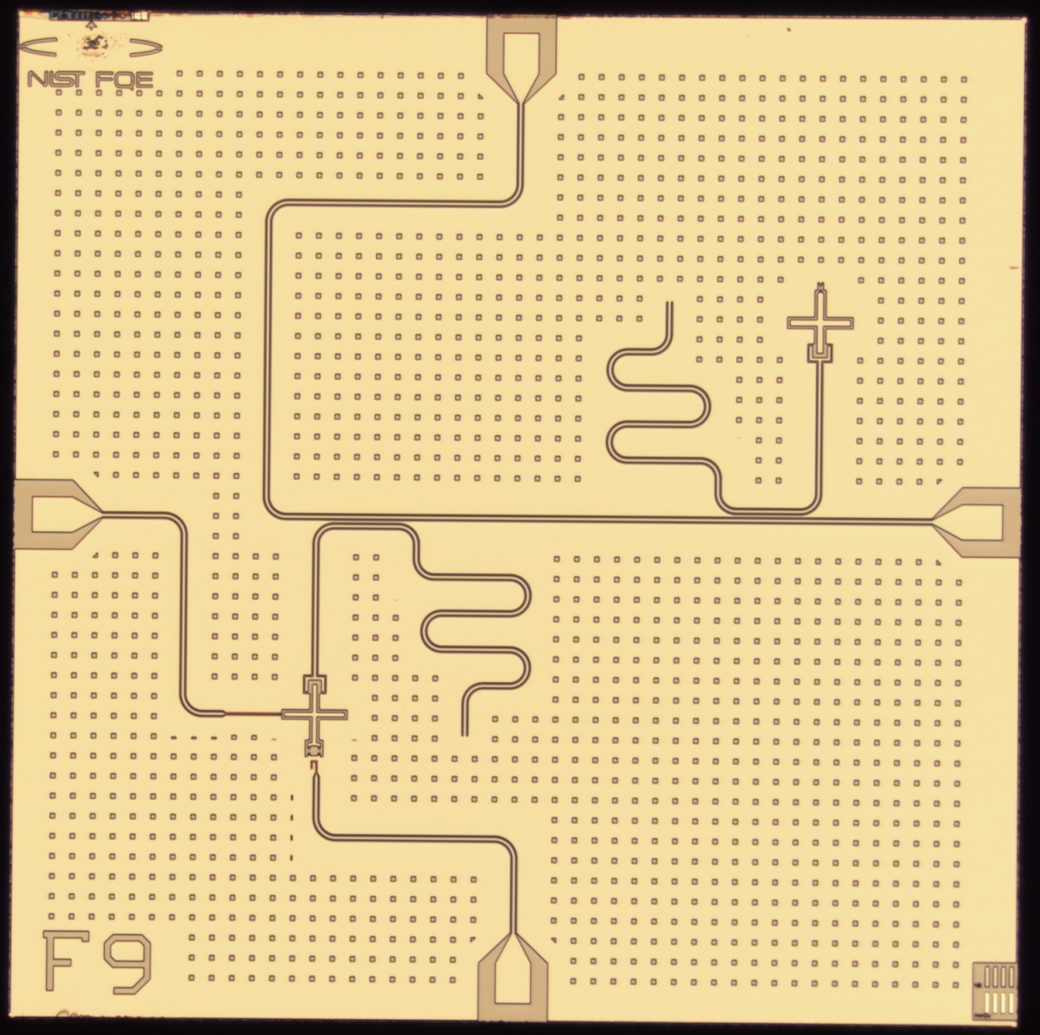
Transmon qubit chip design
Need good prediction of the detector parameters
First design focuses on simulation-experiment agreement
Two non-interacting qubits
One is tunable with external flux and can be driven directly with a dedicated drive-line
Each qubit features a simple coplanar resonator for readout
A. Sirois, M. Castellanos, D. Olaya, J. Bieseker, P. Hopkins, S. Benz.

Slide 5
Transmon qubit chip design
Need good prediction of the detector parameters
First design focuses on simulation-experiment agreement
Two non-interacting qubits
One is tunable with external flux and can be driven directly with a dedicated drive-line
Each qubit features a simple coplanar resonator for readout
Qubit
Readout resonator
A. Sirois, M. Castellanos, D. Olaya, J. Bieseker, P. Hopkins, S. Benz.

Slide 6
Transmon qubit chip design
Josephson Junction
We need good prediction of the detector parameters
First design focuses on simulation-experiment agreement
Two non-interacting qubits
One is tunable with external flux and can be driven directly with a dedicated drive-line
Each qubit features a simple coplanar resonator for readout
Qubit
Capacitance
Coupler
Readout resonator
A. Sirois, M. Castellanos, D. Olaya, J. Bieseker, P. Hopkins, S. Benz.

Slide 7
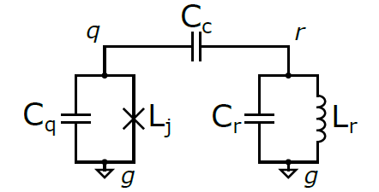
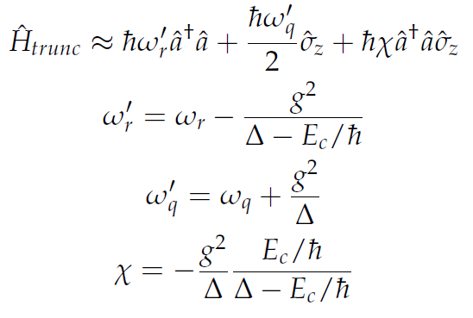
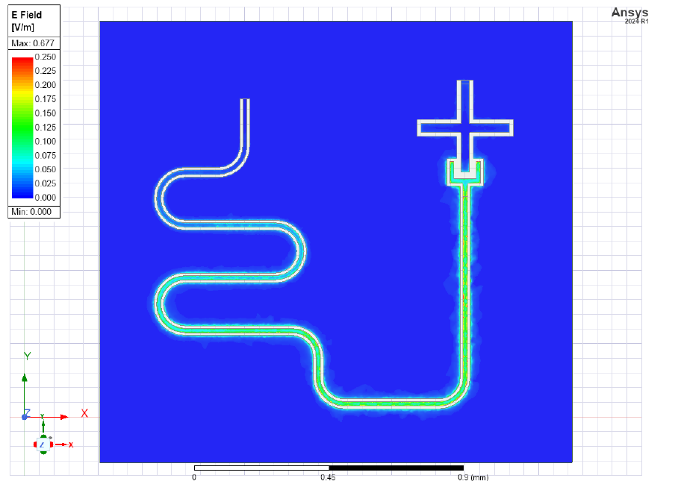
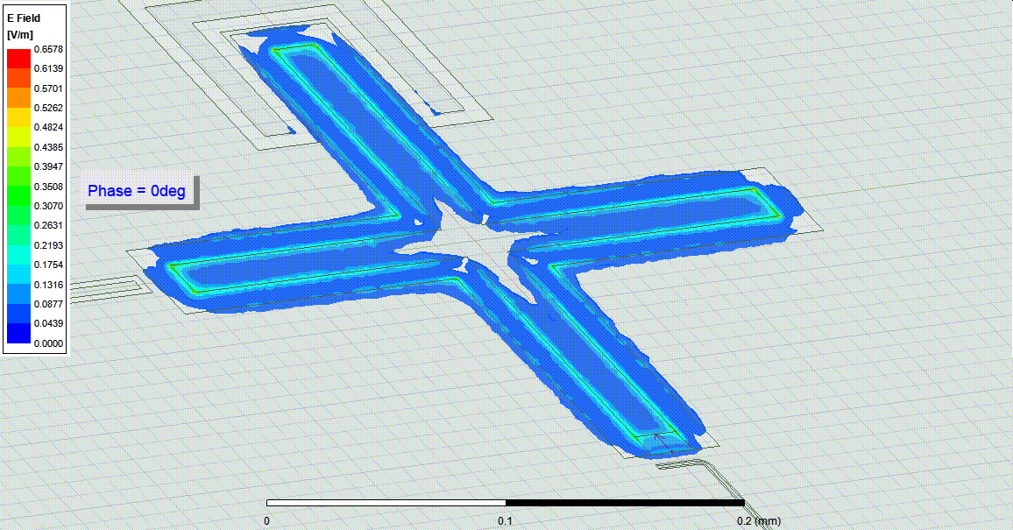
Chip simulation
Lumped Oscillator Model (LOM)
Ansys Q3D extract the capacitance matrix of the qubit and the coupler
Energy Participation Ratio (EPR)
Ansys HFSS to extract the resonant frequencies of the circuit
Both methods lead to the main Hamiltonian parameters of the circuit

Slide 8
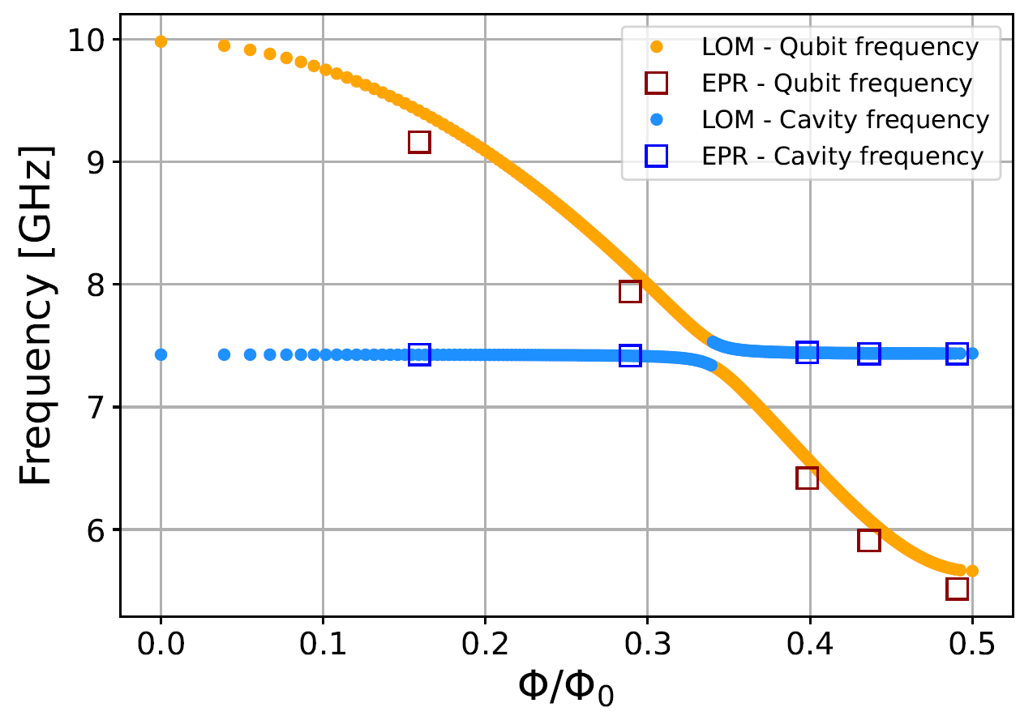
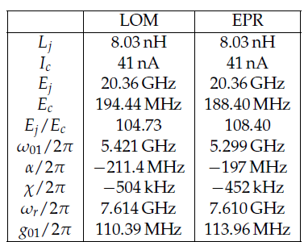
Chip simulation
Lumped Oscillator Model (LOM)
Ansys Q3D extract the capacitance matrix of the qubit and the coupler
Energy Participation Ratio (EPR)
Ansys HFSS to extract the resonant frequencies of the circuit
Both methods lead to the main Hamiltonian parameters of the circuit

Slide 9
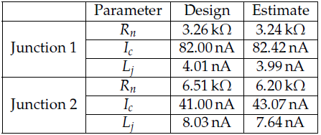
Chip simulation
Lumped Oscillator Model (LOM)
Ansys Q3D extract the capacitance matrix of the qubit and the coupler
Energy Participation Ratio (EPR)
Ansys HFSS to extract the resonant frequencies of the circuit
Both methods lead to the main Hamiltonian parameters of the circuit

Slide 10
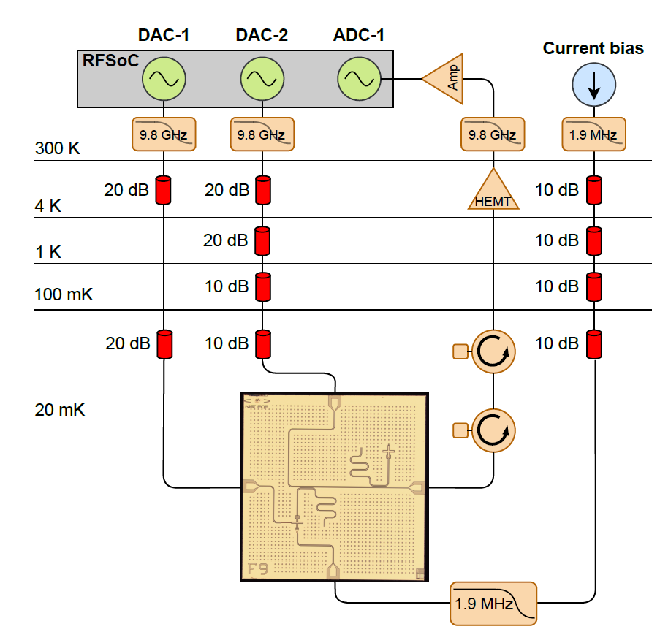
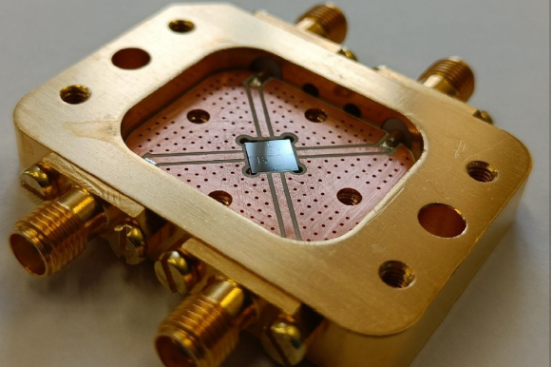
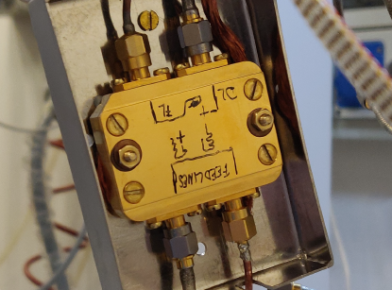
Measurement setup

Slide 11
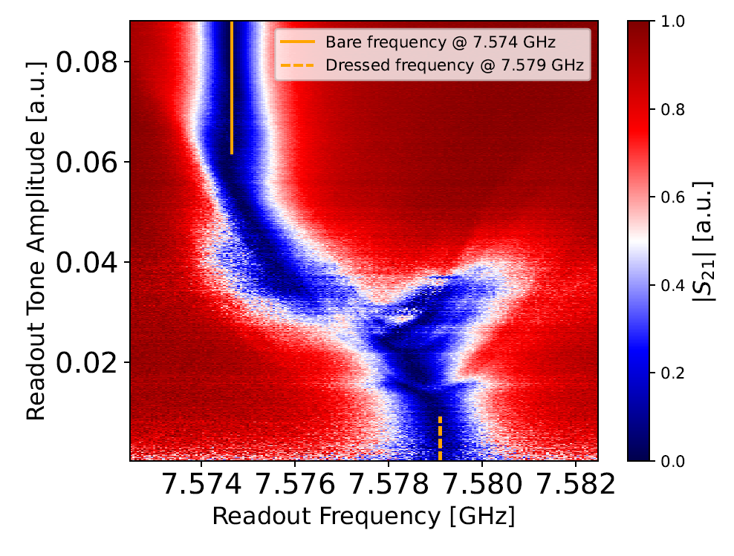
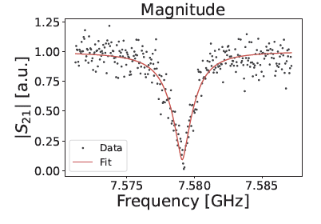
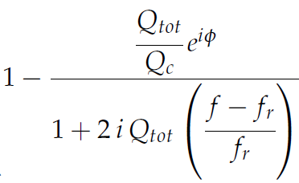
Resonator spectroscopy
At high power:
The qubit energy levels are saturated
The resonator behaves like it is alone in the chip
At low power:
The qubit is in the ground state and interacts with the resonator
The distance between the bare and dressed frequencies is
$$ω_{r}^{bare}−ω_{r}^{dressed}≈\frac{g^{2}}{Δ}$$
$$g^{2}/Δ$$
$$ω_{r}$$ | $7.579$ GHz
$$Q_{i}$$ | $$3×{10}^{4}$$
$$Q_{c}$$ | $$3034$$
$$Q_{tot}$$ | $$2760$$
$Q_{c}$ HFSS | $$10^{3}$$
$$S_{21}(f)=$$
$$k≈2χ$$

Slide 12
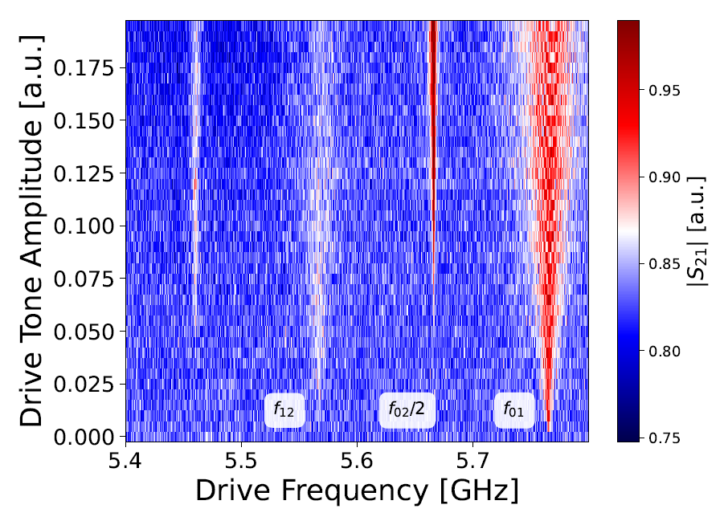
Qubit spectroscopy
One tone (readout tone) at $f_{readout}≈7.579$ GHz is used to continuously readout the resonator (the $\left|S_{21}\right|$)
A second microwave tone (drive tone) is used to scan for the qubit frequency
The $\left|S_{21}\right|$ changes when the qubit gets excited by this second pulse
$α/2π=(ω_{01}−ω_{12})/2π$ = $−195.7±1.7$ MHz

Slide 13
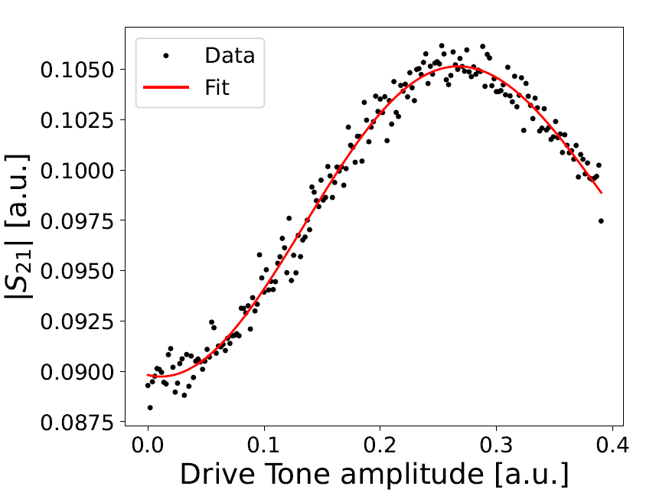
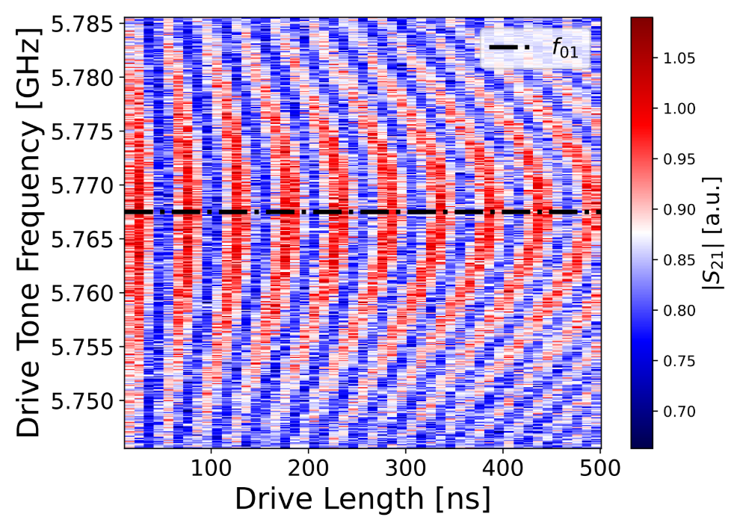
Control pulse calibration
The calibrated pulses are:
$π$-pulse: prepares the qubit $\left|1\right\rangle$
$\frac{π}{2}$-pulse: prepares the qubit $\left|+\right\rangle =\frac{\left|0\right\rangle +\left|1\right\rangle }{2}$
$Δt=40$ ns
$π$-pulse

Slide 14
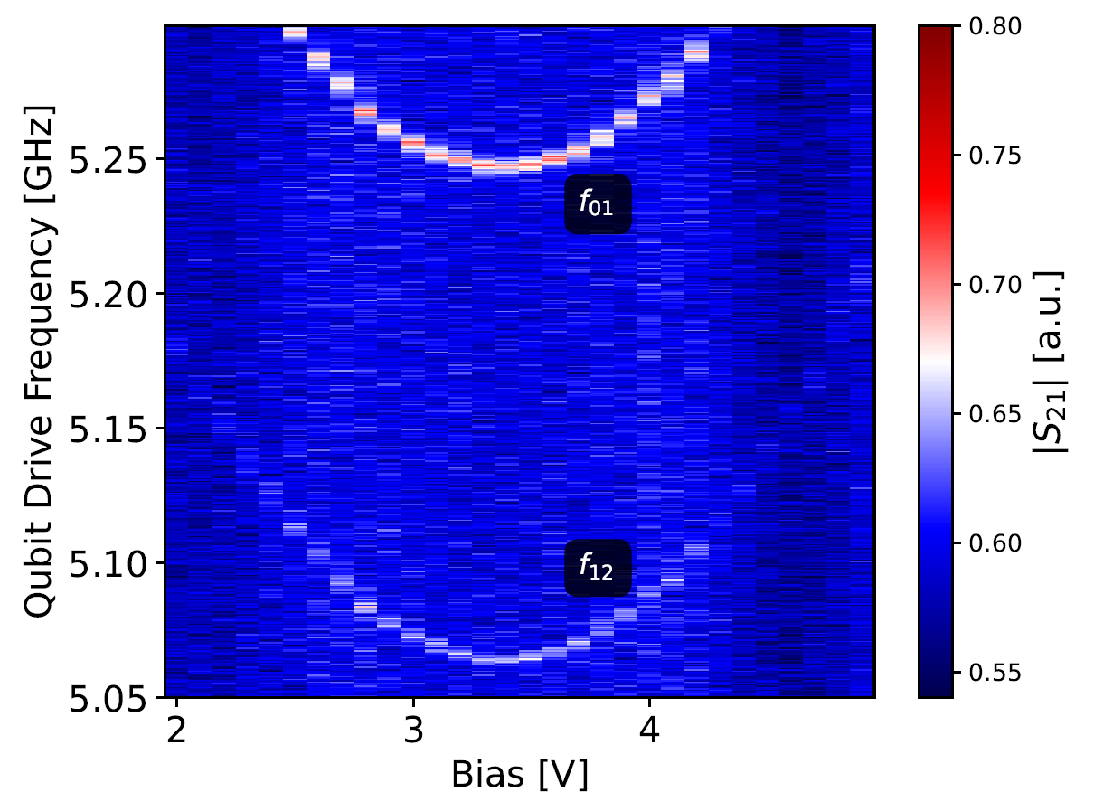
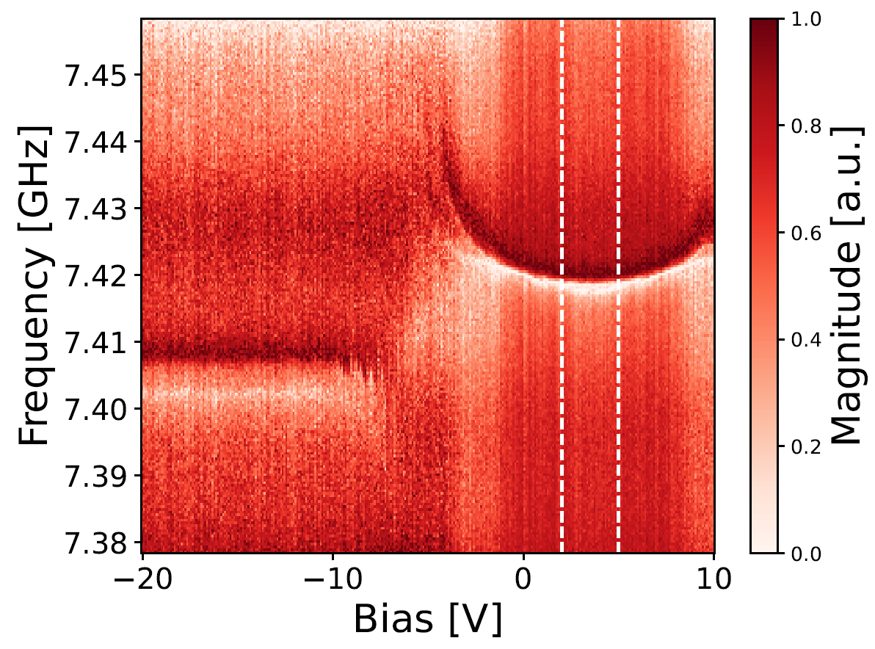
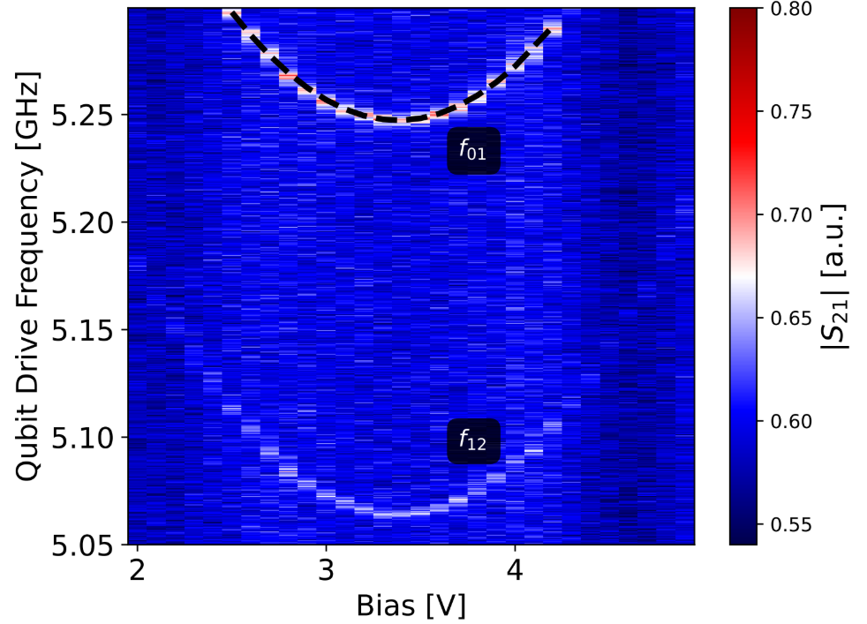
Frequency tunable transmon
Resonator and qubit spectroscopy as a function of flux bias
Resonator spectroscopy shows the avoided crossing
The full characterization is performed at the minimum frequency
$d=\frac{\left|L_{j1}−L_{j2}\right|}{L_{j1}+L_{j2}}≈0.29$ from fit
Resonator spectroscopy
Qubit spectroscopy

Slide 15
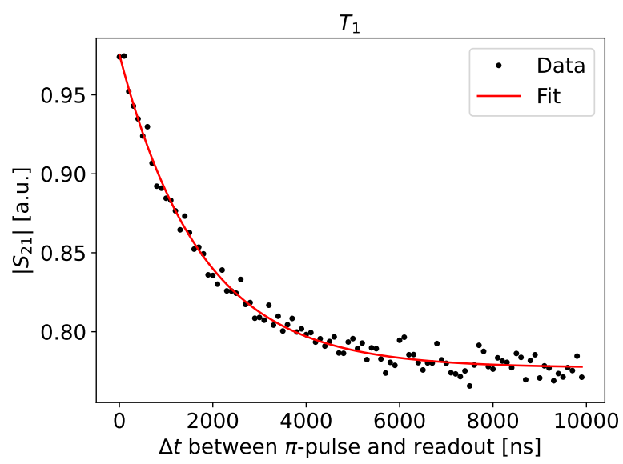
Relaxation time measurement
The relaxation time $T_{1}$ is the mean time necessary for the qubit in the $\left|1\right\rangle$ to spontaneously relax into the $\left|0\right\rangle$ state
$$p_{1}=e^{−t/T_{1}}$$

Slide 16
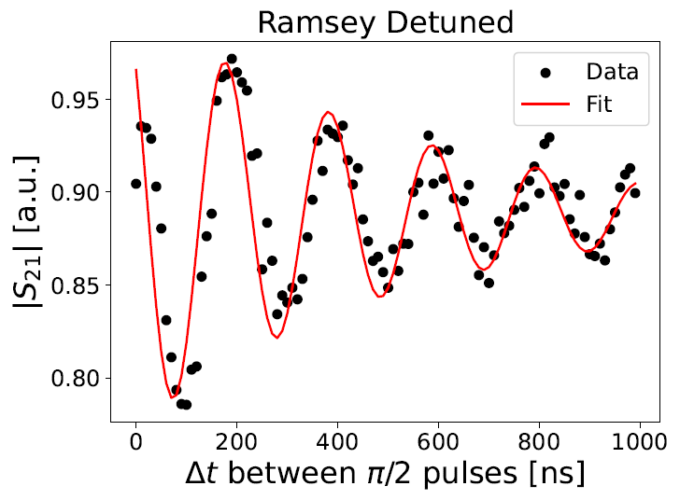
Coherence time measurement
The decoherence time $T_{2}^{∗}$ is the mean time necessary for the qubit to lose the phase information
With $δ=ω_{d}−ω_{01}≈5$ MHz
$T_{2}^{∗}≈517$ ns

Slide 17
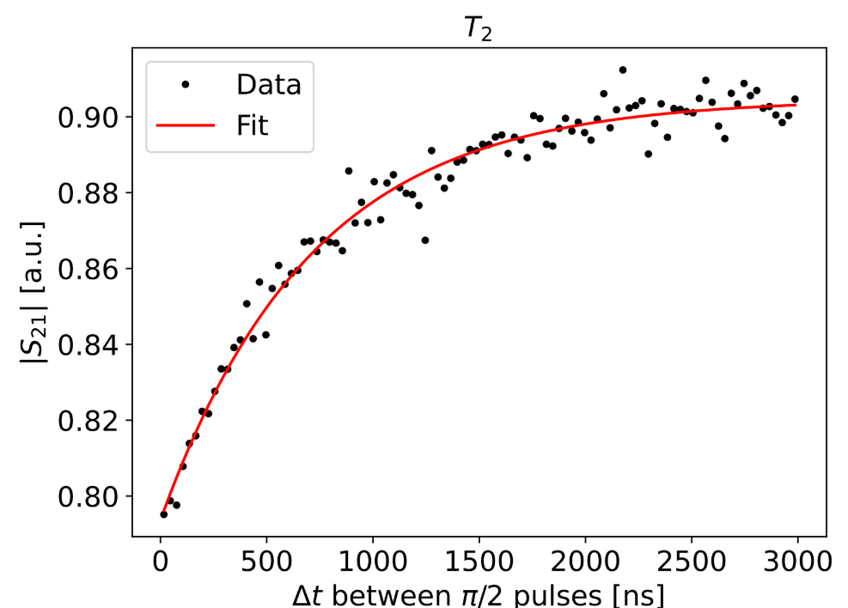
Spin-Echo measurement
Focusing 𝝅-pulse at half pulse sequence refocuses the state
Removes the inhomogeneous dephasing
$$p_{1}=e^{−t/T_{2}}$$

Slide 18
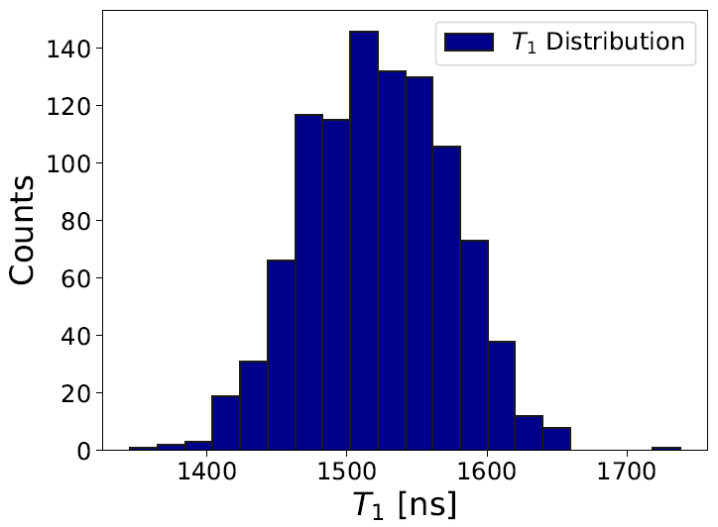
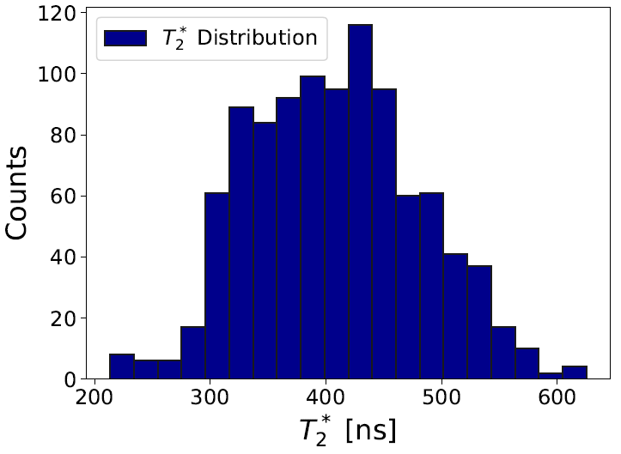
Relaxation and Coherence time measurement
These measurement were performed multiple times (about 24 hours) for both qubits
 | Fixed frequency qubit | Tunable qubit
$$T_{1}$$ | $1522±51$ ns | $1928±136$ ns
$$T_{2}^{∗}$$ | $408±73$ ns | $585±53$ ns
$$T_{2}$$ | $611±31$ ns | $1033±105$ ns
The Purcell limit on the $T_{1}$is approximately $20 μs$
The limiting factor:
Unoptimal setup
Ground loops
Substrate and interface losses

Slide 19
Summary of qubit characterization
Parameter | LOM | EPR | Experiment
$$L_{j}$$ | $7.64$ nH (Fixed) | $7.64$ nH (Fixed) | $7.64$ nH (Estimate)
$$ω_{01}/2π$$ | $5.556$ GHz | $5.434$ GHz | $5.770±0.001$ GHz
$$α/2π=(ω_{01}−ω_{12})/2π$$ | $−210.8$ MHz | $−196.5$ MHz | $−195.7±1.7$ MHz
$$ω_{r}/2π$$ | $7.614$ GHz | $7.610$ GHz | $7.579$ GHz
$$χ/2π$$ | $−572$ kHz | $−508$ kHz | $−517.7$ kHz
$$g_{01}/2π$$ | $110$ MHz | $114$ MHz | $97.2$ MHz
Fixed frequency
qubit
Tunable frequency
qubit
Parameter | Estimate | Fit
$$d=\left|L_{j1}−L_{j2}\right|/(L_{j1}+L_{j2})$$ | $$0.31$$ | $$0.29$$

Slide 20
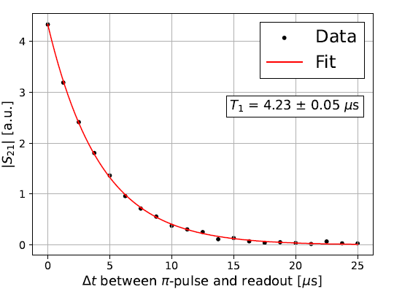
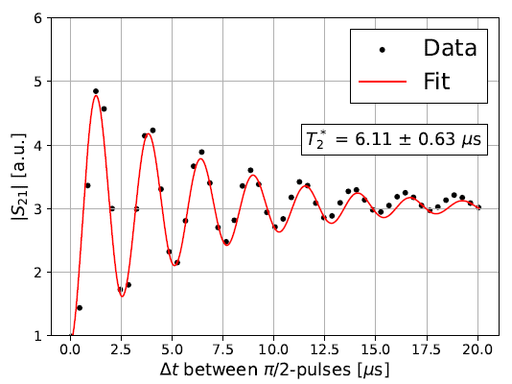
Summary of results and next steps
The simulation-experiment agreement is very good:
Within 6% for frequencies and 2% for dispersive shifts
The performance are not as high as expected
$T_{1}$ and $T_{2}^{∗}$ are limited to about $2μs$ and $500 ns$ respectively
The Purcell limited $T_{1}$ is $≈20μs$ and does not justify the measured values
Possible causes for the lower performance:
Unoptimized setup (no IR filters, low attenuation, ground loop)
Additional unaccounted losses (interfaces and substrate)
Measure the exact same chip again adjusting the measurement setup
The measurement on the right were performed on the same design but in a different setup

Slide 21
Thank you!
D. Labranca, R. Moretti, P. Campana, R. Carobene, M. Gobbo, M. A. Castellanos-Beltran, D. Olaya, P. Hopkins, L. Banchi, M. Borghesi, A. Candido, S. Carrazza, A. Cattaneo, H. A. Corti, A. D’Elia, M. Faverzani, E. Ferri, S. Gamba, A. Nucciotti, L. Origo, A. Pasquale, A. S. Piedjou Komnang, A. Rettaroli, S. Tocci, C. Gatti, A. Giachero

Slide 22
Backup slides

Slide 23
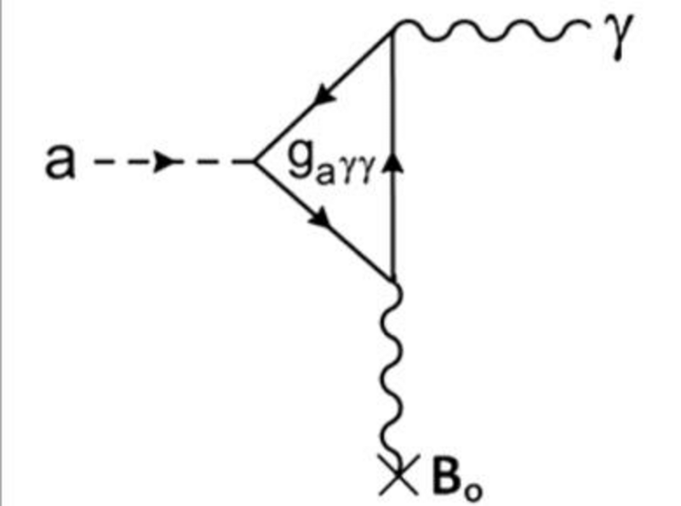
Light DM conversion into photons
Axions:
Inverse Primakoff effect
In resonant cavities with
$f=\frac{m_{a}c^{2}}{h}$
Large $B$ fields → conversion probability scales as $B^{2}$
Dark photons:
Kinetic mixing
In resonant cavities with
$f=\frac{m_{A^{′}}c^{2}}{h}$
No need for $B$ fields
$$P_{A^{′}→γ}=ε^{2}ρ_{A^{′}}V\frac{Q}{m_{A^{′}}}\frac{1}{1+4\left[\frac{Q\left(f−f_{0}\right)}{f_{0}}\right]}$$
$$P_{a→γ}=g_{aγγ}^{2}ρ_{a}B^{2}VC\frac{Q}{m_{a}}$$
https://doi.org/10.48550/arXiv.2403.02321
https://doi.org/10.1103/PhysRevD.110.043022

Slide 24
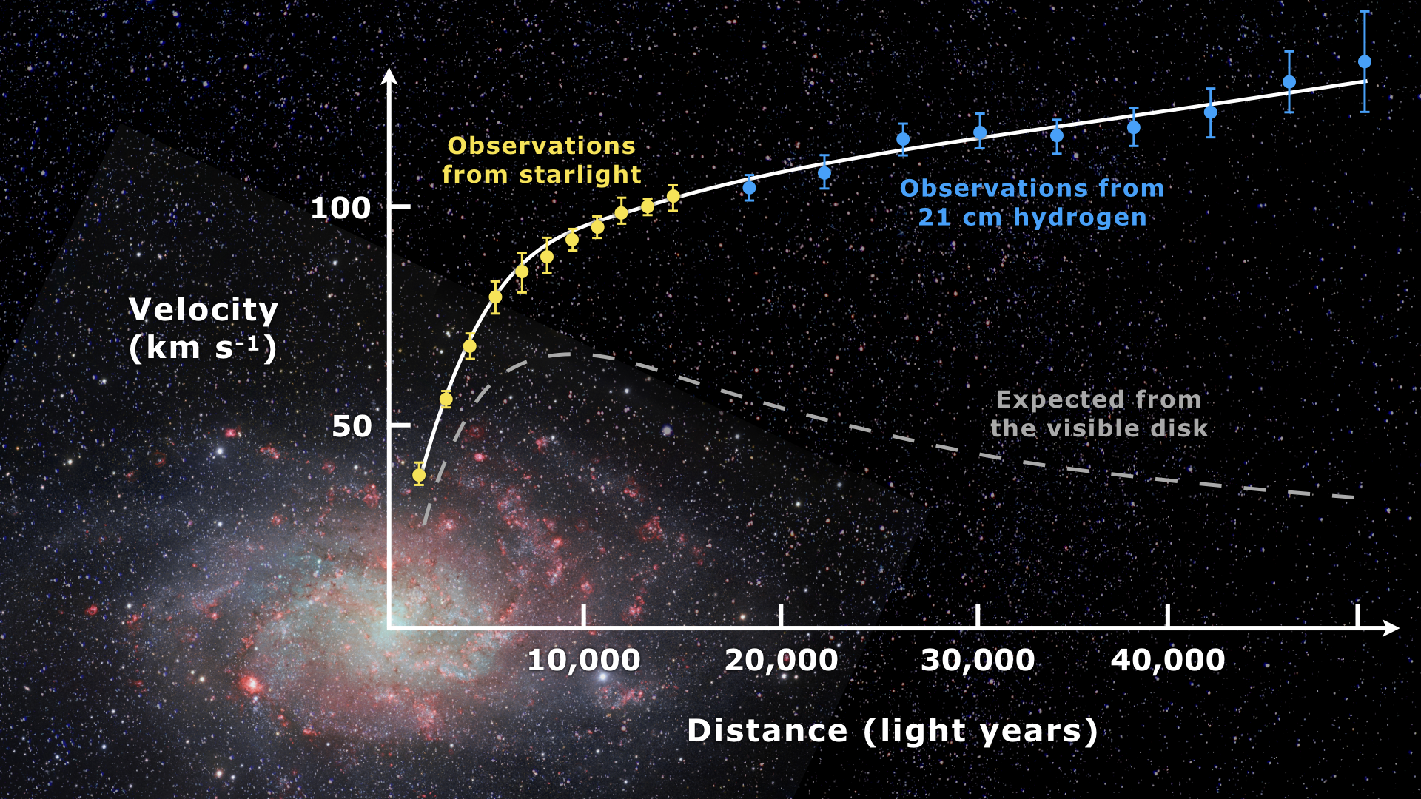
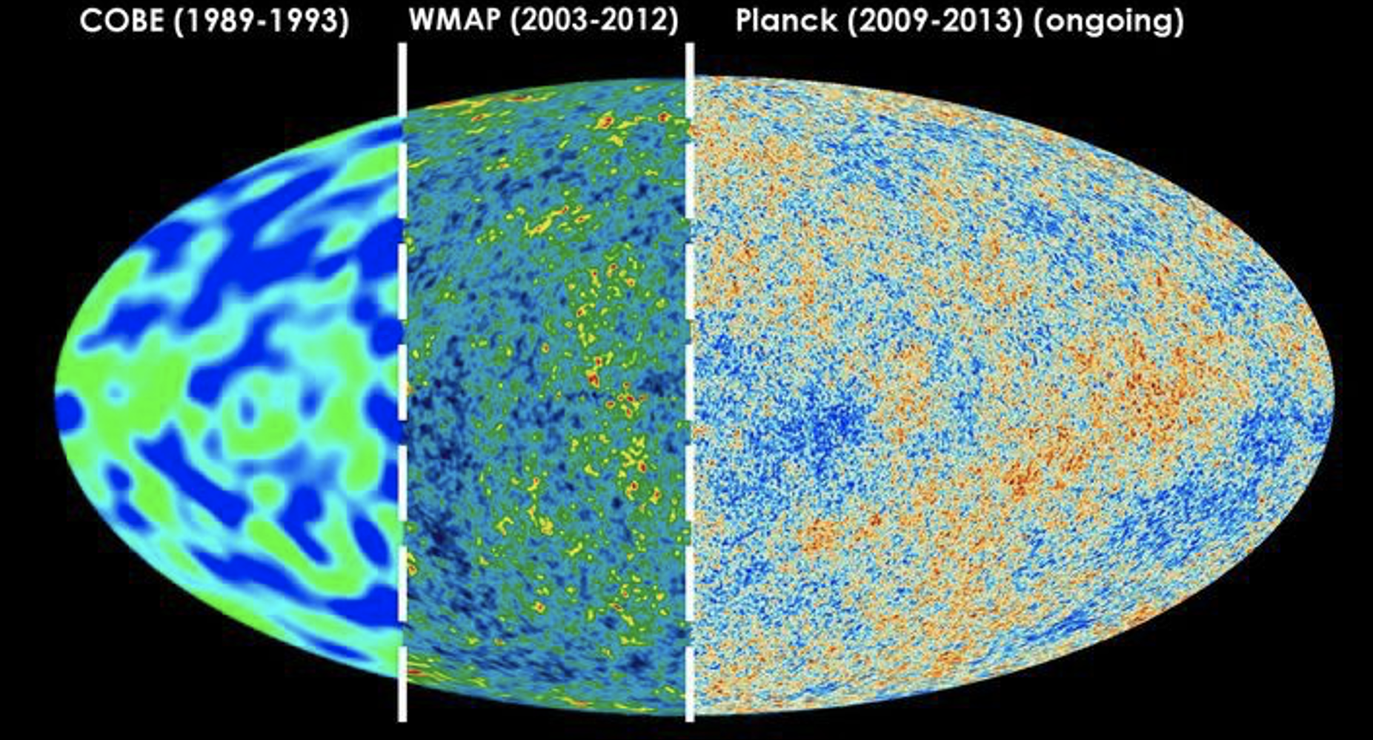
Dark Matter evidences
Galaxy rotation curves
Visible matter does not explain the rotational speed of galaxies at large distances from the center
Cosmic Microwave Background (CMB)
Measurements of the CMB anisotropies support the ΛCDM model with dark matter
Galaxy clusters
Velocity of galaxies within cluster is too high to be explained by visible matter (as well as velocity dispersion)
Gravitational Lensing

Slide 25
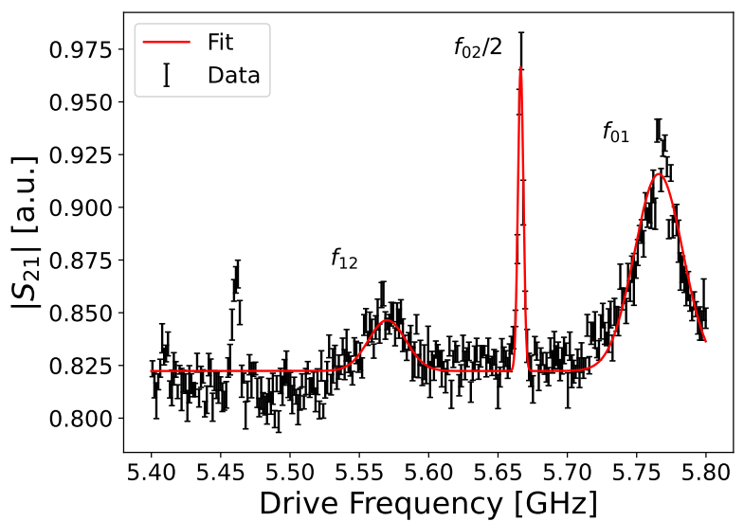
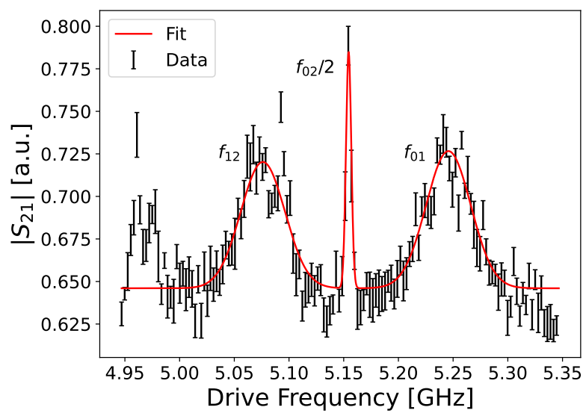
Qubit Spectroscopy

Slide 26
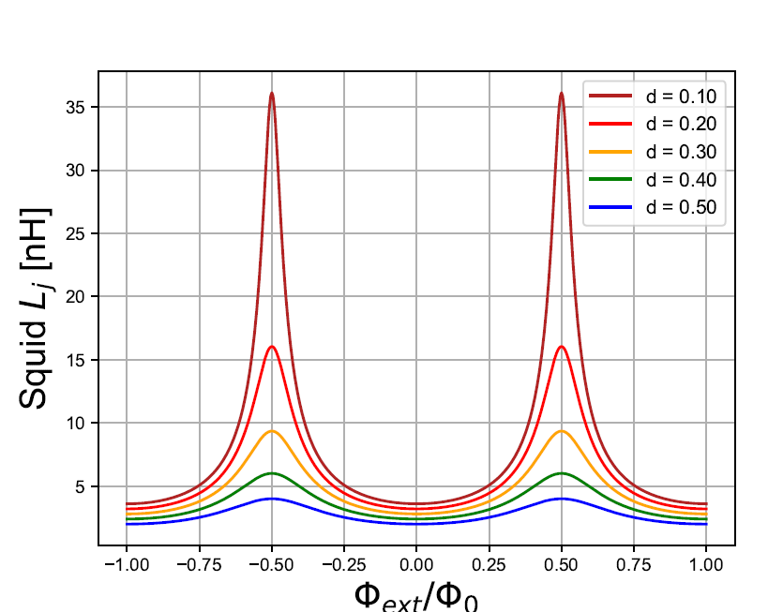
dc-Squid inductance

Slide 27
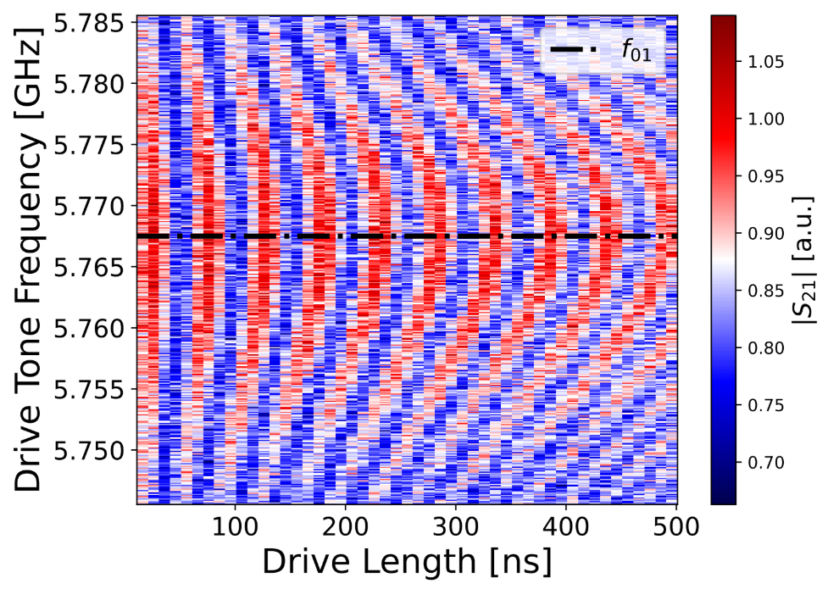
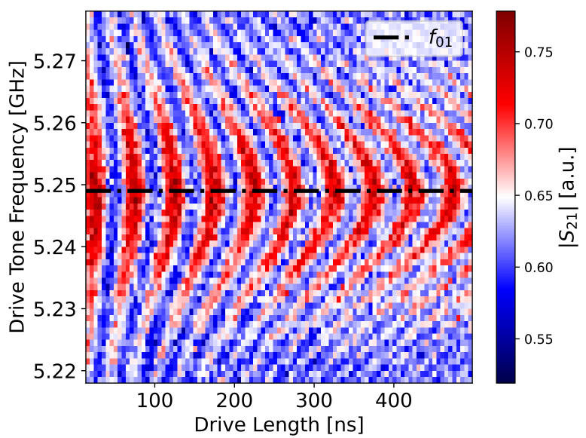
Rabi oscillations

Slide 28
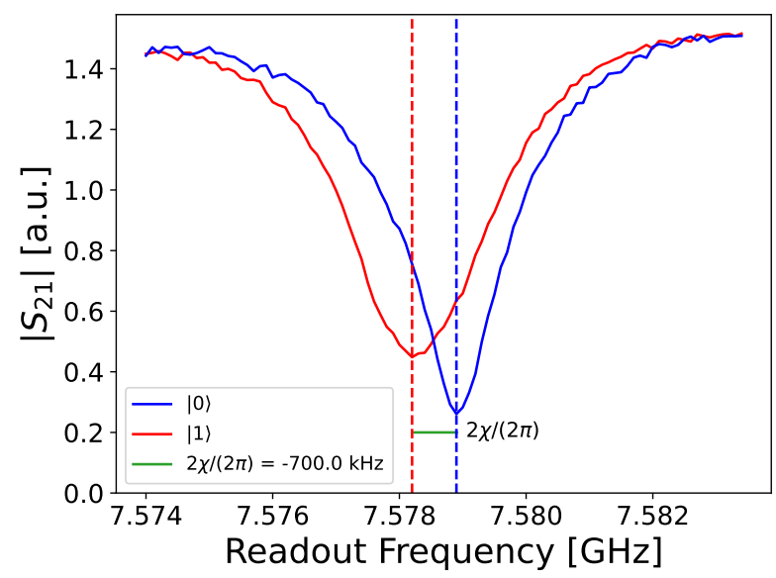
Dispersive shift

Slide 29
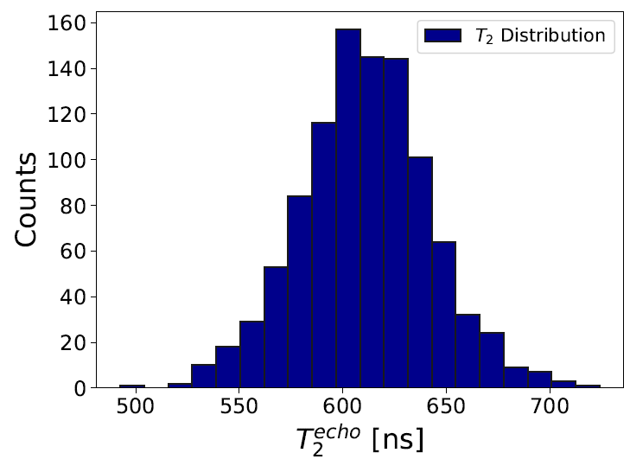
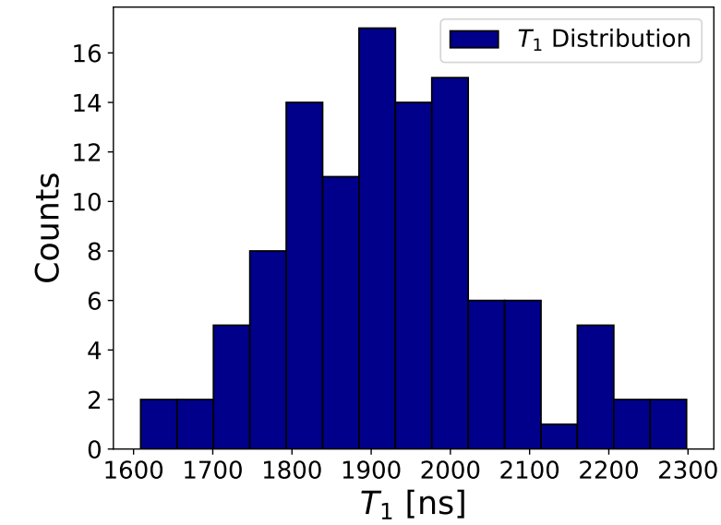
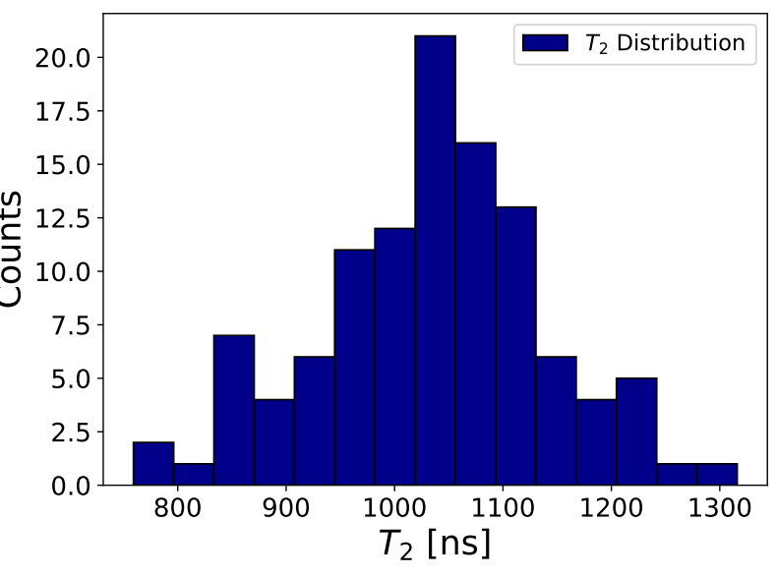
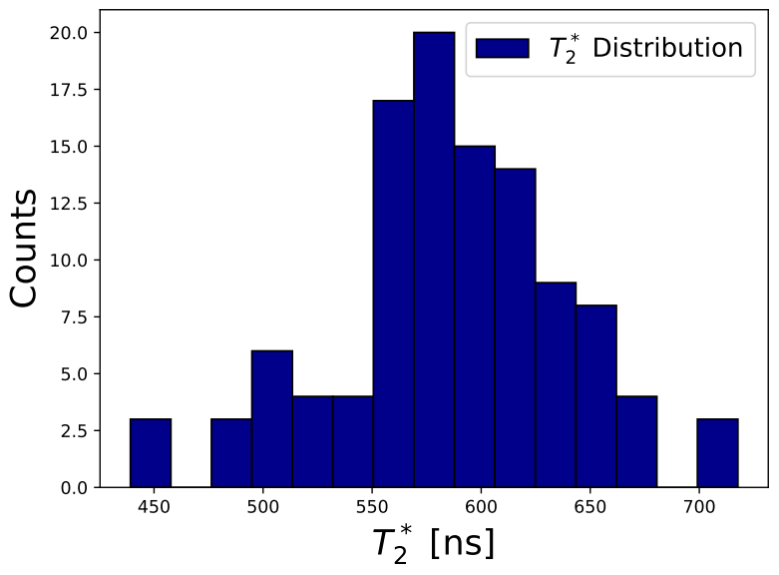
Relaxation and Coherence time measurement

Slide 30
Relaxation and Coherence time measurement
 | Fixed frequency qubit | Tunable qubit
$$T_{1}$$ | $1522±51$ ns | $1928±136$ ns
$$T_{2}^{∗}$$ | $408±73$ ns | $585±53$ ns
$$T_{2}$$ | $611±31$ ns | $1033±105$ ns

Slide 31
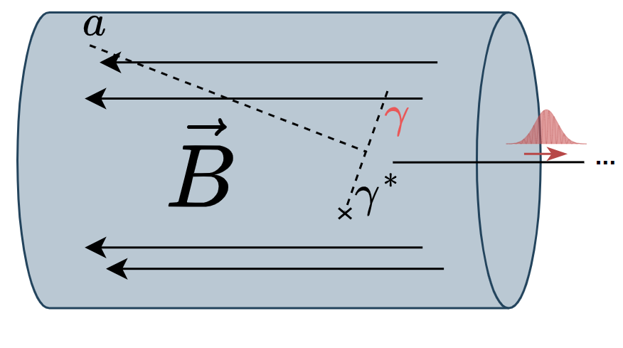
Light DM conversion into photons
Axions: itinerant photon detection scheme
Dark photons: localized dection scheme
Axion conversion cavity
Readout cavity
Transmission line
Resonator + Qubit
Dark photon conversion cavity

