Slide 1
Novel phenomena in oxide
two-dimensional electron systems
Marco Salluzzo
Research Director CNR-SPIN
Napoli, Italy
Consiglio Nazionale delle Ricerche
Istituto SPIN - Napoli
M. SALLUZZO (CNR-SPIN)
Secondo Congresso NQSTI, 05-07 febbraio 2025, Roma
06/02//2025

Slide 2
EXPERIMENTAL
Samples preparation
Yu Chen, M.Rath, CNR-SPIN
Transport measurements on LAO/ETO/STO and LAO/STO
-Yu Chen,M. D’Antuono and D. Stornaiuolo UNINA and CNR-SPIN
-D. Preziosi CNRS-Strasbourg
-B. Jouault CNRS-Montepellier
Transport measurements and FE characterizations on LAO/ETO/Ca-STO
J. Bréhin, M. Bibes, CNRS-Thales (Lab. A. Fert)
XAS, XLD, XMCD, RIXS
-Yu Chen, M. Rath, CNR-SPIN
-C. Piamonteze, PSI-SLS
-N.B. Brookes, G. Ghiringhelli, ESRF and Politecnico di Milano
Structural HRTEM
J. SantaMaria, M.Cabero Piris, UCM, GMFC Madrid
THEORY
Theory (DFT+U)
-M. Verma and R. Pentcheva (LAO/ETO/STO), University of Duisbourg-Essen
-J. Varignon (LAO/ETO/Ca-STO), CRISMAT, CNRS
Theory (quantum transport, Model Hamiltonian)
Yu Chen, A. Perroni, M. Trama, R. Citro
M. SALLUZZO (CNR-SPIN)
Secondo Congresso NQSTI, 05-07 febbraio 2025, Roma
06/02//2025

Slide 3
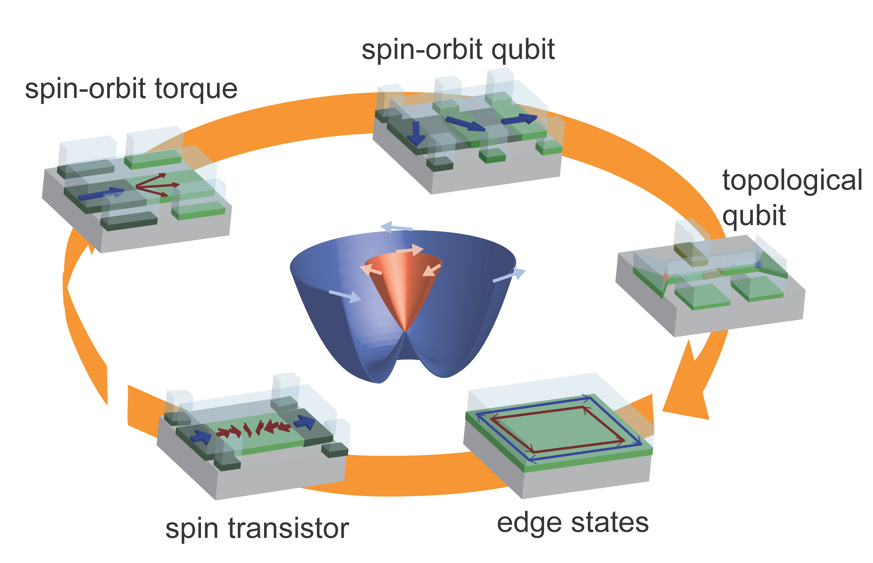
Spin(orbi)tronics
Quantum(topological)
Electronics
Inversion and time reversal symmetry breaking in low dimensional systems give rise to novel physical phenomena and might allow the coexistence of order parameters which normally compete:
NOVEL PHYSICS AND NOVEL FUNCTIONALITIES
2D-Ferromagnetism
2D-Ferroelectricity
Spin-orbit
coupling
2D-Superconductivity
QUANTOX
ERA-NET EU H2020
GA No. 731473
PNRR MUR project
PE0000023-NQSTI
IQARO Path-Finder
Horizon Europe
GA No. 101115190
M. SALLUZZO (CNR-SPIN)
Secondo Congresso NQSTI, 05-07 febbraio 2025, Roma
06/02//2025

Slide 4
STO-Based heterostructures: Novel Physical phenomena
(Nat. Mat. 278 (2016) )
LaAlO3/STO
Ferromagnetic
and SC 2DEG
Multiferroic
2DEG
LAO/ETO/Ca-STO
Nature 427, 423 (2004)
LAO/ETO/STO
High Tc-SC
NdNiO2/STO
SC 2DEG
Nature 572, 624 (2019)
M. SALLUZZO (CNR-SPIN)
Secondo Congresso NQSTI, 05-07 febbraio 2025, Roma
06/02//2025

Slide 5
Ferromagnetism, Superconductivity, Ferroelectricity
Heavy fermions
FE-STO
S. S. Saxena et al. NATURE |VOL 406 | 10 AUGUST 587 (2000)
Rischau et al., Nature Physics 13, 643 (2017)
Talk by Inoue !
Co-intecalated NbSe2 (Co-NbSe2)
FM+FE+SC. in 2D?
Tingyu Qu et al. https://doi.org/10.21203/rs.3.rs-2965127/v1
M. SALLUZZO (CNR-SPIN)
Secondo Congresso NQSTI, 05-07 febbraio 2025, Roma
06/02//2025

Slide 6
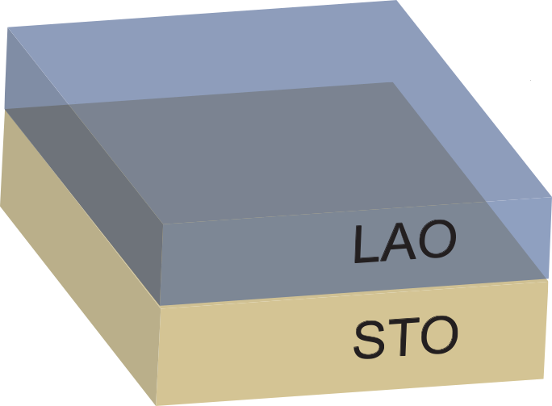
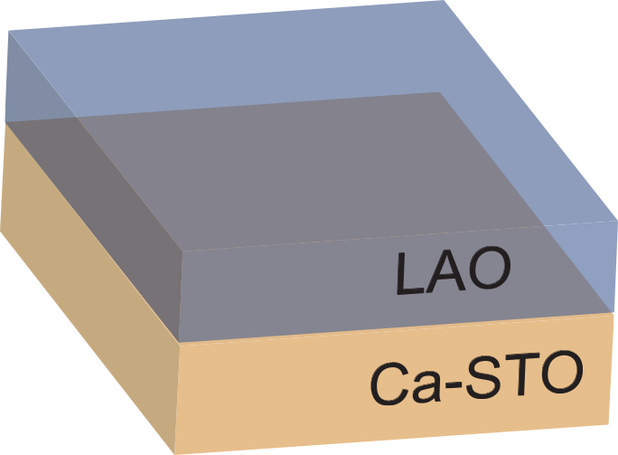
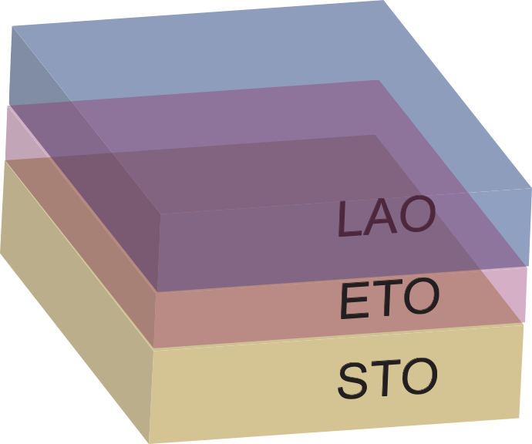
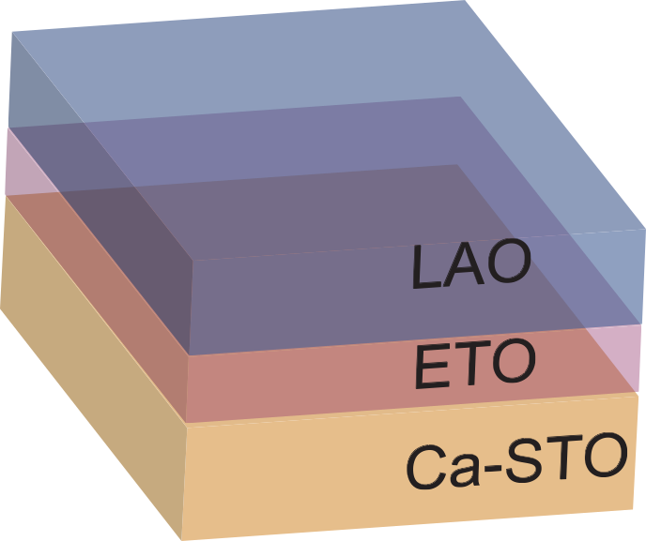
A metallic ferroelectric: the q2DEG based on FE Ca-STO
q2DEG
FE (and SC) q2DEG
FE and FM q2DEG
FM (and SC) q2DEG
J. Bréhin, Y. Chen, M. D’Antuono, S. Varotto, D. Stornaiuolo, C. Piamonteze, J. Varignon, M. Salluzzo, and M. Bibes, Nat. Phys. 19, 823 (2023).
M. SALLUZZO (CNR-SPIN)
Secondo Congresso NQSTI, 05-07 febbraio 2025, Roma
06/02//2025

Slide 7
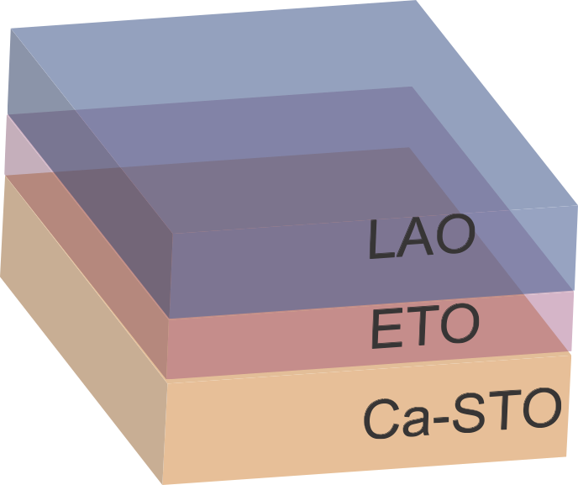
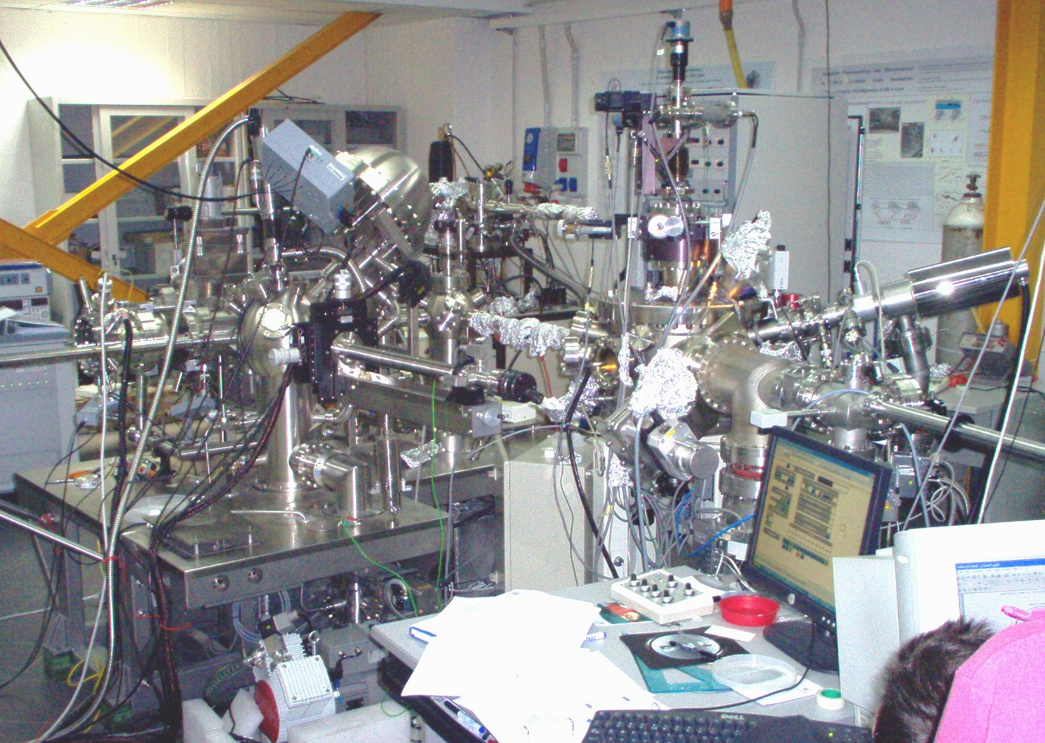
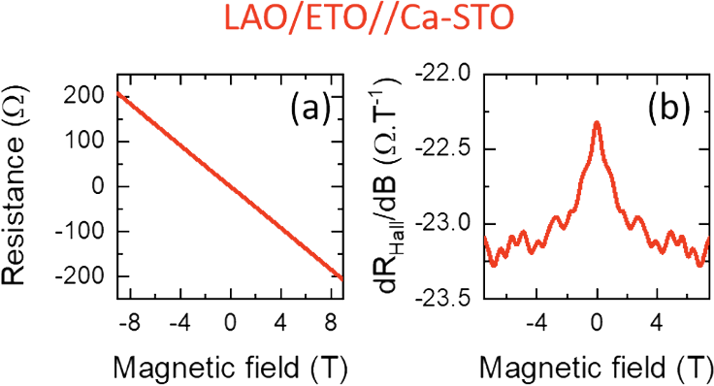
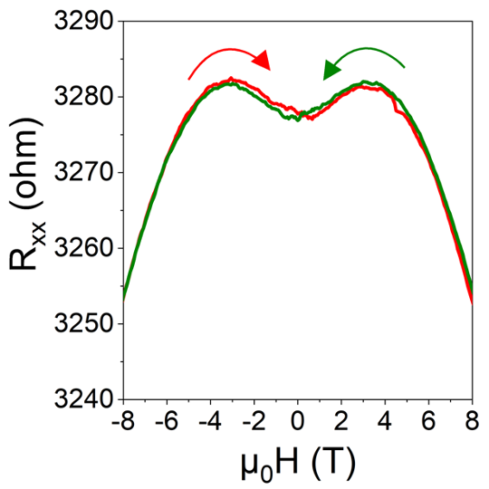
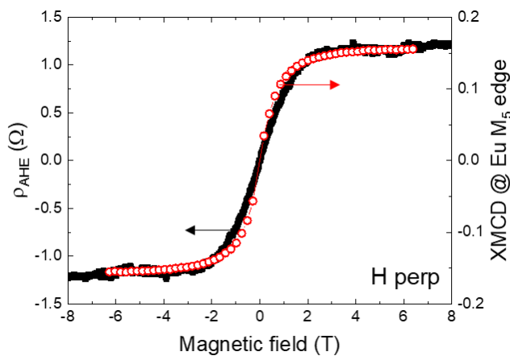
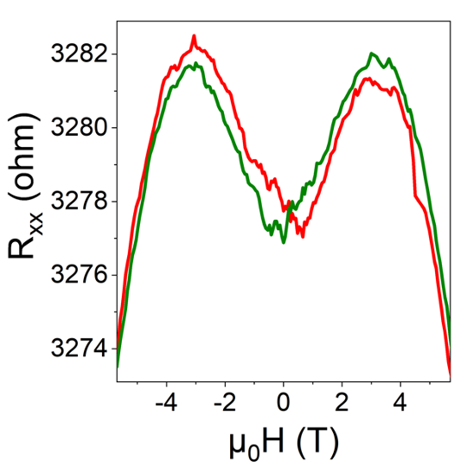
Ferroelectric-like transition
PLD growth of ETO and LAO on 1% and 2% Ca-STO
Surface Analysis chamber,
AFM, STM, SPA-LEED, XPS, UPS
RsvsT
Modular system for
Oxide
Deposition and
Analyses
PLD chamber
Anomalous Hall effect
Magneto-resistance hysteresis
TC (FE)
Remanent
Polarization
∆n2D
(Pup-Pdown)
M. SALLUZZO (CNR-SPIN)
Secondo Congresso NQSTI, 05-07 febbraio 2025, Roma
06/02//2025

Slide 8
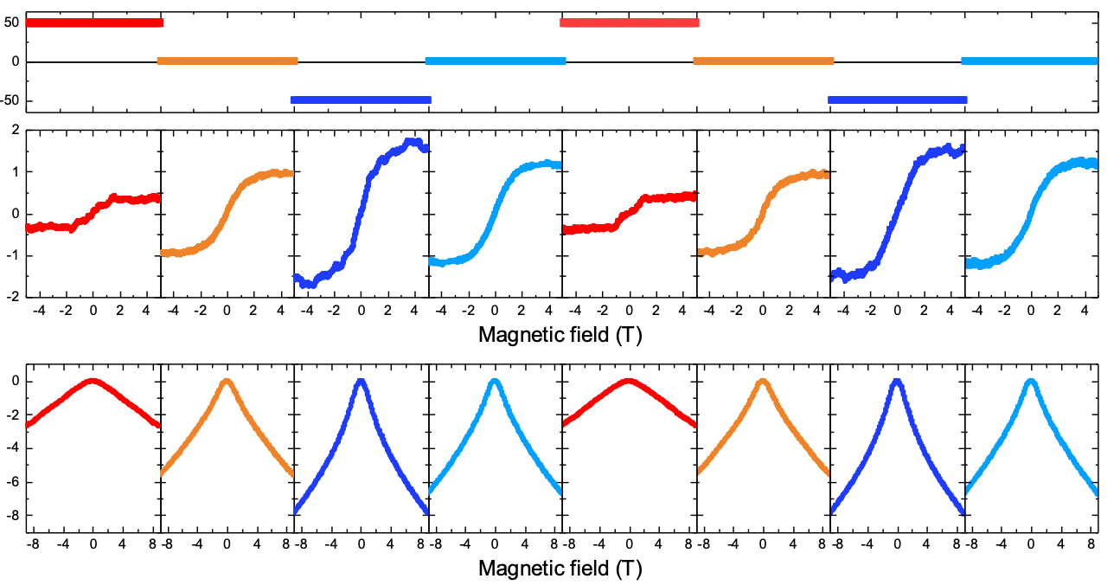
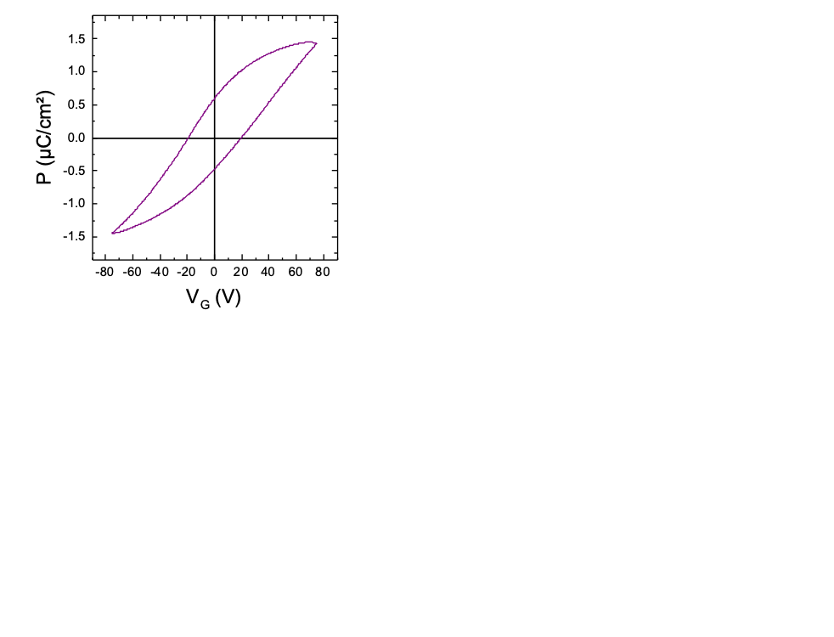
Coupling between Ferroelectricity and magnetism in the transport
VG (V)
Back-gate voltage
RAHE (Ω)
Anomalous Hall resistance non volatile switching
MR (%)
Magnetoresistance
non volatile switching
Electro-magnetoresistance emerging well-below Tc(FE)
Is the 2DEG Ferroelectric and Ferromagnetic?
Are the two order parameters coupled?
J. Bréhin, et al. Nat. Phys. 19, 823 (2023).
M. SALLUZZO (CNR-SPIN)
Secondo Congresso NQSTI, 05-07 febbraio 2025, Roma
06/02//2025

Slide 9
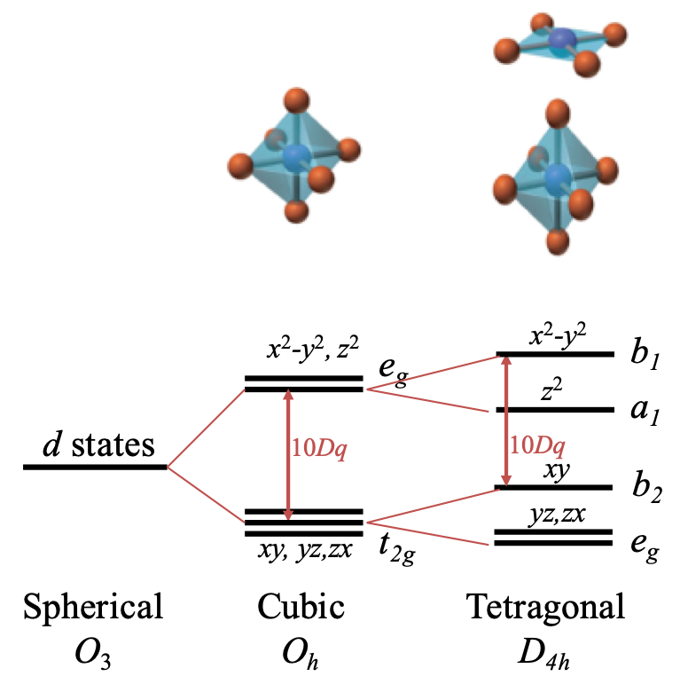
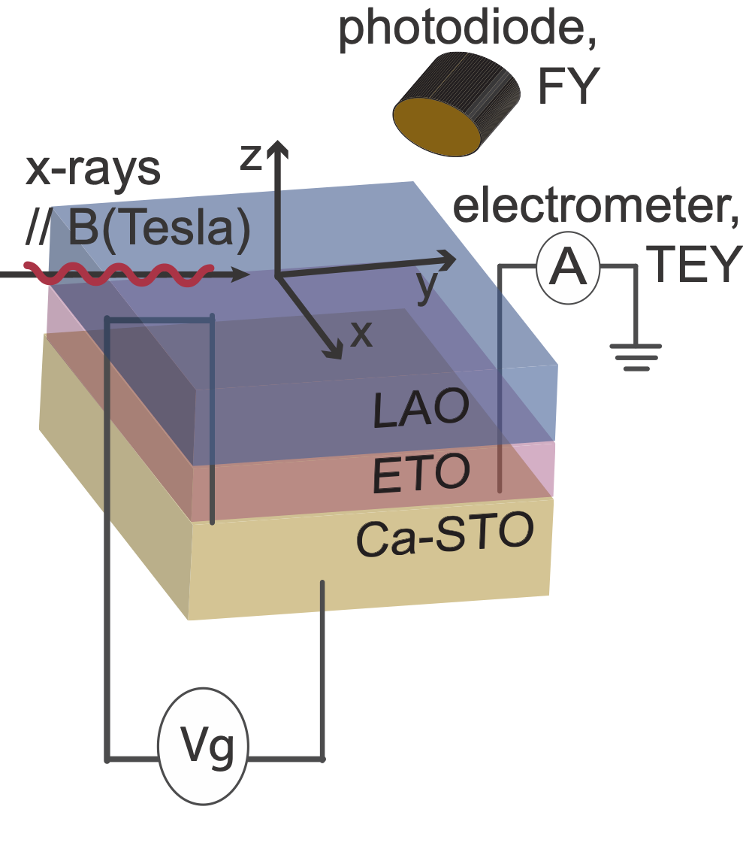
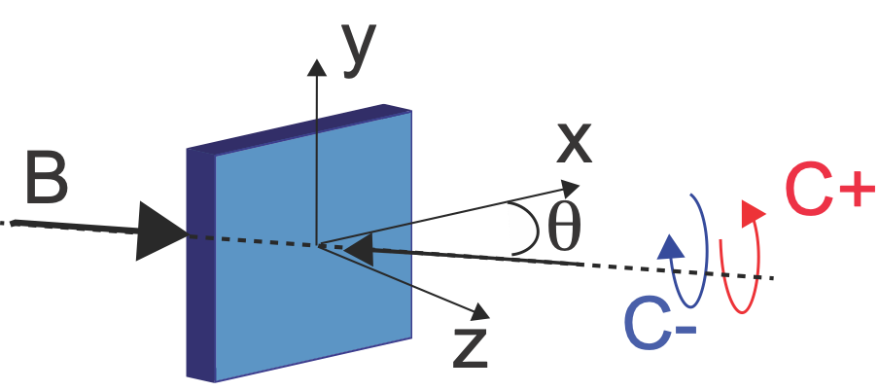
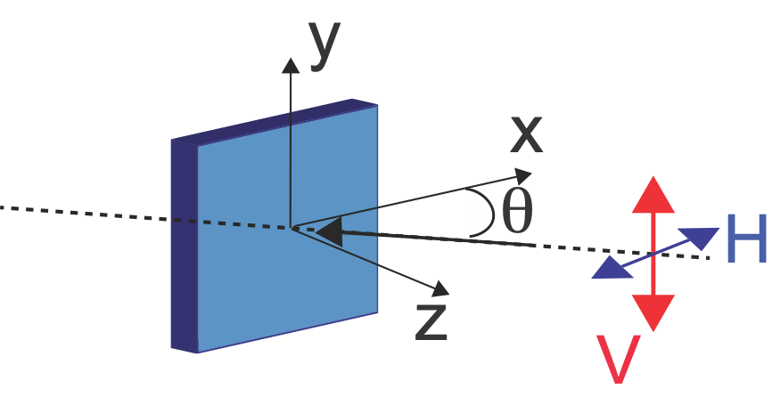
eg
3dz²
3dx²-y²
t2g
3dxz/3dyz
3dxy
L2
x-rays
L3
2p3/2
2p1/2
XMCD
XLD
FY: Bulk sensitive but interfacial sensitive to the Eu-magnetic moment
TEY: Interface Sensitive (probe depth 2 nm)
M. SALLUZZO (CNR-SPIN)
Secondo Congresso NQSTI, 05-07 febbraio 2025, Roma
06/02//2025

Slide 10
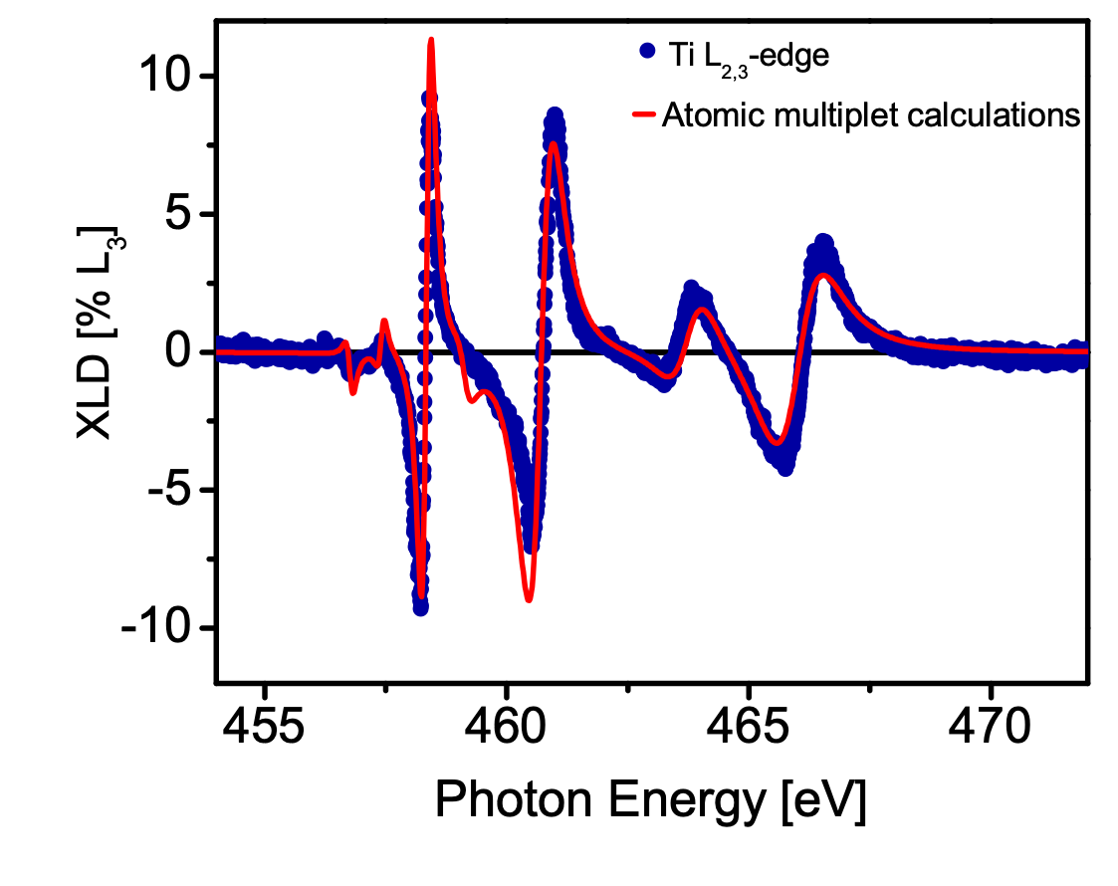
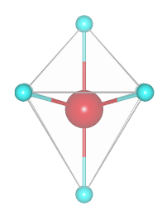
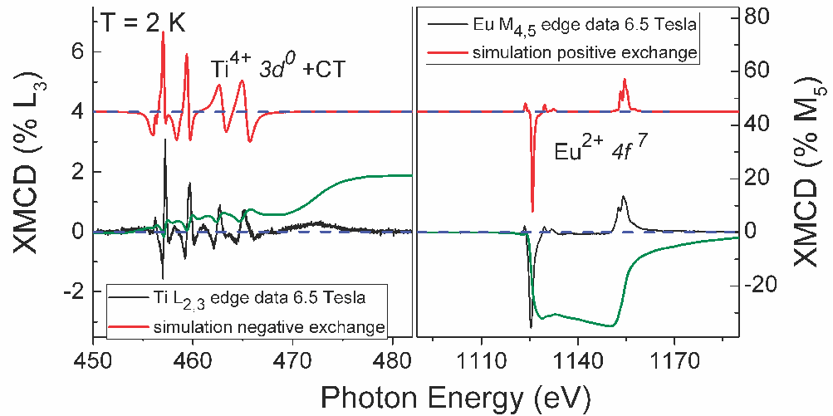
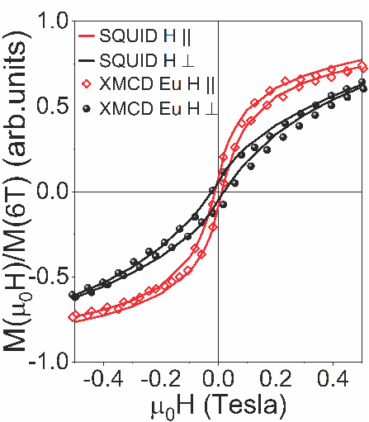
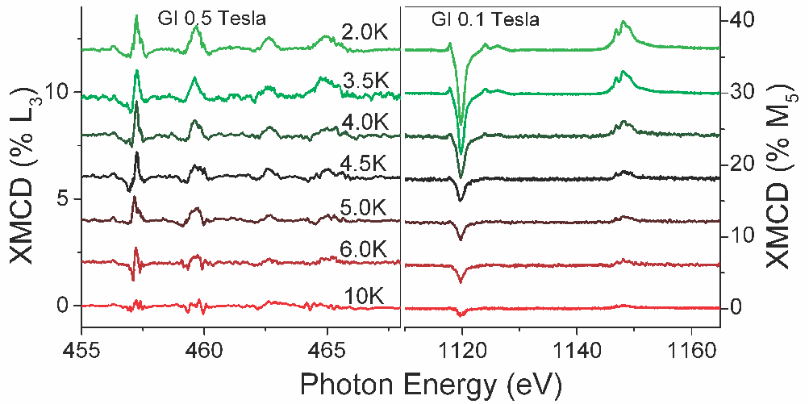
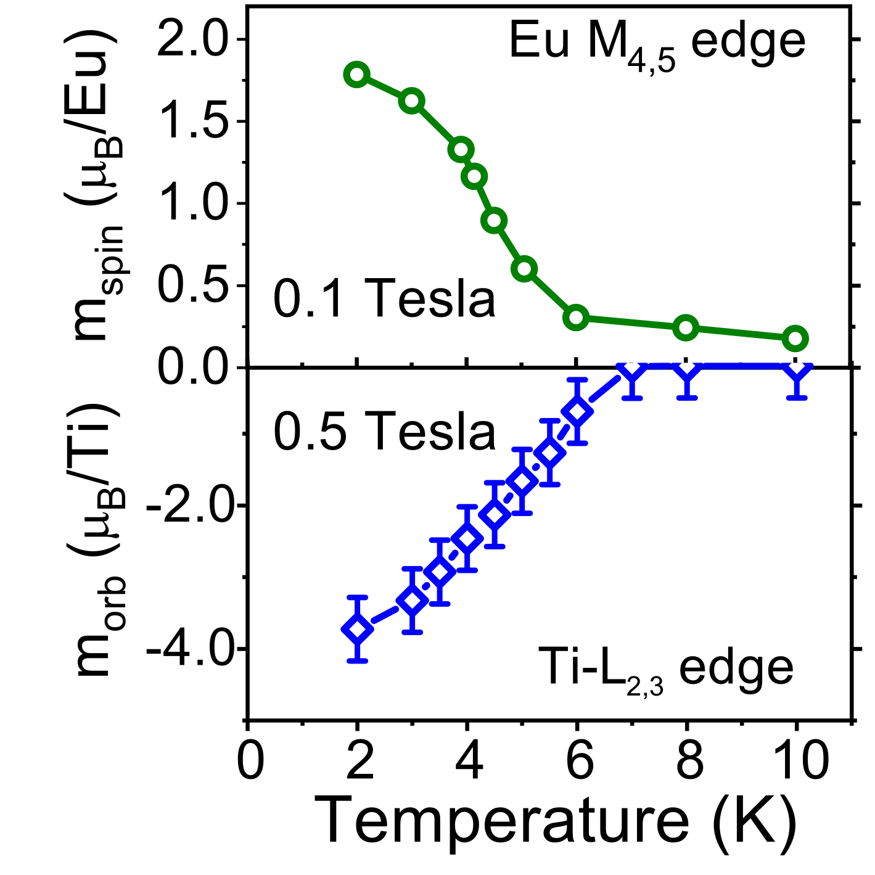
XLD and XMCD in LAO/ETO/STO
3d_{xy} lowest in energy as in LAO/STO
M. S. et al., Phys. Rev. Lett. 102, 166804 (2009)
M. S., et al. Adv. Mater. 25, 2333 (2013)
D. Stornaiuolo, et al. Nature Materials 15, 278 (2016)
100 meV
50 meV
Eu and Ti magnetic moment coupled: in-plane easy-axis, Tc =6-8 K
M. SALLUZZO (CNR-SPIN)
Secondo Congresso NQSTI, 05-07 febbraio 2025, Roma
06/02//2025

Slide 11
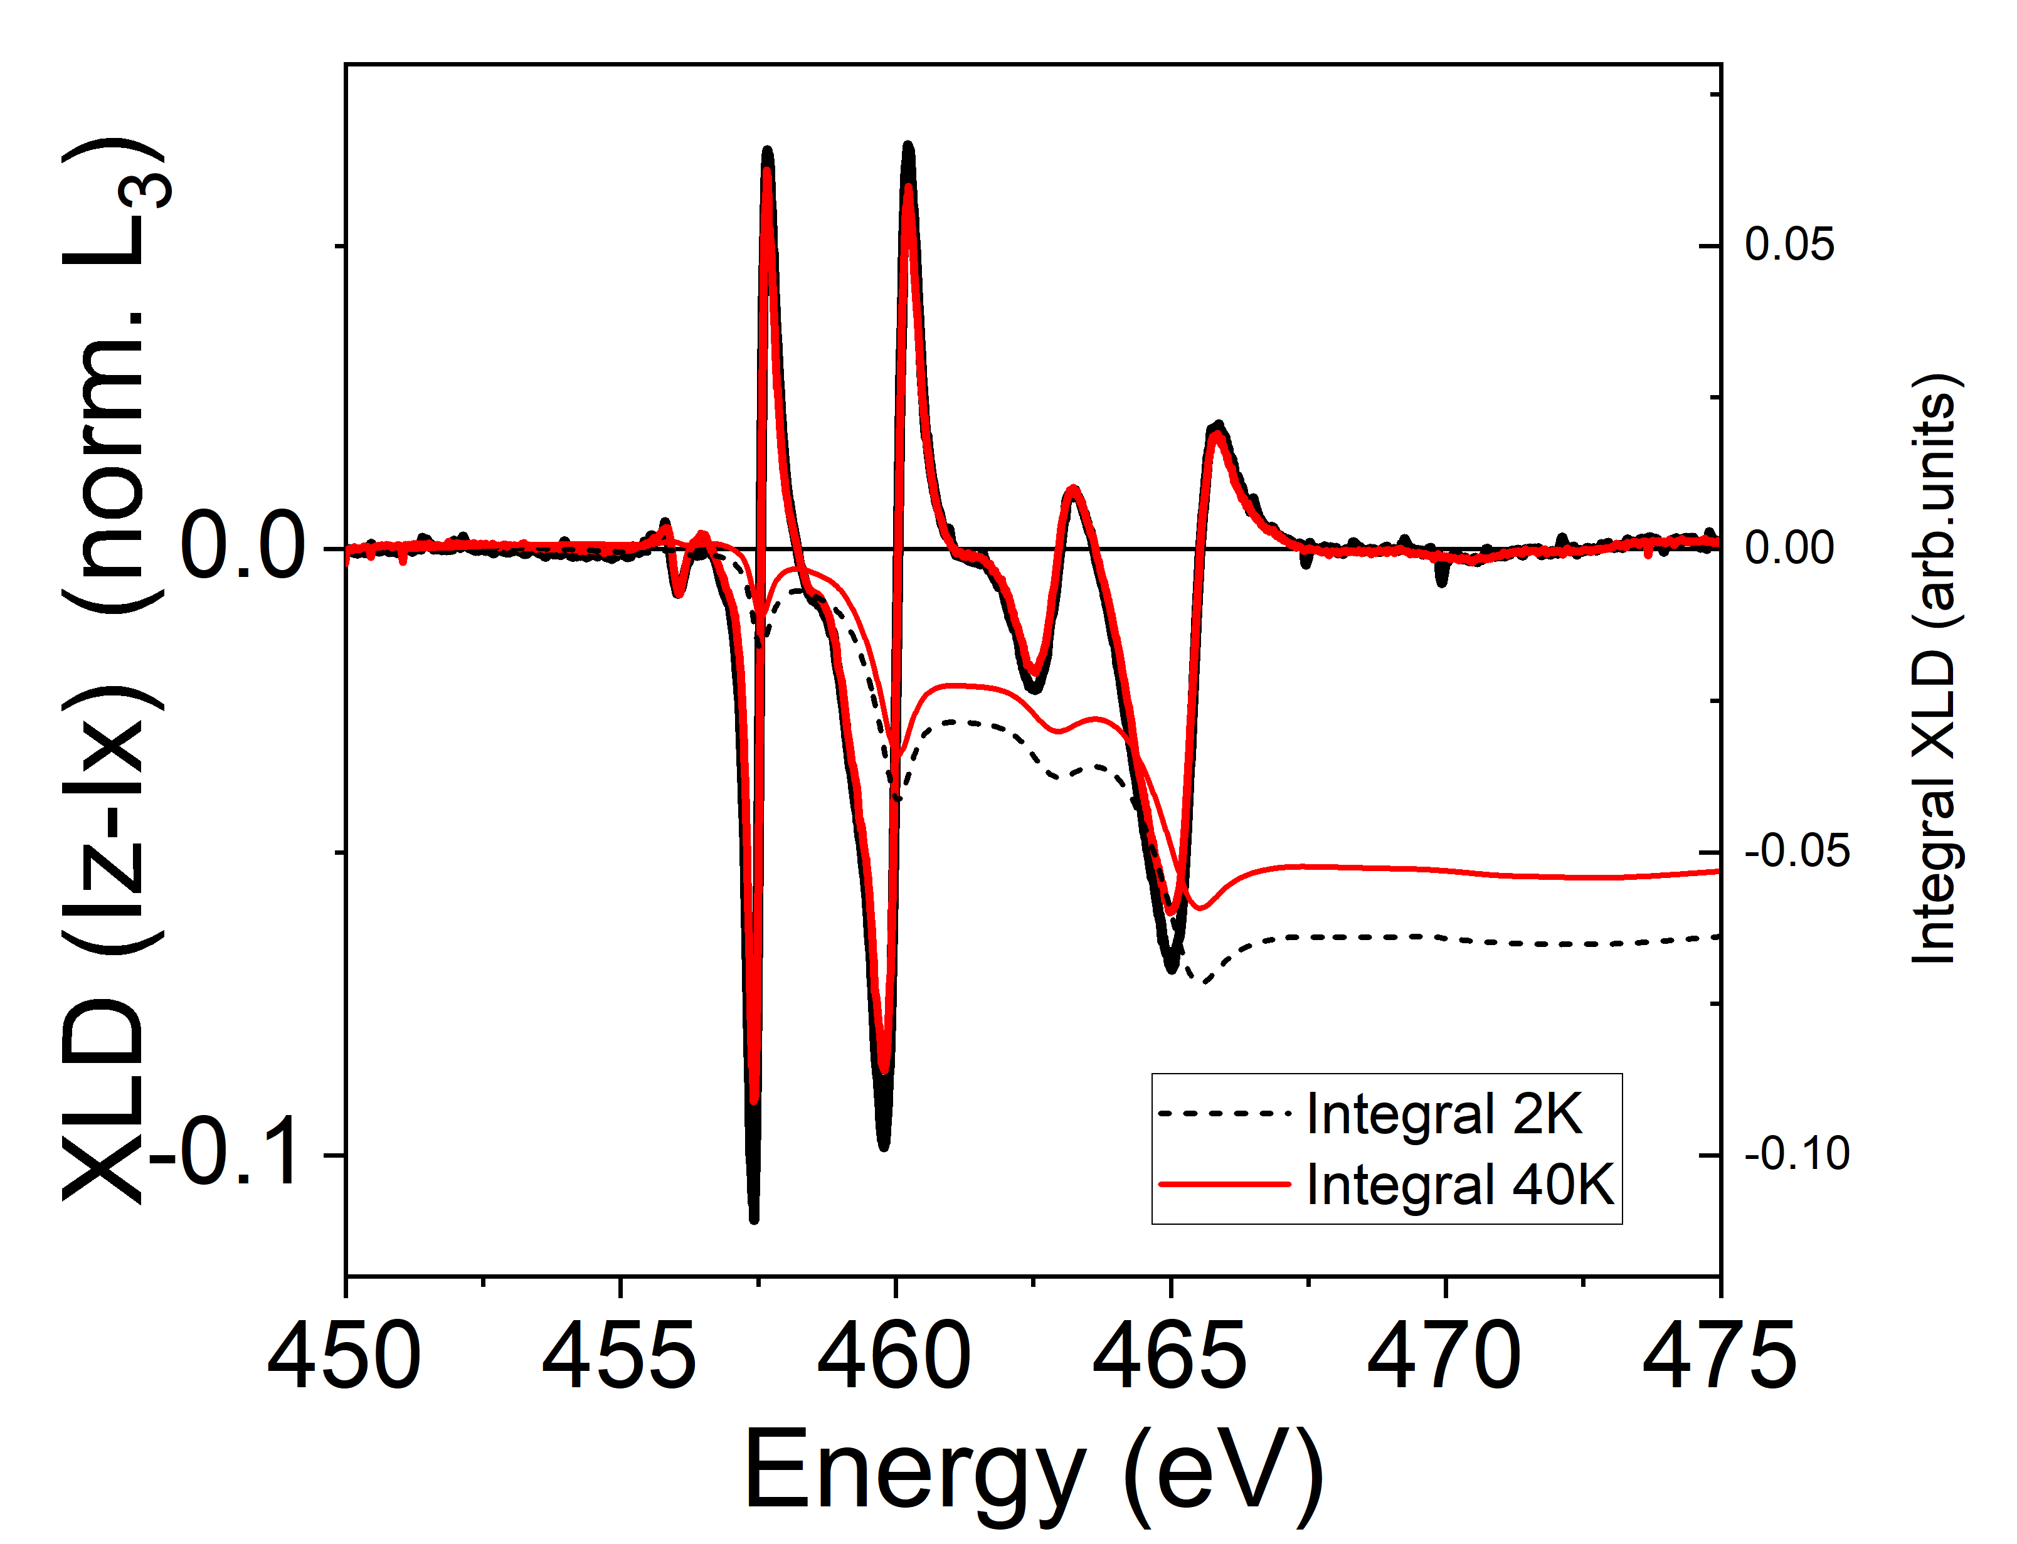
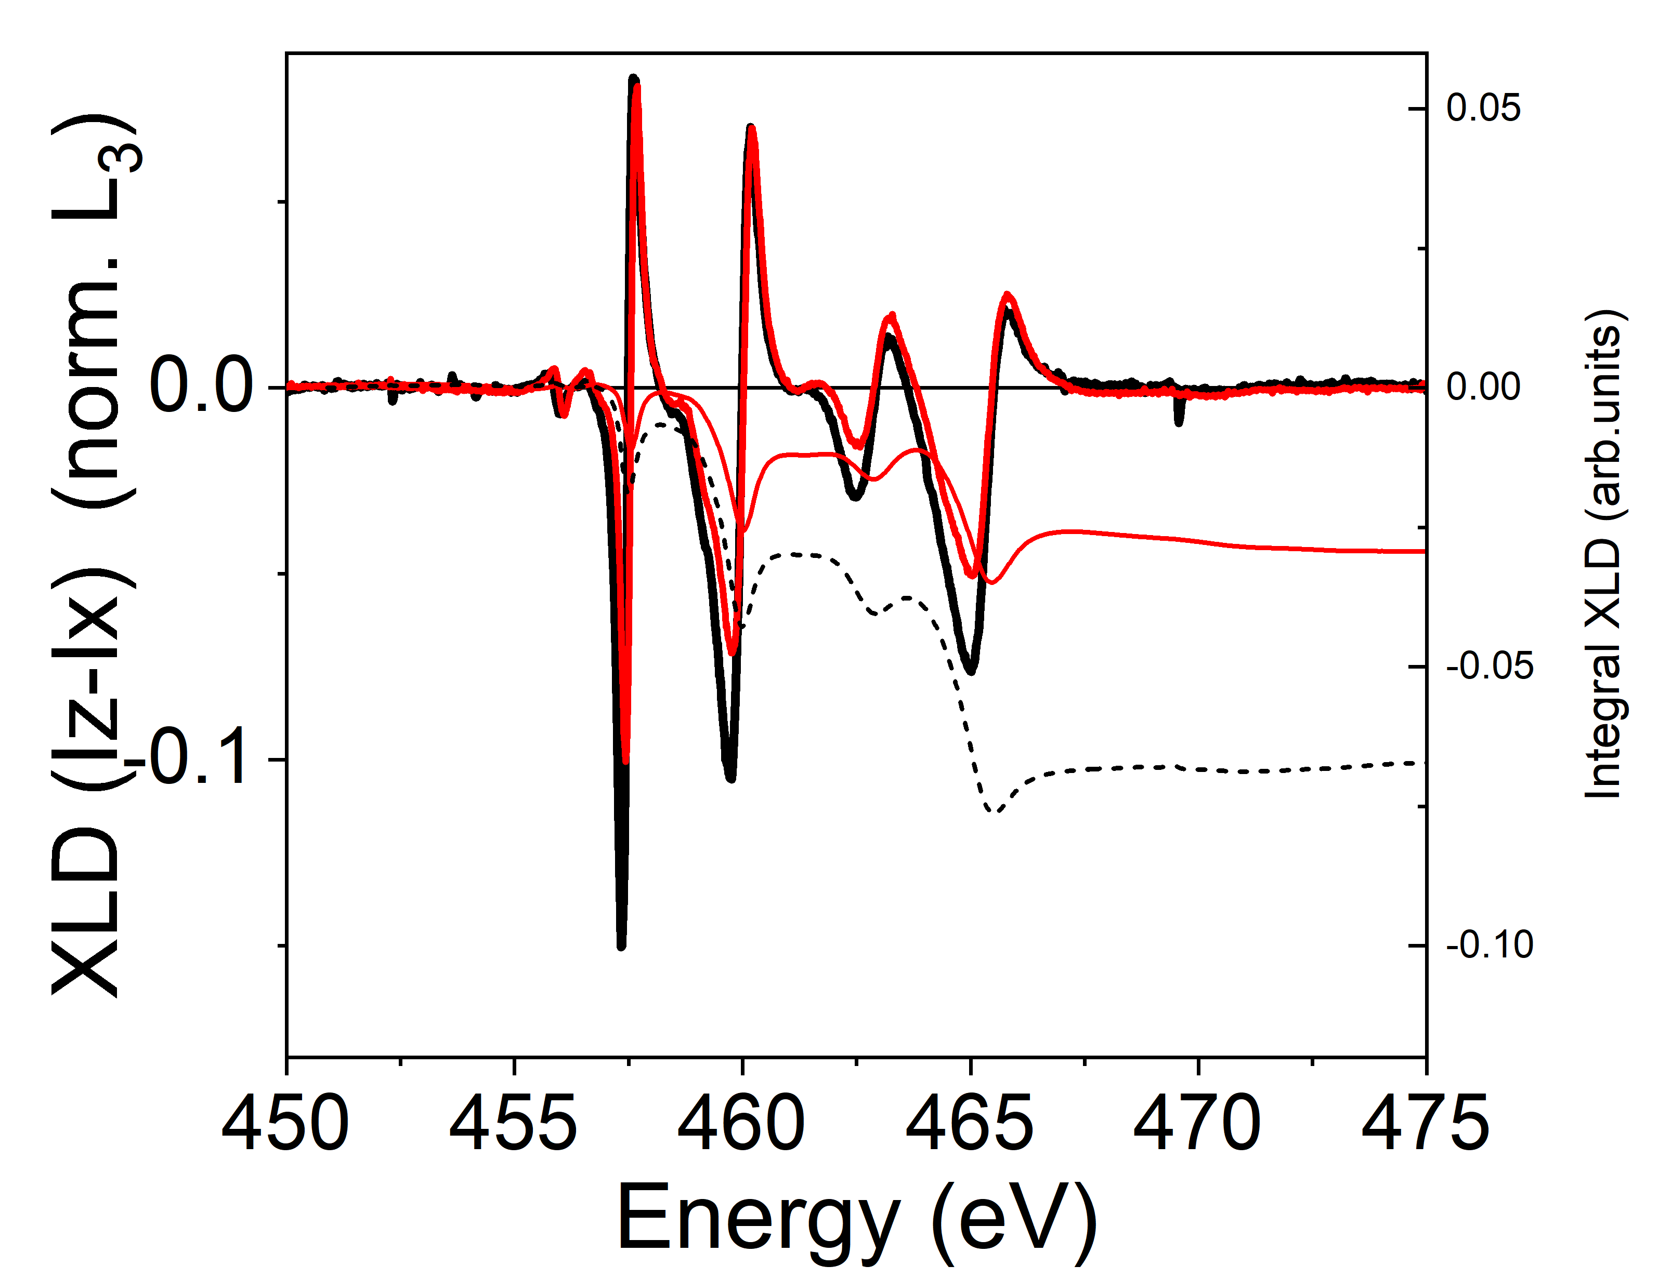
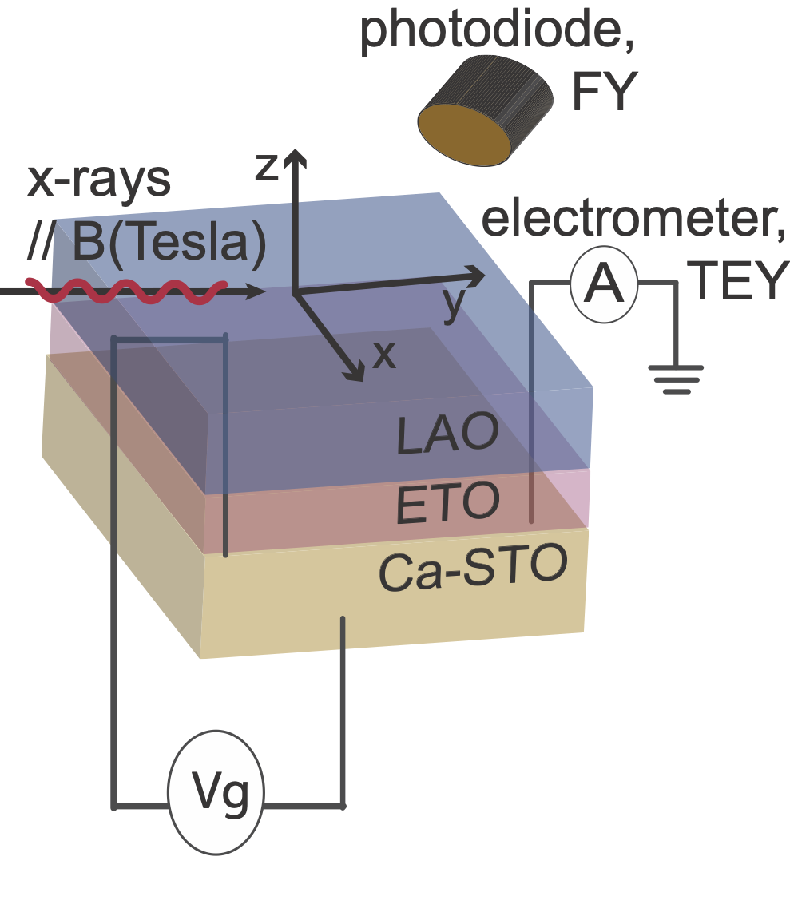
TEY mode (interface sensitive) Ti L2,3 edge XLD across the FE transition
2 K BLACK T<TFE
40 K RED T>TFE
LAO/Ca(2%)-STO
LAO/ETO/Ca(2%)-STO
VG=0
VG=0
Clear effect of the FE-transition on the
TEY Ti-XLD spectra (probing the 2DEG Ti-states)
Signature of the FE-transition are seen in the Ti 3d-orbital splitting
M. SALLUZZO (CNR-SPIN)
Secondo Congresso NQSTI, 05-07 febbraio 2025, Roma
06/02//2025

Slide 12
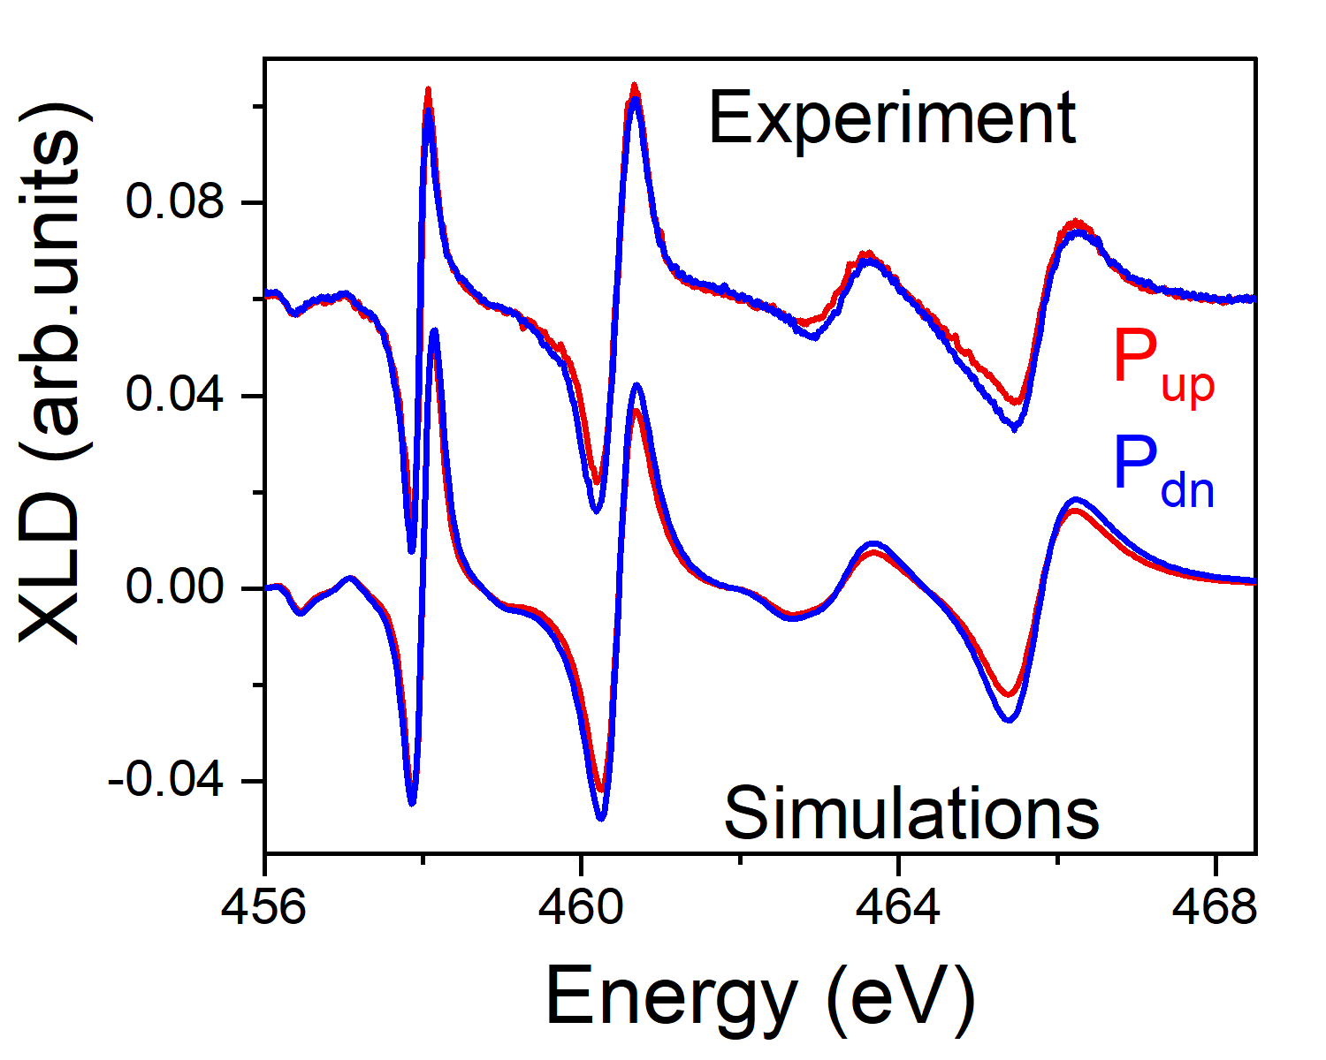
TEY mode (interface sensitive) Ti L2,3 edge XLD SWITCHING
LAO/ETO/Ca(1%)-STO
Pup ∆eg= -80 meV ∆t2g = -60 meV
Pdown ∆eg= -95 meV ∆t2g = -70 meV
Strong XLD expected from off-centered Ti ions with respect to oxygen ions in the 2DEG: electric dipole
XLD depends on P direction: different electric dipole amplitude for different P states
Atomic multiplet simulations reproducing data indicate larger electric dipole in Pdn than Pup, consistent with DFT
Switchable dipoles in the 2DEG region: Ferroelectric-like switching
M. SALLUZZO (CNR-SPIN)
Secondo Congresso NQSTI, 05-07 febbraio 2025, Roma
06/02//2025

Slide 13
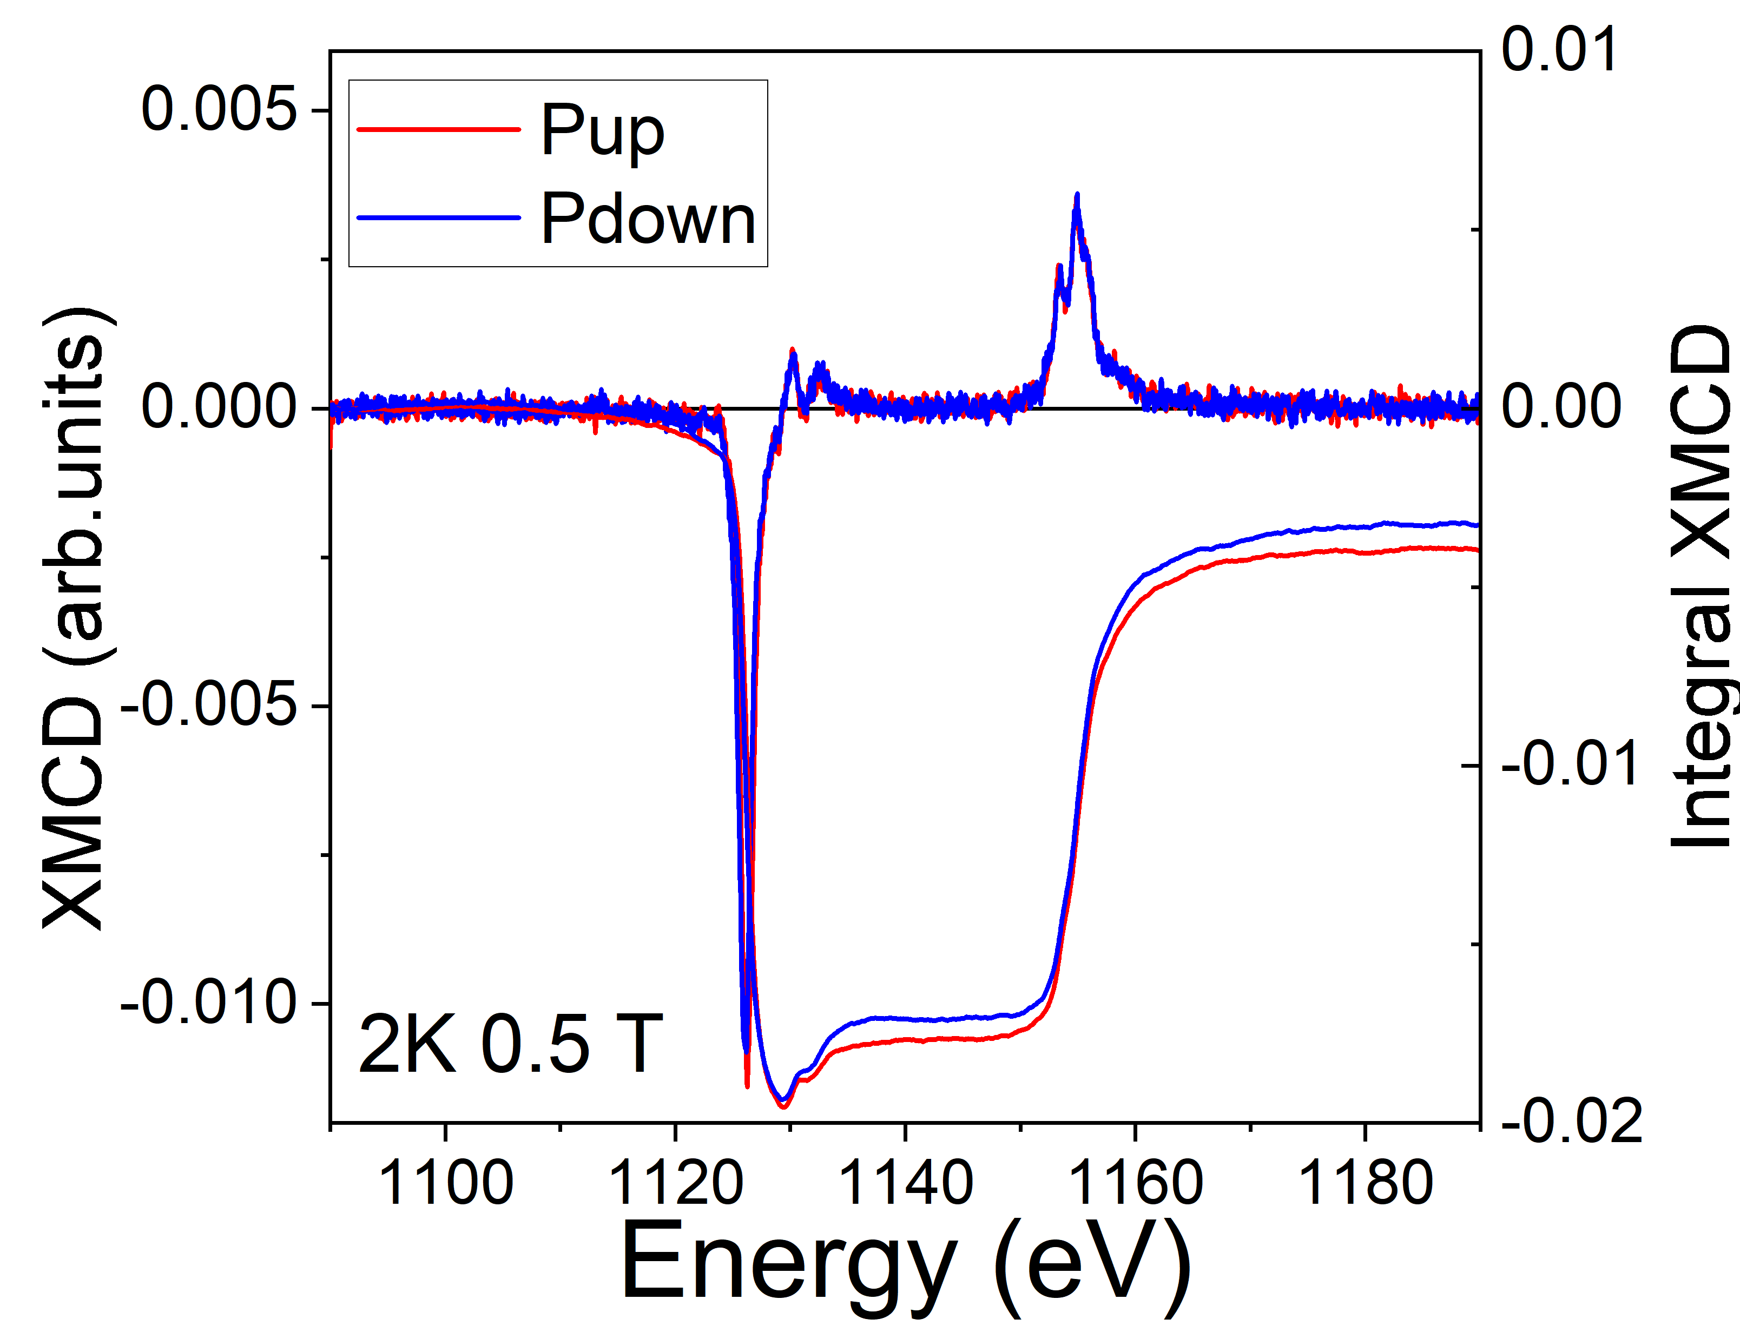
FY Eu-XMCD vs FE Polarization
FY mode on Eu M4,5 edge XMCD is sensitive to the Eu-magnetization at the interface
q
morb ∝-q
mspin ∝ -(5p-3q)
p
-Effect of the remanent FE-polarization on the Eu-Magnetism (probing the 2DEG Eu 4f -states)
Magnetoelectric Coupling: change of 1.5% of the spin moment and of about 10% of the orbital moment at 0.5 Tesla
M. SALLUZZO (CNR-SPIN)
Secondo Congresso NQSTI, 05-07 febbraio 2025, Roma
06/02//2025

Slide 14
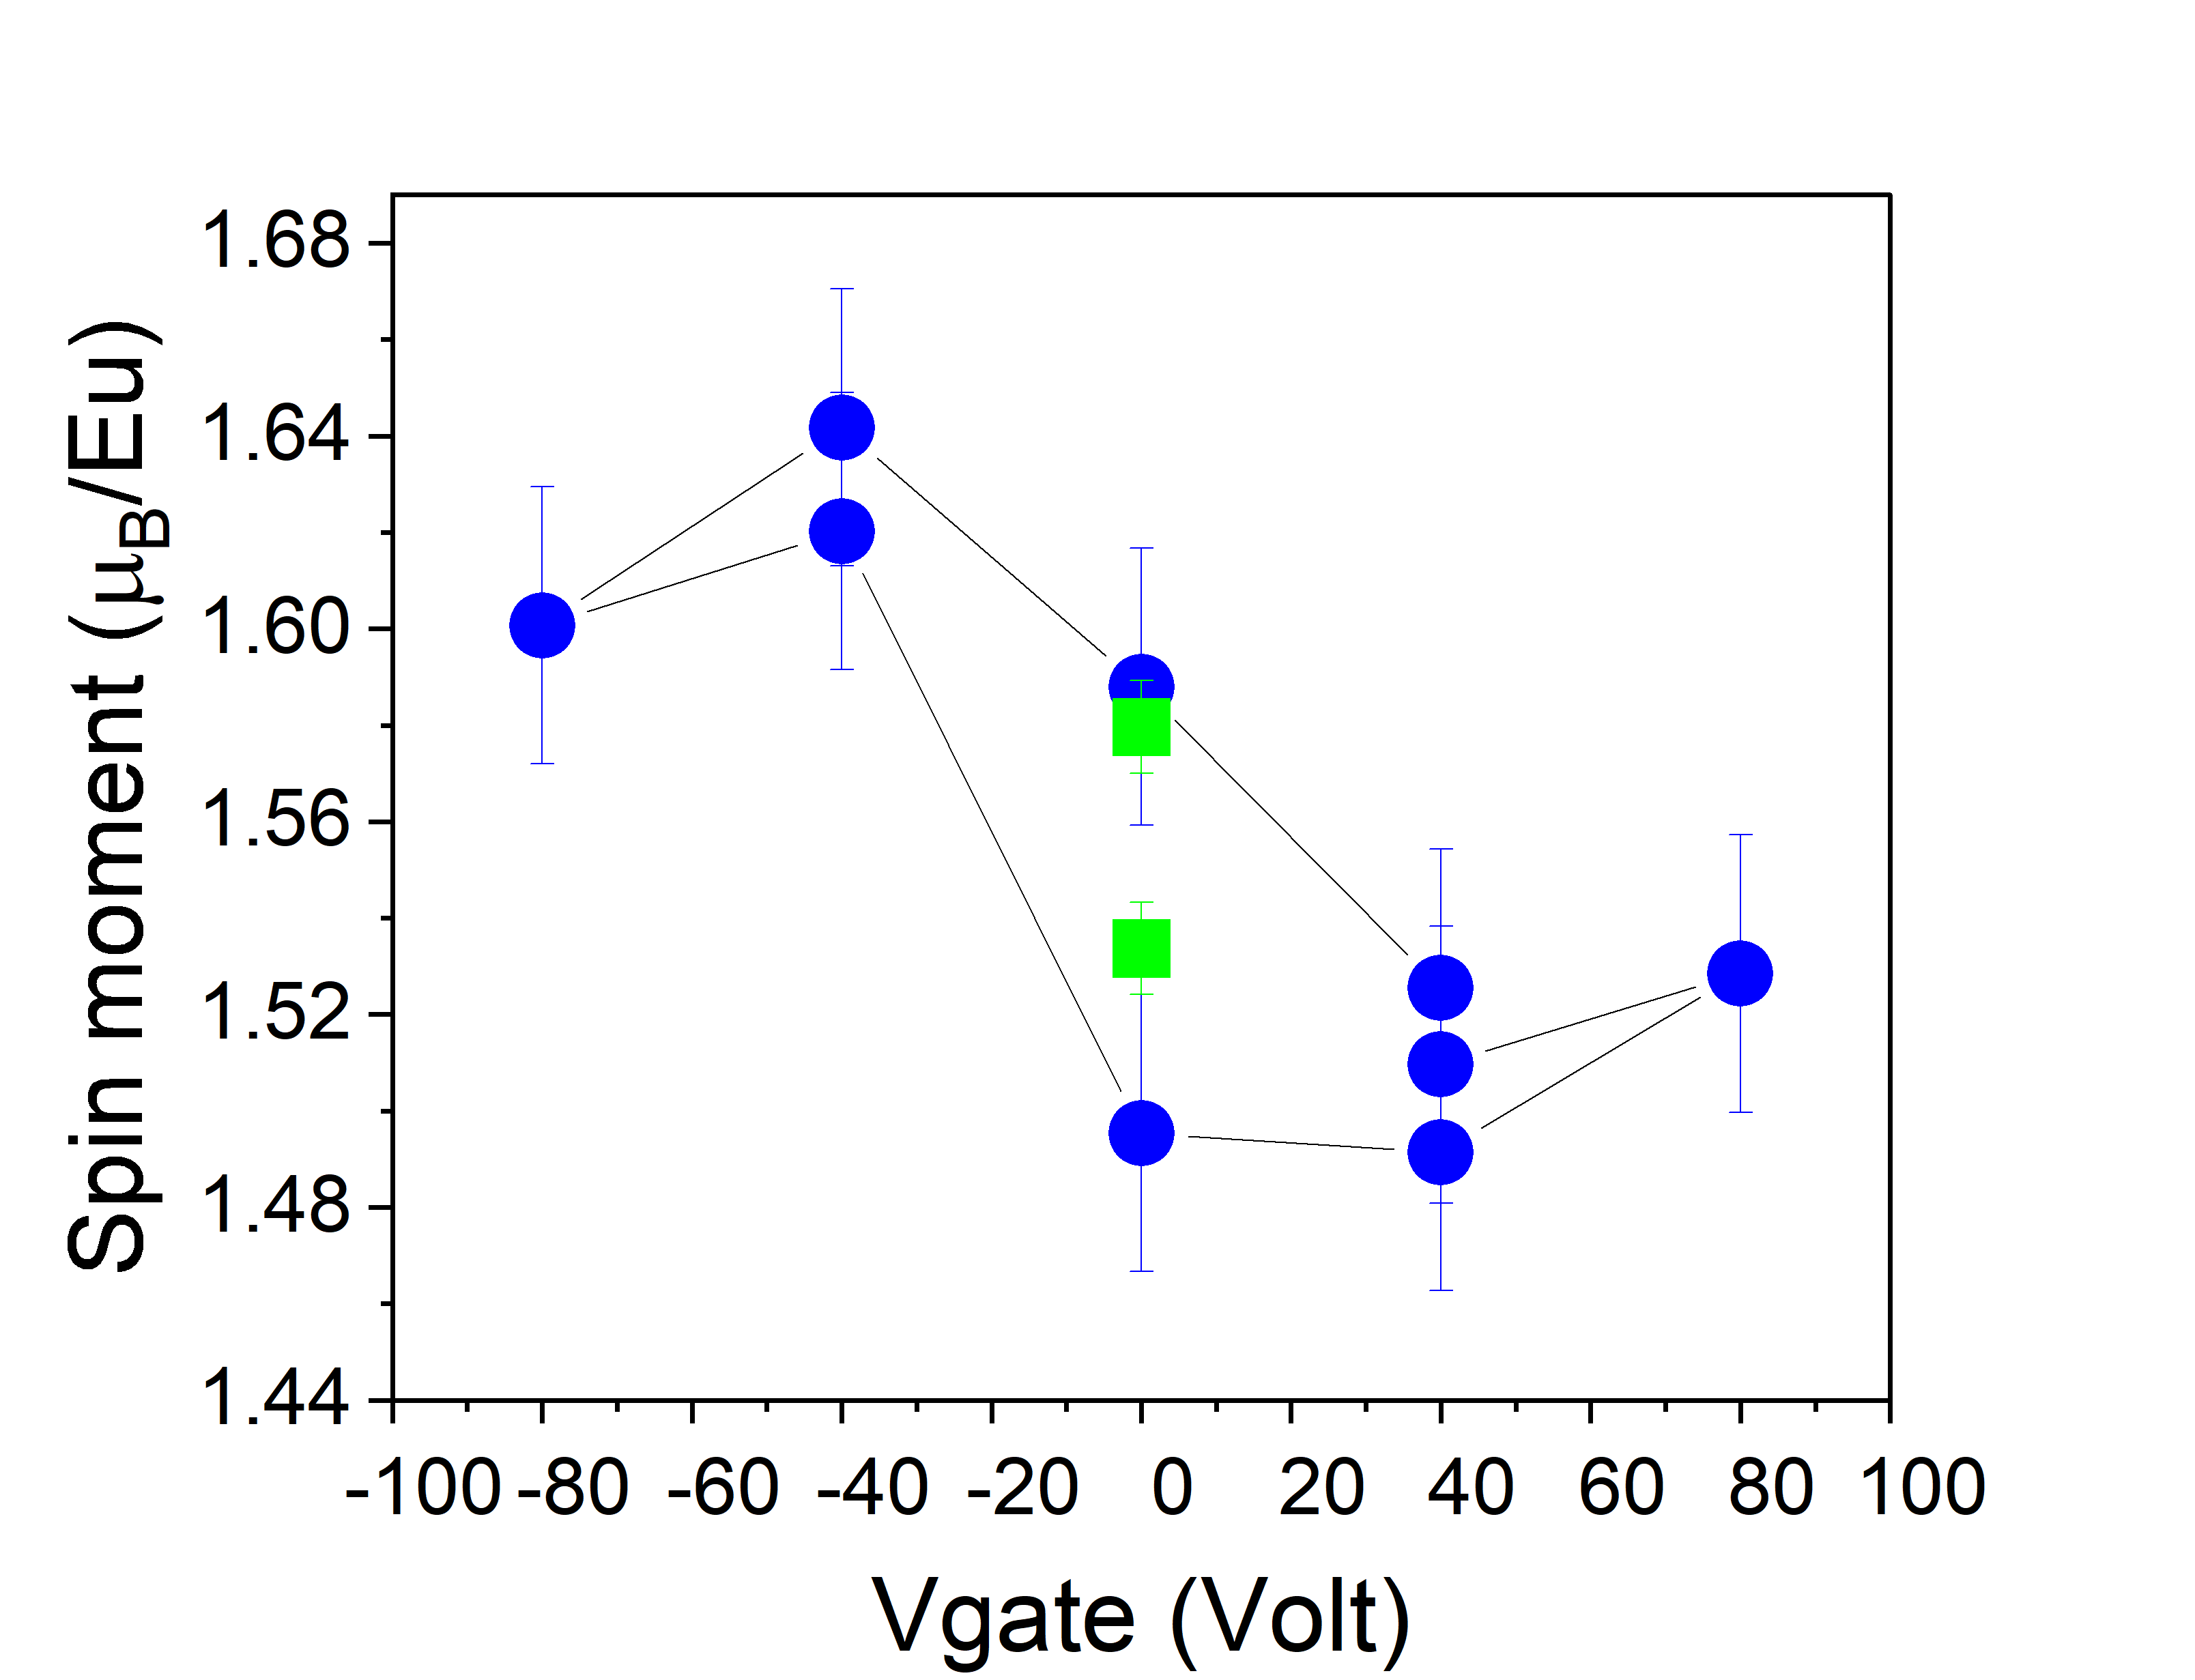
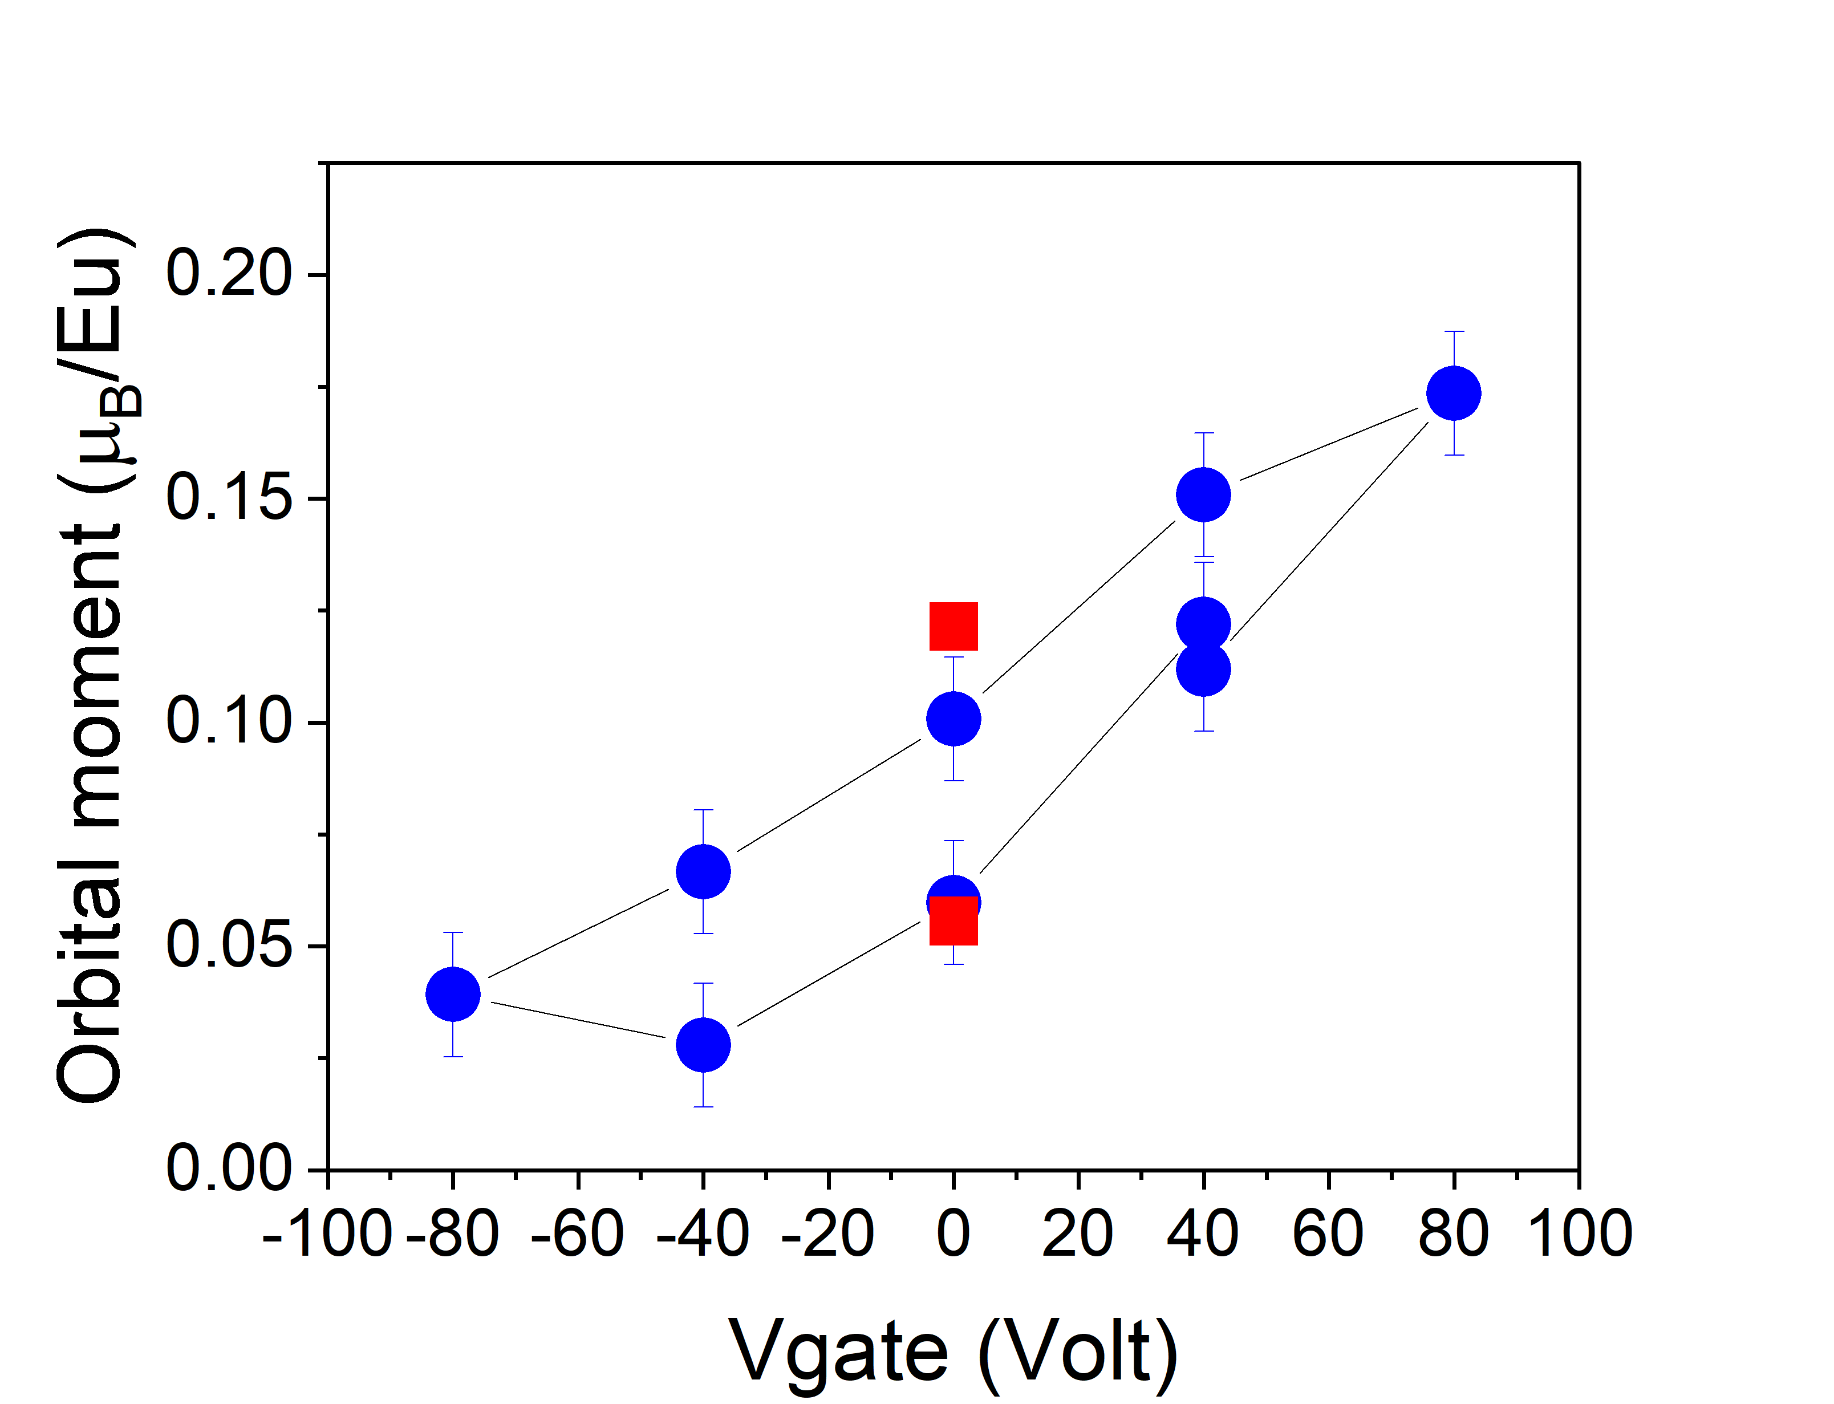
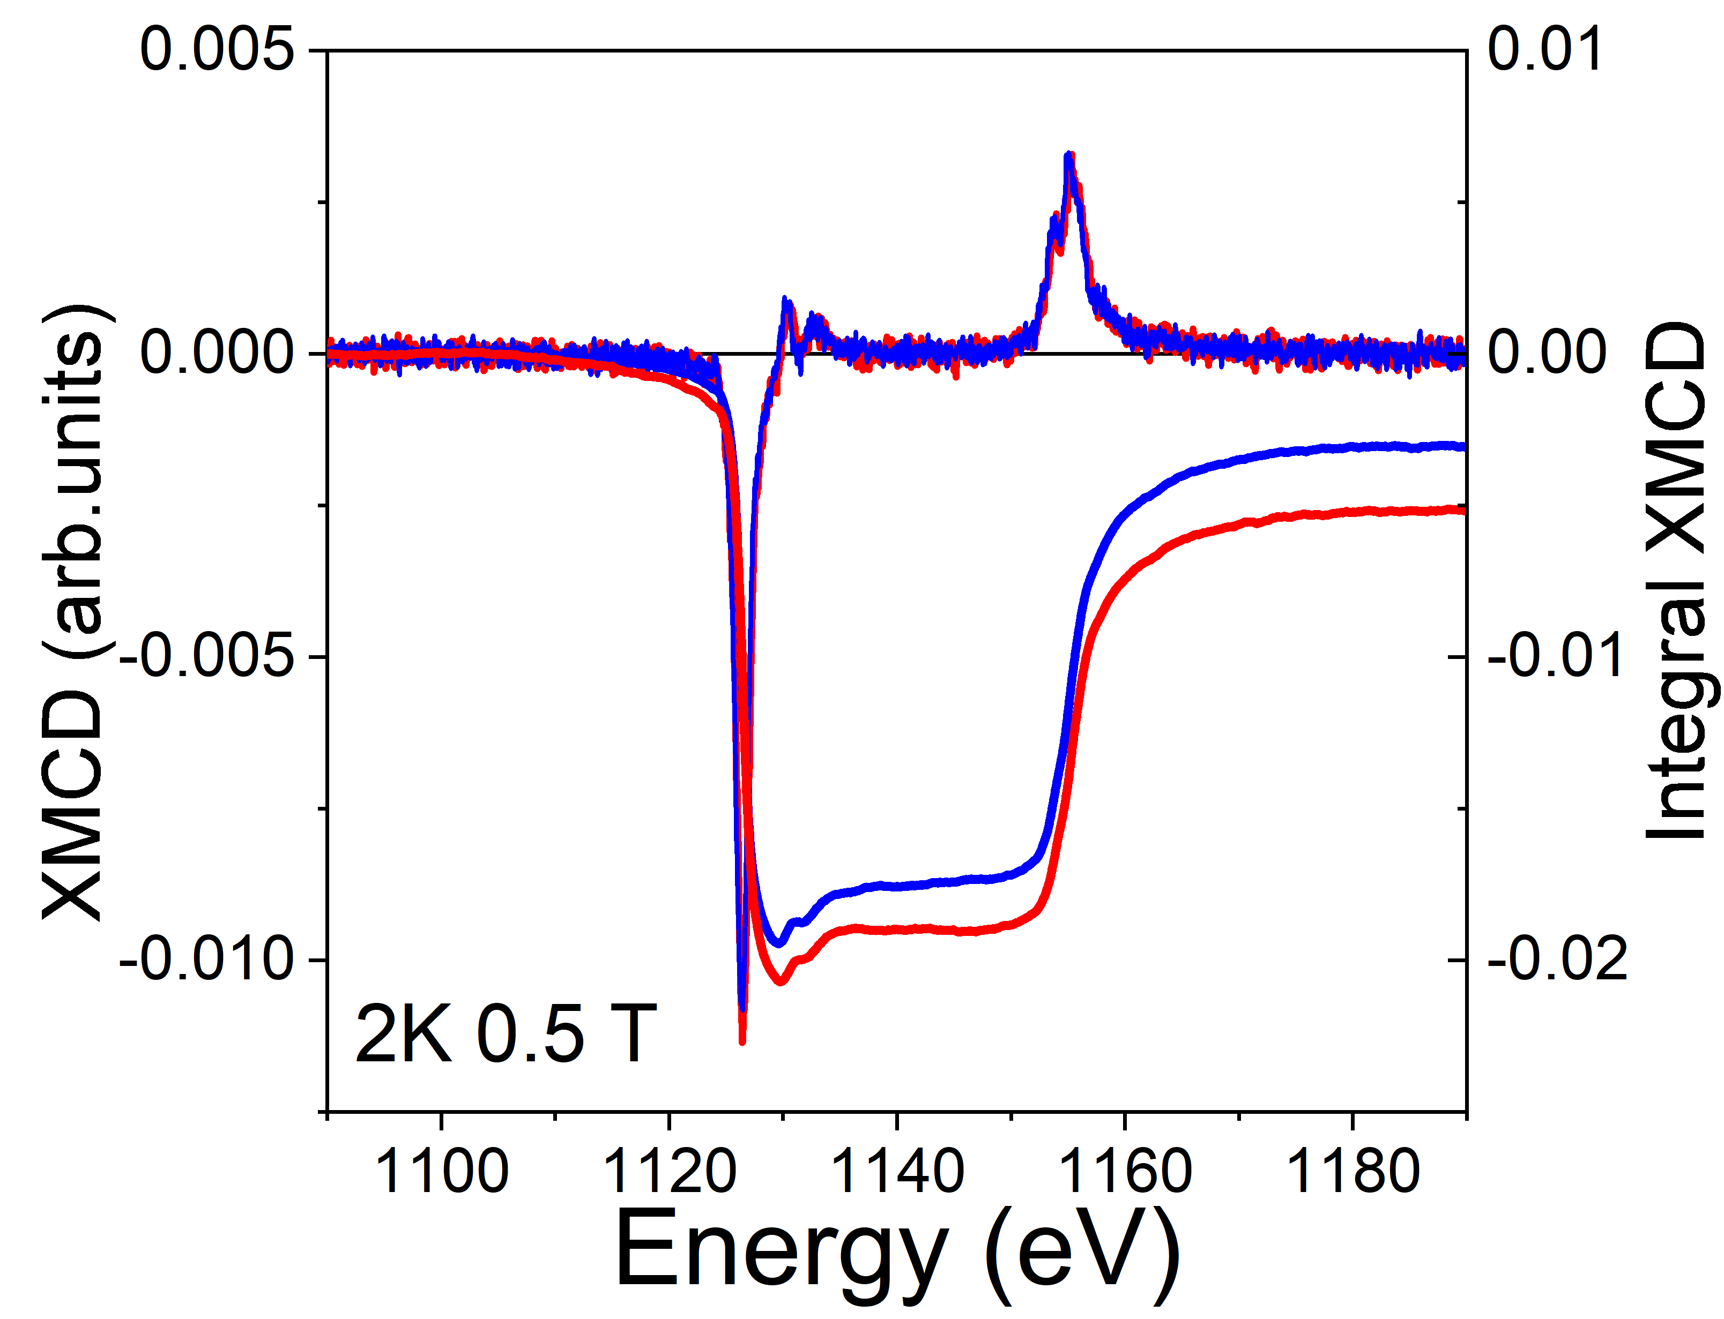
FY Eu-XMCD vs GATE VOLTAGE
morb ∝-q
VG= -80 V
VG= +80 V
mspin ∝ -(5p-3q)
Magnetoelectric Coupling: main modulation of the orbital moment of Eu²⁺
M. SALLUZZO (CNR-SPIN)
Secondo Congresso NQSTI, 05-07 febbraio 2025, Roma
06/02//2025

Slide 15
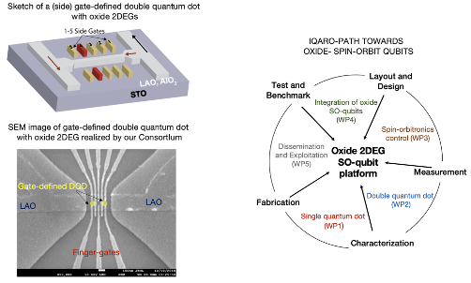
SPIN-ORBIT QUBITS BASED ON OXIDE 2DEGs
Realization of a prototype of SO-qubit with oxide 2DEGs with fast control of spin quantum states through tunable spin-orbit coupling (TRL4). In particular we aim a reduction of of direct and indirect sources of decoherence with respect to state of art SO-qubits due to:
- intrinsic properties of oxide materials, in particular the reduced nuclear hyperfine interaction due to carriers characterized by 3d- orbital wavefunctions and small intrinsic inner nuclear field;
- large tunability of the Rashba SOC and of the giant STO dielectric screening, for the reduction of charge noise;
IQARO Path-Finder
Horizon Europe
GA No. 101115190
M. SALLUZZO (CNR-SPIN)
Secondo Congresso NQSTI, 05-07 febbraio 2025, Roma
06/02//2025

Slide 16
Summary
A FE and FM 2DEG have been engineered using EuTiO3 delta-doping layer at the interface between LaAlO3 and FE Ca-SrTiO3
- ferromagnetism demonstrated by XMCD
-Anomalous Hall effect due to the interplay of magnetism and SOC
-Non-volatile switching of the resistance, Hall-effect and magnetoresistance
-XLD data show the the orbital splitting is modulated by the polarization switching and across the FE transition temperature
- XMCD data show a modulation of the orbital magnetic moment of Eu-4f
states by the electric field effect.
-Spin-orbit qubits based on oxides
M. SALLUZZO (CNR-SPIN)
Secondo Congresso NQSTI, 05-07 febbraio 2025, Roma
06/02//2025

