Slide 1
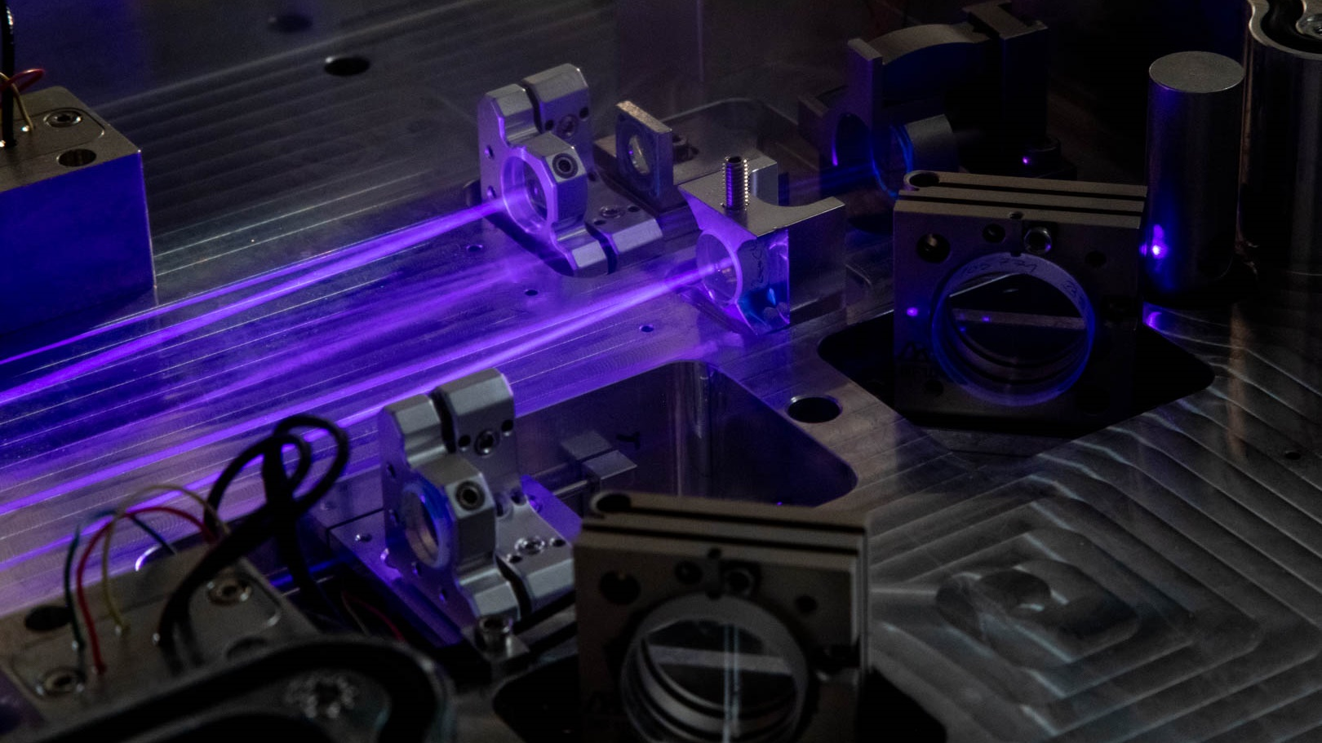



Spontaneous parametric down-conversion
from nanostructured LiNbO₃ resonators
supra Nano-Optics milano Labs
February 6th, 2023
2° Congresso Nazionale NQSTI

Slide 2

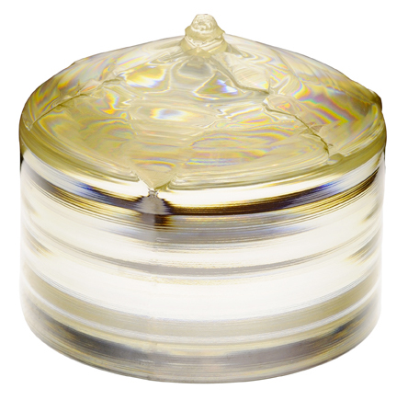
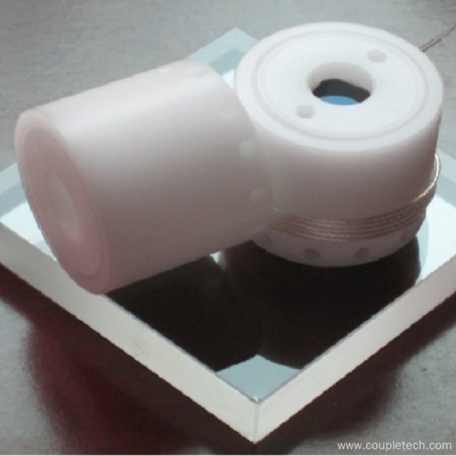
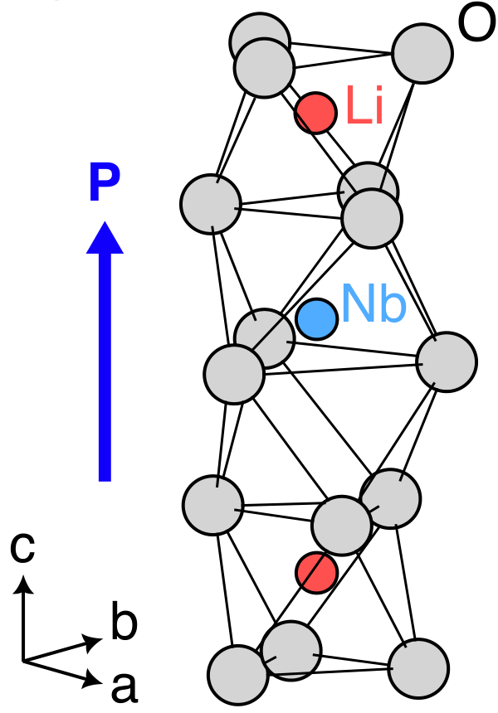
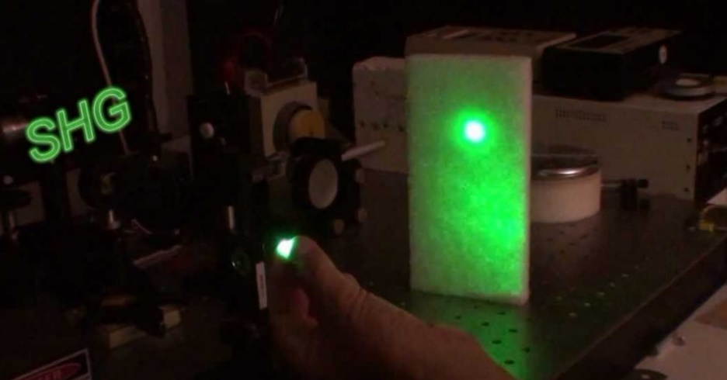
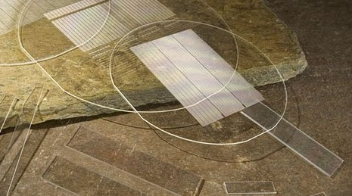
Lithium niobate — a wonder material for (nano?)photonics
Transparency from 350 nm to 5000 nm
Large electro-optic coefficient (r₃₃ = −35 pm/V)
→ Pockels cells and Q-switching in the near-IR
Second-order nonlinearity (d₃₃ = 27 pm/V)
  → Frequency up-conversion to the visible
LiNbO₃ Pockels cells
Bring these functionalities to the nanoscale!
Harmonic generation in Nd:YAG lasers
Periodically-poled LiNbO₃

Slide 3

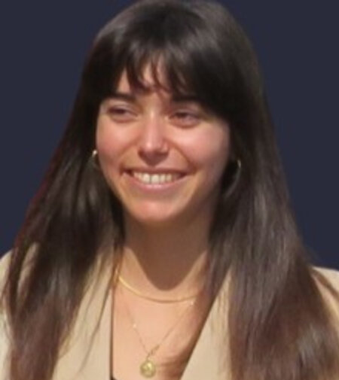

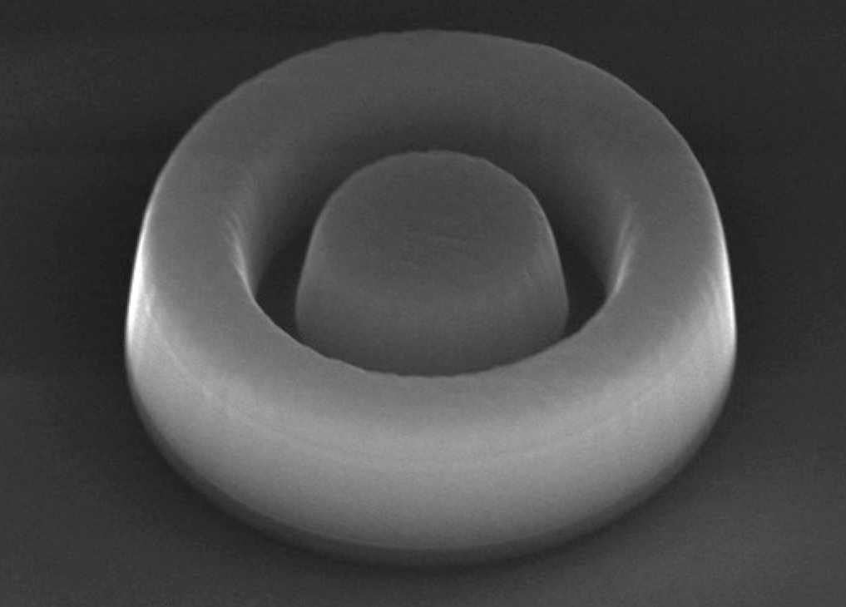
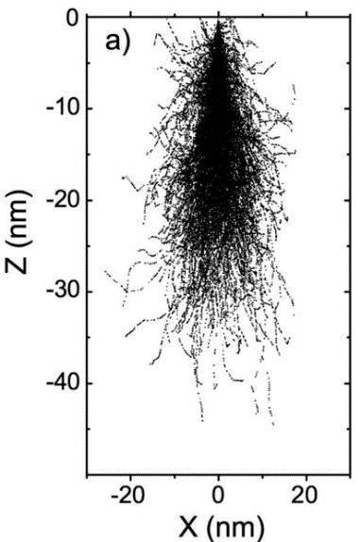
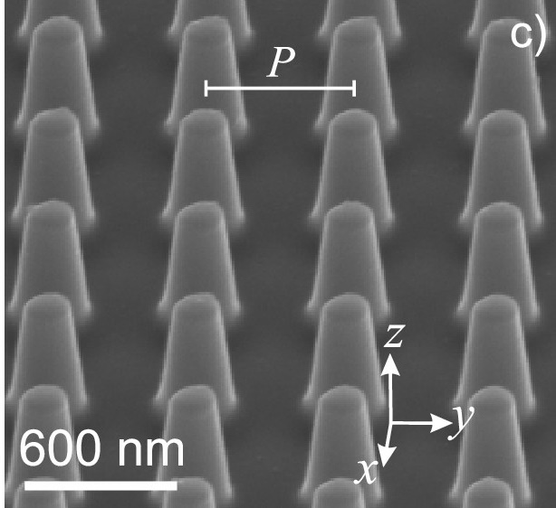
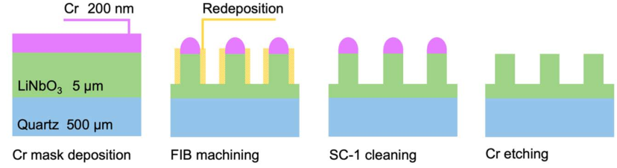
Nanofabrication of lithium niobate
Scanning electron microscopy
LiNbO₃ is very hard and chemically stable
→ Challenging nanofabrication
Ga⁺ focused ion beam machining
of LNOI thin films (500 nm)
+ High aspect ratio
+ Smallest spatial features
− Highly expensive
− Hardly scalable
1 μm
Marzia Ferrera
Andrea Toma
→
Monte Carlo collision simulation
7˚
→
→
→

Slide 4
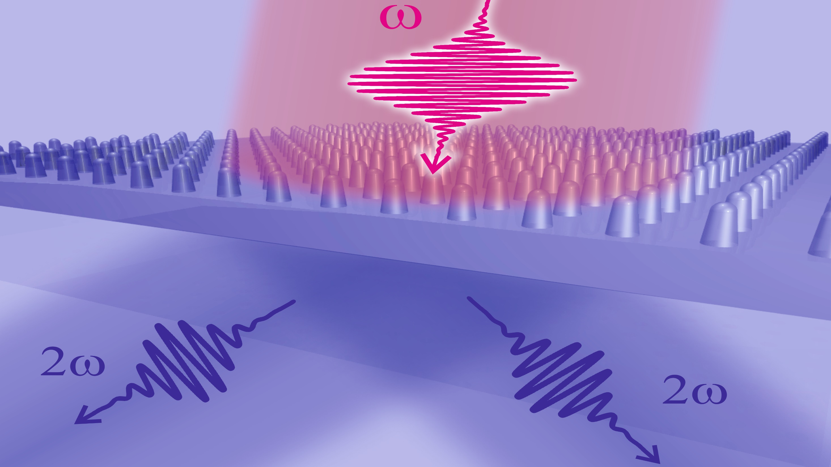

Slide 5
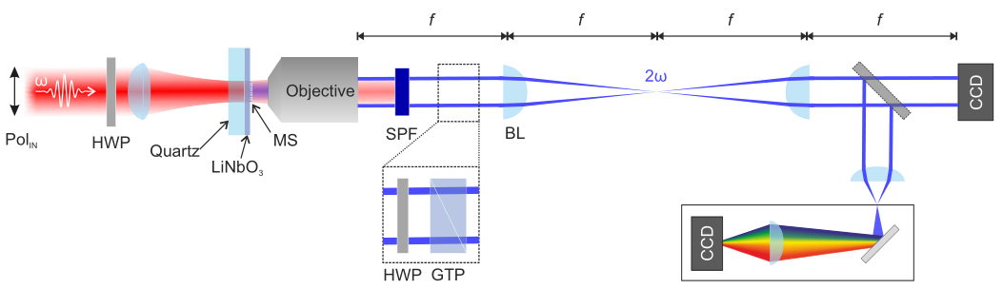
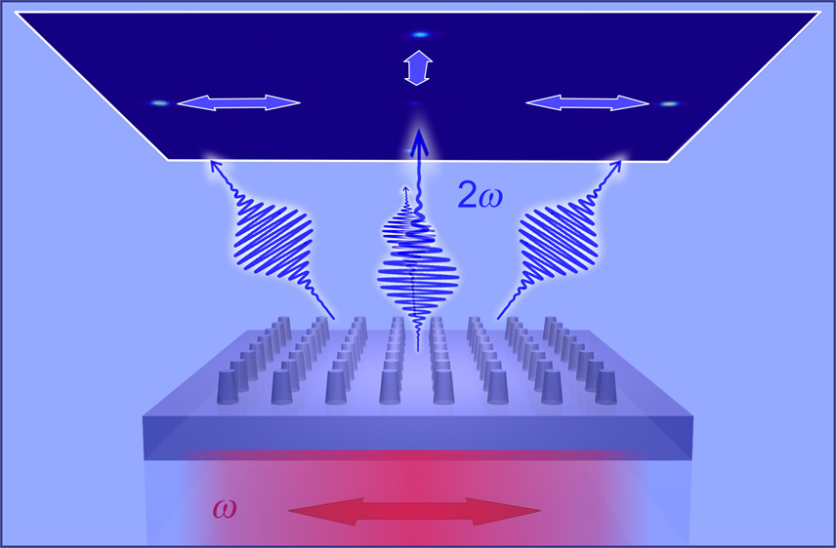
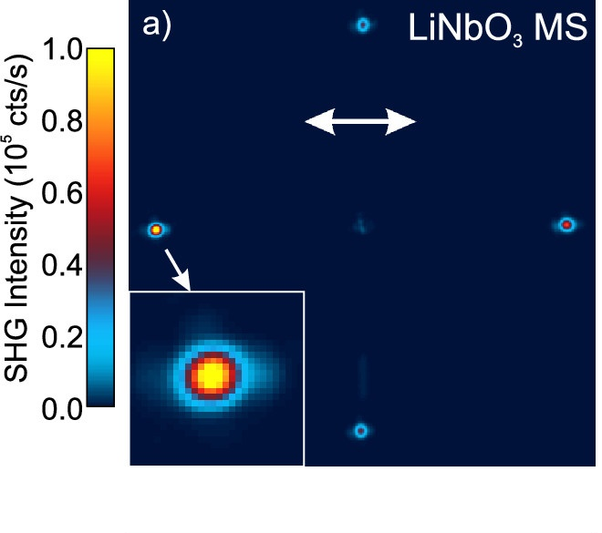
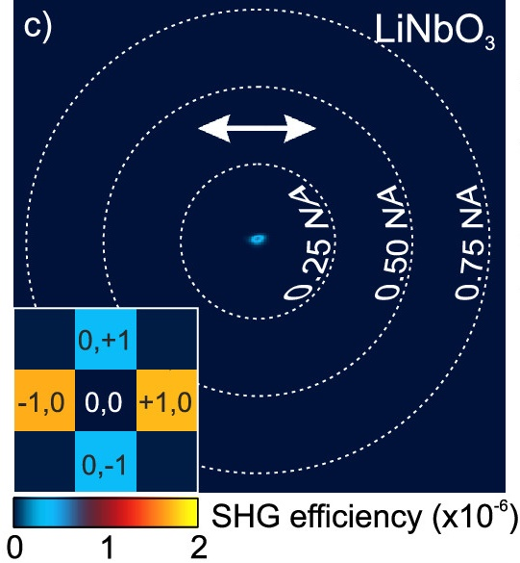
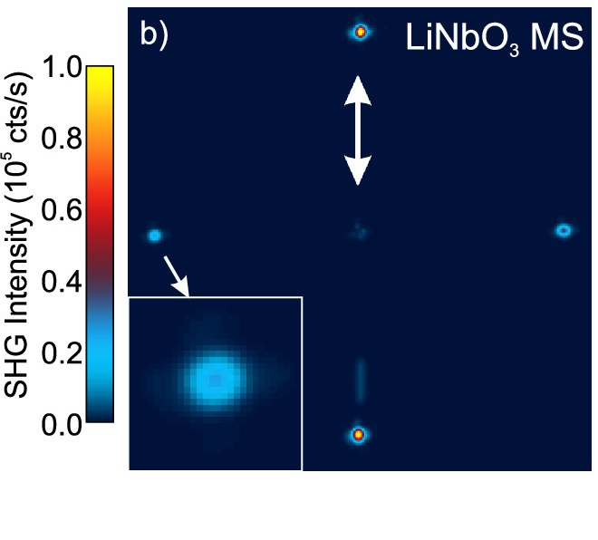
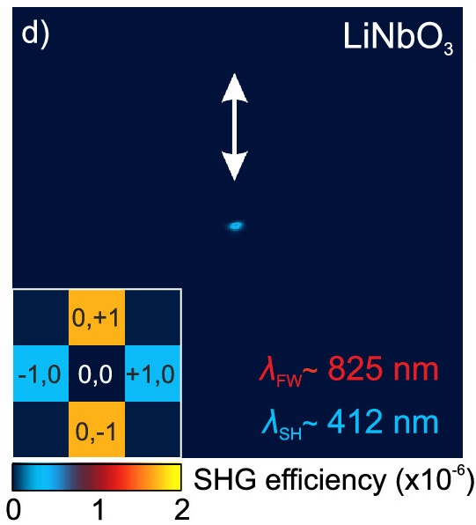

Back-focal plane imaging of the second-harmonic emission
$$\frac{λ_{SH}}{P}=\frac{415 nm}{590 nm}=0.70 NA$$
LiNbO₃
LiNbO₃

Slide 6
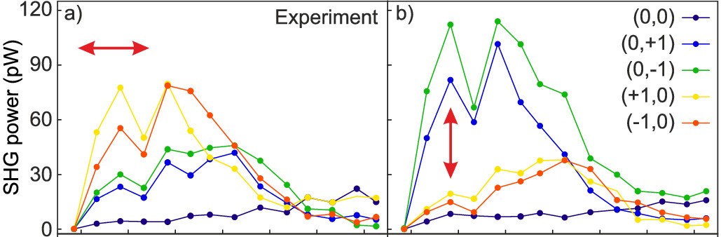
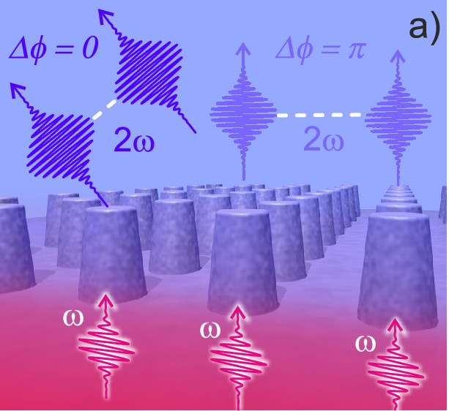
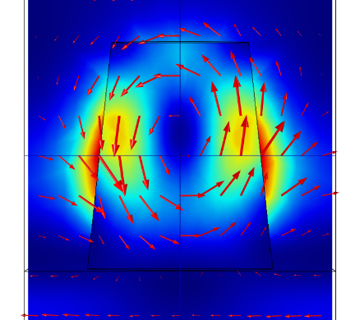




Visible second harmonic from a lithium niobate metasurface
50
Magnetic
dipole (MD)
resonance
Resonance in the NIR at 820 nm
|E|² /|E₀|²
→ SHG in the VIS at 410 nm
0
1
2
3
4
L. Carletti¹, A. Zilli², F. Moia³, A. Toma³, M. Finazzi²,
C. De Angelis¹, D. N. Neshev⁴, and M. Celebrano²
ACS Photonics 8, 731 (2021)
Notes:
Isabelle Staude, Tomas Santiago-Cruz
Ma LPR21: Pavg = 23 mW, 200 fs, 80 MHz, eta = 2.0e-6, gamma = 2e-6 / (0.033 W / 200e-15 / 80e6)

Slide 7

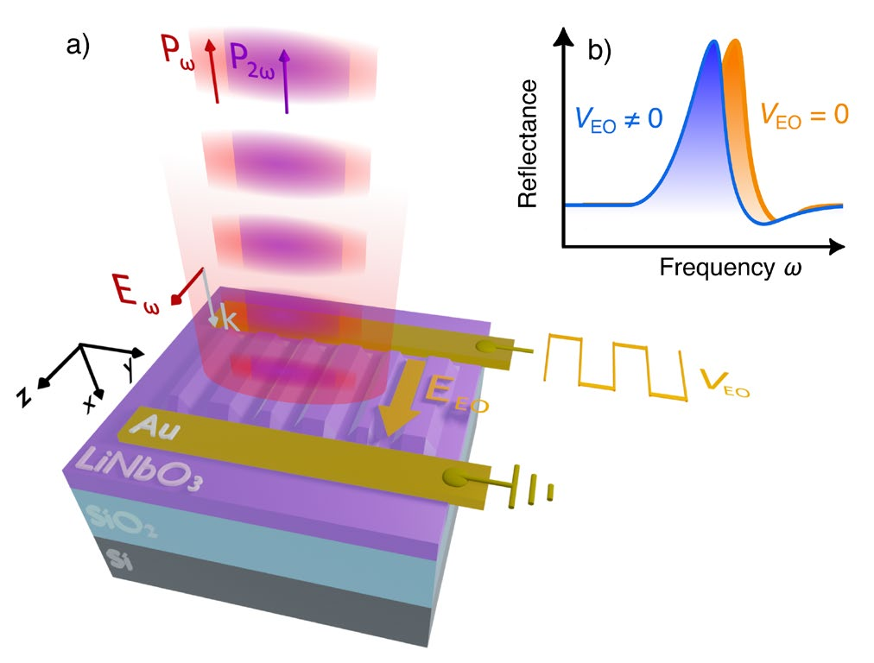
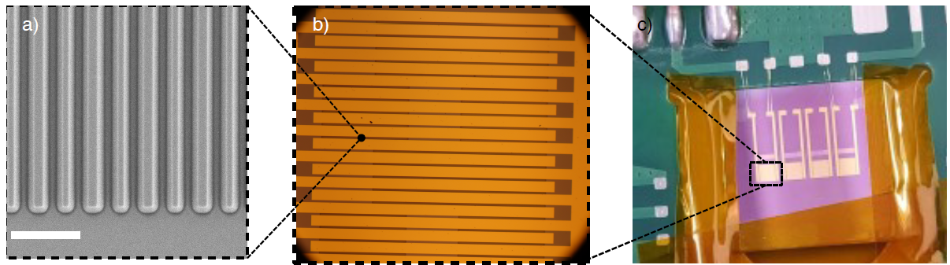
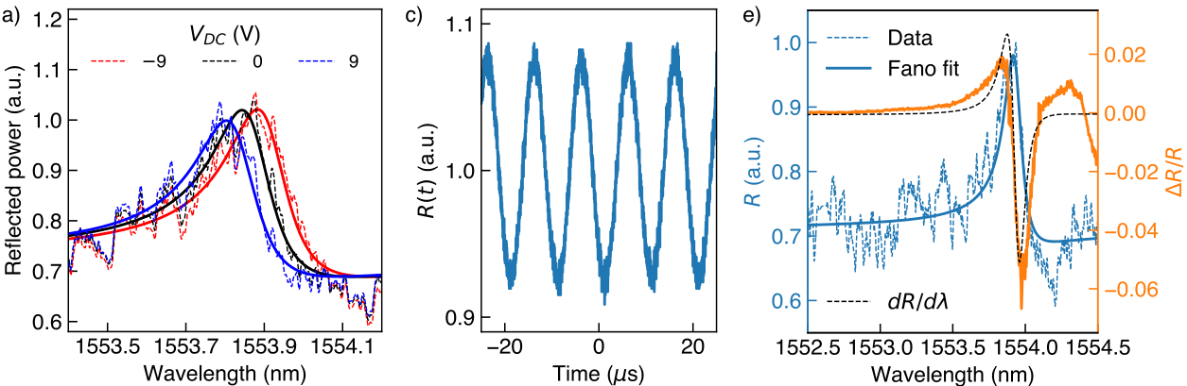
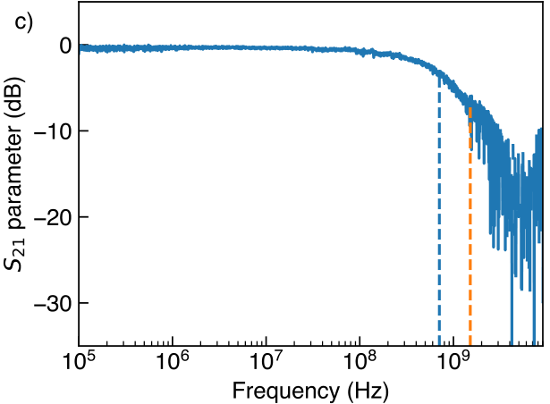
An electro-optic integrated metasurface
Monolithic LiNbO₃ architecture with Interdigitated electrode design
1 µm
Speed > 1GHz
Efficiency > 0.01/V
Notes:
This slide can go

Slide 8

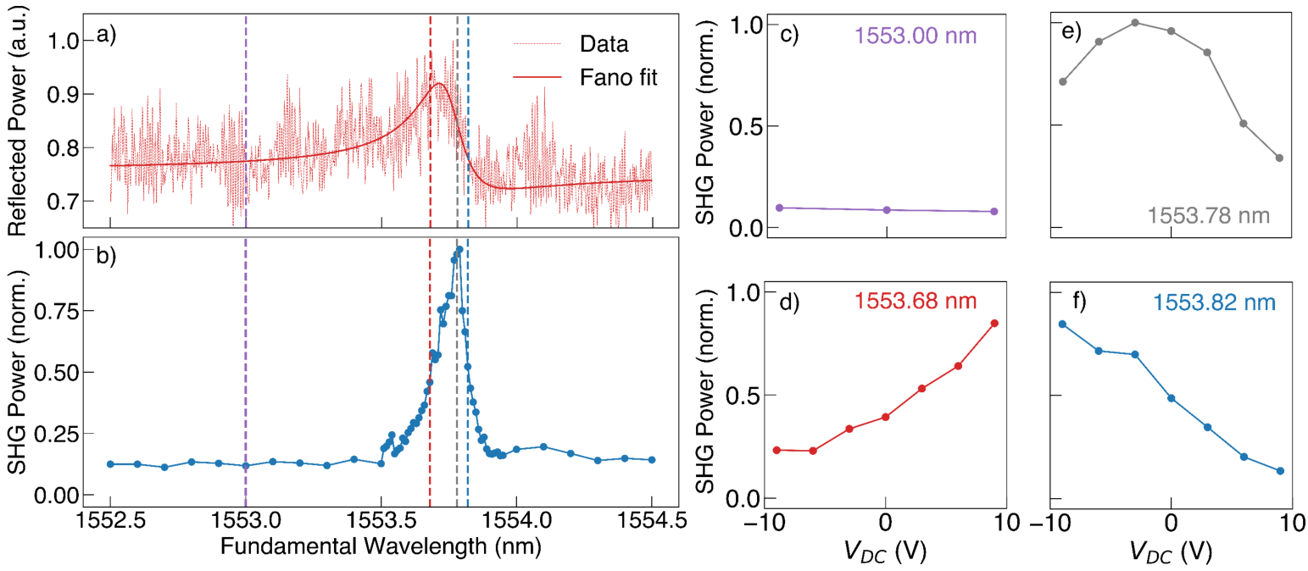

SHG modulation with CW pumping
Agostino Di Francescantonio
Rachel Grange
1
2
3
A. Di Francescantonio¹, A. Sabatti², H. Weigand², E. Bailly², M.A. Vincenti³,
L. Carletti³, J. Kellner², A. Zilli¹, M. Finazzi¹, M. Celebrano¹, and Rachel Grange²
arXiv 2412.03422 (2024)
Notes:
This slide can go

Slide 9

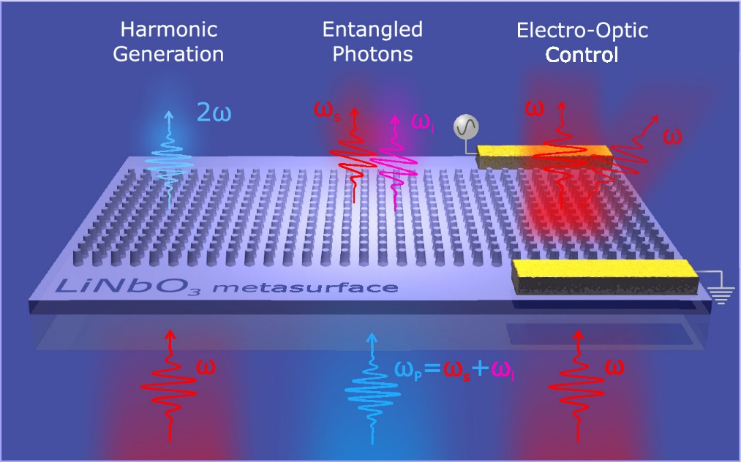
Meta-optics with lithium niobate – Our perspective
1
2
3
4
5
A. Fedotova¹, L. Carletti², A. Zilli³, F. Setzpfandt¹,
I. Staude¹, A.Toma⁴, M. Finazzi³, C. De Angelis²,
T. Pertsch¹, D. N. Neshev⁵, and M. Celebrano¹
ACS Photonics 9, 3745 (2022)
NQSTI Spoke 6 − Topic A3: Integration of single-photon sources into lithium niobate

Slide 10

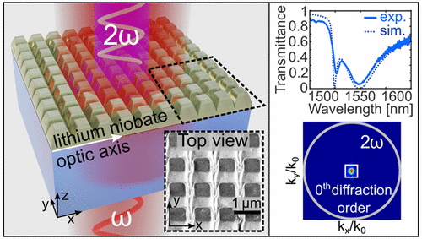
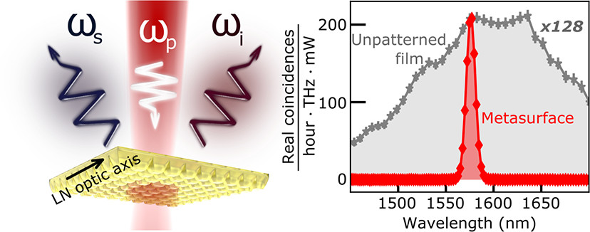
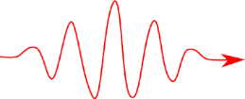


A classical−quantum correspondence
Fedotova et al. Nano Lett. 20, 8608 (2020)
Santiago-Cruz et al. Nano Lett. 21, 4423 (2021)
SHG
Time reversal
SPDC
ω
Experimental challenges
Low photon-pair yield from ultrathin platforms
Pairs are emitted over a broad angular range
ω
(s)
2ω
(p)
2ω
ω
ω
(i)
→ Resonances to boost and control emission
→ Quantum−classical correspondence as a heuristic design tool
d₃₃
d₃₃

Slide 11

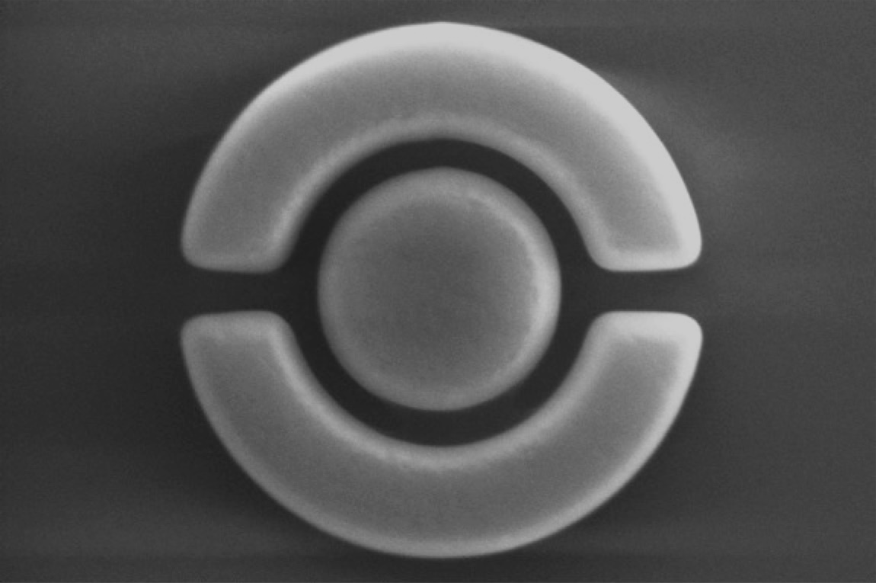

Can we reduce the footprint to a single nanoresonator?

Slide 12
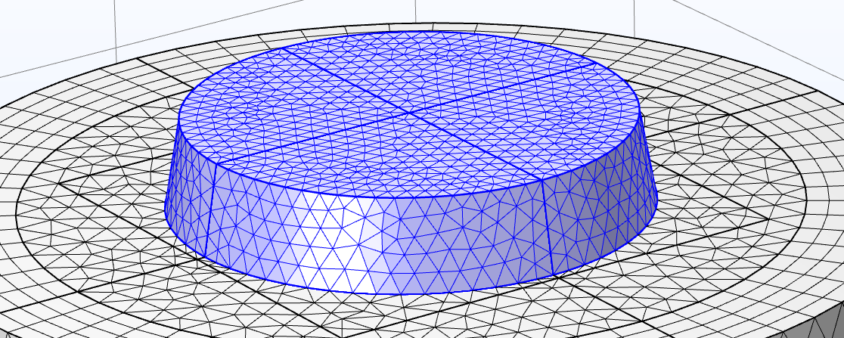

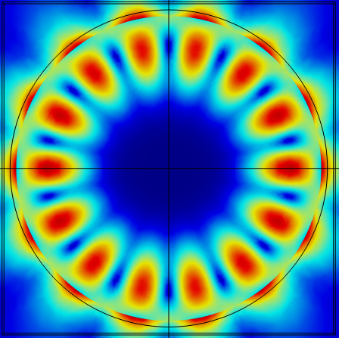
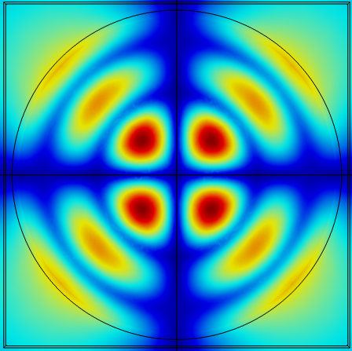
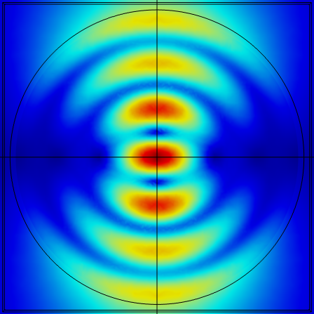

Numerical design: eigenmodes of a LiNbO₃ disc
M. Poloczek
Full vectorial simulations with Comsol+Matlab+Retop
No classical approach available to simulate SPDC
Eigenmode study of a disc (H = 500 nm, R = 1300 nm) in the telecom range
λ = 1465 nm, Q = 37
λ = 1476 nm, Q = 11
λ = 1487 nm, Q = 13

Slide 13
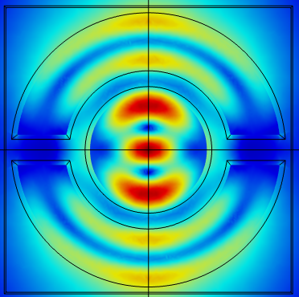

Numerical design: eigenmodes of a LiNbO₃ disc
M. Poloczek
Full vectorial simulations with Comsol+Matlab+Retop
No classical approach available to simulate SPDC
Eigenmode study of a disc (H = 500 nm, R = 1300 nm) in the telecom range
λ = 1465 nm, Q = 37
λ = 1476 nm, Q = 11
λ = 1487 nm, Q = 13

Slide 14
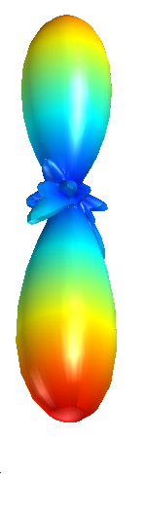
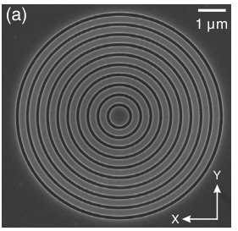
Numerical design: boosting and beaming SPDC with resonances
Electron microscopy
Resonance
Resonant enhancement
Purcell effect
Check with simulated SHG efficiency
Directional emission
Inspired by Bragg gratings as SPDC beamers
Check with test dipole →
Cr
disc
LiNbO₃
SiO₂
x
d
d
groove
size
z
cut
1 μm
Wang, Pan et al. Phys. Rev. Lett. 122, 113602 (2019)
Liu, Wang et al. Nat. Nanotechnol. 14, 586 (2019)

Slide 15

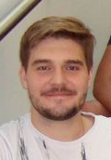
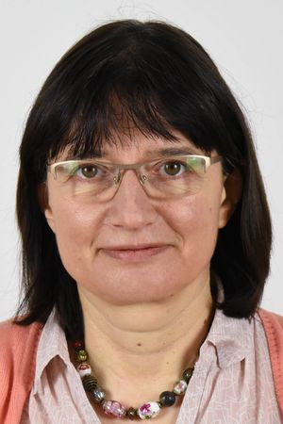



Measurements of photon pair emission
SHG raster imaging
disc
CW pump
λ = 785 nm
P = 5 mW
t = 10 min
N_{coi}
N_{coi} + N_{acc}
g⁽²⁾ =
N_{acc}
disc
SiO₂
N_{acc}
LiNbO₃
V. Sultanov
M. Chekhova
disc
cut
groove
z
cut
5 μm
Notes:
Us: 300 Hz/W
DuongOME22: 15 Hz/W

Slide 16
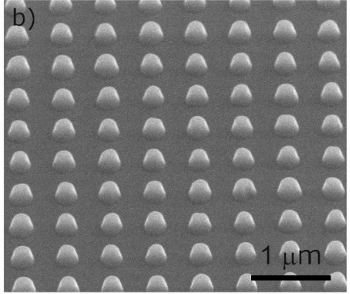
Marzia
Ferrera
Andrea
Toma
Biphoton rate order of magnitude better than previous reports from nanoparticles
Large luminescence from groove/cut
Implantation of FIB Ga+ ions?
FIB milling
+ High aspect ratio
+ Smallest features
EBL + dry etching
+ Larger areas
+ Less destructive

Slide 17

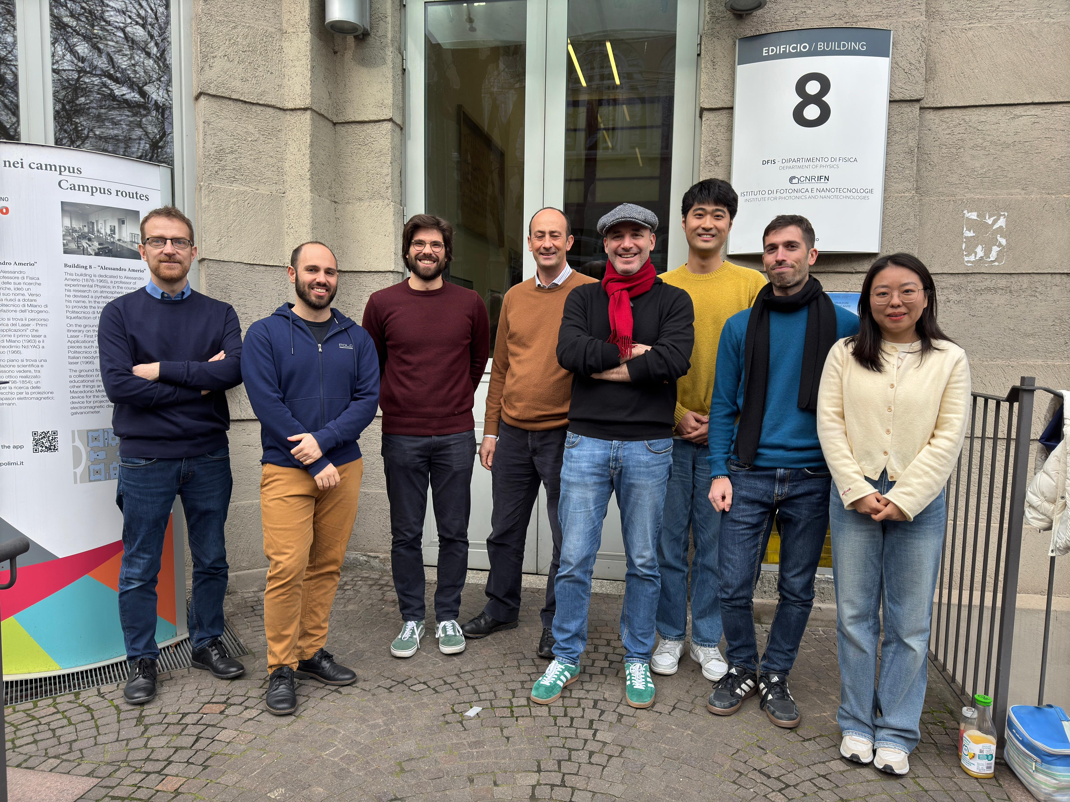
The QuantumLiNbO team @ PoliMi
Marco Finazzi
Project PI
Attilio Zilli
Project co-PI
Michele Celebrano
Team member
Alfonso Nardi
Post-doc

Slide 18













Acknowledgements
Nanofabrication @IIT (Genova)
Marzia Ferrera Andrea Toma
Simulations and SHG @PoliMi
SPDC @Max-Planck (Erlangen)
Attilio Zilli
Michael Poloczek
Yigong Luan
Michele Celebrano
Marco Finazzi
Vitaliy Sultanov
Michael Poloczek
Emmanouil Kokkinakis
Tomàs Santiago-Cruz
Maria Chekhova
Theory & calculations @ Uni. Brescia
Luca Carletti
Spesa finanziata a valere sulle risorse previste dal bando a cascata emanato da UNIMIB con DR 443/2024 prot. 53652 del 31/01/24, ai sensi dell’Avviso MUR n. 341 del 15 marzo 2022, nell'ambito del PNRR, M4C2 Investimento 1.3- Progetto NQSTI PE_00000023, finanziato dall'Unione europea- NextGenerationEU - CUP H43C22000870001 - Spoke 6 – bando a cascata prog. “NQSTI” – QuantumLiNbO.

Slide 19
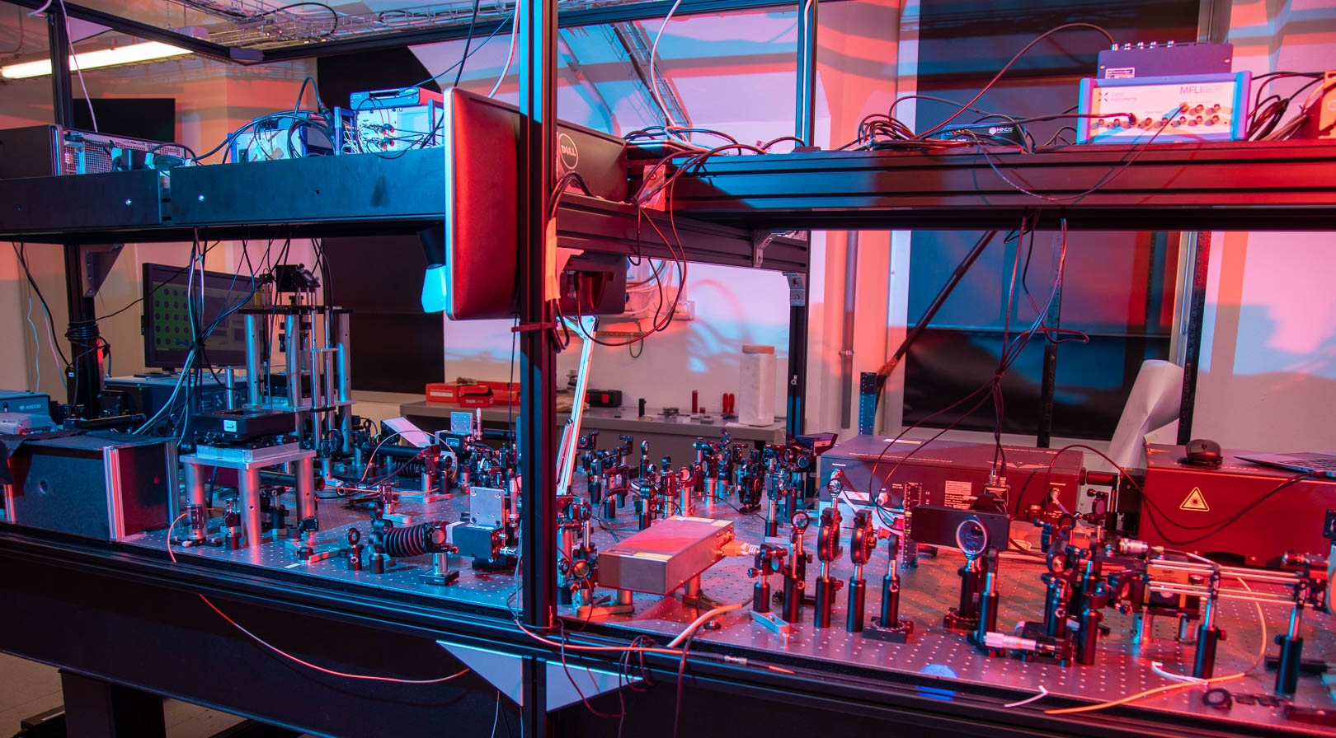
Summary and outlook
  LiNbO₃ is emerging as a prime material for nonlinear nanophotonics
  Progress enabled by steady advances in nanofabrication capabilities
  Metasurface exhibit polarization-controlled second-harmonic steering
  Nanostructured resonator designed as a directional source of photon pairs
  → Directional emission still to be proven experimentally

