Slide 1

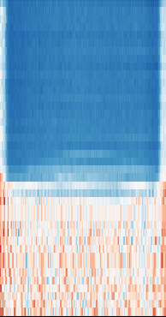
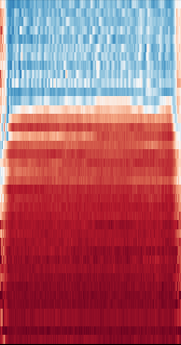




Ferromagnetism in an atomic quantum spin mixture
Giacomo Lamporesi
CNR-INO Trento
06/02/2025

Slide 2
PNRR PE4 - NQSTI
Spoke 6 Integration
Activity A6.1 Integration of atomic devices
Design and implementation of atomic circuits to resemble electron-based networks of different classes of conductors, semiconductors, superconductors or magnets. Design and implementation of fully controllable quantum devices based on strongly interacting degenerate atomic gases with tunable interactions trapped in engineered and fully programmable optical structures.
Direct connection to Spoke 2 (theory) and Spoke 3 (experimental techniques)
FLORENCE fermions ⁶Li (Giacomo Roati)
TRENTO bosons ²³Na
Missione 4 • Istruzione e Ricerca
Missione 4 • Istruzione e Ricerca

Slide 3
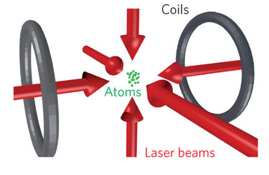
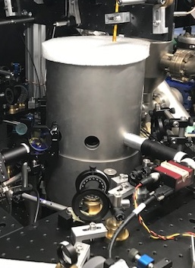

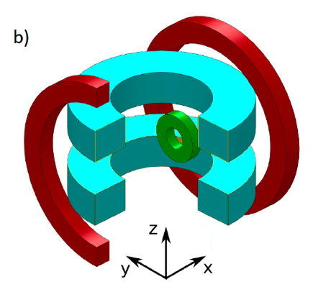
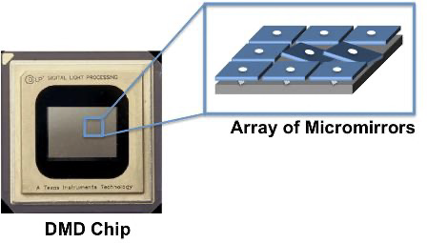
EXPERIMENTAL PLATFORM
Sodium bosonic atoms in two different spin states
Ultracold gas
(T=μK)
Laser-cooling
BEC / Superfluid
Ultimate control of external and internal degrees of freedom
Ultrastable
magnetic field
(ΔB=μG)
Magnetic and
Optical traps
Interparticle interaction
State
manipulation
Farolfi et al., RSI 90, 115114 (2019)
Rogora et al., PRA 110, 113319 (2024)
Missione 4 • Istruzione e Ricerca
Missione 4 • Istruzione e Ricerca

Slide 4
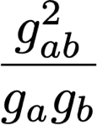
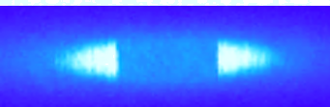
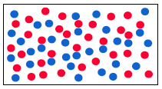
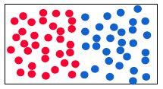
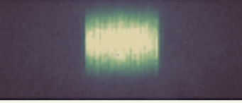




Quantum mixture
Intracomponent interactions
Intercomponent interactions
Baroni et al., Nat. Rev. Phys. 6, 736 (2024)
Quasi 1D geometry
Spin selective imaging
1
Miscible
Immiscible
Total DENSITY
SPIN density (magnetization)
F=2
m_{F} = -2
F=2
²³Na
²³Na
m_{F} = +1
F=1
m_{F} = -1
F=1
m_{F} = -1
Missione 4 • Istruzione e Ricerca
Missione 4 • Istruzione e Ricerca

Slide 5
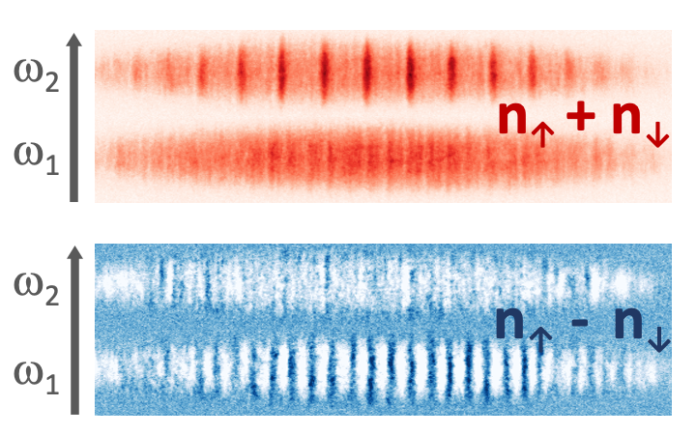
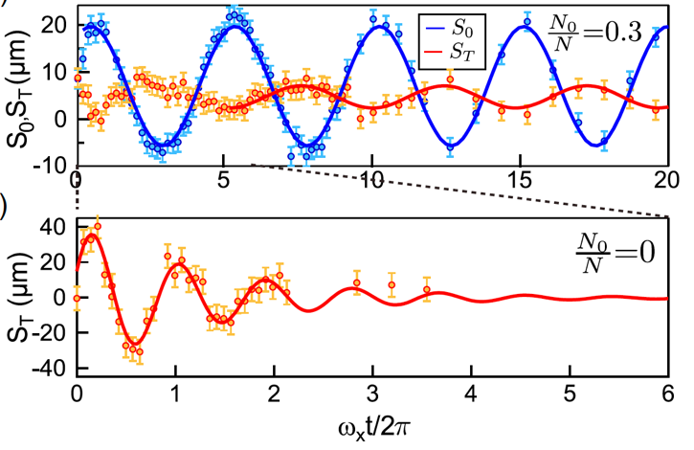
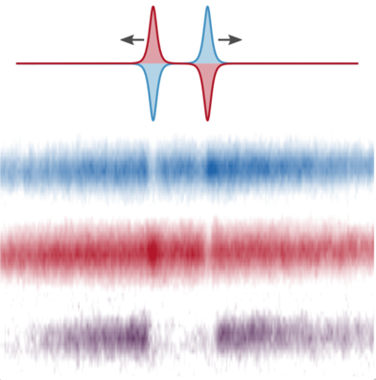
Miscible spin mixture
Measurement of spin dipole mode
Observation of spin superfluidity
Faraday waves
Measurement of the Bogoliubov spectrum for density and spin channels
Magnetic solitons
Dipole mode
Spin-dipole mode
Bienaimé et al., PRA 94, 063652 (2016)
Fava et al., PRL 120, 170401 (2018)
Cominotti et al., PRL 128, 210401 (2022)
Farolfi et al., PRL 125, 030401 (2020)
Missione 4 • Istruzione e Ricerca
Missione 4 • Istruzione e Ricerca

Slide 6

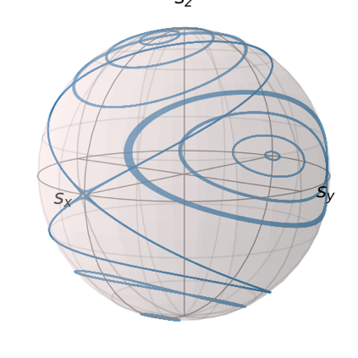
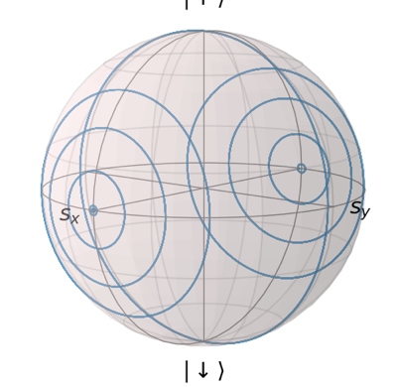
Immiscible spin mixture
Competition between
interactions and coupling
Many-body interacting system
Coherent coupling
Non interacting system
Ω, Δ
Coupling
dominates
Spin interactions
dominate
PARAMAGNETIC
FERROMAGNETIC
Simulation of magnetic material
Missione 4 • Istruzione e Ricerca
Missione 4 • Istruzione e Ricerca

Slide 7
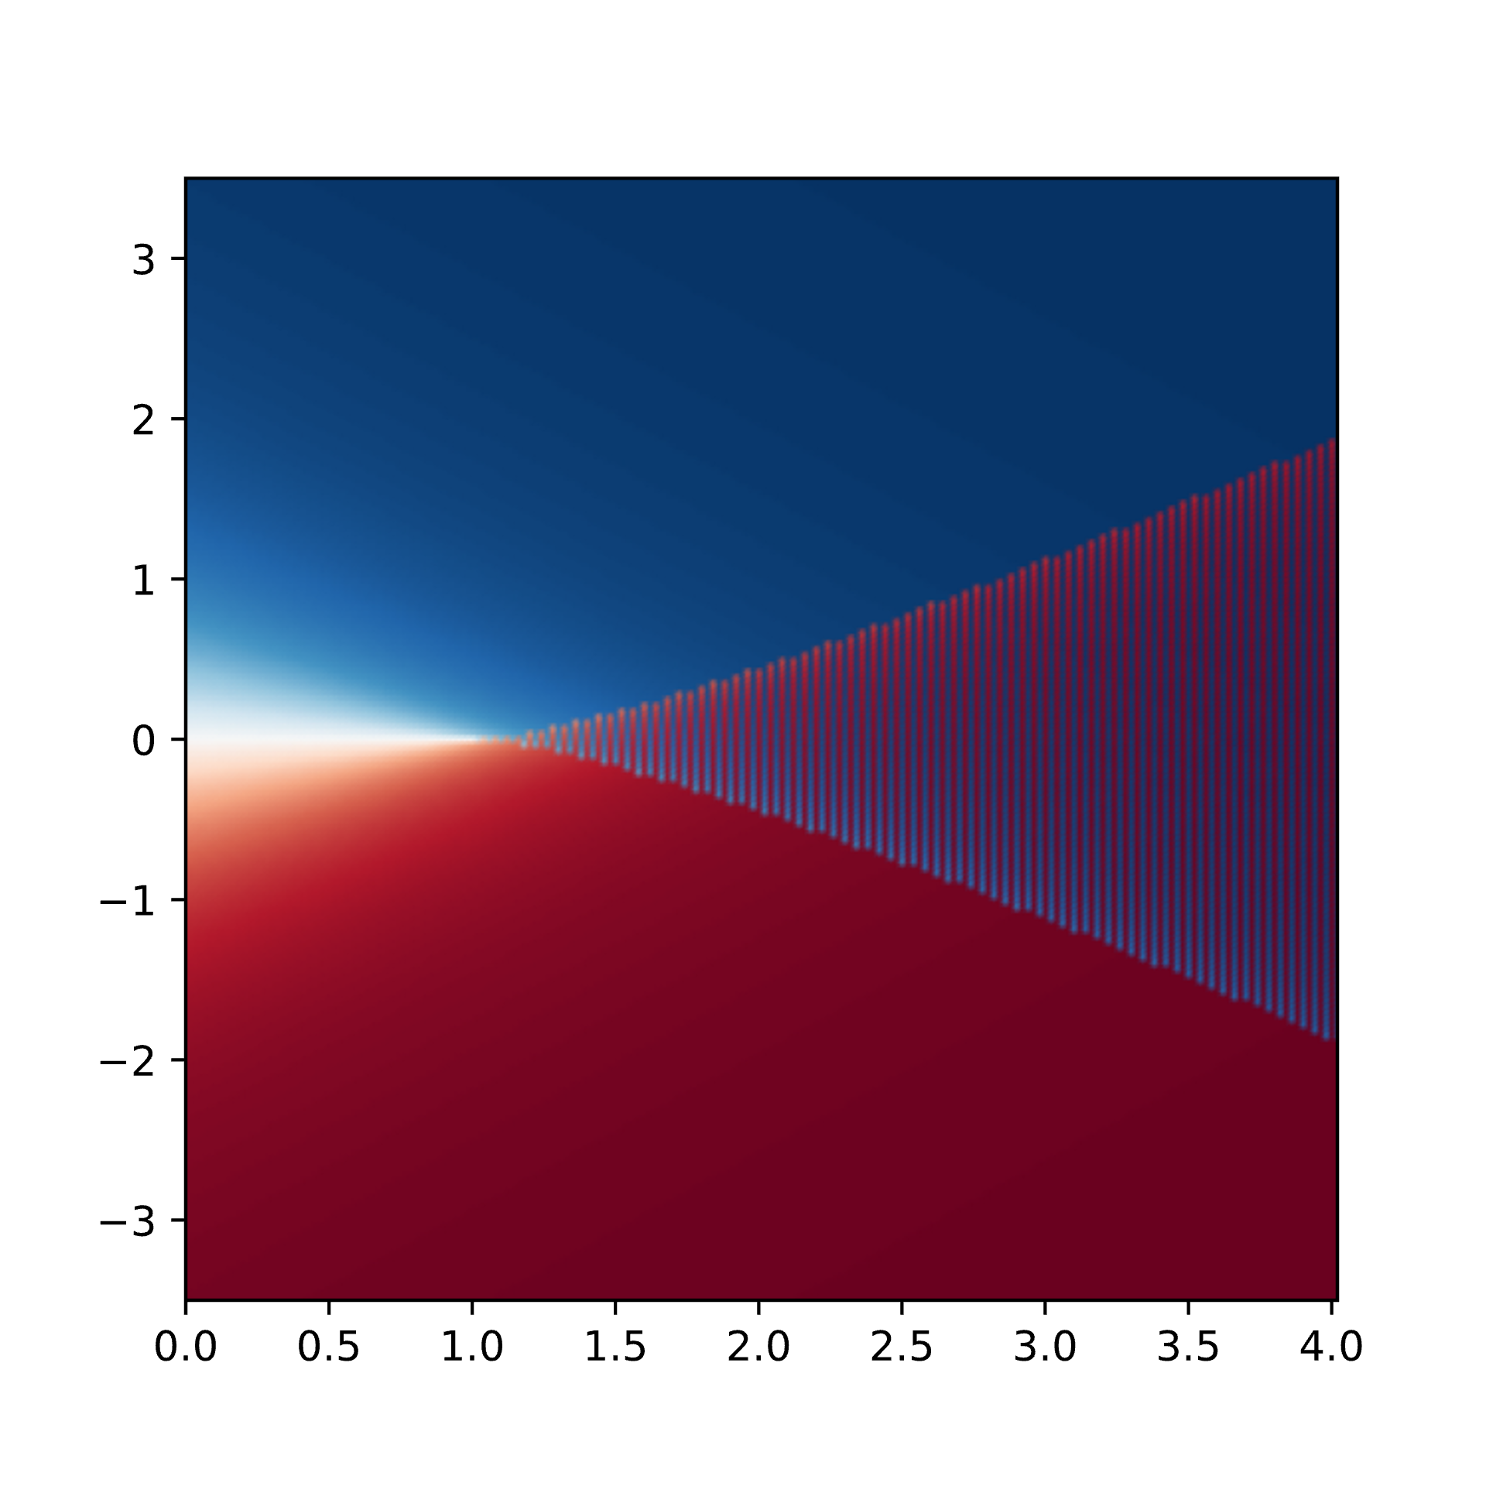
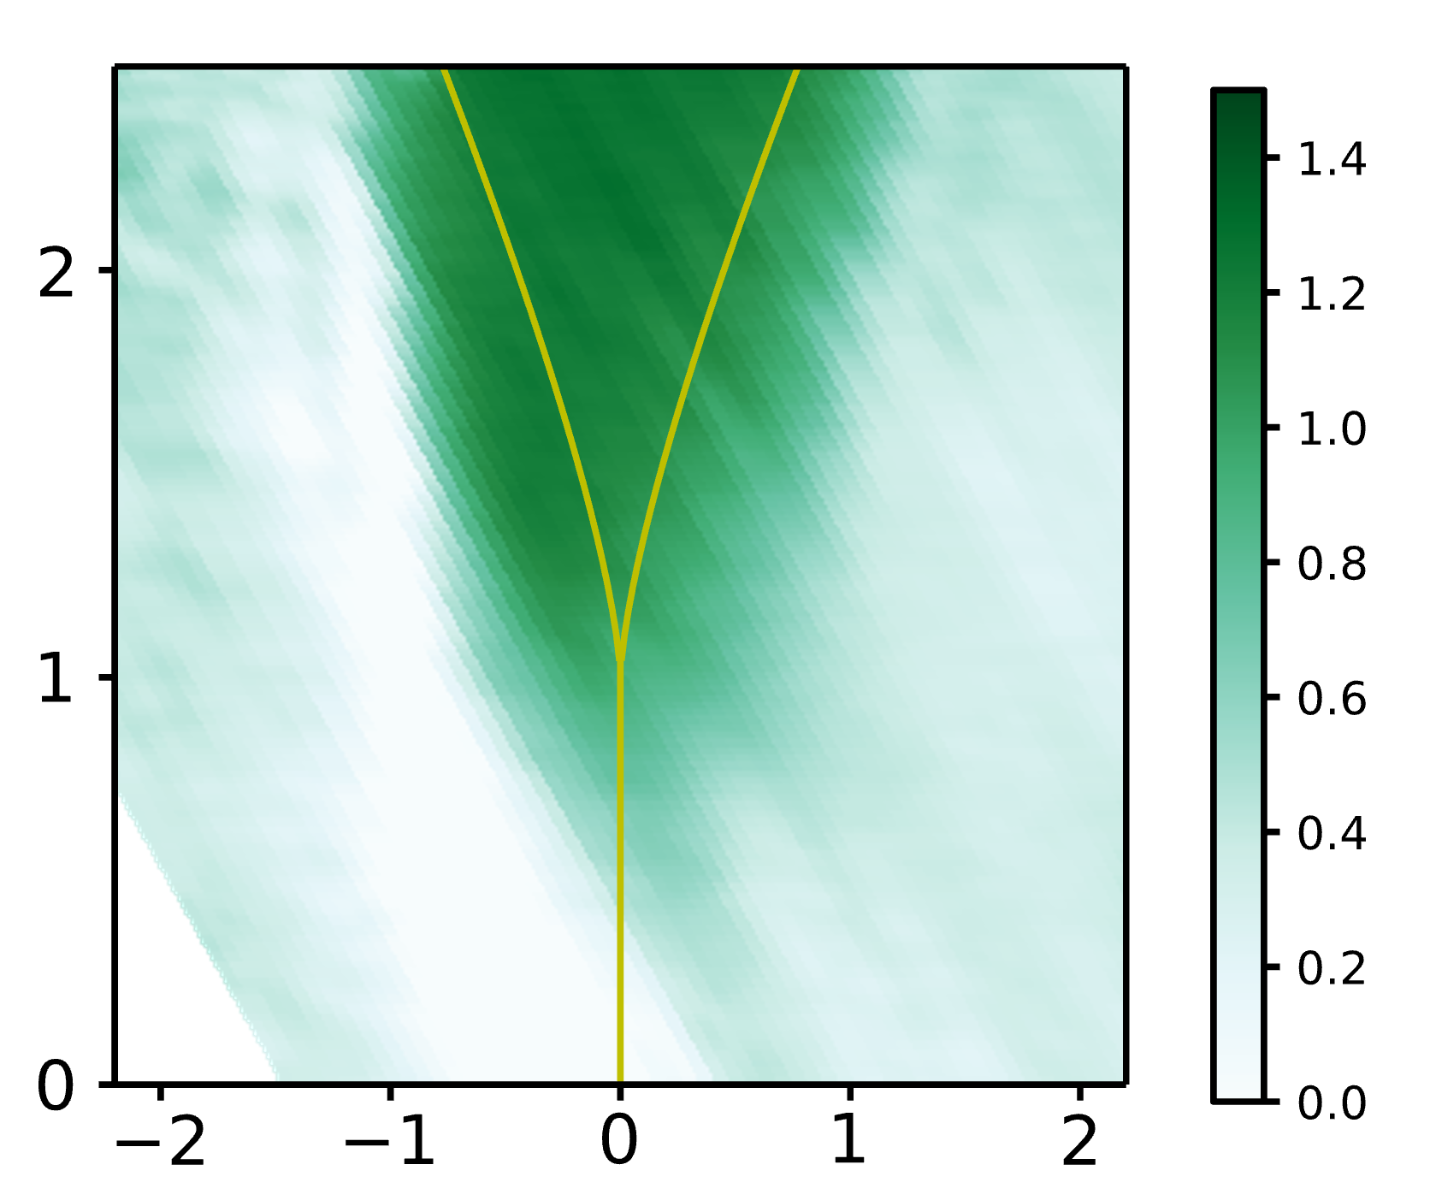
FM
Phase diagram
SFM
SFM
Spin interactions
PM
PM
Detuning
Ferromagnetism in an Extended Coherently Coupled Atomic Superfluid
Cominotti et al., Phys. Rev. X 13, 021037 (2023)
Missione 4 • Istruzione e Ricerca
Missione 4 • Istruzione e Ricerca

Slide 8
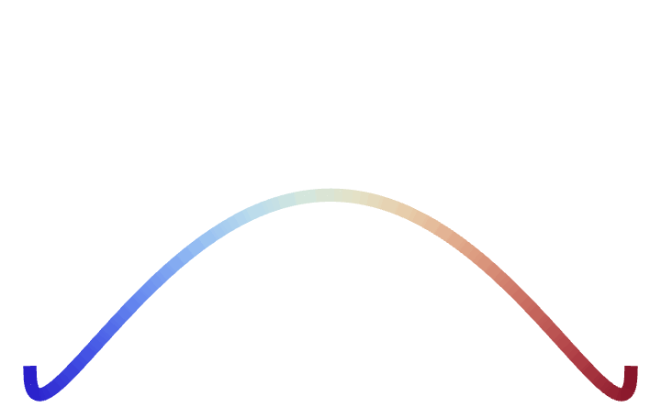



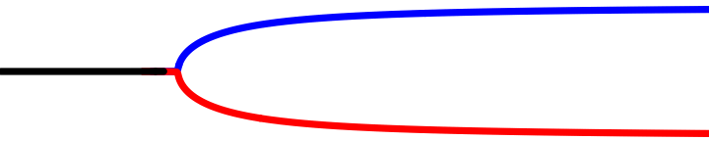
Δ=0, vary spin interactions
SECOND ORDER QPT Para-Ferromagnetic
FM
Spin interactions
SFM
SFM
Spin interactions
PM
PM
Ground state
BIFURCATION
Detuning
Cominotti et al., Phys. Rev. X 13, 021037 (2023)
Missione 4 • Istruzione e Ricerca
Missione 4 • Istruzione e Ricerca

Slide 9
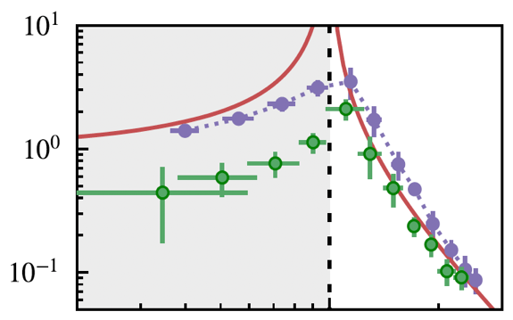



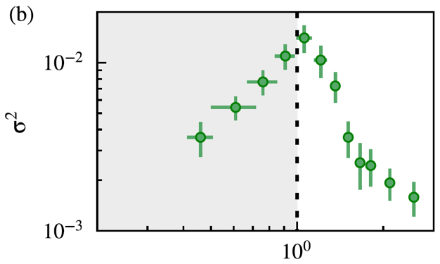
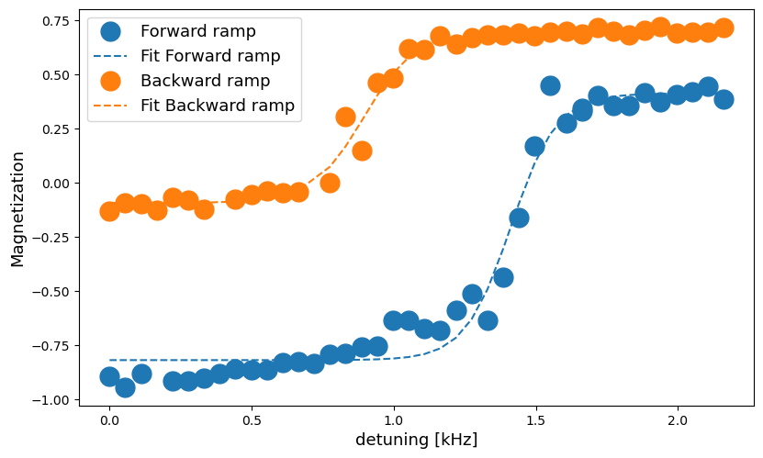
MAGNETIC SUSCEPTIBILITY
FM
Fixed spin interactions, vary Δ
FIRST ORDER QPT
Hysteresis in the Ferrom. region
SFM
SFM
Spin interactions
FERROMAGNET
PM
FM
Detuning
PM
PM
PARAMAGNET
FLUCTUATIONS OF THE MAGNETIZATION
Detuning
HYSTERESIS
PM
FM
Cominotti et al., Phys. Rev. X 13, 021037 (2023)
Missione 4 • Istruzione e Ricerca
Missione 4 • Istruzione e Ricerca

Slide 10
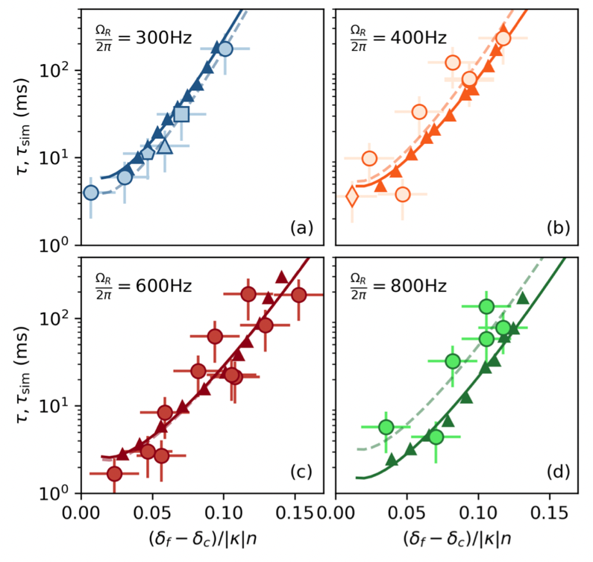

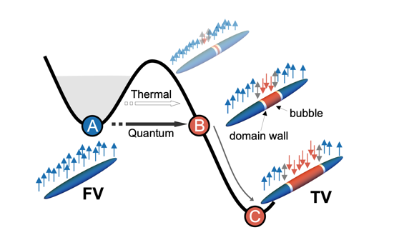
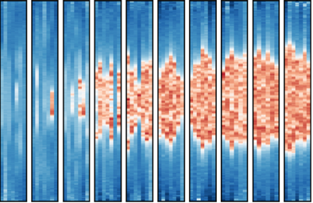
Decay of metastable states Simulation of False Vacuum Decay mechanism in quantum Field theory
x
time
Zenesini et al., Nature Physics 20, 558 (2024)
Missione 4 • Istruzione e Ricerca
Missione 4 • Istruzione e Ricerca

Slide 11
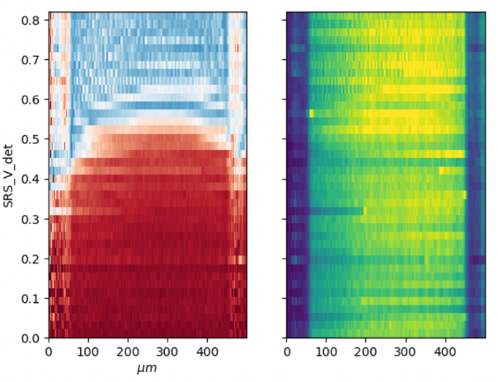
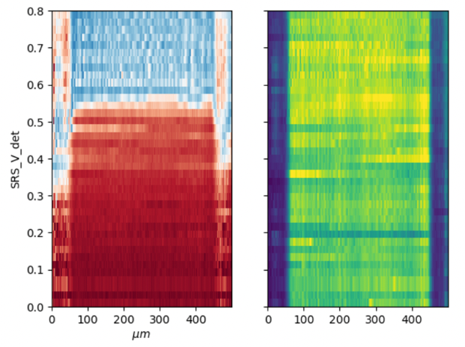
Harmonic to flat potential
Large extended uniform region to study
Missione 4 • Istruzione e Ricerca
Missione 4 • Istruzione e Ricerca

Slide 12
1D linear geometry
to
1D Ring
2D Disk
Uniform to local coupling
Two different spin currents
(flat total density)
Ω
CW spin current
Pulsed current
(magnetic solitons)
Missione 4 • Istruzione e Ricerca
Missione 4 • Istruzione e Ricerca

Slide 13
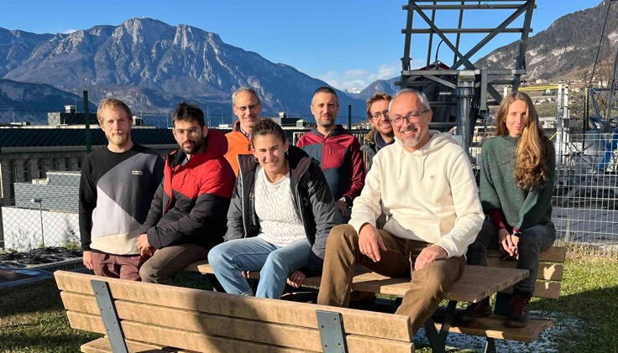
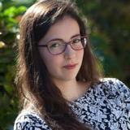
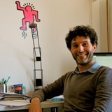
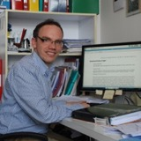


Spoke 3
Spoke 6
LAB team
Spoke 2
Theory team
Anna
Berti
Iacopo Carusotto
Alessio Recati
Gabriele Ferrari
Alessandro Zenesini
Riccardo Cominotti
Cosetta Baroni
Giacomo Guarda
Diego
Andreoni
Chiara Rogora
GL
Missione 4 • Istruzione e Ricerca

Slide 14
Missione 4 • Istruzione e Ricerca
Missione 4 • Istruzione e Ricerca

