Slide 1

Missione 4
Istruzione e Ricerca
Superconducting Qubit in a 3D Cavity
Simone Tocci
16 January 2024
Notes:
Good morning everyone, I'm Simone Tocci and today I'm going to talk to you about the characterisation of a superconducting qubit in a 3D cavity and then I will talk about the future optimisations we plan to apply in order to improve the performance of the system.

Slide 2
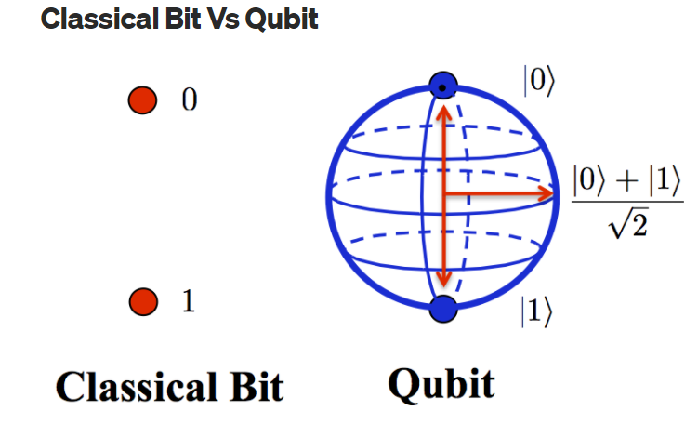
Qubit
Qubits exploits the states superposition to increase calculation power
A two level quantum system is required
By Abhishek Dubey
JJ provide a solid state system that is able to mimic the features of an artificial atom with discrete energy levels
Missione 4 • Istruzione e Ricerca
Missione 4 • Istruzione e Ricerca
Notes:
The qubit is the quantum mechanical analogue of the Boolean bit. To realise a qubit, it is necessary to fabricate a two-level system. This requirement is met by the Josephson junction.

Slide 3
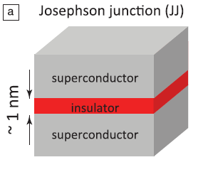
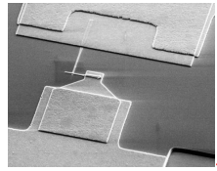
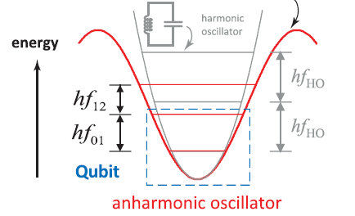



Josephson Junction
The most widespread qubit type is the transmon.
$$ψ_{1}=\left|ψ\right|e^{iφ_{1}}$$
$φ_{1}$-$φ_{2}=φ$
$$ψ_{2}=\left|ψ\right|e^{iφ_{2}}$$
Transmon consists of a small JJ shunted by two large capacitors to reduce the charge noise. Its simple design and high quality performance make the transmon one of the best candidates for large-scale production.
W. D. Oliver, P.B. Welander, MRS Bulletin, 2013
Notes:
A JJ is a device consisting of two superconductors separated by an insulating layer of the order of 1 nm. The phase difference between two SC layers is governed by the Josephson equations. Solving these equatiosn shows that the energy landscape of the junction is that of an anharmonic oscillator where the first two levels can be used as a two-level system for the qubit.
There are many types of qubits based on JJ. We have studied the transmon, which consists of a small JJ shunted by two large capacitors to reduce the charge noise. Its simple design and high quality performance make the transmon one of the best candidates for large-scale production.

Slide 4
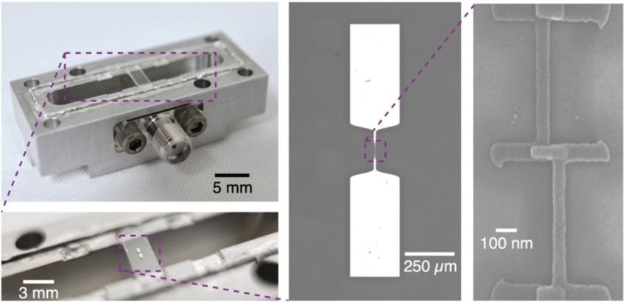
Transmon in a RF cavity
Two metal pads (two large capacitors)
Josephson Junction
Transmon
Notes:
In order to improve the performance of the transmon, such as coherence time, we place it inside a RF cavity. Here we can see an example of a transmon inside a cavity where we can see the JJ shunted by two rectangular metal pads that act as two large capacitors and then we can see the all placed inside a cavity

Slide 5
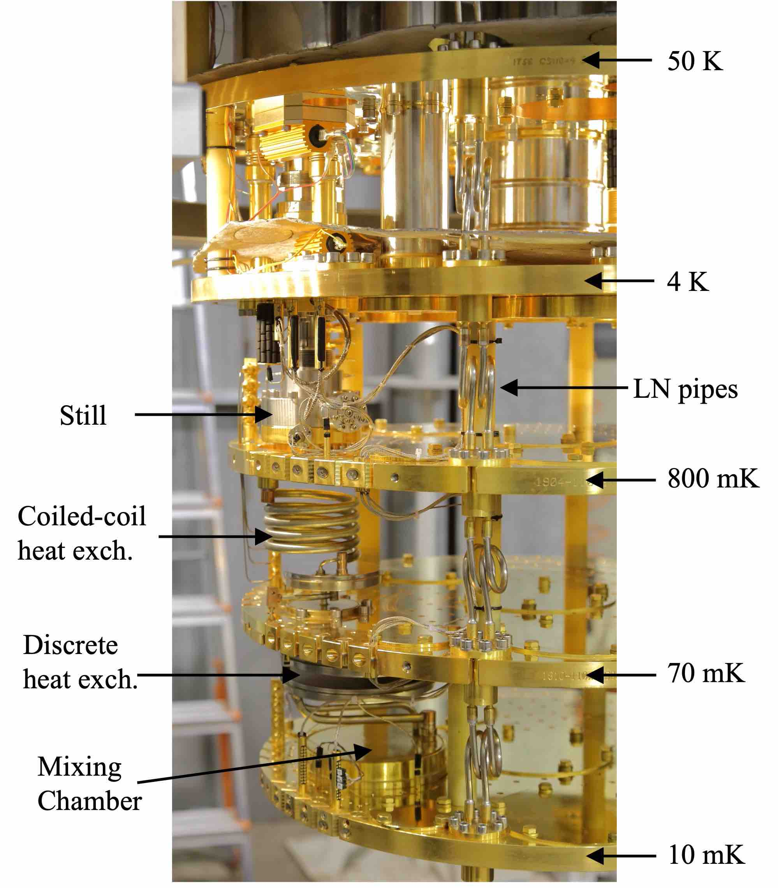

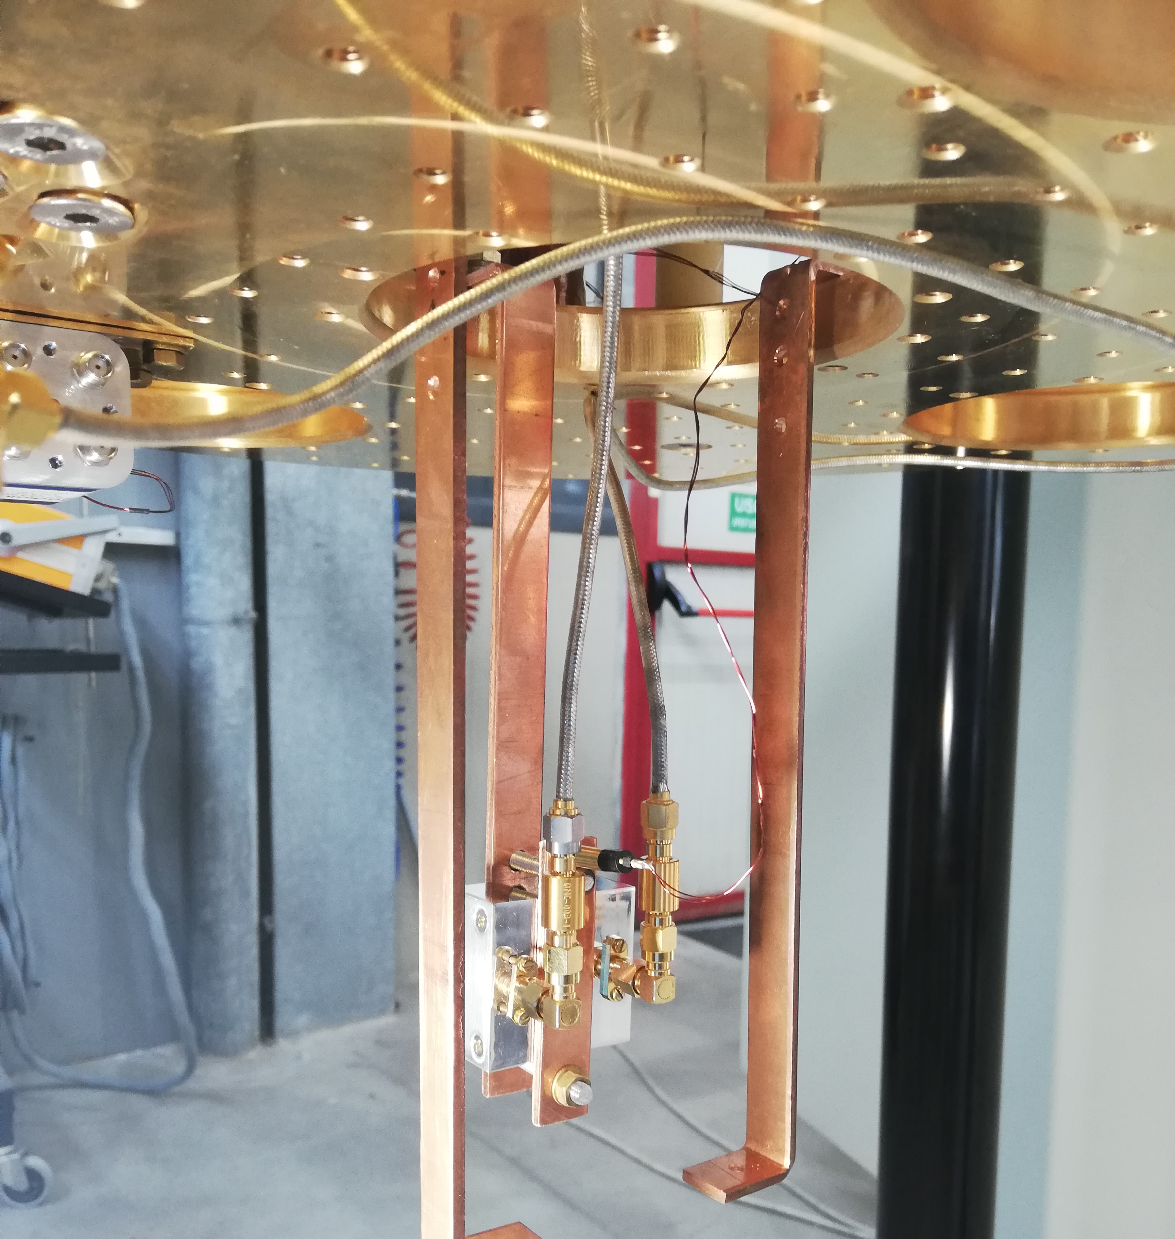
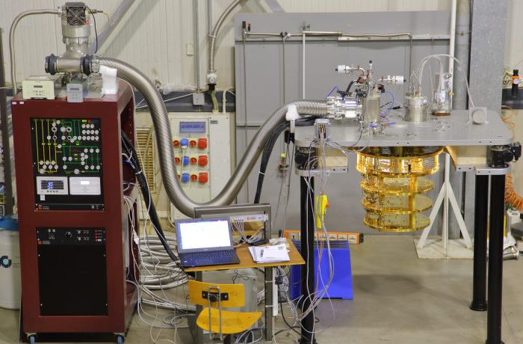
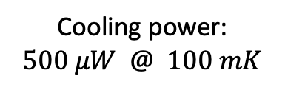

LNF-cryostat
$$T_{base}=8 mK$$
Cooling power:
$$500 μW @ 100 mK$$
Transmon
Courtesy of A. Rettaroli
Notes:
We tested the transmon inside a 3D cavity in our dilution cryostat located in LNF. It is a Leiden cryostat that can reach 8 mK with a cooling power of $500 μW @ 100 mK$. Here is a picture (indicare immagine destra) of the different plates of the cryostat where the device is hosted on the 10 mK plate

Slide 6
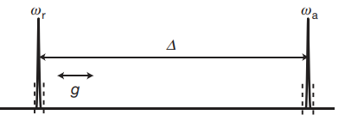
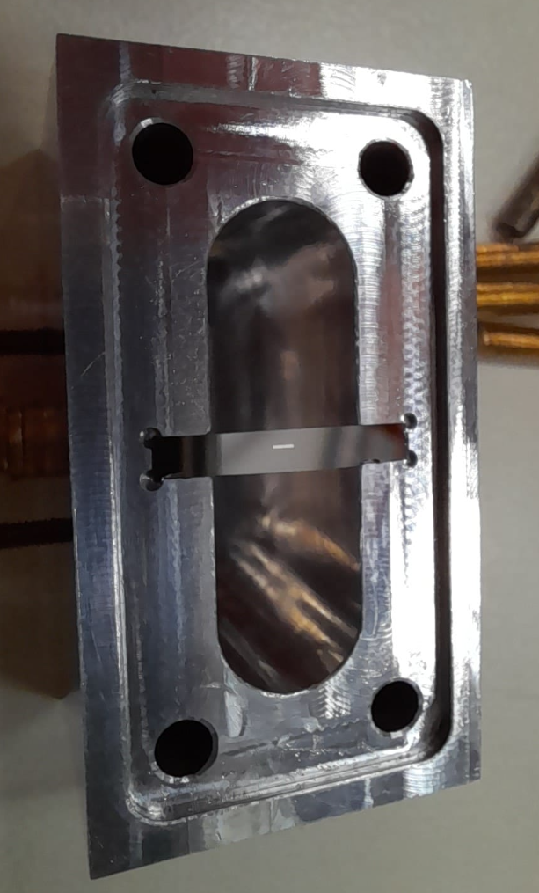


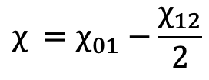
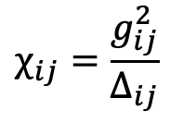
Qubit in 3D cavity
Dispersive regime
ω_{q}
ω_{r}
Δ₀₁
$$χ_{ }=χ_{01}−\frac{χ_{12}}{2}$$
$$χ_{ij}=\frac{g_{ij}^{2}}{Δ_{ij}}$$
Δ₀₁=ω_{q}-ω_{r}
ω_{q}=ω₀₁
We read the Qubit state through a cavity measurement
Fabricated @ Technology Innovation Institute, Abu Dhabi
Notes:
Here we can see a picture of our transmon inside the cavity. The transmon and the cavity we tested have been fabricated at the Technology Innovation Institute, of Abu Dhabi. The cavity and the Qubit have been designed to be coupled in the dispersive regime, meaning that the resonance frequency of the qubit and of the cavity are detuned of about 1 GHz. In this regime the Jaynes Cumming Hamiltonian is the following « indicare». Wr is the resonance frequency of the bare cavity, chi is the effective dispersive shift and is defined as following « indicare equazione sotto», wq is the qubit frequency. Chi01 and chi12 are the dispersive shift relative to the levels 01 and 12 of the transmon. For an arbitrary couple of levels the dispersive shift can be written as a function of the coupling strength and the detuning from the resonator (indicare equazione). Since the qubit and the cavity are coupled we plan to read the Qubit state through a cavity measurement and to characterize the system to extract the Hamiltonian parameters and the coherence properties of the qubit.

Slide 7
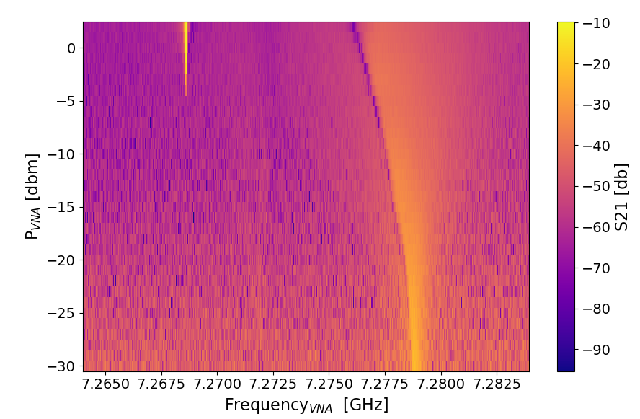

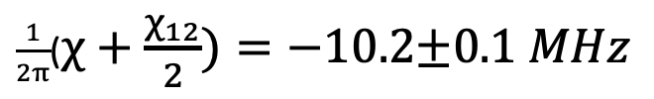
Qubit in 3D cavity: Cavity spectroscopy
Bare cavity frequency
ν_{r}= 7.268 GHz
Transmission coefficient
$\frac{1}{2π}$($χ+\frac{χ_{12}}{2})=−10.2\text{±0.}1 MHz$
$\frac{1}{2π}$($χ+\frac{χ_{12}}{2})$
Qubit in ground state
Notes:
So, for this purpose We start performing a cavity spectroscopy measurement. We used the VNA to acquire different spectra with different probing powers. We can note that increasing the VNA power a second feature at low freq. appears
It can be attributed to the bare resonator. With this information, we are able to calculate the sum of chi and chi12 that is equal to -10.2 MHZ

Slide 8
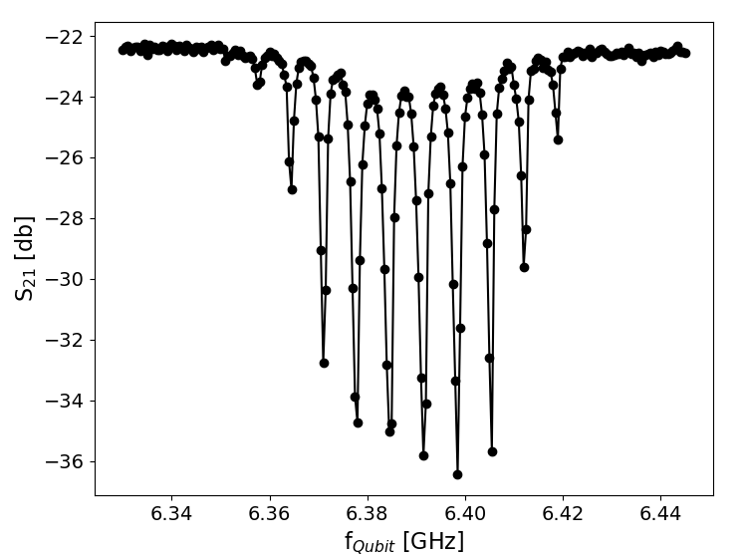




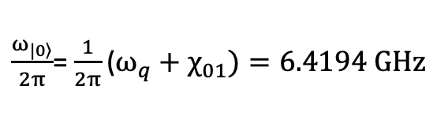
Qubit in 3D cavity: Resolving Photon Number
With a two tone measurement, we measure the qubit frequency
$$\frac{χ_{12}}{2π}=−13.6\text{±0.3}\text{MHz}$$
Number of photons in cavity
4 3 2 1 0
$$\frac{χ_{01}}{2π}=−10.2\text{±0.}2 MHz$$
$\frac{χ_{ }}{2π}$ = $−$3.41±0.08 MHz
The deep position depends on the number of photons (P_{VNA}) in the cavity
Transmission coefficient
The qubit frequency depends on the number of photons in the cavity
2χ
f_{VNA} = 7.227 GHz
$\frac{ω_{\left.|0\right\rangle }}{2π}$= $\frac{1}{2π}\text{(}ω_{q}+χ_{01})=6.4194 GHz$
P_{VNA}=-30 dBm
$$\frac{ω_{q}}{2π}=ν_{q}=6.4296 GHz$$
Notes:
In order to extract the other dispersive shift we performed qubit absorption spectroscopy. We used the cavity as a probe of the qubit state. Sending a second tone to the system, whenever the qubit is excited a deep in the cavity transmission coefficient appears at the qubit frequency. We can note that the deep position depends on the number of photons in the cavity that is the frequency of the qubit depends on the number of photons in the cavity. Each negative peak is separated from the other by a frequency distance of 2chi and with chi we can now calculate the chi01 and chi12. From these spectra we can also extract the bare qubit frequency.

Slide 9
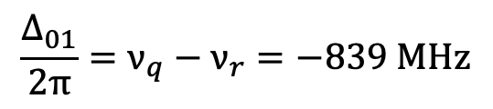
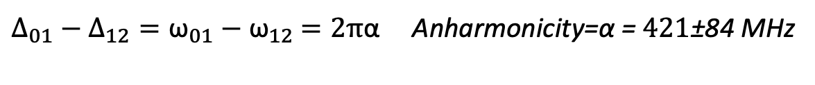
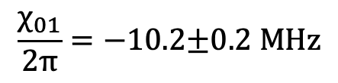
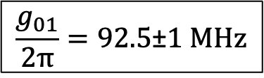
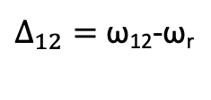
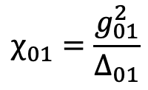
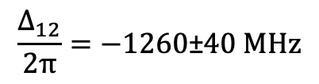
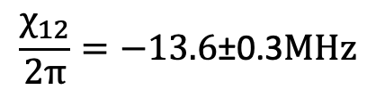

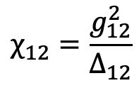
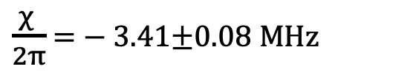

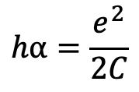
Estimate of anharmonicity and capacity
$$\frac{χ_{12}}{2π}=−13.6\text{±0.3}\text{MHz}$$
$$\frac{Δ_{01}}{2π}=ν_{q}−ν_{r}=−839 MHz$$
$$χ_{01}=\frac{g_{01}^{2}}{Δ_{01}}$$
$\frac{χ_{ }}{2π}$ = $−$3.41±0.08 MHz
$$\frac{χ_{01}}{2π}=−10.2\text{±0.}2 MHz$$
$$\frac{g_{01}}{2π}=92.5\text{±}1 MHz$$
$$g_{12}=\sqrt{2}g_{01}$$
$$χ_{12}=\frac{g_{12}^{2}}{Δ_{12}}$$
$$\frac{Δ_{12}}{2π}=−1260\text{±}40 MHz$$
$Δ_{12}=$ ω₁₂-ω_{r}
$Δ_{01}−Δ_{12}={\text{ω}}_{01}−{\text{ω}}_{12}$ $=2π$α Anharmonicity=α = $421\text{±}\text{84}$ MHz
$$hα=\frac{e^{2}}{2C}$$
Transmon Capacity
$$C=46\text{±}5fF$$
Notes:
With this parameters, using this equation (indicare) we are able to calculate the detuning and then inverting this equation (indicare) we estimate the coupling strength between the qubit and the cavity to be 92.5 MHz. We can then calculate g12 and extract delta12, from which we can extract the anharmonicity and finally we can compute the charging energy and therefore the capacitance of the qubit.

Slide 10
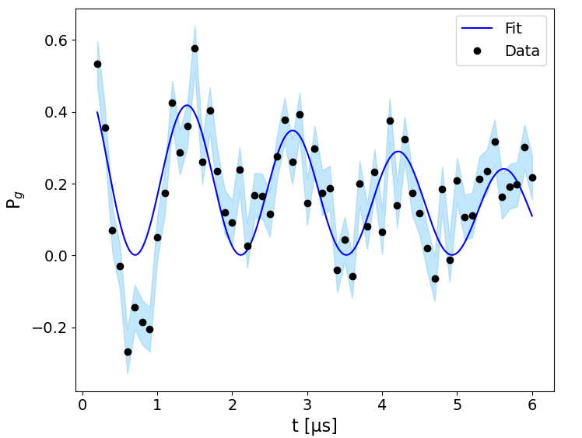
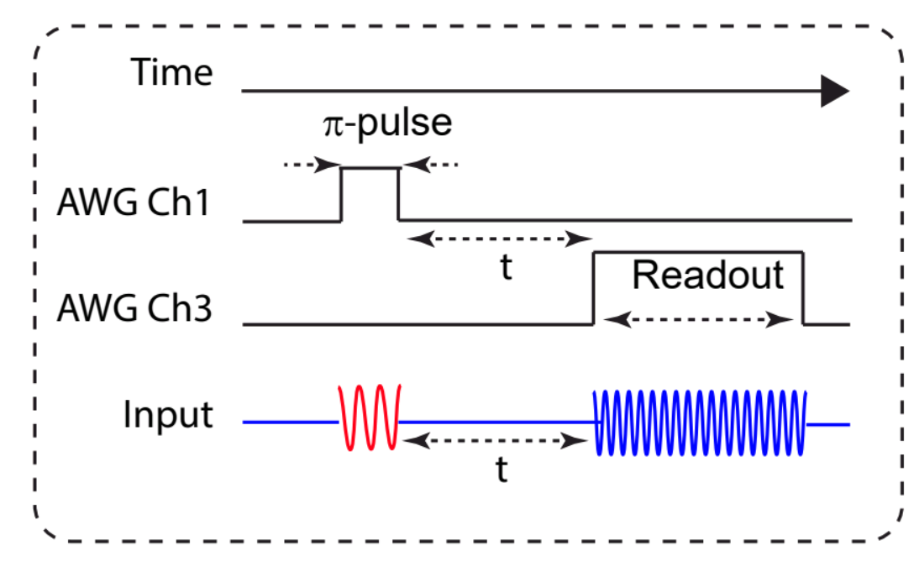
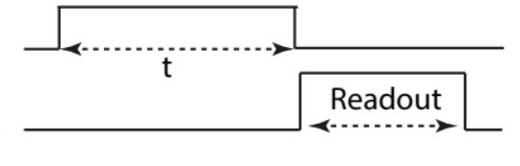
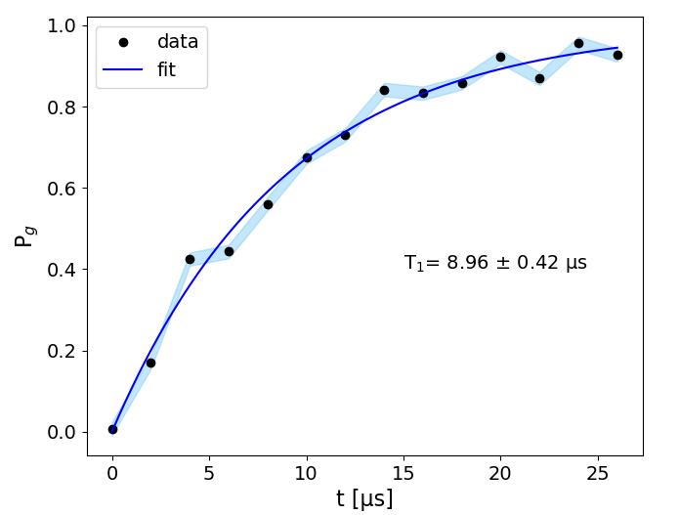
Qubit in 3D cavity: Rabi and T1 measurements
Rabi
P_{G}
Time [µs]
T₁
P_{G}
T₁=8.68±0.72 µs
Time [µs]
Notes:
After taking frequency measurements we then moved to time domain characterization of the qubit. We performed Rabi spectroscopy to measure the temporal length of the pi pulse, and then we performed T1 spectroscopy obtaining a T1 of 8.68 microseconds.

Slide 11
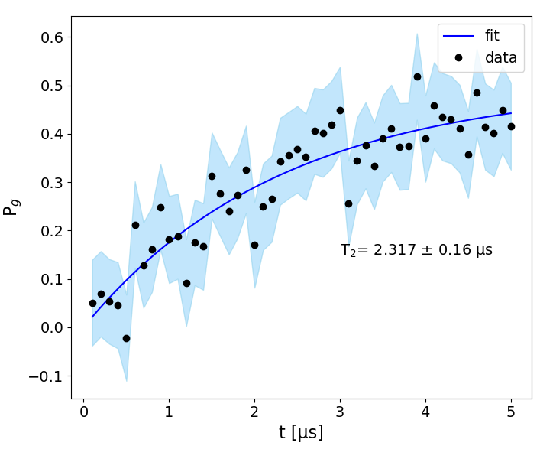
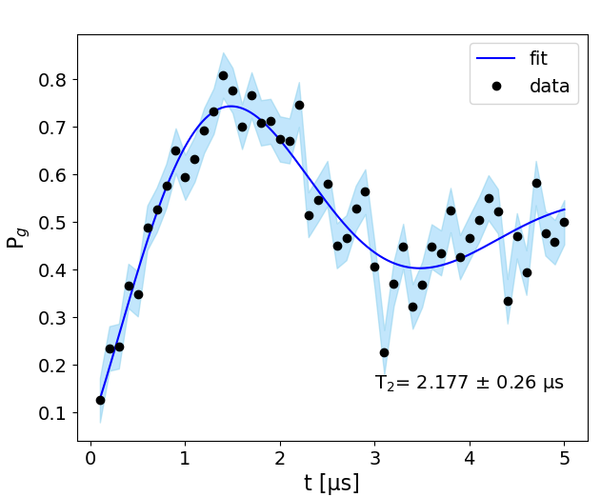
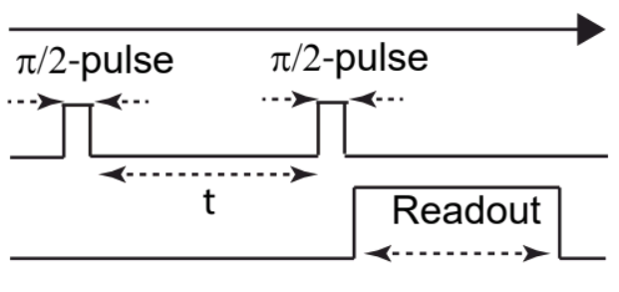
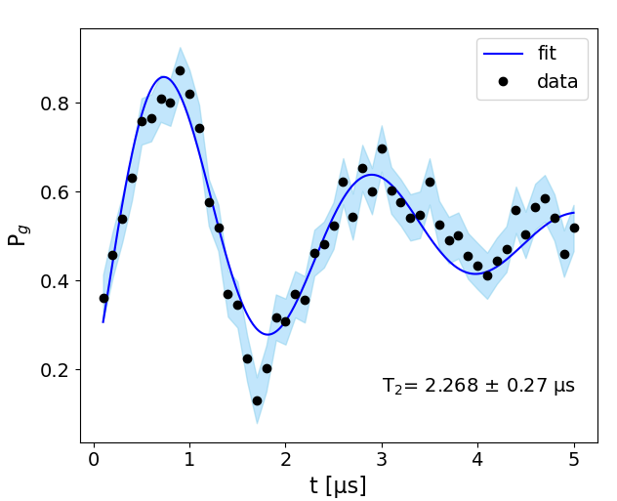
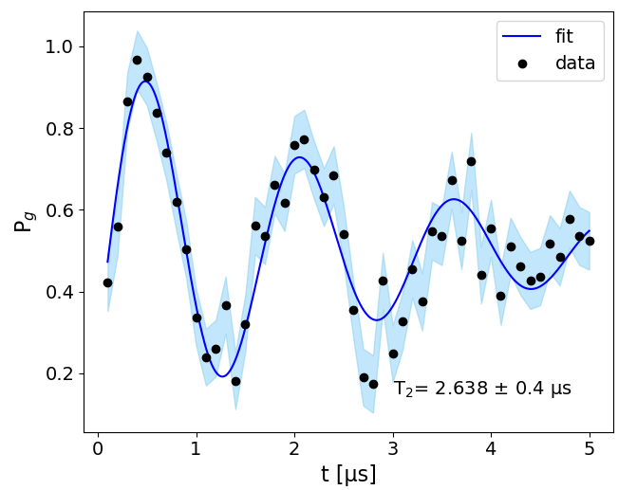
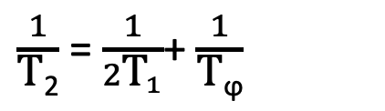
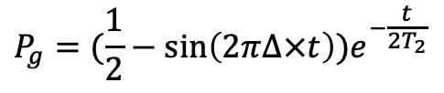
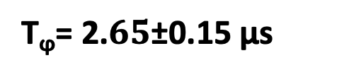
Qubit in 3D cavity: Ramsey spectroscopy
Δ=0 KHz
Δ=200 KHz
$$P_{g}=(\frac{1}{2}−\sin\left(2π∆×t\right))e^{−\frac{t}{2T_{2}}}$$
Δ=600 KHz
Averaging over all the T₂ measurements
T₂ =2.30±0.11 μs
$\frac{1}{\text{T}\text{2}}$= $\frac{1}{2{\text{T}}_{1}}$+ $\frac{1}{\text{T}\text{ϕ}}$
Δ=400 KHz
T_{ϕ}= 2.$65\text{±0.}\text{15 }$μs
Notes:
We also performed Ramsey spectroscopy for different pump frequency detuning to measure the T2, obtaining T2 of 2,3 microseconds. We also estimated the pure dephasing time to be of 2,65 microseconds.

Slide 12
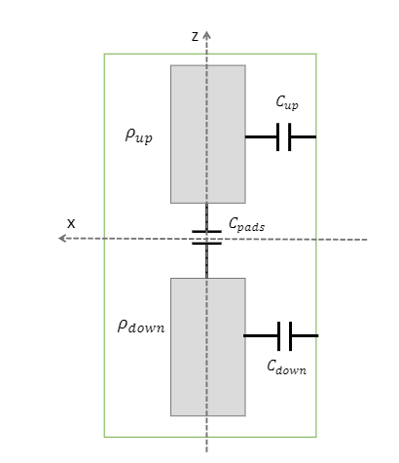
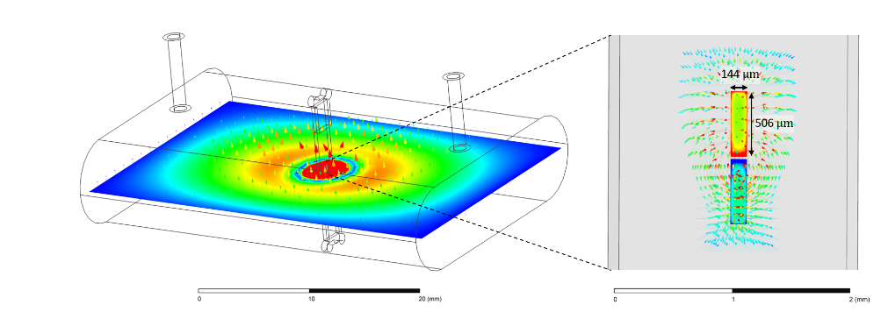



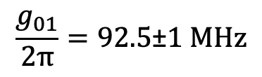


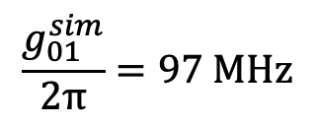

Qubit in 3D cavity: HFSS simulations
$$\frac{g_{01}^{sim}}{2π}=97 MHz$$
$$\frac{g_{01}}{2π}=92.5\text{±}1 MHz$$
E$xperimental data are$
$$well reproduced by simulations$$
$$C^{sim}=56 fF$$
$$C=46\text{±}5fF$$
Notes:
In order to optimize the performance of the qubit we developed a simulation workspace using Ansys HFSS. We performed the electromagnetic simulations of a transmon inside a 3D cavity. In figure ( indicare) we can see the electric field map for the TE110 mode. We can also see a zoom on the electric field distribution around the transmon chip. We modelled the transmon as an LC circuit shunted by two metal pads. From Ansys we obtained the effective distance between two metal pads of the transmon and we used this value to calculate the coupling strength g01 by this formula (indicare). The calculated g01 is 97 MHz and is in very good agreement with the experimental value of 92,5 MHz. We also calculated the capacitance of the transmon using the HFSS and we obtained 56 fF again in good agreement with the experimental value of 46 fF.

Slide 13
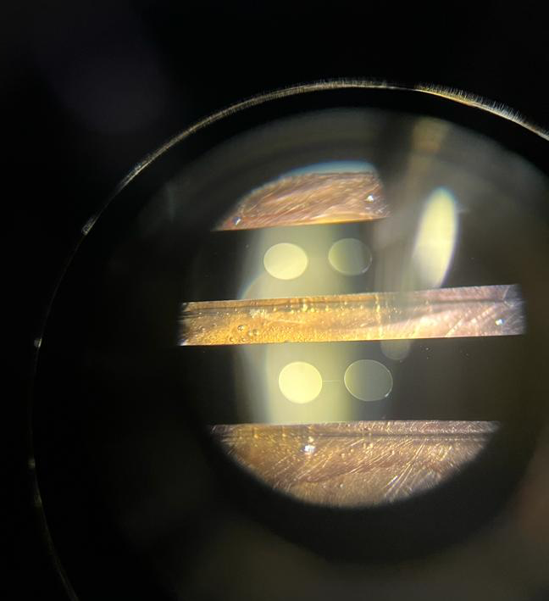
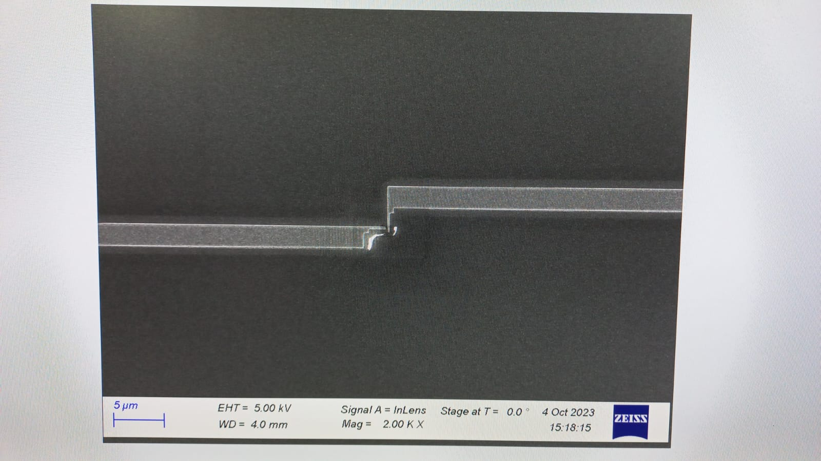

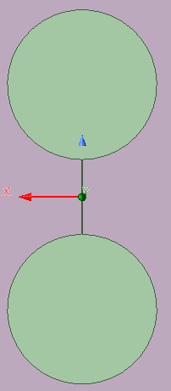
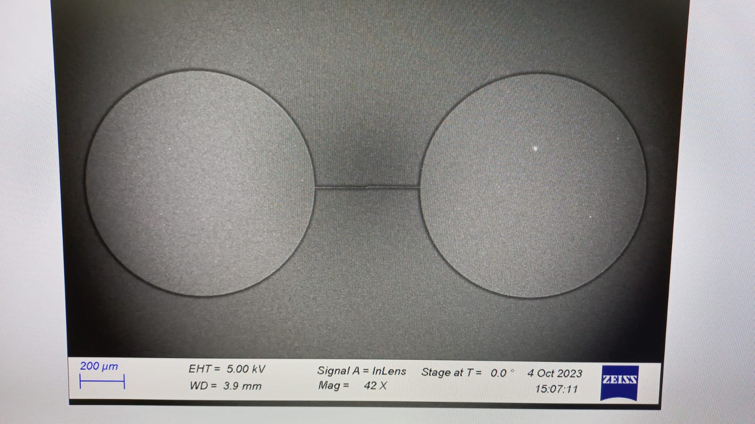
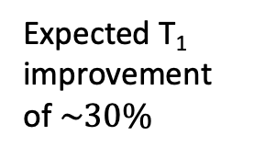
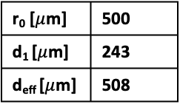

Manufacturing of 3D qubits with circular pads at IFN CNR
Qubit in 3D cavity: Design and fabrication a new Transmon
F_{q}=6.57GHz
C_{tot}=100fF
r₀
Aluminum JJ with area about 200 x 350 nm
r₀ [$μ$m] | 500
d₁ [$μ$m] | 243
d_{eff} [$μ$m] | 508
d₁
Expected T₁ improvement of $\sim 30\%$
New design already fabricated and soon to be tested
500 $μm$
Notes:
In fact, having now a simulation that is able to reproduce the experimental values, we aim to optimize the transmon performances by minimizing the loss of the qubit-cavity system. We followed a twofold approach. On one side we optimized the design of the transmon in order to avoid the losses due to the geometry of the pads. On the other hand, we improved the quality factor of the cavity by minimising surface losses.
The qubit we measured had rectangular pads, which is not the optimized geometrical shape for loss reduction. We tried different geometries and the better results are given by pads of circular geometry. By this new design we expect an improvement of the coherence time T1 of about 30%. This new transmon has been fabricated at IFN-CNR and will be soon tested.

Slide 14


Qubit in 3D cavity: Ultra –pure Al cavity
Alloy cavity and qubit
fabricated at Technology Innovation Institute, Abu Dhabi
$$Q=(1.78±0.9)⋅{10}^{5}$$
Al alloy
Move to Al 5N (99.999% purity) to reduce surface loss and improve the quality factor
Notes:
As I told you few moments ago, the other approach to reduce cavity-qubit loss is to improve the quality factor of the cavity. The cavity we tested was fabricated using an Aluminum alloy. We measured a Q of about 178000. The approach we are following, mainly in the group of LNL, is to use an ultra-pure Al to fabricate the cavity.

Slide 15








3D Cavity Fabrication
Mechanical
machining
Vibro-tumbling
Electropolishing
Notes:
Here we can see the different phases of cavity production carried out at LNL. The new cavity of exactly the same shape as the one we tested.

Slide 16









Qubit in 3D cavity: pure Al cavity measurement
Scattering parameters results
All measurements at 30 mK
S₁₁
S₂₁
The first new cavity in ultra-pure Al
2
1
2
1
Cavity
Cavity
7.46 GHz
Already improved with
respect to previous Al alloy cavity!
$$Al alloy$$
$$Al 5N$$
$$Q=(1.78±0.9)⋅{10}^{5}$$
$$Q=\left(2.2±1.0\right)⋅10^{5}$$
Notes:
The test of the new cavity have been performed in Frascati. We measured the scattering parameters S11 and S21 and we extracted a Q of 220000. This value is already an improvement of about 20% respect to the first cavity. Considering that we have some problems with the processing of the cavity and therefore the quality of the fabrication can be improved, this result is very encouraging.

Slide 17
Conclusion:
In conclusion, we showed our characterization of a dispersively coupled qubit-cavity system.
We measured all the relevant parameters of the Hamiltonain and the coherence properties of the qubit.
The simulations reproduce the measured parameters very well.
A superconducting qubit with circular pads has been designed and fabricated.
We fabricated and tested the superconducting cavities with pure Al

Slide 18




People involved in this work
Boulos Alfakes, Anas Alkhazaleh, Leonardo Banchi, Matteo Beretta, Stefano Carrazza, Fabio Chiarello, Alessandro D’Elia, Daniele Di Gioacchino, Claudio Gatti, Andrea Giachero, Felix Henrich, Alex Stephane Piedjou Komnang, Carlo Ligi, Giovanni Maccarrone, Massimo Macucci, Federica Mantegazzini, Giovanni Marconato, Francesco Mattioli, Angelo Nucciotti, Emanuele Palumbo, Andrea Pasquale, Luca Piersanti, Cristian Pira, Florent Ravaux, Alessio Rettaroli, Matteo Robbiati.
A. D’Elia et al., “Characterization of a Transmon Qubit in a 3D Cavity for Quantum Machine Learning and Photon Counting,” submitted to Applied Sciences.
Notes:
I would like to thank all the people who have contributed to this work.

Slide 19
Thank you for your attention

